Slide 1
Recursion
Unit-ii

Slide 2
Introduction of Recursion
A function that is defined in terms of itself is called recursive.
The process of recursion involves solving a problem by turning it into smaller varieties of itself.
Recursion in the data structure is one of the most compact and improved strategies for creating function calls or deploying functions in programming.
It helps you to implement many functions and algorithms efficiently, at the same time
For example :- folder could be a storage device that is used to store files and folders. defining a folder could be a tough task. It could be anything that holds some files and folders that could be files and folders in their own right, and this could again go on. This is why recursion makes defining situations a lot easier than usual.

Slide 3
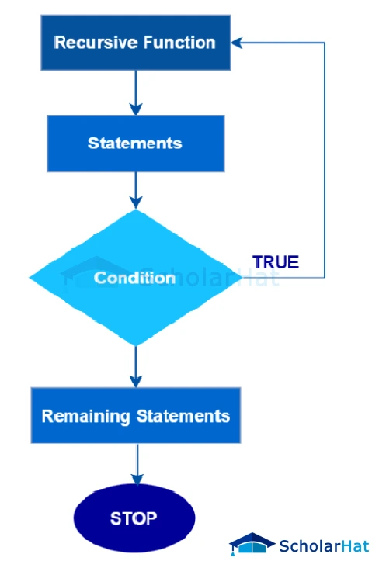

Slide 4
Principle of Recursion
The fundamental rules of Recursion:
A recursive algorithm has to call itself recursively.
A recursive algorithm needs a base case.
base case is nothing but the condition that helps initiate the process of returning to the original call function. (not go in infinite loop)
If base case is not define” it will raise an error as “Internal Stack Overflow”.
A recursive algorithm should change its move and mention the base case.
Recursive case
Partial solution

Slide 5
Principle of Recursion
identifying a base case where the problem is simple enough to solve directly.
Breaking down the original problem into smaller subproblems using the recursive case.
Solving these subproblems recursively, obtaining partial solutions.
Combining the partial solutions to reach the final solution for the original problem.

Slide 6
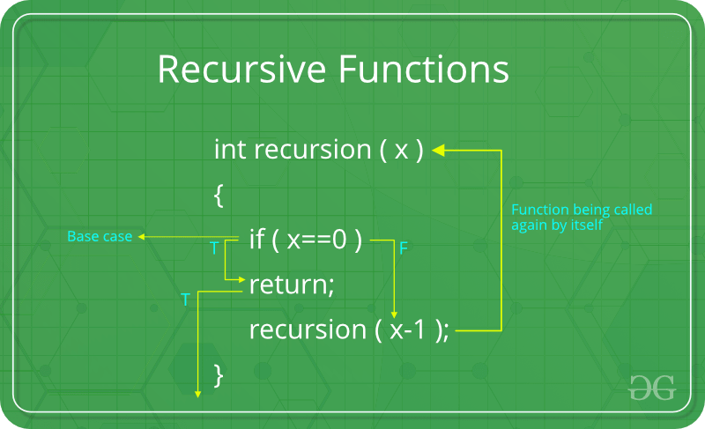

Slide 7
Recursive Algorithms
Greatest Common Divisor
Sum of Natural Numbers
Factorial of a positive numbers
Fibonacci series
Tower of Hanoi

Slide 8
Recursive Algorithms
Factorial
5! = 5*4*3*2*1
fac(n) = n*fac(n-1)
Fibonacci series
0,1,1,2,3,5,8…..
fib(n) = fib(n-1) + fib(n-2)

Slide 9
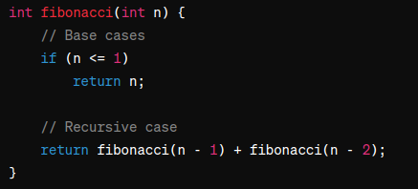
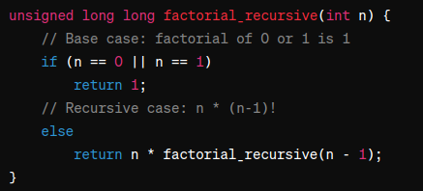
Algorithms

Slide 10
Tower of Hanoi
Show Single disk movement
Show 2 disk movement
Show 3 disk movement
Solve it (3,X,Y,Z)
Show video.

Slide 11
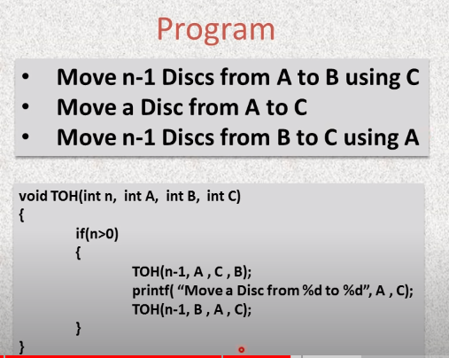
Tower of Hanoi

Slide 12
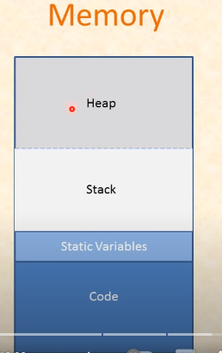
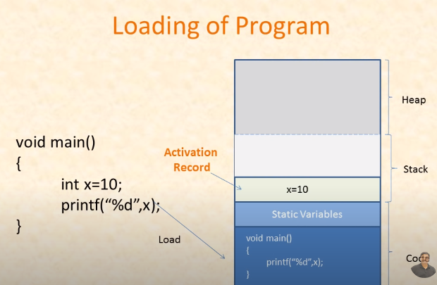
Recursion and stack

Slide 13
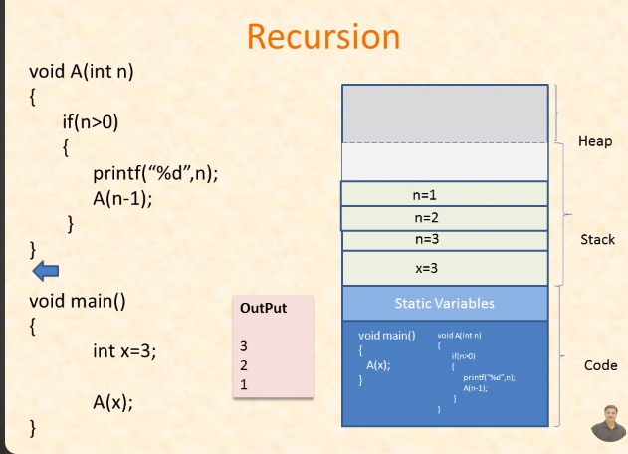
Recursion and stack

Slide 14
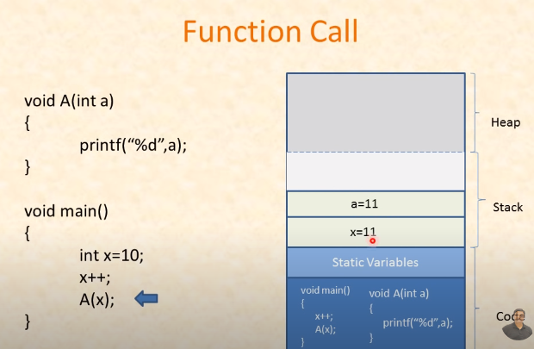
Recursion and stack

Slide 15
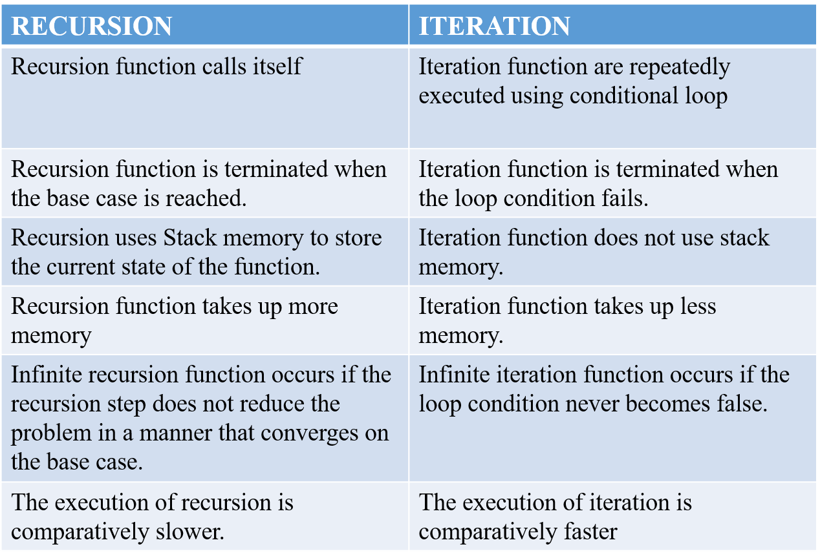
Recursive Vs Iteration

Slide 16
Recursive Data Structure
A recursive data structure is a data structure that can be defined in terms of itself, either directly or indirectly.
This self-referential definition allows the structure to contain instances of the same type within itself.
E.g linked list , trees, graphs (imp)
Advantages:- Dynamice Size ,Hierarchical Relationship,to solve Complex problems

Slide 17
Types of Recursion
Direct recursion: This is typified by the factorial implementation where the methods call itself.
Indirect recursion:The recursion in which the function calls itself via another function is called indirect recursion.
Tail recursion: The recursive call is the last statement.
Head recursion: The recursive call is made at the beginning of the method.
Linear Recursion:-A function is called the linear recursive if the function makes a single call to itself at each time the function runs and grows linearly in proportion to the size of the problem.
Non-Tailed Recursion :-A recursive function is said to be non-tail recursive if the recursion call is not the last thing done by the function.
Mutual recursion: This happens where one method, say method A, calls another method B, which then calls method A. This involves two or more methods that eventually create a circular call sequence.
Binary/Tree/ Recursion

Slide 18
Application of Recursion
Tree and Graph Traversal
Divide-and-Conquer Algorithms
Mathematical Functions
Fractals and Computer Graphics
Functional Programming
Backtracking
Game /AI/File system

