Slide 1
Stack
Unit-3

Slide 2
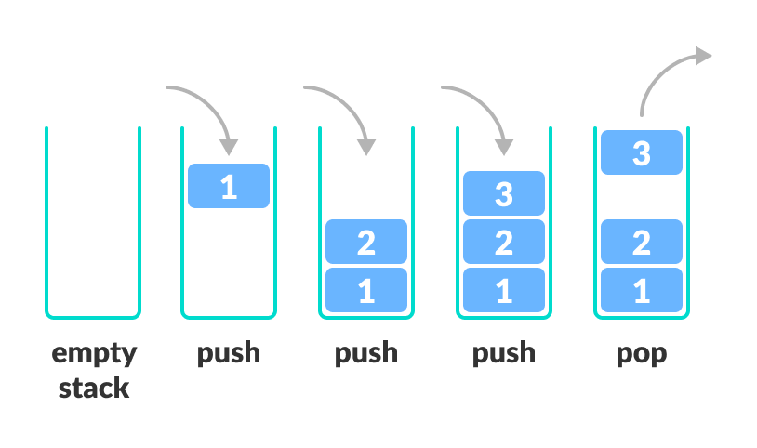
Stack

Slide 3
STACK
Stack is a data structure in which elements can be added and removed from one end known as "TOP".
The operations in Stack are performed in LIFO order.
The last element inserted in the stack is the first element to be removed from the stack.
Stack can be implemented using array or linked list.
Array implementation of Stack is static in nature; that is the size of stack if fixed.
Linked List implementation of Stack is dynamic.

Slide 4
STACK ADT
Some common operations on stacks include:
Push: Adds an element to the top of the stack.
Pop: Removes the top element from the stack.
Peek: Returns the top element of the stack without removing it.
IsEmpty: Checks if the stack is empty.
IsFull: Checks if the stack is full.
These operations define how we interact with a stack, regardless of whether it's implemented using arrays, linked lists, or any other underlying data structure.

Slide 5
STACK ADT-Array Implementation
First of all since the implementation is static we need to declare the array size ahead of time.
The following are two of the attributes associated with the Stack:
MaxSize: This is the maximum size of the stack and is the size of the array.
Top: This is the index of the top element of stack Stack which is the array which stores elements of stack

Slide 6
Algorithm stack
Step 1 - Include all the header files which are used in the program and define a constant 'SIZE' with specific value.
Step 2 - Declare all the functions used in stack implementation.
Step 3 - Create a one dimensional array with fixed size (int stack[SIZE])
Step 4 - Define a integer variable 'top' and initialize with '-1'. (int top = -1)

Slide 7
Push() and Pop() Operation Using Array
Discuss Code in Class

Slide 8
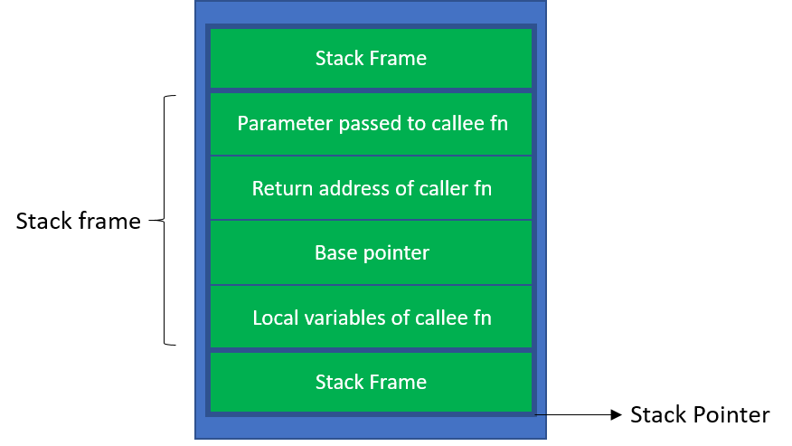
Stack Application
1.Stack Frame
Each function has local memory associated with it to hold incoming parameters, local variables, and (in some cases) temporary variables. This region of memory is called a stack frame and is allocated on the process’ stack.
Each stack frame contains 4 parts:
Parameter passed to the callee function
Return address of the caller function
Base pointer
Local variables of the callee function

Slide 9
Stack Application
2. Reverse String
3. Calculate the postfix operation/Evaluation
E.g.1 2*
This notation is known as postﬁx, or reverse Polish notation
Practice
Evaluate postfix expression => 6523+8*+3+* and 2 3 4 * +
=>623+-382/+*2$3+

Slide 10
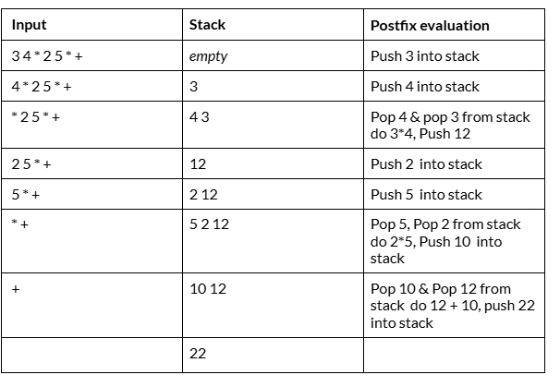

Slide 11
Expression Notation
4 + 5+ 6 ∗ 2=?
Stacks provide a convenient data structure for handling the order of operations, managing operands and operators, and ensuring the correct evaluation of expressions in various expression notations.
Types of expression notations:-
Infix notation
Postfix notation
Prefix notation

Slide 12
Infix Notation
Demo class
<operands> <operators> <operands>
Not use due to ambiguity
ambiguity refers to situations where the interpretation of an expression is not clear or can be interpreted in multiple ways.
This ambiguity arises due to the presence of operators with the same precedence or when parentheses are not used to explicitly define the order of operations.

Slide 13
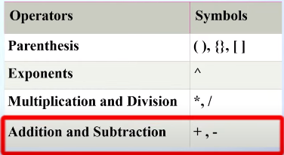
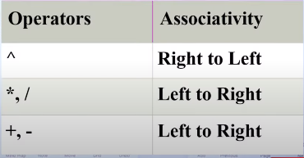

Slide 14
Postfix Notation
Demo Class
<operands> <operands> <operators>

Slide 15
Prefix Notation
Demo Class
<operators> <operands> <operands>

Slide 16
Rules for the conversion from infix to postfix expression
Print the operand as they arrive.
If the stack is empty or contains a left parenthesis on top, push the incoming operator on to the stack.
If the incoming symbol is '(', push it on to the stack.
If the incoming symbol is ')', pop the stack and print the operators until the left parenthesis is found.
If the incoming symbol has higher precedence than the top of the stack, push it on the stack.
If the incoming symbol has lower precedence than the top of the stack, pop and print the top of the stack. Then test the incoming operator against the new top of the stack.
If the incoming operator has the same precedence with the top of the stack then use the associativity rules. If the associativity is from left to right then pop and print the top of the stack then push the incoming operator. If the associativity is from right to left then push the incoming operator.
At the end of the expression, pop and print all the operators of the stack.

Slide 17
convert infix to prefix expression
Reverse the input infix.
Left parenthesis ( convert to → right parenthesis ) and vice versa.
Convert the reversed infix into postfix expression.But While converting to postfix expression, instead of using pop operation to pop operators with greater than or equal precedence, here we will only pop the operators from stack that have greater precedence.
Now reverse the resulting postfix expression obtained from the previous step. The resulting expression is prefix expression

Slide 18
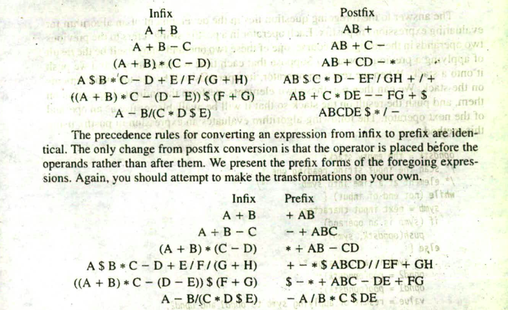
Notes:
Input || stack || postfix/output || remarks

Slide 19
