Slide 1
Queue
Unit-4

Slide 3
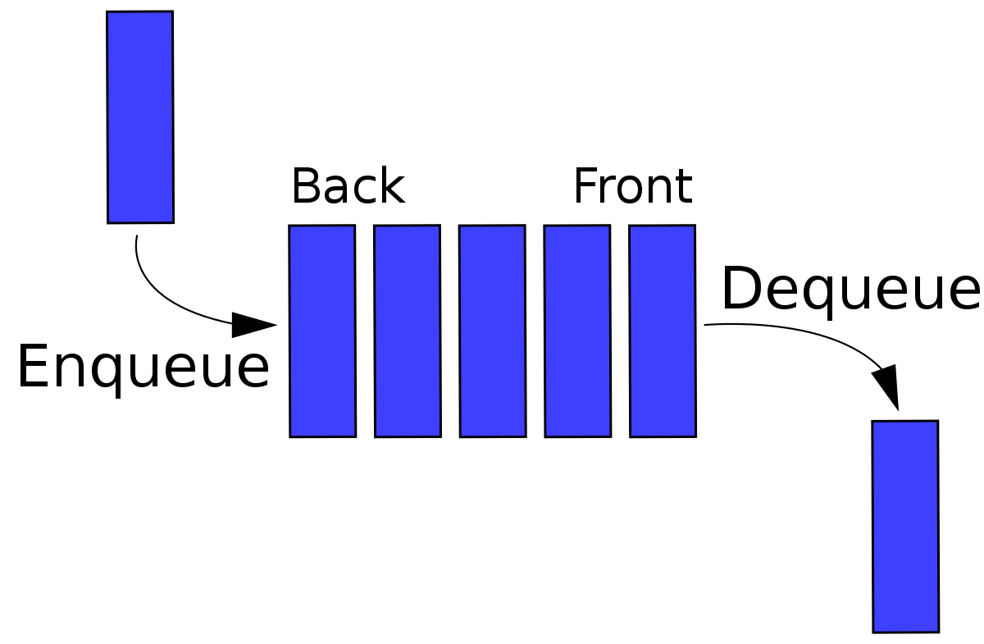
Queue

Slide 4
Queue ADT
A Queue ADT (Abstract Data Type) represents a collection of elements in a specific order.
It follows the First-In-First-Out (FIFO) principle, which means that the element added first will be the first one to be removed.
The main operations supported by a Queue ADT are:
Enqueue: This operation adds an element to the back of the queue.
Dequeue: This operation removes and returns the element at the front of the queue.
Front: This operation returns the element at the front of the queue without removing it.
IsEmpty: This operation checks if the queue is empty.
IsFull()
Size: This operation returns the number of elements currently in the queue.

Slide 5
Queue ADT
Queue data structure can be implemented in two ways. They are as follows...
Using Array
Using Linked List (LATER IN THIS CHAPTER)

Slide 6
Queue ADT and its array Implementation
Class Demo
//problem in Linear queue
Notes:
Front can be increased so need to reduced

Slide 7
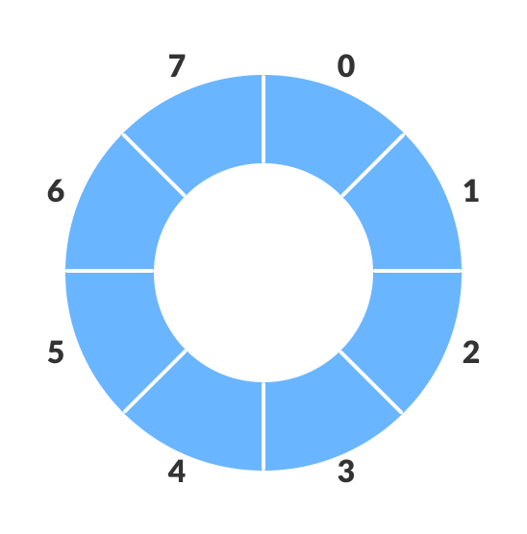
Circular Queue

Slide 8
Circular Queue and its array implementation
A circular queue, also known as a circular buffer, is a type of queue data structure in which the last element is connected to the first element, forming a circular structure.
This allows for efficient utilization of the underlying array or memory block used to implement the queue.
when the queue is full and a new element needs to be inserted, it wraps around to the beginning of the queue and fills the empty slots there.
Similarly, when elements are dequeued from the queue, the vacant slots at the front of the queue are filled by elements from the end.
(Rear+1)%N==front

Slide 9
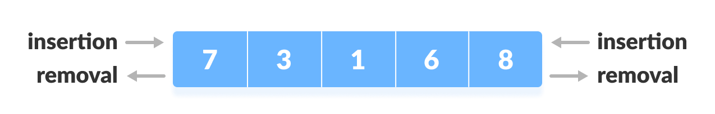
Double Ended Queue (DEQUE)
Deque or Double Ended Queue is a type of queue in which insertion and removal of elements can either be performed from the front or the rear.
Thus, it does not follow FIFO rule (First In First Out).

Slide 10
Double Ended Queue (DEQUE)
Types of Deque
Input Restricted Deque
In this deque, input is restricted at a single end but allows deletion at both the ends.
Output Restricted Deque
In this deque, output is restricted at a single end but allows insertion at both the ends.

Slide 11
performing the following operations deque
Insert at the Front
Insert at the Rear
Delete from the Front
Delete from the Rear
getFront()
getRear()

Slide 12
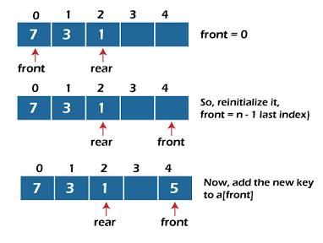
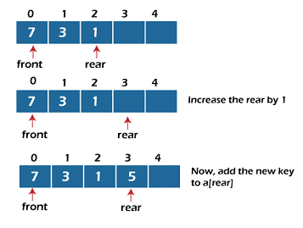

Slide 13
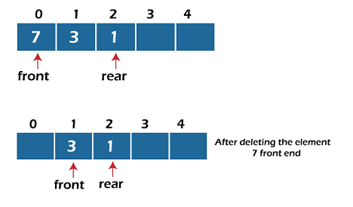
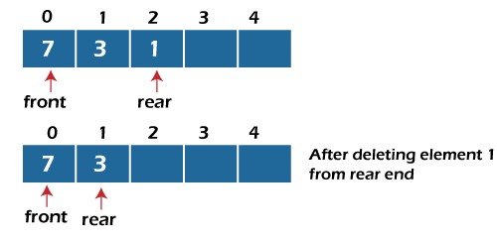

Slide 14
Priority Queue
FIFO
Similar to Queue but it gives some priority according to data
Types:-
Ascending priority ==>small priority(item) has Higher priority
Descending priority ==>larger priority(item) has Higher priority

