Slide 1
Linked List
Unit-5

Slide 2
List
The list can be defined as an abstract data type in which the elements are stored in an ordered manner for easier and efficient retrieval of the elements.
The list can store heterogeneous data items in its object.
List Data Structure is also known as a sequence.
Memory: Can be stored contiguously (like arrays) or non-contiguously (like linked lists).
Size: Can change dynamically, grows or shrinks as needed.
Flexibility: More flexible, adding or removing elements is easier.
Access: Sequential access, slower random access compared to arrays.
List can be implemented as array or Linked list.
Notes:
A=[1,2,3], A=[‘name’,1,’111’] , contiguously means =”fixed memory 0,1 index” opposite is data can be anywhere random

Slide 3
List ADT
Operations:-
insert-inserts an element to a list
insert(X,k)- which inserts element X at kth position of the list.
size() – this is a method which gives the size of the list and
isEmpty() – is a Boolean method which gives a value of true if the list is empty.
Delete(X) which removes the item/element X from the list.
printList() – prints the contents of the entire list
find(X) – finds out the location of the element X is in the list
Remove()

Slide 4
Array Implementation of List
See code

Slide 5
Limitation of array implementation
An array store its nodes in consecutive memory locations.
The number of elements in the array is fixed and it is not possible to change the
number of elements.
Insertion and deletion operation in array are expensive. Since insertion is performed
by pushing the entire array one position down and deletion is performed by shifting
the entire array one position up.

Slide 6
Importance of Linked List
Dynamic memory allocation: Unlike arrays, linked lists can be dynamically allocated in memory. This means that linked lists can be resized during runtime, which is not possible with arrays.
Easy insertion and deletion: Insertion and deletion of elements in a linked list are much easier and efficient than in an array. In a linked list, adding or removing an element requires only a few pointer changes, whereas in an array, adding or removing an element can involve shifting all the subsequent elements.
Flexibility: Linked lists can be singly linked, doubly linked, or circular, which provides greater flexibility in implementation.
Efficient memory usage: Linked lists use memory more efficiently than arrays in certain situations. For example, if the size of the list is not known in advance, a linked list can be a better choice since it can be dynamically allocated in memory.
Implementation of advanced data structures: Linked lists are used as a building block for implementing other advanced data structures like stacks, queues, and trees.

Slide 7
Disadvantages of linked list
Memory overhead: Unlike arrays, linked lists require extra memory to store the pointers that link the nodes together. This overhead can be significant if the number of nodes is small, but becomes less significant as the number of nodes grows.
Slower access: Accessing an element in a linked list takes longer than accessing an element in an array because it involves following the pointers from one node to the next. This can be a problem when fast access is important.
Sequential access: Linked lists are designed for sequential access. If you need to access the elements in a list randomly, a linked list can be inefficient..
More difficult to implement: Linked lists are more difficult to implement than arrays because they require dynamic memory allocation and management of the nodes. This can make the code more complex and error-prone.

Slide 8
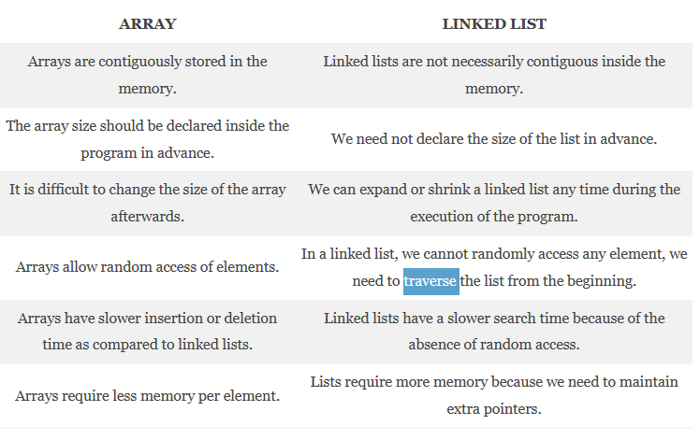
Notes:
Traversing in Data Structure means systematically visiting every element of it

Slide 9
Linked List
A linked list is a sequence of elements in which each element points to the next element.
Each element in a linked list, called a node.
Linked list requires a non-contiguous memory location,
A node is a data structure that contains two parts:
Data Field: The data part contains the actual data that is being stored in the list.
Pointer (Linked Field): The pointer part contains a reference to the next node in the list (Address).

Slide 10
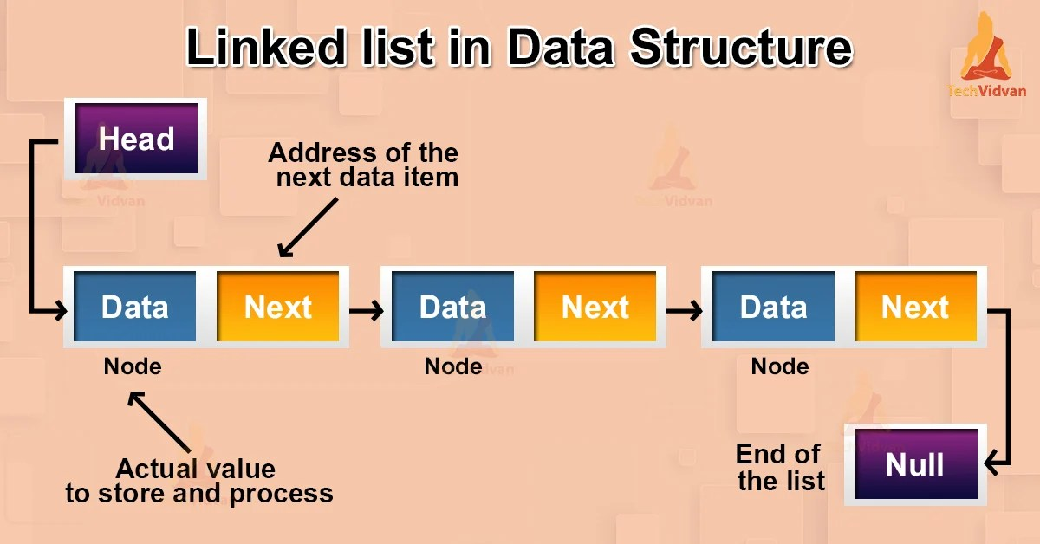

Slide 11
Implementation of Linkedlist in C:
Linked list can be implemented using structure in C,
struct Node{
int data; //the first part of the node where data is stored
struct Node *next; //Self-referencing structure. It links two nodes.
};
We will always create individual nodes and link them to the next node via the arrow operator ‘→’.
The linked list supports dynamic memory allocation. Therefore, we will use the functions malloc, calloc and realloc for memory allocation.
Malloc allocates a block of memory of the specified size and returns a pointer to the beginning of the block.
Calloc allocates a block of memory of the specified size and initializes all of the bytes in the block to zero.
Realloc changes the size of a block of memory that was previously allocated with malloc or calloc.

Slide 12
Basic Operations on Linked List
1. Traversal:
It means visiting each node from the beginning till the end.
2. Insertion:
This operation inserts an element at any given position in the list.
3. Deletion:
Deletion operation helps in deleting a node from the linked list.
4. Display:
This operation is used to print/display all the data elements of the linked list.
5. Search:
search operation helps in searching an element by traversing it.

Slide 13
Types of Linked List
Singly Linked List
Circular Linked List
Circular singly linked list
Circular double linked list
Doubly Linked List

Slide 14
Singly Linked List
A singly linked list is a type of data structure that consists of a sequence of nodes, where each node contains data and a reference (or link) to the next node in the list.
The last node in the list has a reference to null, indicating the end of the list.
The first node in the list is called the head, and it serves as the starting point to traverse the linked list.
To access or modify the elements in the list, we start from the head and follow the next references until we reach the desired node.

Slide 15
Traversal in Linked List(Singly)
Traversing a singly linked list is the process of visiting each node in the list exactly once.
Here is a step-by-step process for traversing a singly linked list:
Start at the head node: Set a pointer or reference variable to the head of the linked list.
Iterate through the list: While the current node is not null, continue to the next node.
Access or perform operations on the data in the current node.
Move to the next node by updating the pointer or reference variable to point to the next node in the list.
Repeat until the end of the list: Continue the traversal until the current node becomes null, indicating the end of the list.

Slide 16
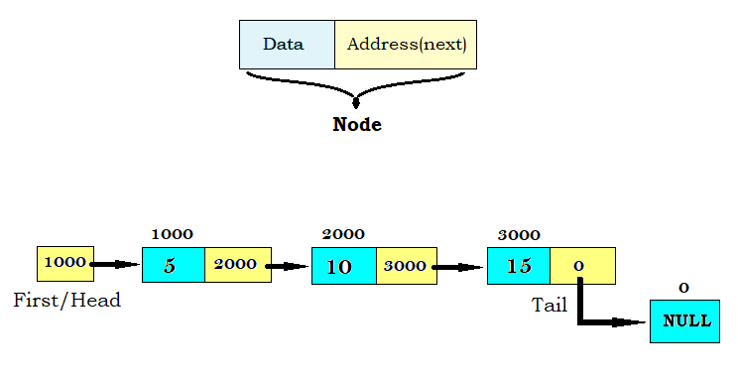
void linkedListTraversal(struct Node *ptr)
{
while (ptr != NULL)
{
printf("Element: %d\n", ptr->data);
ptr = ptr->next;
}
}

Slide 17
Insertion in a Linked List
1. Insertion at the beginning of the list
2. Insertion after a particular node/Position (index).
3. Insertion at the end of the list
Notes:
Always walk from beginning head pointer always pointing first node

Slide 18
Code
struct Node* head = (struct Node*)malloc(sizeof(struct Node));
struct Node* second = (struct Node*)malloc(sizeof(struct Node));
struct Node* third = (struct Node*)malloc(sizeof(struct Node));
// Assign data and link nodes
head->data = 11;
head->next = second;
second->data = 22;
second->next = third;
third->data = 33;
third->next = NULL;
Normal insert

Slide 19
Deletion operation
Deletion operation can be done in following cases;
Deleting the first node
Deleting the node at the index
Deleting the last node
Deleting the node with given value (node)

Slide 20
Circular Linked List
A circular linked list is a variation of a linked list where the last node's next pointer is not set to NULL, but instead points back to the first node, forming a circular structure.
This means that the elements in a circular linked list are connected in a loop.
Circular linked lists are often used in applications where the order of the elements is important, such as in a queue or a stack.

Slide 21
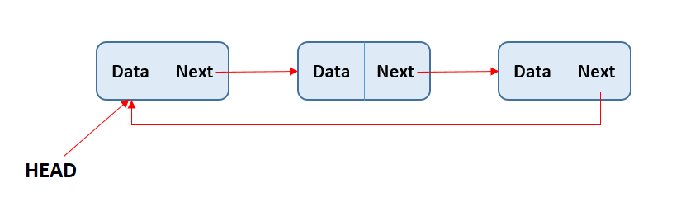

Slide 22
Doubly Linked List
A doubly linked list is a data structure that consists of a series of nodes, each of which contains a piece of data and a pointer to the next node and the previous node.
This bidirectional linkage allows traversal in both directions, forward and backward, making it more flexible than a singly linked list.

Slide 23
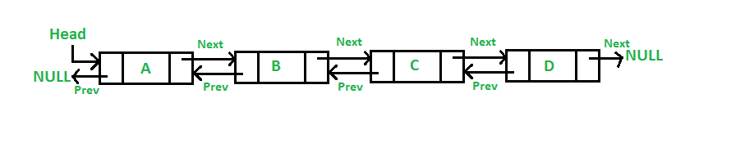

Slide 24
Circular double linked list
Circular: A circular doubly linked list's main feature is that it is circular in design.
Doubly Linked: Each node in a circular doubly linked list has two pointers - one pointing to the node before it and the other pointing to the node after it.
Header Node: At the start of circular doubly linked lists, a header node or sentinel node is frequently used. This node is used to make the execution of certain operations on the list simpler even though it is not a component of the list's actual contents.

Slide 25
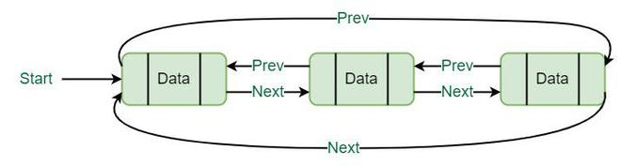

Slide 26
Linked List implementation
Stack
Queue

Slide 27
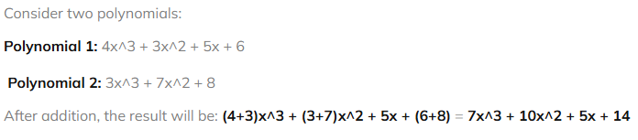

Applications :- Adding two polynomials using Linked List
Notes:
tacks and queues, representing polynomials, handling large number arithmetic, and managing memory in operating systems

