Slide 1
Tree
Unit-6

Slide 2
Introduction to Trees
a tree is a hierarchical data structure that consists of nodes connected by edges.
It is a nonlinear data structure that represents a set of elements in a hierarchical manner.
A hierarchical manner is a way of organizing things in a system of levels.
The highest level is at the top, and the lowest level is at the bottom.

Slide 3
Introduction to Trees
In a tree, there is a special node called the root node that serves as the starting point of the tree.
The root node can have zero or more child nodes, each of which may have its own child nodes, forming a branching structure.
The nodes in a tree are typically connected in a parent-child relationship, where each child node has a single parent node.

Slide 4
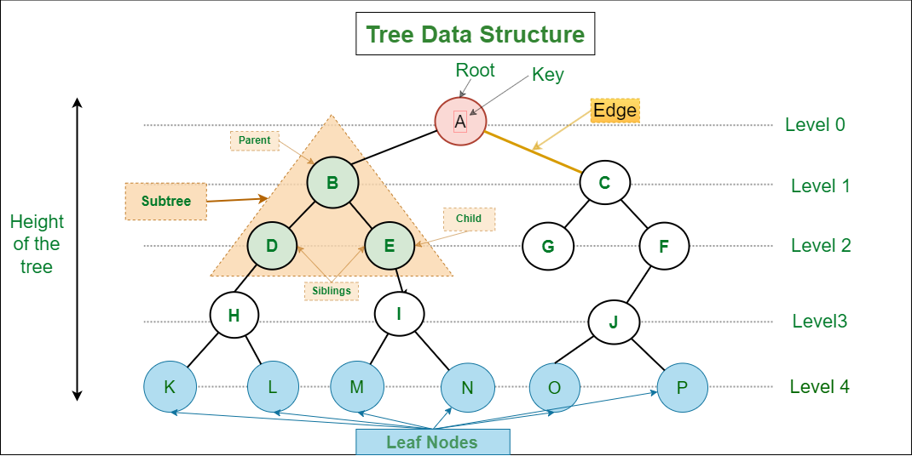

Slide 5
Terminologies used in Tree
Node: Each element in a tree is called a node. It represents a single entity in the tree and can hold data.
Root: The root is the topmost node of a tree. It is the starting point or the main access point to the tree.
Parent: The parent of a node is the node directly above it. It is the immediate ancestor of the node.
Child: The children of a node are the nodes directly below it. They are the immediate descendants of the node.
Siblings: Nodes that share the same parent are called siblings. They are at the same level in the tree.
Leaf: A leaf node, also known as a terminal node, is a node that has no children. It is at the end of a branch.
Internal Node: An internal node is any node in the tree that is not a leaf. It has at least one child.
Edge: An edge is a connection between two nodes. In the picture, the edges are the lines that connect the nodes.

Slide 6
Terminologies used in Tree
Path: A path is a sequence of nodes that connects two nodes in a tree. It starts from one node and ends at another.
Depth: The depth of a node is the number of edges from the root to that node.
Height: The height of a tree is the maximum depth among all the nodes in the tree.
Subtree: A subtree is a portion of the tree that consists of a node and all its descendants.
Degree: The degree of a node is the number of children it has.
Binary Tree: A binary tree is a tree in which each node has at most two children, referred to as the left child and the right child.
Balanced Tree: A balanced tree is a tree in which the heights of the left and right subtrees of every node differ by at most one.

Slide 7
most common applications of trees
Storing hierarchical data: Trees are a natural way to store data that is organized in a hierarchical structure, such as the file system on a computer or the organization chart of a company.
Searching: Trees can be used to search for data quickly and efficiently. For example, a binary search tree can be used to search for a specific value in a sorted list of elements in logarithmic time.
Traversal: Trees can be traversed in a variety of ways, depending on the application. For example, a depth-first traversal can be used to print all of the nodes in a tree, while a breadth-first traversal can be used to find the shortest path between two nodes.

Slide 8
most common applications of trees
Sorting: Trees can be used to sort data. For example, a binary search tree can be used to sort a list of elements in ascending or descending order.
Compression: Trees can be used to compress data. For example, a Huffman tree can be used to compress a text file by representing common characters with shorter codes.
Decision making: Trees can be used to make decisions. For example, a decision tree can be used to help a doctor diagnose a patient by considering a series of symptoms.

Slide 9
Binary Tree
A binary tree is a tree data structure in which each node can have at most two children.
Sometimes referred to as the left child and the right child.
In a binary tree, each node can have a maximum degree of 2.
A node with no children is called a leaf node or a terminal node. It has a degree of 0.
A node with one child has a degree of 1. The child can be either the left child or the right child.
A node with two children has a degree of 2. It has both a left child and a right child.

Slide 10
Binary Tree Components
There are three binary tree components.
Data element
Pointer to left subtree
Pointer to right subtree

Slide 11

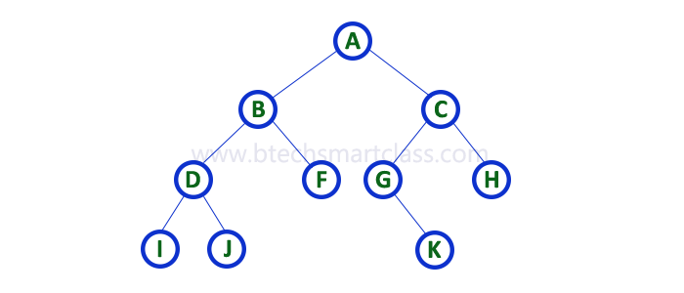
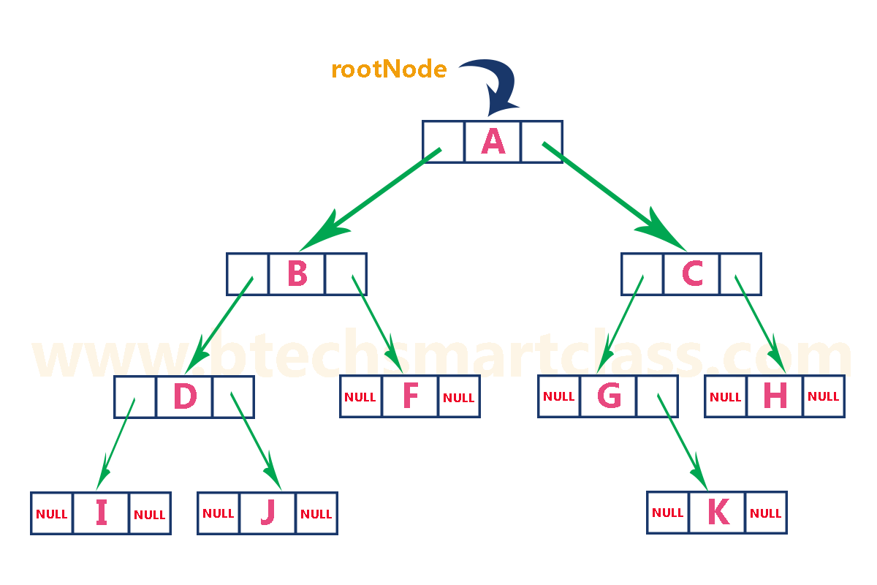
Array and Linked List Representation

Slide 12
Types of Binary Tree
Full Binary Tree/Proper:
A full binary tree is a binary tree in which every node has either 0 or 2 children.
Complete Binary Tree:
A complete binary tree is a binary tree in which all levels except possibly the last level are completely filled, and all nodes are left-justified.
In a complete binary tree, the last level is filled from left to right.
Skewed binary tree :
it is a type of binary tree in which most of the nodes are either left-skewed or right-skewed. In other words, all the nodes in the tree have only one child, either on the left side or the right side.
Notes:
https://www.scaler.com/topics/types-of-binary-tree/

Slide 13
Types of Binary Tree
Perfect Binary Tree:
A perfect binary tree is a binary tree in which all internal nodes have two children.
all leaf nodes are at the same level.
In other words, all levels of the tree are completely filled.
Balanced Binary Tree:
A balanced binary tree is a binary tree in which the difference in height between the left and right subtrees of any node is at most 1.
Degenerate binary tree :
A degenerate binary tree, also known as a pathological tree, is a type of binary tree where each parent node has only one child. In other words, it is a tree that is heavily skewed to one side, either left or right

Slide 14
Types of Binary Tree
Almost Complete Binary Tree
All levels except possibly the last level are completely filled.
All nodes of the last level are as far left as possible.
Here left side maybe not complete at all

Slide 15
Create a Binary tree
#include <stdio.h>
#include <stdlib.h>
struct Node {
int data;
struct Node *left;
struct Node *right;
};
struct Node* createNode(int d) {
struct Node* newNode =
(struct Node*)malloc(sizeof(struct Node));
newNode->data = d;
newNode->left = NULL;
newNode->right = NULL;
return newNode;
}
int main() {
// Initialize and allocate memory for tree nodes
struct Node* firstNode = createNode(2);
struct Node* secondNode = createNode(3);
struct Node* thirdNode = createNode(4);
struct Node* fourthNode = createNode(5);
// Connect binary tree nodes
firstNode->left = secondNode;
firstNode->right = thirdNode;
secondNode->left = fourthNode;
return 0;
}
Notes:
https://www.geeksforgeeks.org/introduction-to-binary-tree/

Slide 16
Tree traversal
Tree traversal refers to the process of visiting and examining all the nodes in a tree data structure in a specific order.
Tree traversal (also known as tree search and walking the tree) is a form of graph traversal and refers to the process of visiting (e.g. retrieving, updating, or deleting) each node in a tree data structure, exactly once.

Slide 17
Tree traversal
The three most commonly used traversal methods are:
Inorder traversal: The left subtree is visited first, then the root, and then the right subtree.
Preorder traversal: The root is visited first, then the left subtree, and then the right subtree.
Postorder Traversal: First visit left child, then right child, then root of the tree

Slide 18
Example
A
B
E
C
D
F
Notes:
Preorder[Ro,L,R] : -ABCDEF // A,B,D,E,H,I,C,F,G,J
Post order [L,R,Ro]: - CDBFEA // D, H, I, E, B, F, J, G, C, A.
Inorder[L,Ro,R] :- CBDAFE // D, B, H, E, I, A, F, C, J, G.

Slide 19
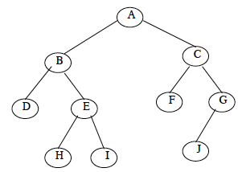

Slide 20
Binary Search Tree
It is called a binary tree because each tree node has a maximum of two children.
A binary search tree follows some order to arrange the elements. In a Binary search tree, the value of left node must be smaller than the parent node, and the value of right node must be greater than the parent node.
Notes:
s

Slide 21
Binary Search Tree
Following are the properties of Binary Search Tree (BST);
i) All nodes of left sub tree are lesser.
ii) All nodes of right sub tree are greater.
iii) Left and right sub tree are also BST.
iv) There are no duplicate nodes.
v) Inorder traversal of a BST gives an ascending sorted array.

Slide 22
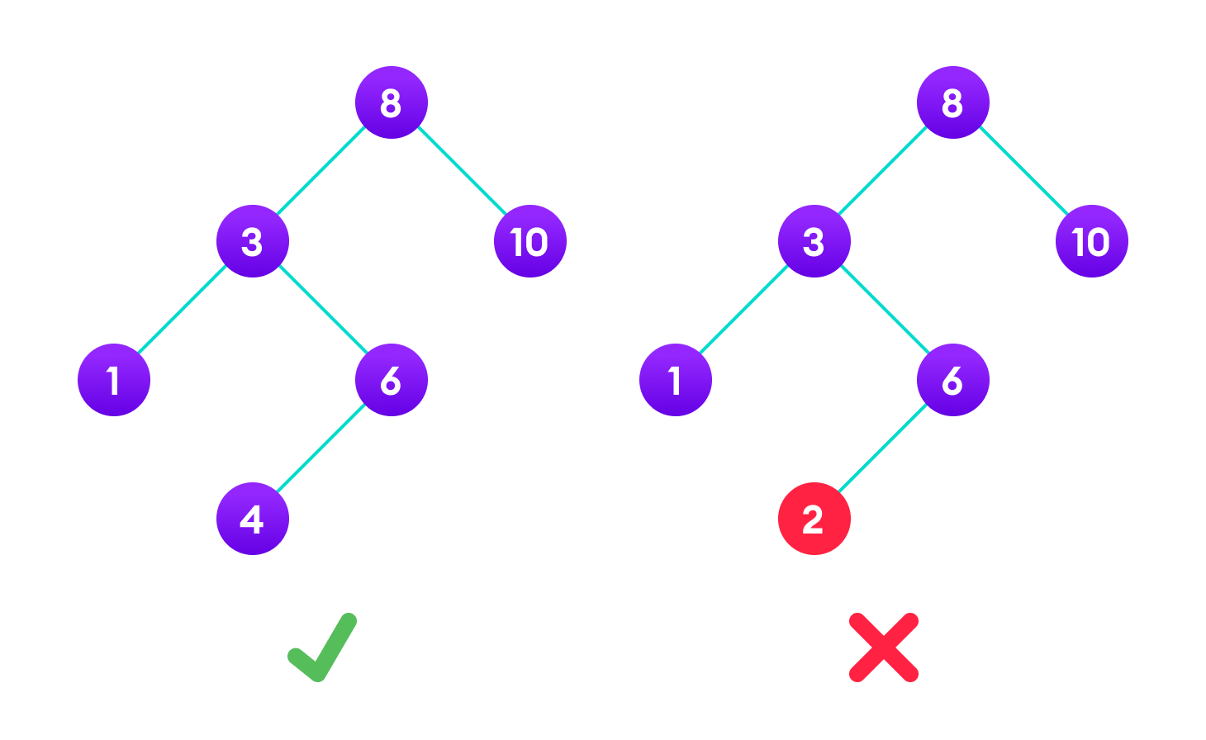

Slide 23
Binary search tree
Operation :-
Searching
Insertion
Deletion
Traversing

Slide 24
Insertion Operation
Start at the root node of the tree.
If the tree is empty, create a new node with the given value and make it the root.
Else
Compare the value of the new node to the value of the root node.
If the value of the new node is less than the value of the root node, then recursively insert the new node into the left subtree of the root node.
If the value of the new node is greater than the value of the root node, then recursively insert the new node into the right subtree of the root node.
If the value of the new node is equal to the value of the root node, then do nothing.

Slide 25
Deletion operation
Start at the root node and traverse the tree to find the node to be deleted, keeping track of the parent node.
If the node with the given key value is not found, the deletion operation ends.
If the node to be deleted has no children (it is a leaf node), simply remove it by updating the parent node's reference to NULL.
If the node to be deleted has only one child, update the parent node's reference to point to the child node, bypassing the node to be deleted.
If the node to be deleted has two children, find the node with the smallest key value in the right subtree(inorder successor) (or the node with the largest key value in the left subtree(inorder predecessor)). This node will be a leaf or a node with only one child.
Replace the key value of the node to be deleted with the key value of the found node.
Delete the found node using the same deletion algorithm recursively.
Return the modified tree.

Slide 26
Search Operation
Start at the root: Begin the search at the root node of the BST.
Compare the key value: Compare the target key value with the key value of the current node.
Go left or right: If the target key value is less than the current node's key value, move to the left child of the current node. Otherwise, if the target key value is greater than the current node's key value, move to the right child of the current node.
Repeat until found or not found: Repeat steps 2 and 3 recursively, moving down the tree based on the comparison results. If the target key value is equal to the current node's key value, the search is successful, and the node containing the key value is found.
If a null node is encountered during the search, it means the target key value is not present in the BST.

Slide 27
Binary Search Tree
Construct Binary search tree
Example : -50,70,60,20,90,10,40,100
Example : - 30 , 40, 24, 58, 48, 26, 11, 13

Slide 28
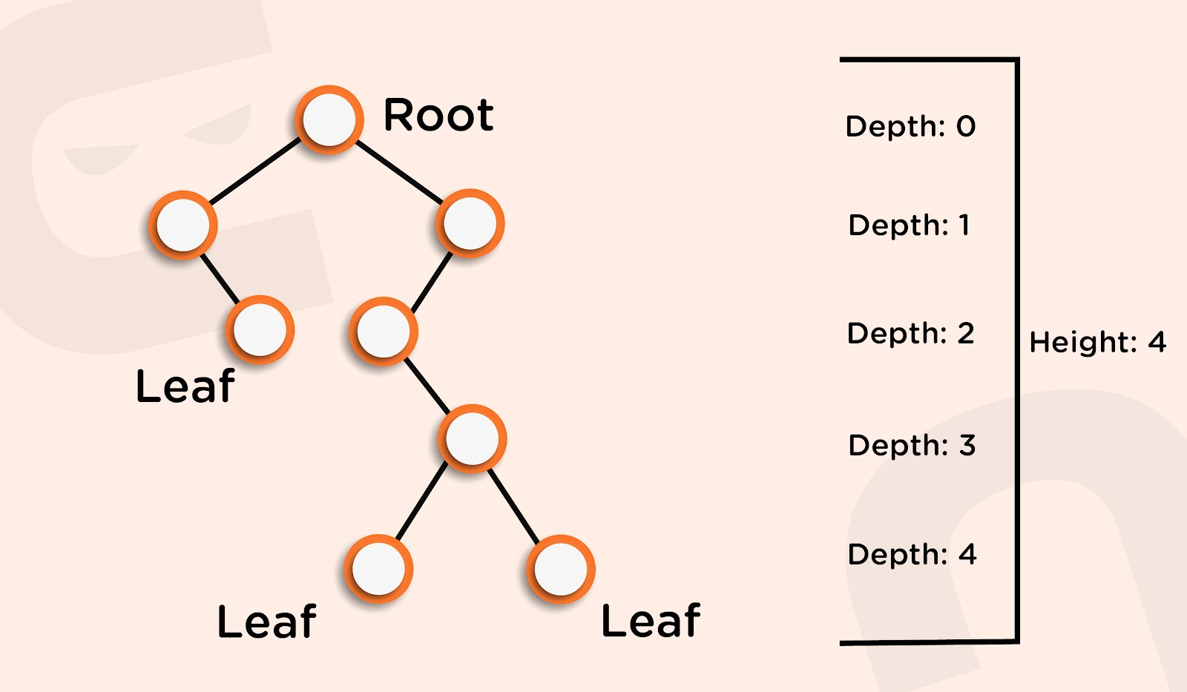
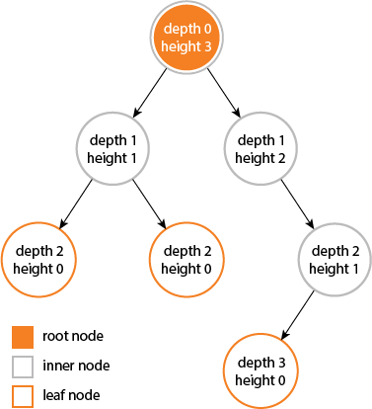
The depth of a node is the number of edges from the node to the tree's root node. A root node will have a depth of 0.
The height of a node is the number of edges on the longest path from the node to a leaf. A leaf node will have a height of 0.

Slide 29
Balanced binary tree
1.Height Balance
2. Weight Balance
A balanced binary tree is a binary tree that follows the 3 conditions:
The height of the left and right tree for any node does not differ by more than 1.
The left subtree of that node is also balanced.
The right subtree of that node is also balanced.

Slide 30
Problem with unbalance binary trees
This is a problem for binary search trees (BSTs) because an ordered linked list is a BST and searching it is linear. Thus, a BST has log-time searching on average, but a linear-time worst case.
Solving this problem and guaranteeing that the tree remains more-or-less balanced is one of the main motivations behind more complex BST-like data structures, e.g. AVL trees[1] and red-black trees[2].

Slide 31
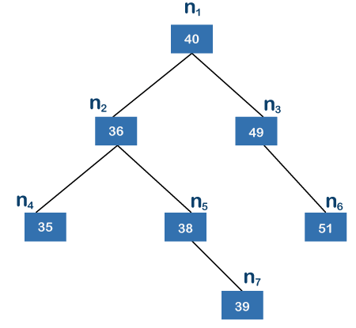
Balanced binary tree
A balanced binary tree is also known as height balanced tree.
It is defined as binary tree in when the difference between the height of the left subtree and right subtree is not more than m, where m is usually equal to 1.
The height of a tree is the number of edges on the longest path between the root node and the leaf node.
Searching, insertion, and deletion operations have time complexity of O(log n), where n is the number of nodes, ensuring efficient performance.
Application databases, compilers, and network
routing algorithms.

Slide 32
AVL Tree
AVL Tree is a self-balancing binary search tree in which the heights of the left and right subtrees of any node differ by at most one.
It is named after its inventors Adelson-Velsky and Landis.
The balancing property of AVL trees ensures efficient search, insert, and delete operations with a time complexity of O(log n) in the worst case.
Balance Factor: The balance factor of a node is the difference between the heights of its left and right subtrees. It can have three possible values: -1, 0, or +1.
Height-Balanced: The AVL tree maintains its height balance by performing rotations or restructurings.

Slide 33
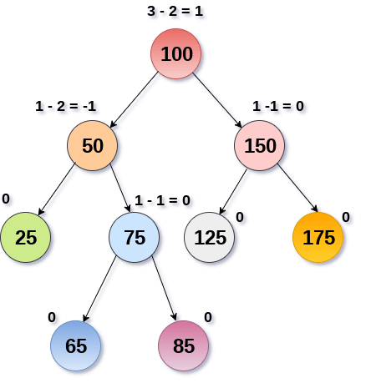

Slide 34
AVL TREE Rotation
Single rotations: These are rotations that involve a single node. There are two types of single rotations: left rotations and right rotations.
Double rotations: These are rotations that involve two nodes. There are two types of double rotations: left-right rotations and right-left rotations.

Slide 35
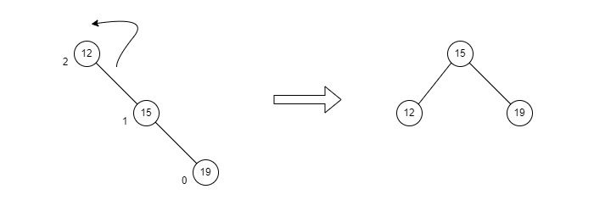
AVL TREE Rotation
RR Rotation : - Anti Clockwise Rotation (Single Left Rotation)

Slide 36
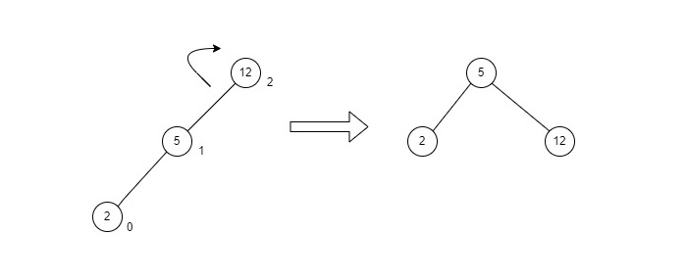
AVL TREE Rotation
LL Rotation : - Clockwise rotation

Slide 37
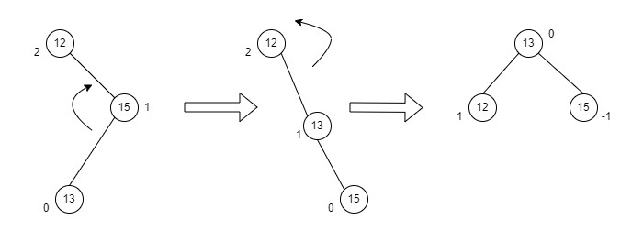
AVL TREE Rotation
Right-Left Rotation : –LL rotation and RR rotation

Slide 38
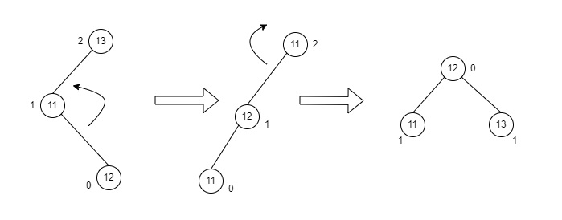
AVL TREE Rotation
Left-Right Rotation : RR rotation and LL rotation.

Slide 39
Creation of AVL Tree
Example : - 1,2,3,4,5,6,7,8
Practice : - 40,20,10,25,30,22,50
Practice : - 35,40,20,90,36,85,15,25,10,5
Practice : - 3,5 ,1,8,4,1,12,7,2,6
Practice : - 35,50,40,25,30,60,78,20,28
Practice : - 21, 26, 30, 9, 4, 14, 28, 18,15,10, 2, 3, 7
Notes:
40,20,10,25,30,22,50 ➔ 22 or 35 check

Slide 40
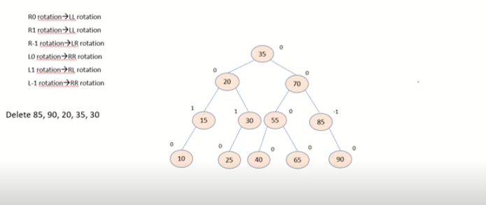
Deletion on AVL Tree
PREDECESSOR(X) SUCCESSOR(X) If X has two children, its predecessor is the maximum value in its left subtree and its successor the minimum value in its right subtree.
8,9,10,2,1,5,3,4,6 =>10(delete)
25,40,60,30,27,35,35,32,33,31,65 => 40(delete)
Rule:-
R(0)=> LL
R(1) => LL
R(-1) => LR
L(0) => RR
L(1)=>RL
L(-1)=>RR
Notes:
DSA30d - Solved Example - Deletion in AVL Tree - YouTube

Slide 41
B-Tree
A B-tree is a self-balancing tree data structure that maintains sorted data and allows searches, sequential access, insertions, and deletions in logarithmic time.
The B-tree generalizes the binary search tree, allowing for nodes with more than two children.
The order of a B-tree is the maximum number of keys that can be stored in a node.
The order of a B-tree is denoted by m.
B-tree guarantees that the time complexity for operations such as insertion, deletion, and searching is always O(log n), regardless of the initial shape of the tree.

Slide 42
B-Tree Applications
Since accessing values held in a vast database saved on a disc takes a long time, B trees index all data and allow quick access to the information stored on the discs.
Large databases employ it to access information stored on discs.
Using the B-Tree, data in a dataset could be found in less time.
Multilevel indexing is possible with the indexing feature.
The majority of servers also use the B-tree method.

Slide 43
B-Tree properties
Each node can have at most m children, m is the order of trees.
Minimum Children :
Leaf Node --> 0
Root Node --> 2
Internal Nodes --> ceil(m/2)
Every node has maximum (m-1) keys.
Minimum keys :
Root Node --> 1
All other nodes : ceil(m/2) -1
All the leaves are in the same level
Insertion is always on leaf node.
All the key values in a node must be in Ascending Order..

Slide 44
Insertion Operation in B-Tree
In a B-Tree, a new element must be added only at the leaf node.
That means, the new keyValue is always attached to the leaf node only.
Step 1 - Check whether tree is Empty.
Step 2 - If tree is Empty, then create a new node with new key value and insert it into the tree as a root node.
Step 3 - If tree is Not Empty, then find the suitable leaf node to which the new key value is added using Binary Search Tree logic.
Step 4 - If that leaf node has empty position, add the new key value to that leaf node in ascending order of key value within the node.
Step 5 - If that leaf node is already full, split that leaf node by sending middle value to its parent node. Repeat the same until the sending value is fixed into a node.
Step 6 - If the spilting is performed at root node then the middle value becomes new root node for the tree and the height of the tree is increased by one.

Slide 45
B-tree Practice Question
Order of 3
1,2,3,4,5,6,7,8,9,10
Order of 4
5,9,3,7,1,2,8,6,0,4
13,76,45,28,47,23,33,29,18,45,56,24,78,88,12
Order of 5
8,14,2,15,3,1,16,6,5,27,37,18,25,7,13,20,22,23,24
A,G,F,B,K,D,H,M,J,E,S,I,R,X,C,L,N,T,U,P

Slide 46
Huffman Algorithm
When constructing a Huffman tree, which is a specific type of binary tree used in the encoding process, a full binary tree is preferred for efficiency.
This is because, in a full binary tree, each internal node has exactly two children, ensuring that the resulting code will be uniquely decodable.
Huffman coding is a technique used for lossless data compression, commonly used in file compression algorithms like ZIP.
It works by assigning variable-length codes to input characters, with shorter codes assigned to more frequent characters, thus reducing the average number of bits required to represent the data.

Slide 47
Huffman Coding
ASCII
A =>65 =>01000001 => for single character we need 8 bits
1bit =>2 character ,2bit =>4 character
Fixed length coding
Send file also (along with our conversion) //basically rule for conversion
Huffman coding
Variable length coding

Slide 48
Huffman Coding
1.frequency in ascending order (frequency is number of character repetition)
2.take 2 minimum frequency [from order] character where from those 2 character smallest in left and greater in right and sum the frequency (make tree)
3. Now again re- arrange the frequency table
4. Repeat step 2 and 3
5. End all character should be in leaf node.
6. Now give each edge a value left side 0 and right side 1
7. Now go from root to the leaf node until character found following each edge and you will get the binary value
8. Now calculate size by => frequency*number of bits

Slide 49
Example
Character | A | B | C | D | E
Frequency | 4 | 7 | 3 | 2 | 4
Character | P | O | K | H | A | R
Frequency | 22 | 9 | 41 | 7 | 2 | 32
Notes:
https://opendsa-server.cs.vt.edu/ODSA/Books/Everything/html/Huffman.html
ABACCDA

