Slide 1
Searching Algorithm and Hashing
Unit-8

Slide 2
Searching algorithms
Searching algorithms are a fundamental concept in Data Structures and Algorithms (DSA).
They are techniques used to locate a specific element or value within a collection of data.
These algorithms are essential for various tasks in computer science, including:
Finding a particular record in a database
Locating a file on a computer system
Identifying an element in an array or list

Slide 3
Sequential Search/Linear Search
Description: It sequentially checks each element of the list until a match is found or the end of the list is reached.
Complexity: O(n) in the worst case, where n is the number of elements in the list.
Algorithm:-
Start: Begin at the first element of the collection of elements.
Compare: Compare the current element with the desired element.
Found: If the current element is equal to the desired element, return true or index to the current element.
Move: Otherwise, move to the next element in the collection.
Repeat: Repeat steps 2-4 until we have reached the end of collection.
Not found: If the end of the collection is reached without finding the desired element, return that the desired element is not in the array.

Slide 4
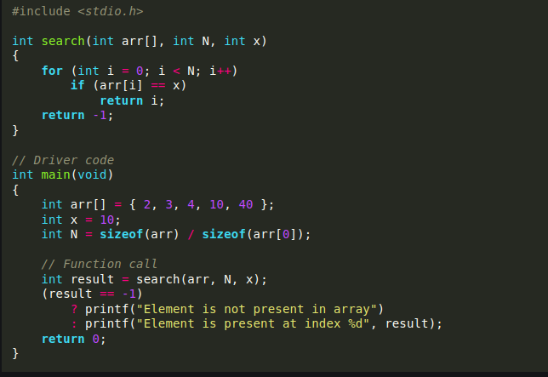
Program

Slide 5
Binary Search
Binary Search, also known as half-interval search is one of the most popular search techniques to find elements in a sorted array. Here, you have to make sure that the array is sorted.
The algorithm follows the divide and conquer approach, where the complete array is divided into two halves and the element to be searched is compared with the middle element of the list.

Slide 6
Algorithm
Consider a key element you wish to search.
Compare the key element with the middle element
If the element you wish to search matches with the middle element, then return the index of the middle element.
Else if the element you wish to search is greater than the middle element, then the key element can only lie on the right-hand side of the middle element. Then, you have to recur the right half of the sub-array.
Else if the element you wish to search is less than the middle element, then you have to recur the left half.
Notes:
Sort the data first

Slide 7
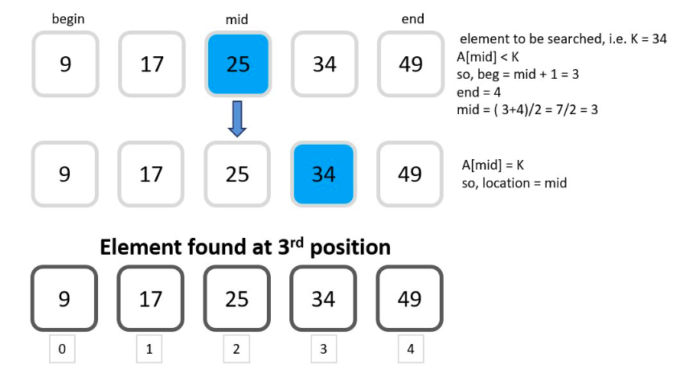

Slide 8
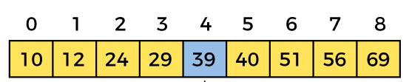
Notes:
Case-I => data ==a[mid]
CASE-ii => data > a[mid]
CASE-III => data <a [mid]
Mid =floor( lb+ub/2)
Stop = if(lb>ub) lower bound and upper bound
Make table

Slide 9
Hashing
Hashing is a technique used in data structures and algorithms to map data to a fixed-size array called a hash table.
It is an efficient way to store and retrieve data based on its key.
The main idea behind hashing is to quickly locate a specific element by computing its hash code and using it as an index in the hash table.
The time complexity of hashing is O(1), which means that the time it takes to add or retrieve data from a hash table is constant, regardless of the size of the hash table.

Slide 10
Hashing
Hash Function
A hash function is a mathematical algorithm that takes an input (key) and generates a fixed-size numeric value called a hash code or hash value.
The hash function should ideally distribute the keys uniformly across the hash table.
Hash Table
A hash table is an array of fixed size, where each element is called a bucket or slot.
The size of the hash table is typically determined based on the expected number of elements to be stored.
Mapping Keys to Hash Codes:
When a key-value pair is inserted into the hash table, the hash function is applied to the key to compute its hash code.
The hash code is then mapped to an index in the hash table using a technique called modulo division (hash code % table size).
This index determines the bucket where the key-value pair will be stored.

Slide 11
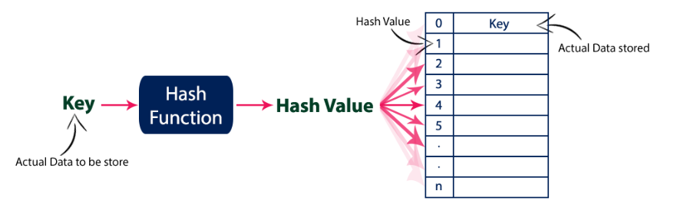

Slide 12
Hashing
Collision Occur ?

Slide 13
Types of Collision
Chaining
Each bucket in the hash table contains a linked list or any other data structure to store multiple elements that hash to the same index.
Open Addressing
If a collision occurs, the algorithm probes for the next available slot in the hash table until an empty slot is found.
Types:-
Linear Probing
Quadratic Probing
Double Hashing

Slide 14
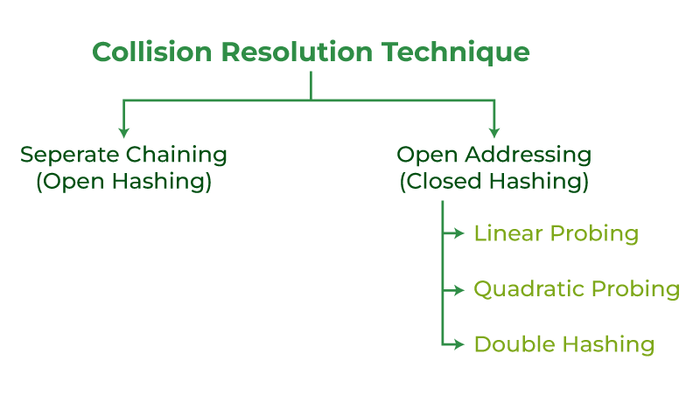

Slide 15
Separate Chaining
Separate chaining is a specific implementation of the chaining collision resolution technique in hashing.
In separate chaining, each bucket in the hash table contains a separate data structure, typically a linked list, to store the key-value pairs that hash to the same index
Separate chaining is also known as open hashing because it involves keeping the hash table "open" by allowing multiple key-value pairs to be stored in the same bucket using a separate data structure, such as a linked list.

Slide 16
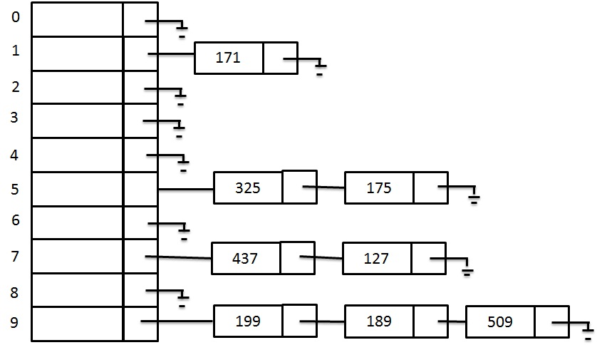

Slide 17
Separate Chaining
66,42,91,87,192,16,227,49
Hash Function :- h(k) =k mod 10
50, 700, 76, 85, 92, 73, 101.
Hash Function : - h(k) = k mod 7
Perfect Hash Function

Slide 18
Open Addressing(Closed Hashing)
Open addressing is a collision resolution technique used in hash tables to handle collisions that occur when two keys hash to the same index.
Open addressing aims to store all the keys within the hash table itself, without using any additional data structures.
The algorithm probes the table to find an alternative empty slot to store the key.
It refers to the process of searching for an available slot or key within the hash table when a collision occurs.
It involves determining the sequence of steps or positions to examine in order to find an empty slot or the desired key.
The probing is done by following a predefined sequence of steps, usually based on a hash function, until an empty slot is found.

Slide 19
Open Addressing(Closed Hashing)
There are different methods for probing:-
Linear probing: The next probe location is calculated by adding a constant value to the original hash value.
Quadratic probing: The next probe location is calculated by adding a quadratic function of the number of probes already attempted to the original hash value.
Double hashing: A second hash function is used to calculate the next probe location.

Slide 20
Linear probing
In linear probing, if a collision occurs, the algorithm checks the next slot in a linear sequence (i.e., next index) until an empty slot is found.
The probing sequence can be represented as: hash(key), hash(key)+1, hash(key)+2, and so on.
H(k, i) = [ h(k) + i] mod m

Slide 21
Linear probing
31, 26, 43, 27, 34, 46, 14, 58, 13, 17.
h(k) = k mod 12
Disadvantage
Search time
Deletion of data
Primary clustering
we need to traverse the whole cluster every time we wish to insert a new value in case of collision.
Secondary Clustering
Notes:
Primary clustering happens when multiple keys hash to the same location. Secondary clustering happens when keys hash to different locations

Slide 22
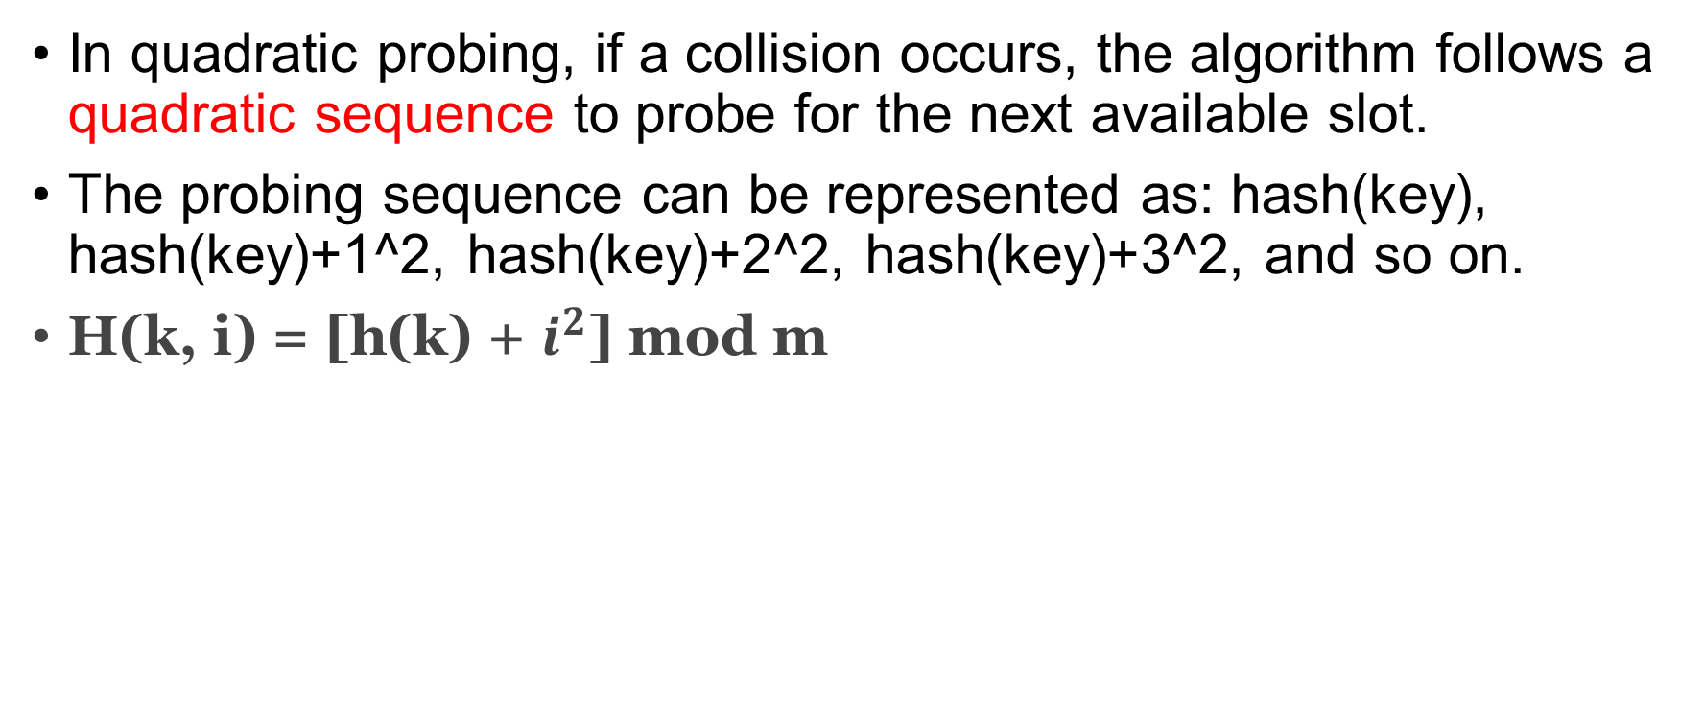
Quadratic probing
In quadratic probing, if a collision occurs, the algorithm follows a quadratic sequence to probe for the next available slot.
The probing sequence can be represented as: hash(key), hash(key)+1^2, hash(key)+2^2, hash(key)+3^2, and so on.
H(k, i) = [h(k) + $i^{2}$] mod m

Slide 23
Quadratic probing
24, 17, 32, 2, 13, 50, 30, 16 and let m = 11 for h(k) = k mod m.

Slide 24
Double hashing
In double hashing, we use two hash functions instead of one. If a collision occurs due to one hash function we can make use of the other hash function to find the next free slot.
Let H(k) represent the new hash function formed. Then, its value will be:
H(k, i) = [h(k) + i* h’(k)] mod m
Here, h(k) = primary hash function And, h’(k) = secondary hash function
In double hashing, choosing a prime number as the size of the hash table has certain advantages.
The use of a prime number for the size of the hash table helps to minimize clustering and improve the distribution of keys within the table.
This can lead to a more even spread of keys and reduce the likelihood of collisions.

Slide 25
20, 34, 45, 70, 56
h₁(k) = k mod 11 (first hash function)
h₂(k) = 8 - (k mod 8) (second hash function)

Slide 26
Rehashing and Load Factor
The load factor in hashing refers to the ratio of the number of elements stored in a hash table to the total number of slots or buckets available in the hash table.
It is calculated as:
Load Factor (λ)= Number of elements / Total number of slots
The load factor provides an indication of how full or empty the hash table is.
A low load factor (less than 0.75) indicates that the hash table is relatively empty and has plenty of available slots.
A high load factor (greater than 0.75 or close to 1) indicates that the hash table is nearing its capacity and has fewer available slots.

Slide 27
Rehashing and Load Factor
Rehashing is a process in hash table operations where the size of the hash table is dynamically increased or decreased to maintain a suitable load factor or accommodate a larger or smaller number of elements.
The need for rehashing arises when the number of elements stored in the hash table exceeds a certain threshold (load factor) or when the hash table becomes too sparse.
Determine the new size of the hash table based on a resizing strategy (e.g., doubling the size, adding a fixed number of slots).
Close to prime number.

