Slide 1
Graph Algorithm
Unit-9

Slide 2
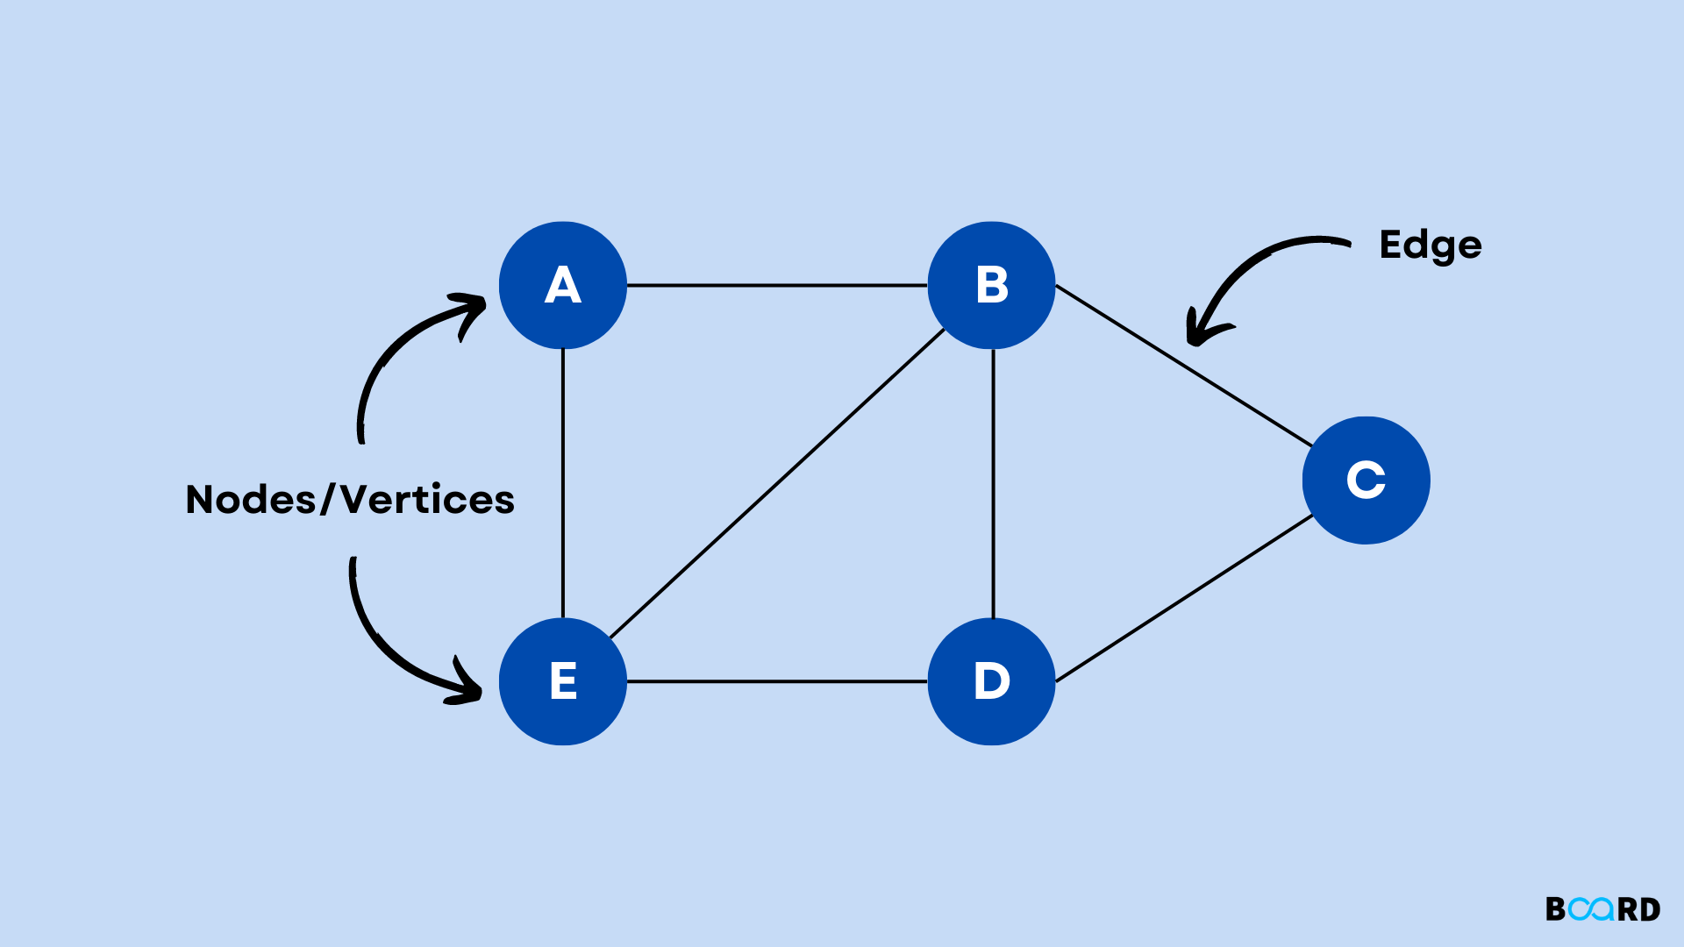
Graph Algorithm
Graph is a data structure that consists of the following two components: G(V,E)
A finite set of vertices also called nodes.
A finite set of ordered pair of the form (u, v) called edge. The pair is ordered because (u, v) is not the same as (v, u) in the case of a directed graph(di-graph). The pair of the form (u, v) indicates that there is an edge from vertex u to vertex v. The edges may contain weight/value/cost.

Slide 3
Graph Representations
Order: Order defines the total number of vertices present in the graph.
Size: Size defines the number of edges present in the graph.
Self-loop: It is the edges that are connected from a vertex to itself.
Isolated vertex: It is the vertex that is not connected to any other vertices in the graph.
Vertex degree: It is defined as the number of edges incident to a vertex in a graph.
Weighted graph: A graph having value or weight of vertices.
Unweighted graph: A graph having no value or weight of vertices.
Directed graph: A graph having a direction indicator.
Undirected graph: A graph where no directions are defined.
Degree: Number of edges incident on a vertex

Slide 4
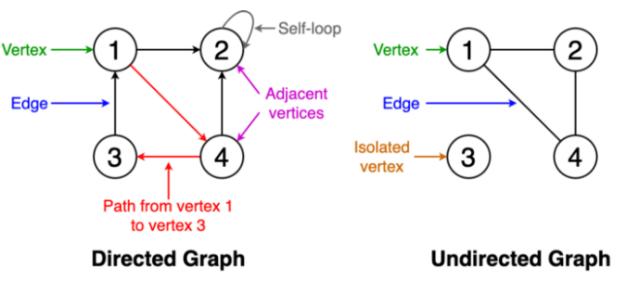
Graph Representations
Notes:
Degree self loop -2

Slide 5
Degree of Graph
Undirected Graph
Isolated
Self loop
Directed Graph
In degree
Out Degree
Types of graphs:-
Graphs in Data Structure: Overview, Types and More [Updated] | Simplilearn
Notes:
Aycyclic, complete different graphs

Slide 6
Representations of a graph.
The following two are the most commonly used representations of a graph.
Incidence Matrix
Rows represents vertices
Column represents edges
Matrix fill with 0,1-1.
Adjacency Matrix
Adjacency matrix is a sequential representation.
Adjacency List
In Incidence matrix representation, graph can be represented using a matrix of size: Total number of vertices by total number of edges.
Notes:
How to draw graph into computer?
http://www.btechsmartclass.com/data_structures/graph-representations.html

Slide 7
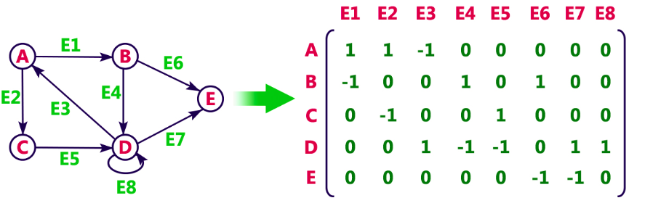
Incidence Matrix
Notes:
0 represents that the row edge is not connected to column vertex,
1 represents that the row edge is connected as the outgoing edge to column vertex and
-1 represents that the row edge is connected as the incoming edge to column vertex.

Slide 8
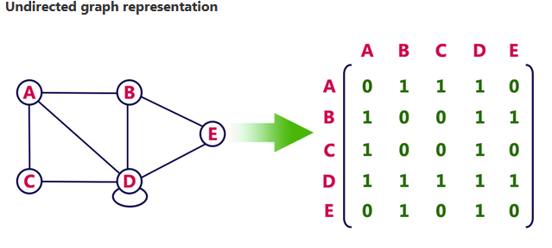
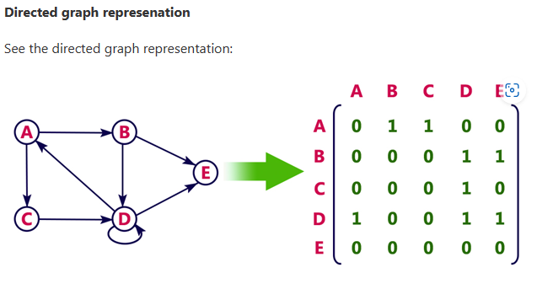
Adjacency Matrix
Notes:
Weighted graph A->B 7

Slide 9
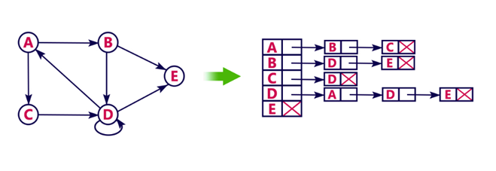
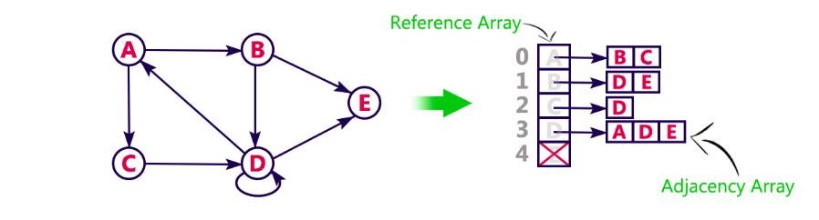
Adjacency List

Slide 10
Graph Traverse
The process of visiting or updating each vertex in a graph is known as graph traversal.
The sequence in which they visit the vertices is used to classify such traversals.
Graph traversal is a subset of tree traversal.
There are two techniques to implement a graph traversal algorithm:
Breadth-first search
Depth-first search

Slide 11
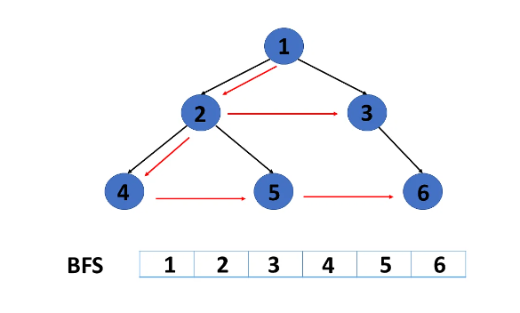
Breadth-first search
Choose any node/vertices
From that vertices to adjacent vertices
Visited and not-visited both
Queue DS

Slide 12
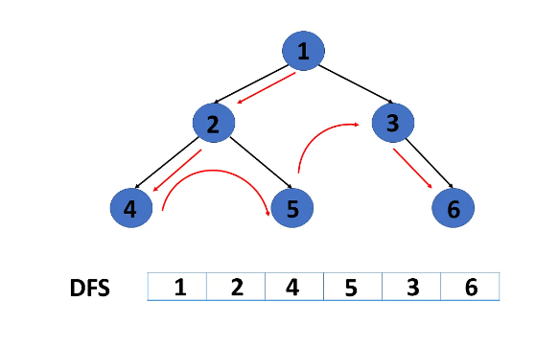
Depth-first search
Visit only one at a time.
If dead end found return back.
Again traverse
Stack DS

Slide 13
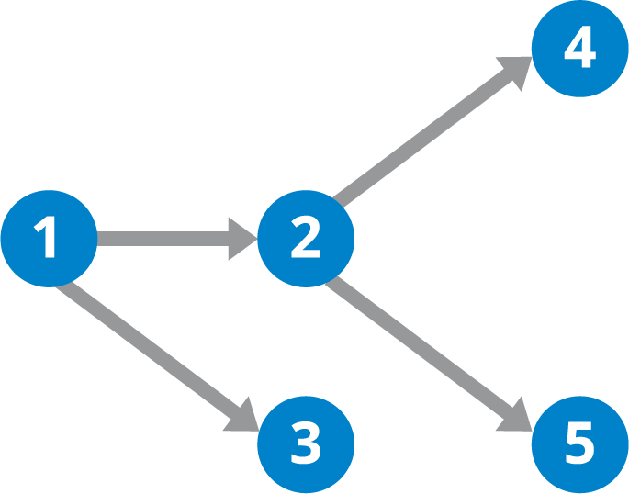
Topological sort
Topological Sort is a linear ordering of the vertices in such a way that if there is an edge in the DAG going from vertex ‘u’ to vertex ‘v’, then ‘u’ comes before ‘v’ in the ordering.
Topological Sorting is possible if and only if the graph is a Directed Acyclic Graph. i.e. No Loop/Cycle
There may exist multiple different topological orderings for a given directed acyclic graph.
Notes:
Prerequisite DFA

Slide 14
Topological sort Algorithm
Step 0: Find indegree for all nodes.
Step 1: Identify a node with no incoming edges.
Step 2: Remove the node from the graph and add it to the ordering.
Step 3: Remove the node’s out-going edges from the graph.
Step 4: Decrement the in-degree where connected edges were deleted.
Step 5: Repeat Steps 1 to 4 till there are no nodes left with zero in-degree.
Step 6: Check if all elements are present in the sorted order.
Step 7: If the result of Step 6 is true, we have the sorted order. Else no topological ordering exists.
Step 8: Exit.

Slide 15
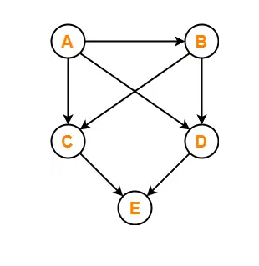
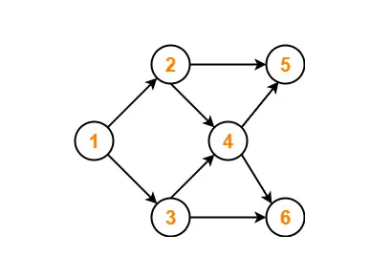
Notes:
A B C D E
A B D C E

Slide 16
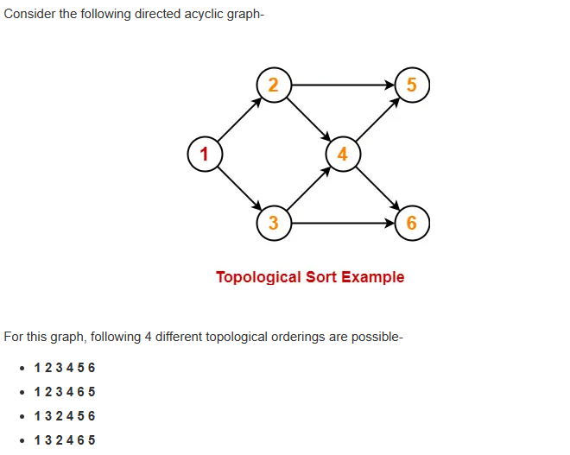

Slide 17
Shortest Path Algorithm
A shortest path algorithm is an algorithm for finding the shortest path between two nodes in a graph.
Graphs are used to model connections between objects, people, or entities.
They have two main elements: nodes and edges. Nodes represent objects and edges represent the connections between these objects.

Slide 18
Dijkstra's Algorithm
Dijkstra's algorithm is used to find the shortest path in a graph with non-negative edge weights.
It starts from a source vertex and explores the neighboring vertices, updating their distances from the source as it progresses.
Dijkstra's algorithm guarantees finding the shortest path when all edge weights are non-negative.
Greedy algorithm
Optimal solution
Application
GPS Navigation Systems
Internet Routing
…….
Notes:
20 min only

Slide 19
Dijkstra's Algorithm
In Dijkstra's Algorithm, relaxation refers to the process of updating the tentative distances of vertices as the algorithm explores the graph.
It involves comparing the current shortest distance to a vertex with the newly calculated distance through an intermediate vertex.
If the newly calculated distance is smaller, the shortest distance to the vertex is updated.
if (currentDistance(d(u)) + edgeWeight(c(u,v)) < tentativeDistance(d(v)))
tentativeDistance(d(v)) = currentDistance(d(u)) + edgeWeight c(u,v)

Slide 20
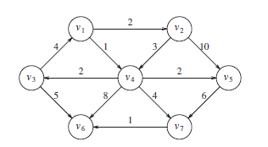

Slide 21
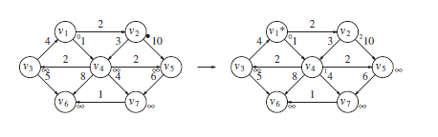

Slide 22
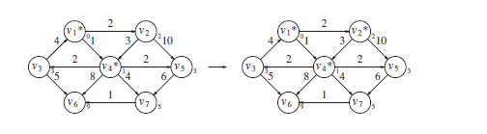

Slide 23
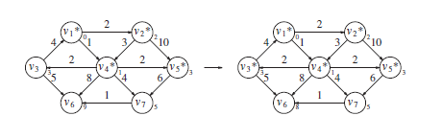

Slide 24
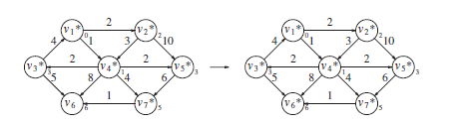

Slide 25
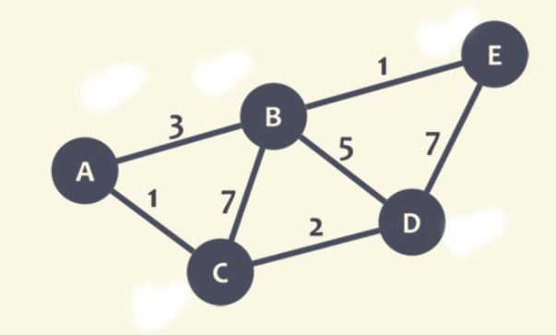
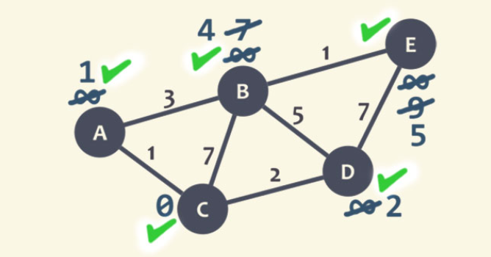
Dijkstra's Algorithm
Examples

Slide 26
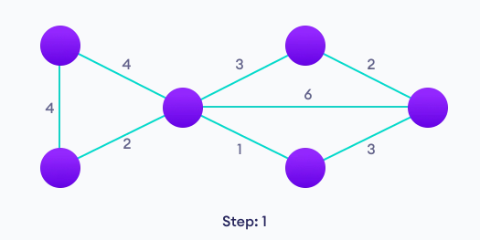
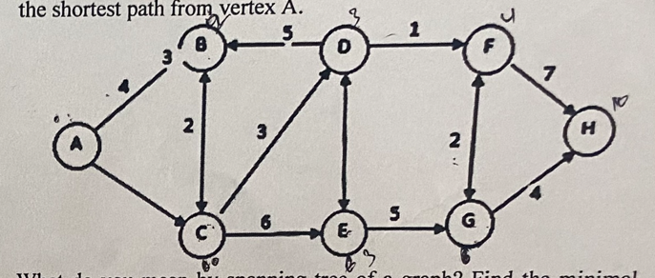

Slide 27
Minimum spanning tree (MST)
A minimum spanning tree (MST) is a subset of the edges of a connected, weighted graph that connects all the vertices with the minimum possible total edge weight.
In other words, it is a tree that spans all the vertices of the graph while minimizing the sum of the weights of its edges.
A connected graph can have multiple spanning trees.
A graph with n vertices can have an n^(n-2) number of spanning trees.
Spanning trees does not have any loop or cycle.
Spanning trees have n vertices and n-1 number of edges.

Slide 28
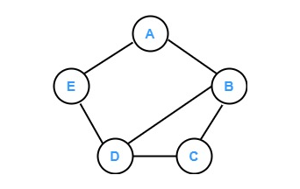
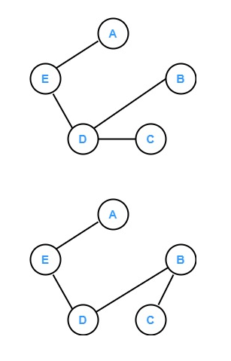
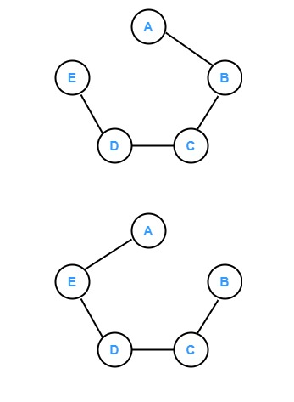
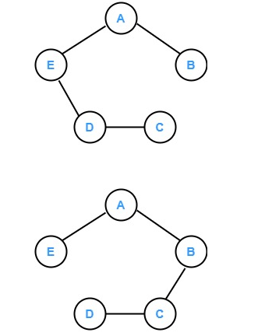

Slide 29
Applications of Spanning Tree
In routing protocols
Cluster mapping and analysis
Network Planning
Explore the path/ route in the maps.

Slide 30
Prim’s MST
Prim’s algorithm starts with a single node/vertex and moves on to the adjacent vertices to explore all the connected edges.
The idea behind prim’s algorithm is that it maintains two sets of vertices.
The first set comprises vertices that are already included in the minimum spanning tree and the other set consists of all the vertices which are not included yet.

Slide 31
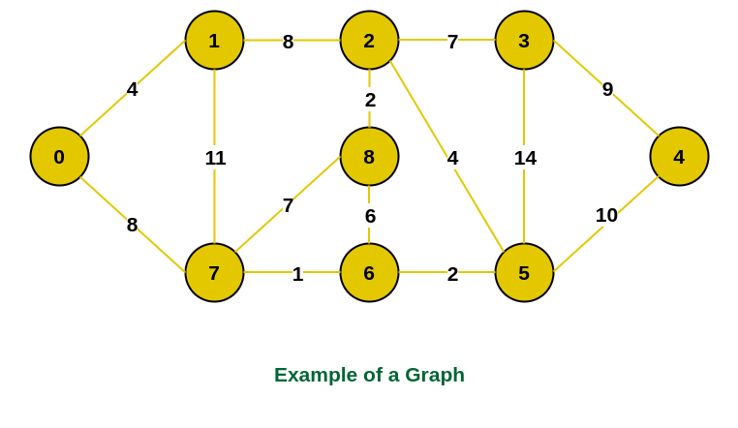
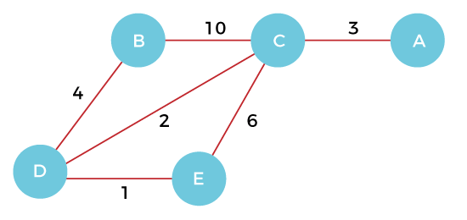

Slide 32
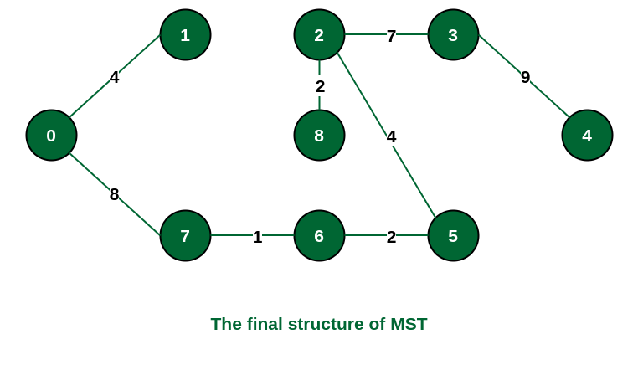
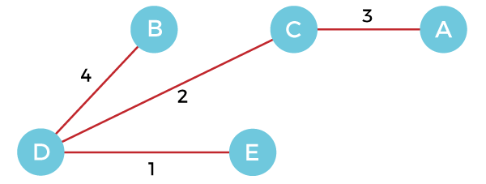

Slide 33
Kruskal’s Minimum Spanning Tree (MST) Algorithm
In Kruskal’s algorithm, sort all edges of the given graph in increasing order.
Then it keeps on adding new edges and nodes in the MST if the newly added edge does not form a cycle.
It picks the minimum weighted edge at first at the maximum weighted edge at last.
Thus we can say that it makes a locally optimal choice in each step in order to find the optimal solution. Hence this is a Greedy Algorithm.

Slide 34
