Slide 1

CAPSTONE
BY TEAM
Karun Kaul
Sachin Singh
Sarah Shah
Sushant Karande
Tilak Nishad

Slide 2
AGENDA
PROBLEM DEFINITION
DATA CLEANING AND MERGING
EXPLORATORY DATA ANALYSIS
MARKET SEGMENTATION AND CLUSTERING
CUSTOMER LIFETIME VALUE

Slide 3

WHAT IS ?
Is a company of MAHINDRA GROUP
India’s leading chain of multi-brand car workshops
335+ workshops
267+ towns & 24 states
>10 lakh cars serviced
ADVANTAGES
Affordability
Quality Spares & Equipment
Skilled Manpower
Transparency
Online Booking
Pick-up & Drop Facility

Slide 4
DATA
Customer Data
Contains details of the customer; data dimension is of 555338 entries
Invoice Data
Categorical: - make – model – cust type – order type – plant – location
Continuous: - labour costs – parts cost – miscellaneous – total
Other: - Job Card Date & Time – Invoice Date & Time
Material Inventory
Categorical: - Item Category – UoM
Numerical : - Net Value – Order Quantity
Other: - Description
PROBLEM DEFINITION
The company aims to establish countrywide network of over 400 workshops
Use the data to address key issues

Slide 5
AGENDA
PROBLEM DEFINITION
DATA CLEANING AND MERGING
EXPLORATORY DATA ANALYSIS
MARKET SEGMENTATION AND CLUSTERING
CUSTOMER LIFETIME VALUE

Slide 6
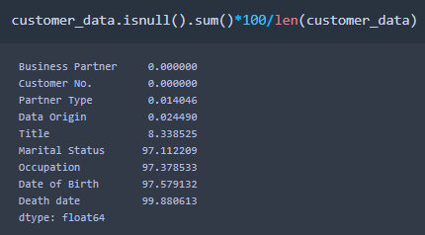
DATA CLEANING
CUSTOMER DATA
Removing missing values
Columns with high missing values:
Marital Status, Occupation, Date of Birth, Death Date
Removing redundant column – Title
Filling missing values of columns – Partner Type and Data Origin
MATERIAL INVENTORY DATA
Columns removed : Unnamed, Labor Value Number (67% missing values)

Slide 7
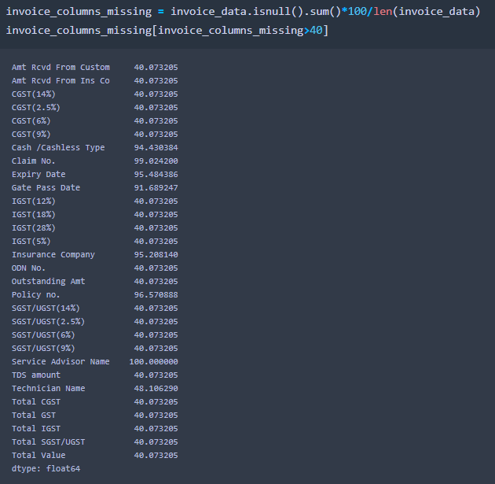
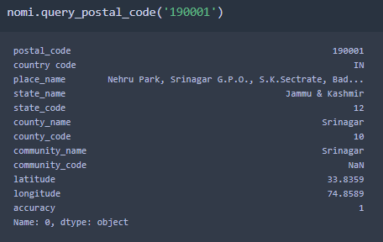
DATA CLEANING
Invoice Data
Removing redundant columns with high missing values
Merge date and time for both ‘Invoice’ and ‘Job Card’
Time taken for SERVICE = Invoice time-Job Card Time
Extracting Area/City/State by Pin Code using pgeocode
- Dropping old columns of area/city/state

Slide 8
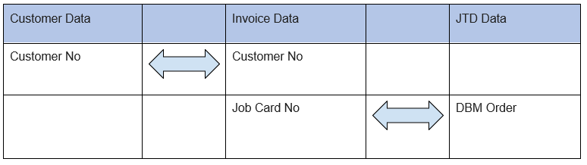
DATA MERGING
Prior to merging, material inventory data was grouped by ‘DBM Order’ and ‘Item Category’
COLUMNS TO MERGE ON

Slide 9
AGENDA
PROBLEM DEFINITION
DATA CLEANING AND MERGING
EXPLORATORY DATA ANALYSIS
MARKET SEGMENTATION AND CLUSTERING
CUSTOMER LIFETIME VALUE

Slide 10
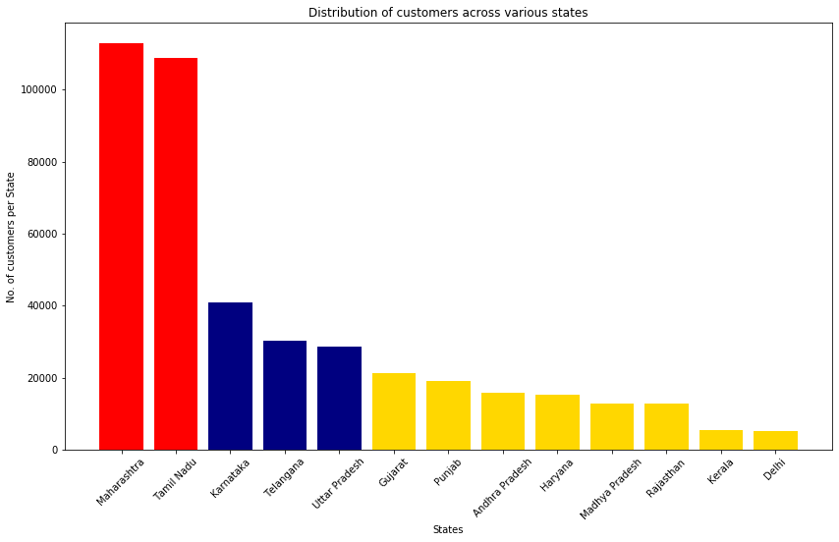
GEOLOCATION BASED CUSTOMER ANALYSIS OWNERSHIP PATTERN OF CARS – BY STATE

Slide 11
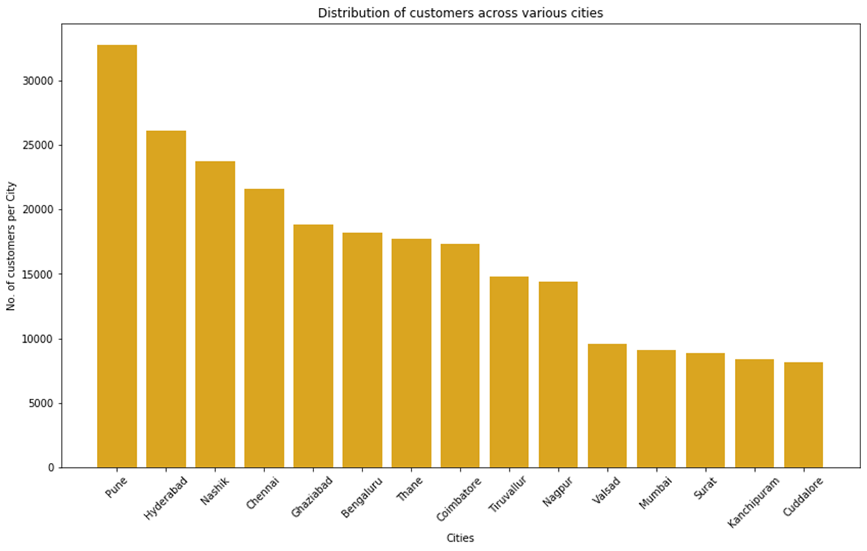
OWNERSHIP PATTERN OF CARS – BY TOP CITIES

Slide 12
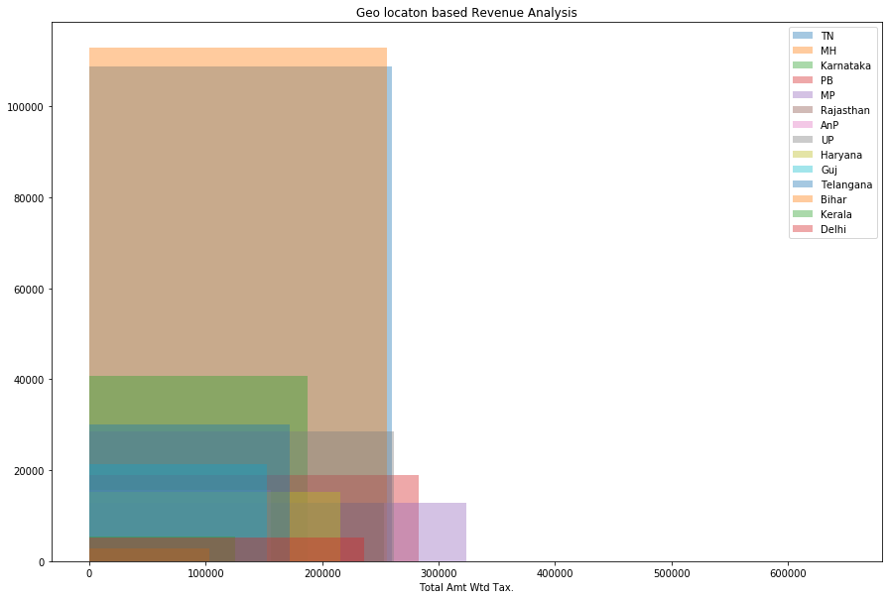
Revenue – By State

Slide 13
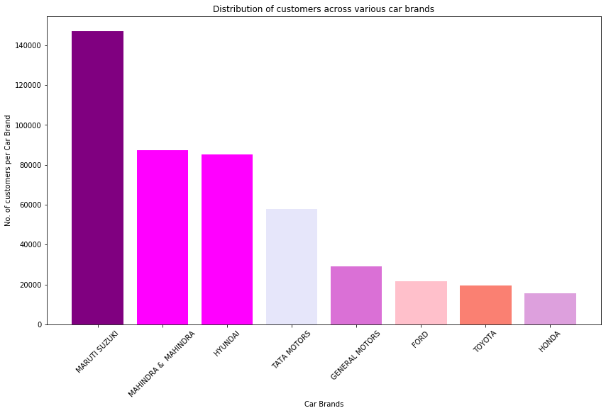
OWNERSHIP PATTERN OF CARS – BY MAKE

Slide 14
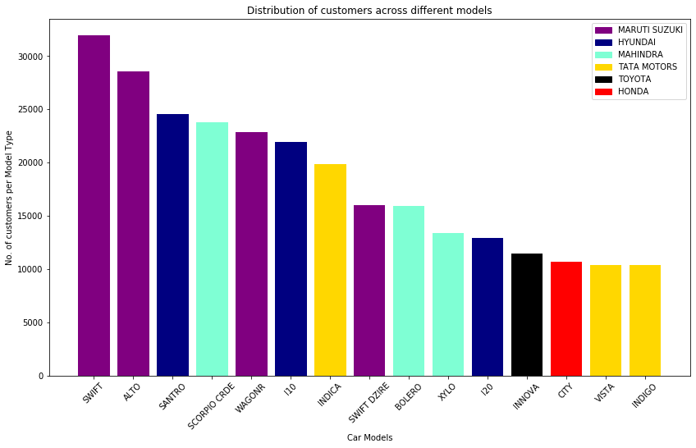
OWNERSHIP PATTERN OF CARS – BY MODELS

Slide 15
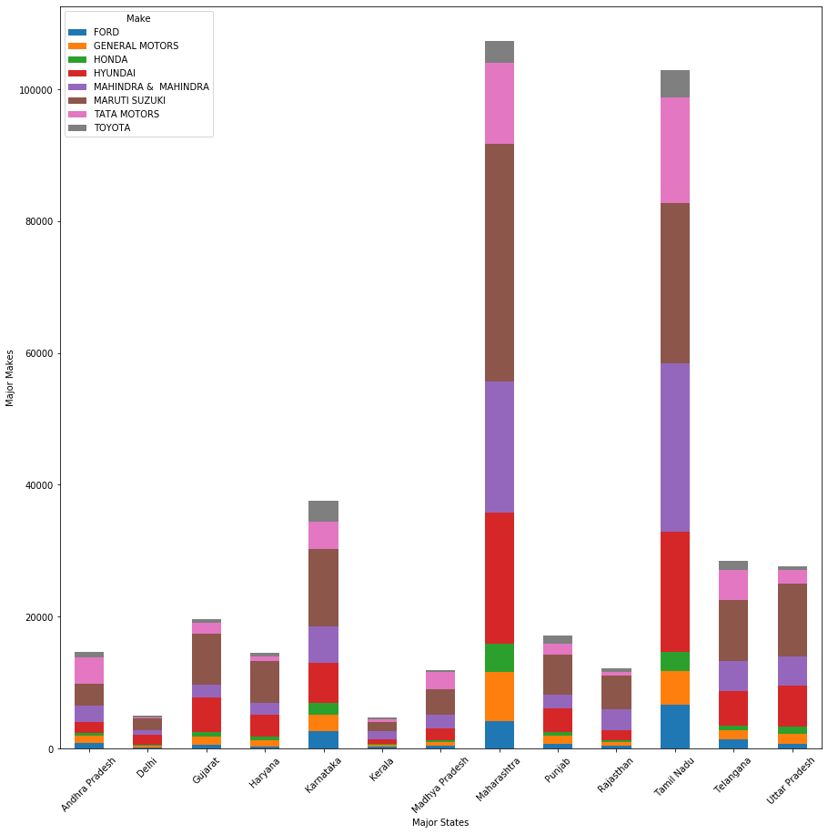
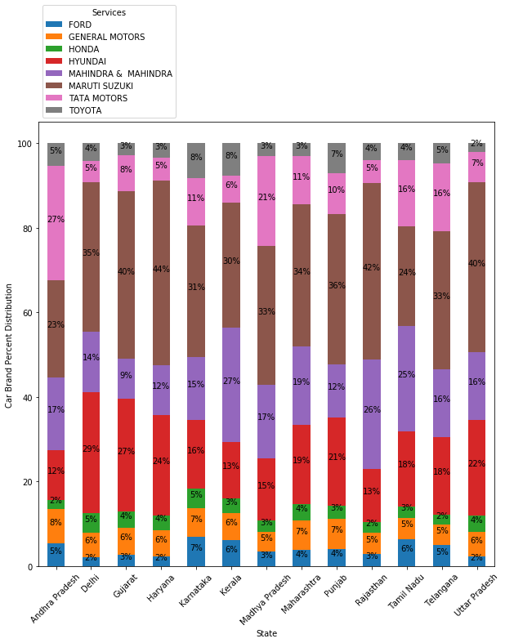
MAJOR CAR BRANDS – STATE WISE

Slide 16
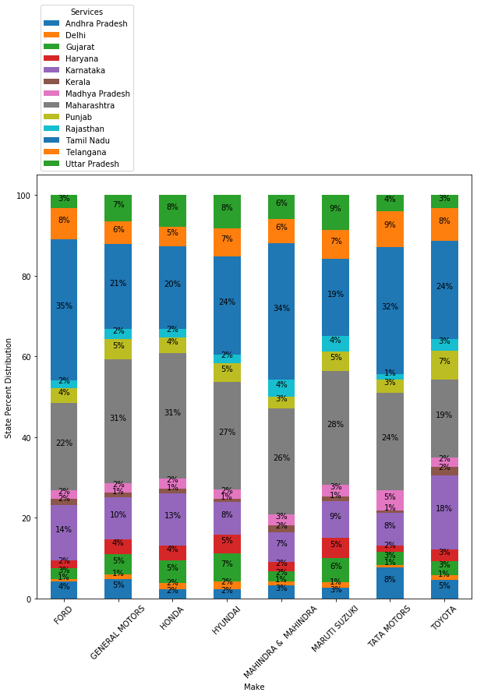

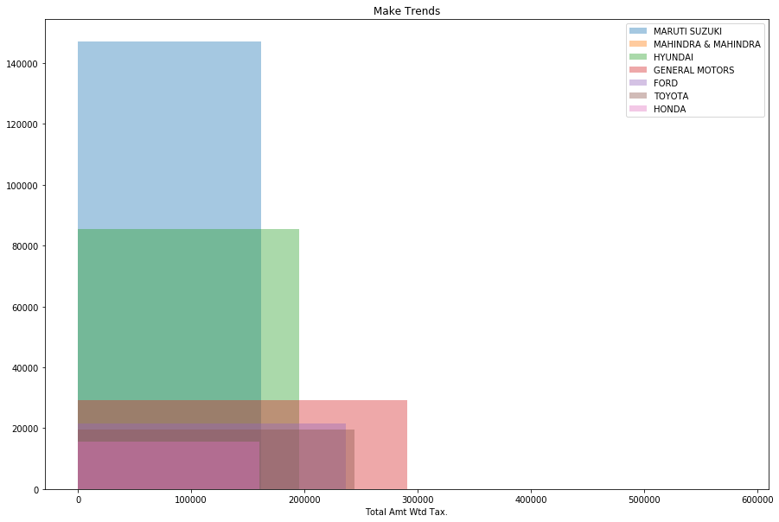
Revenue – By Make

Slide 17
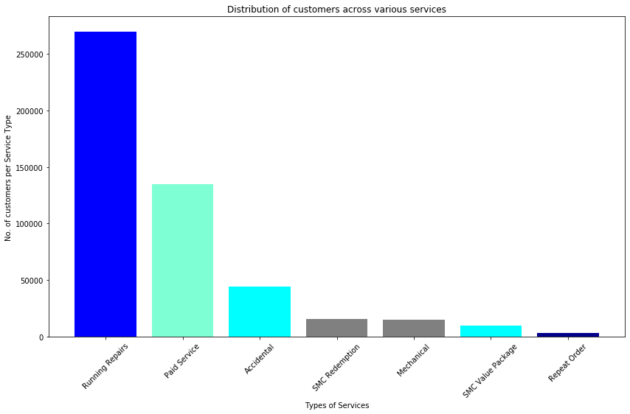
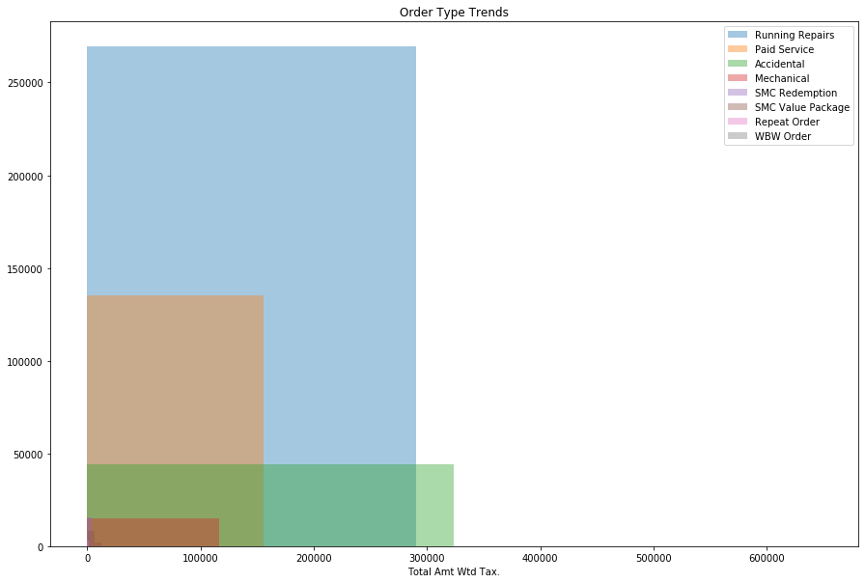
ORDER TYPE/ SERVICES BREAKDOWN
Revenue – By Order Type

Slide 18
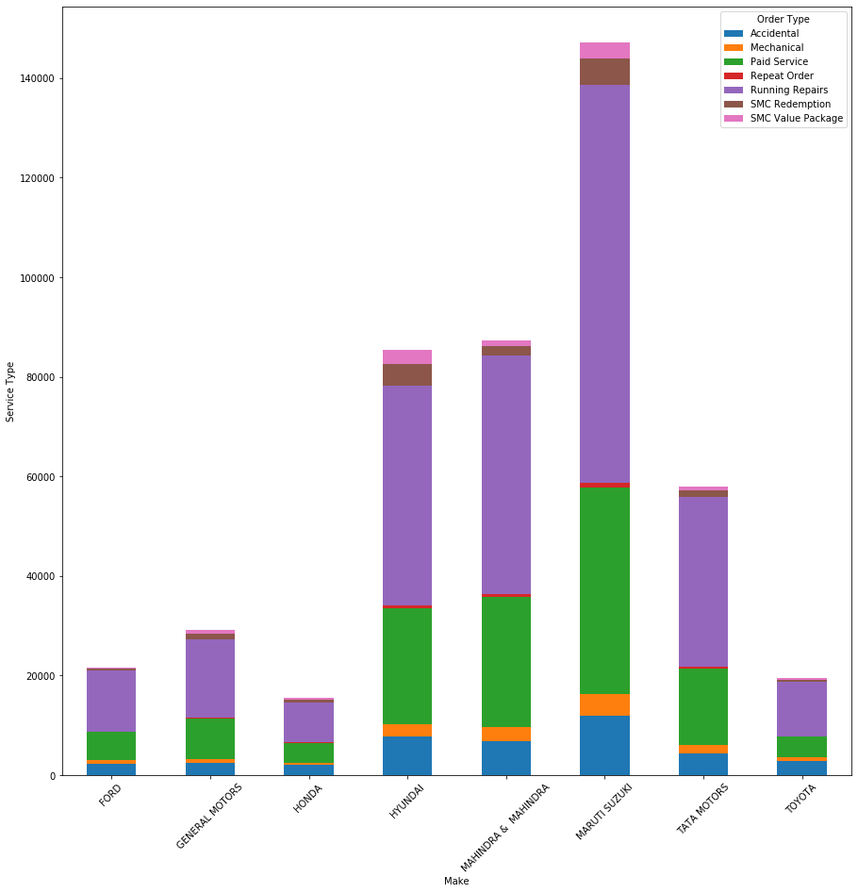
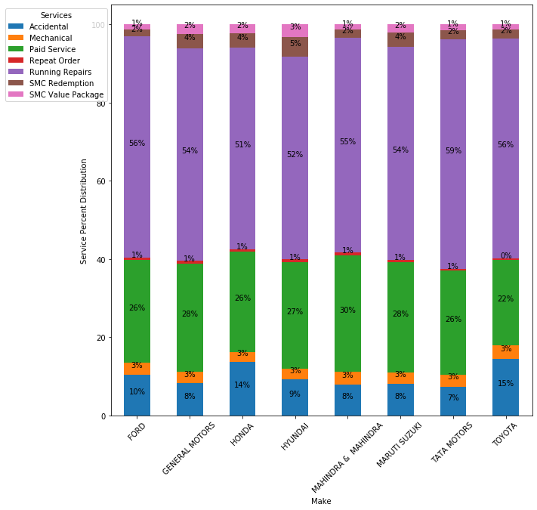
Order Type – By Make

Slide 19
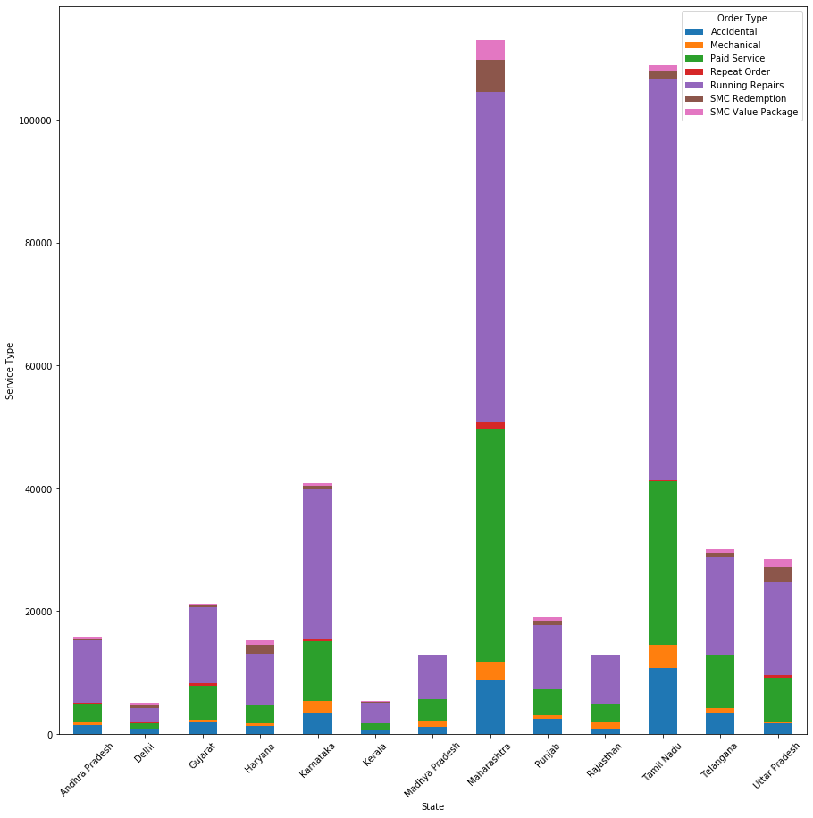
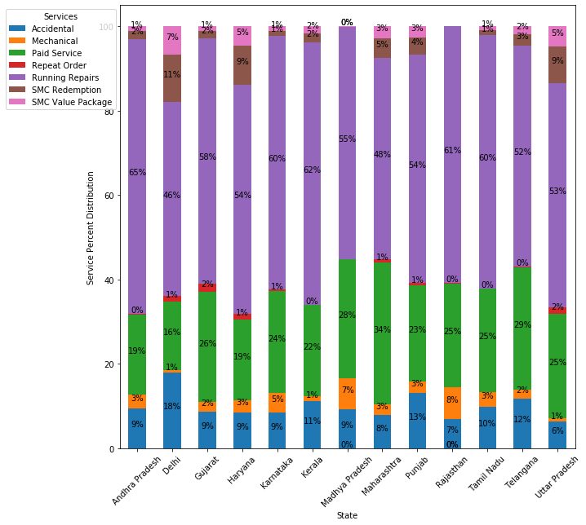
Order Type – By State

Slide 20
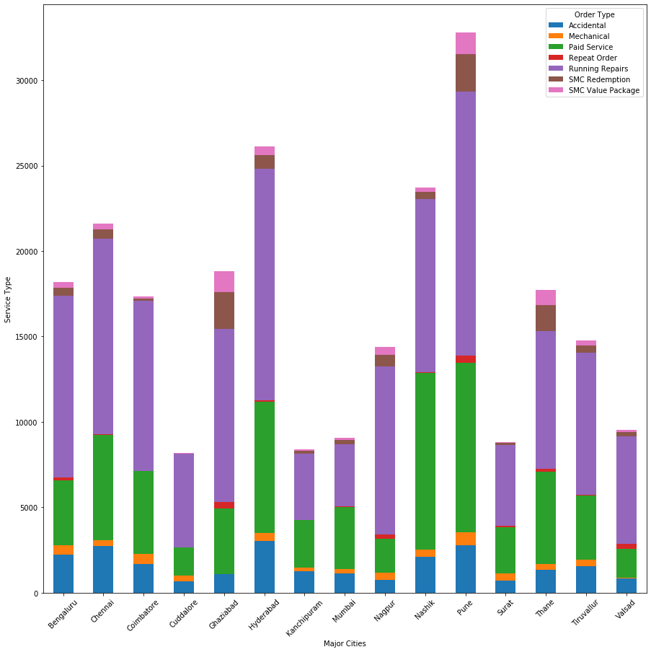
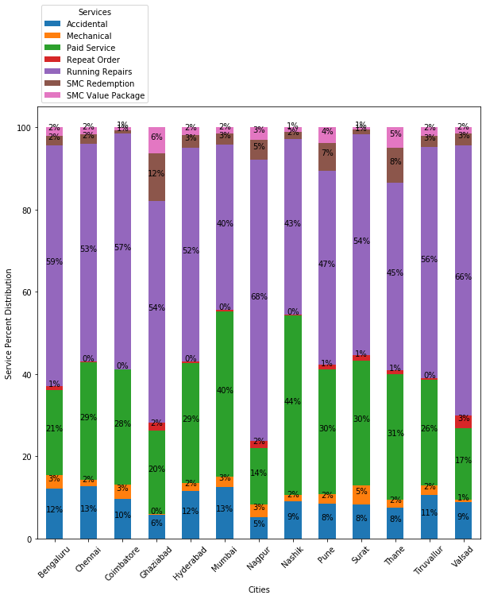
Order Type – By Cities

Slide 21
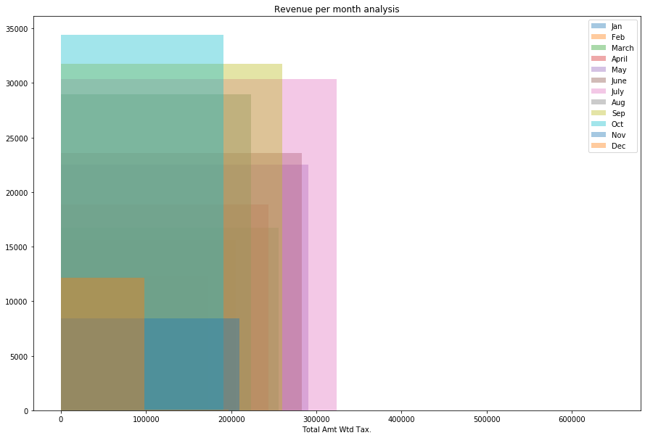
Revenue – By Month

Slide 22
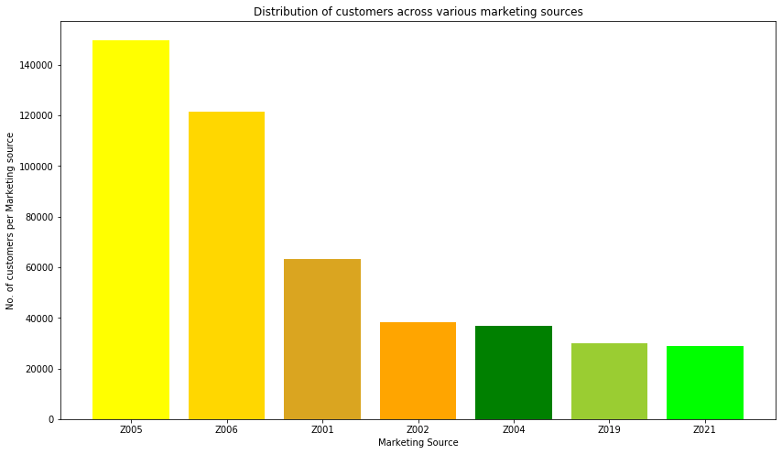
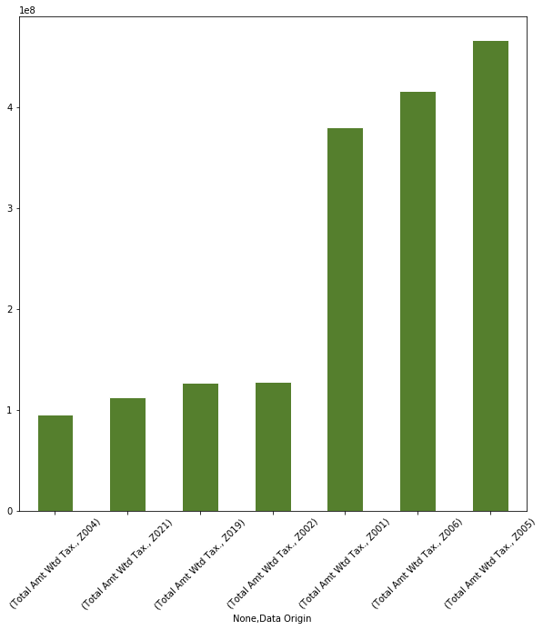
Marketing Recommendations
Data Origin | Description
Z005 | Ref - Customer
Z006 | Ref – Employee
Z001 | Camp – Outdoor
Z002 | Camp – Workshop
Z004 | Fleet
Z019 | Spotted outlet
Z021 | Radio

Slide 23
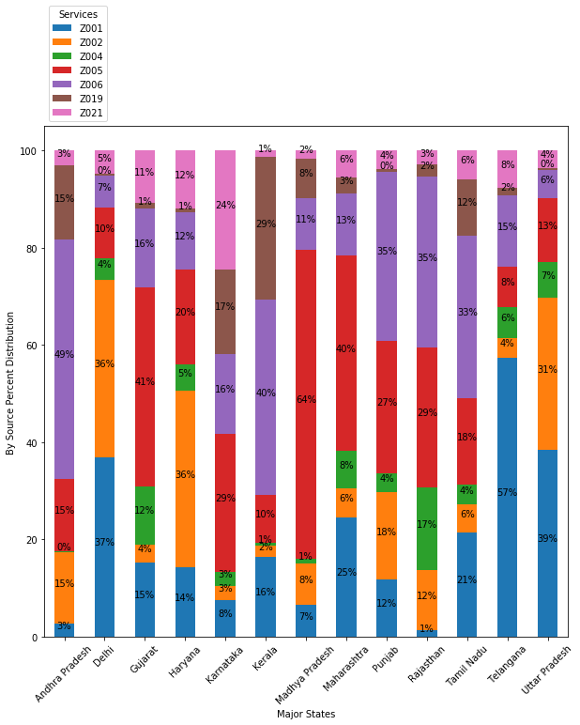
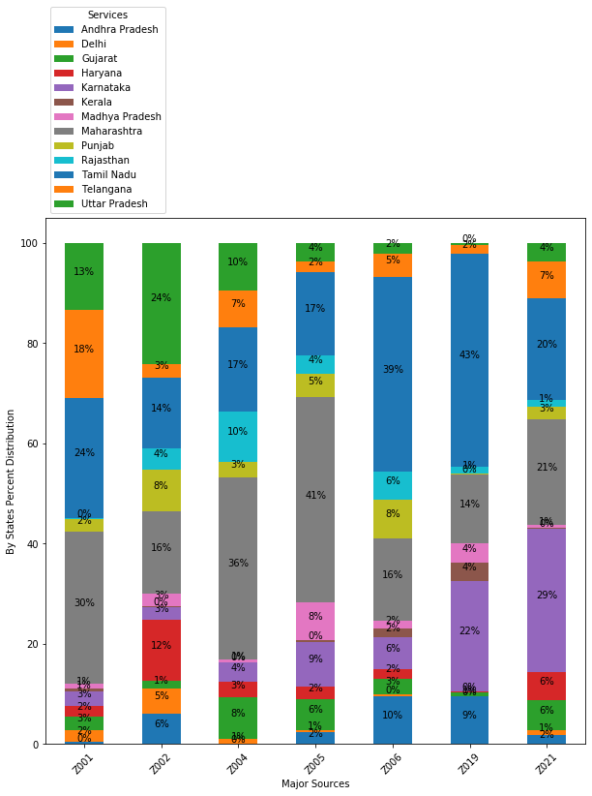
Data Origin – By States

Slide 24
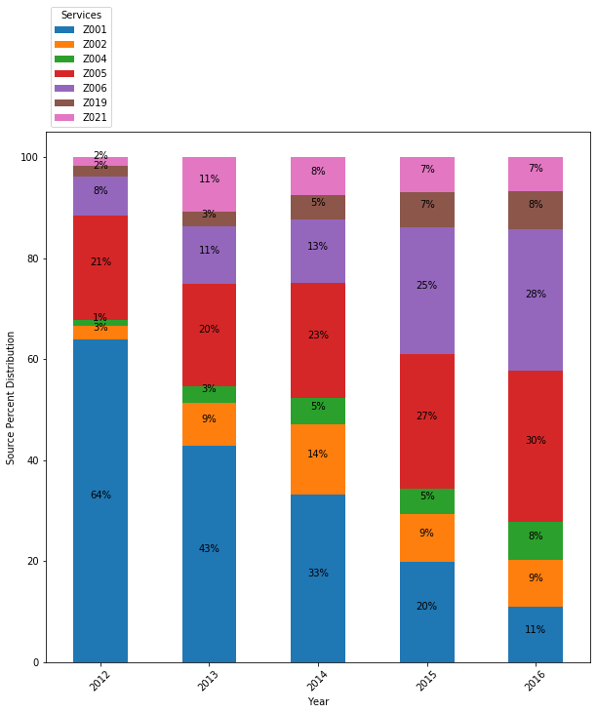
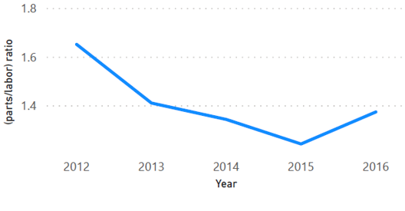
Parts – to – Labour Ratio
Data Origin – By Year
Parts % = Revenue generated by parts charges(year) /Grand Total (year)
Labour % = Revenue generated by labour charges (year) / Grand Total (year)
Parts to Labour Ratio = Parts Revenue(year) / Labour Revenue (year)
Plant Efficiency
Efficiency = (Total Revenue in a year / Total servicing time in hrs * Count of invoices) *100

Slide 25
AGENDA
PROBLEM DEFINITION
DATA CLEANING AND MERGING
EXPLORATORY DATA ANALYSIS
MARKET SEGMENTATION AND CLUSTERING
CUSTOMER LIFETIME VALUE

Slide 26
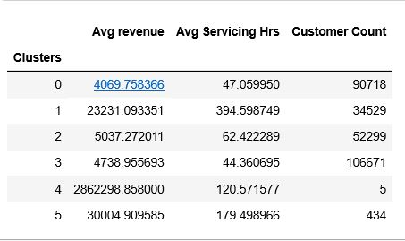
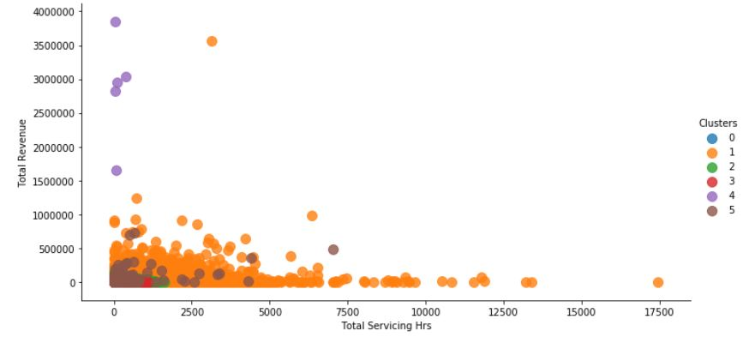
MARKET SEGMENTATION

Slide 27
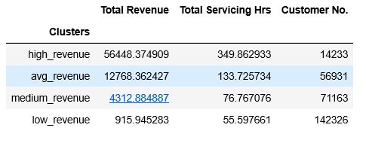
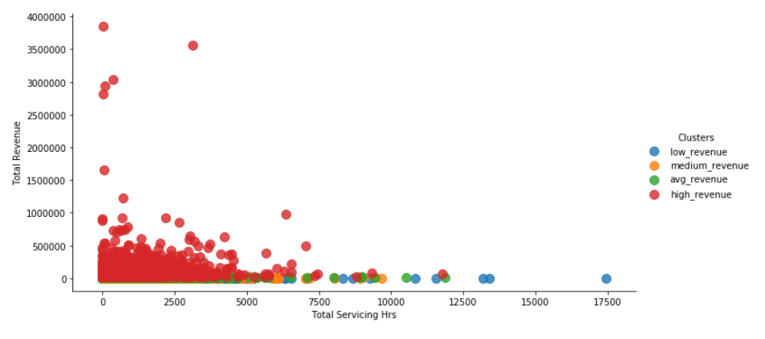
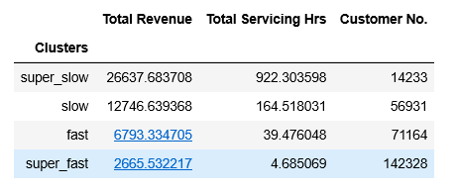
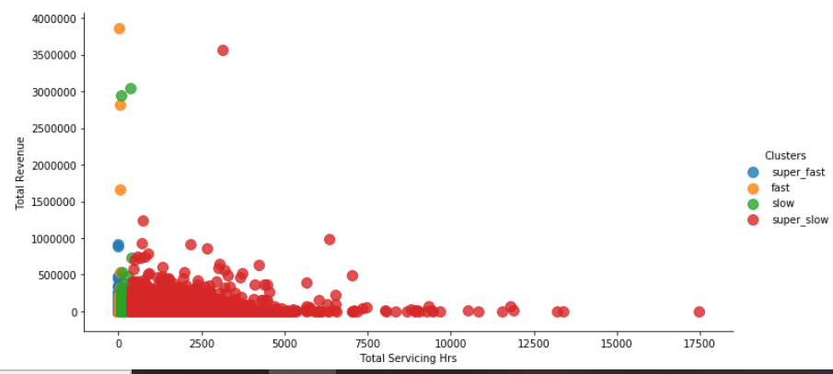
RULE BASED CLUSTERING

Slide 28
AGENDA
PROBLEM DEFINITION
DATA CLEANING AND MERGING
EXPLORATORY DATA ANALYSIS
MARKET SEGMENTATION AND CLUSTERING
CUSTOMER LIFETIME VALUE

Slide 29
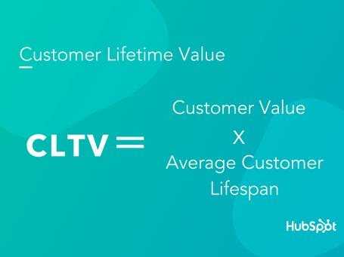
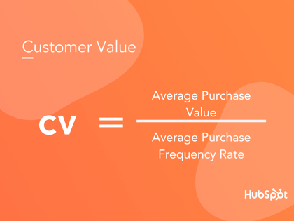
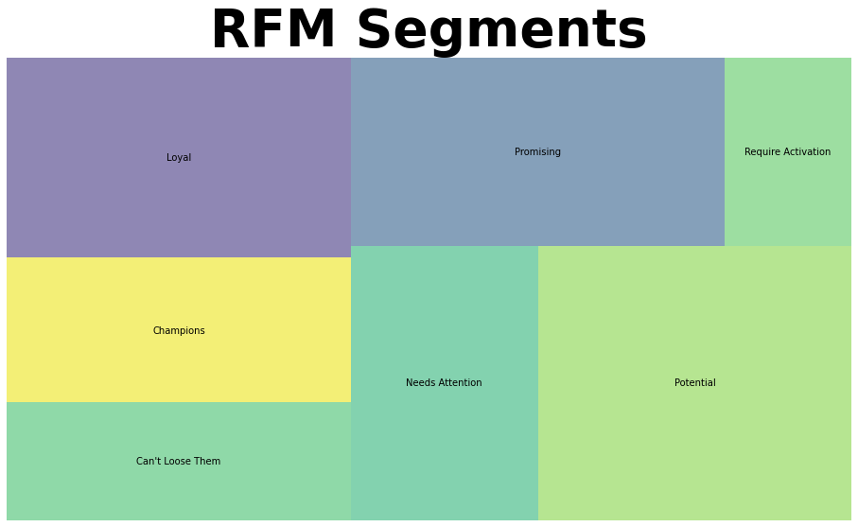
CUSTOMER LIFETIME VALUE (CLV)
CLV is the total worth to a business of a customer over the whole period of their relationship. It is one of the key stats as a part of a customer experience program.
Calculated for year 2015

Slide 30
Model Evaluation
Classification
Regression
Model | Cross Val Score
Decision Tree Classifier | 0.83
Random Forest Classifier | 0.81
XGB Classifier | 0.81
Model | MAE | RMSE
KNN | 0.004860 | 1.559577e-02
DECISION TREE | 0.005185 | 1.739265e-02
LINEAR REG | 40763.384249 | 9.218564e+06

Slide 31
CONCLUSION
Majority of customers are from retail background
Good customer strength from Maharashtra and Tamil Nadu. Customer Strength can be improved in other states
The large share of revenue is from accidental cases. Cars of brands Maruti Suzuki , Hyundai and Mahindra are present most in accidental cases. Spare parts of this cars must be present in stock. So the service time is reduce
Large share of customers come through reference from customers and employees. Incentives should be given for the same. Outdoor and workshop camps are the second best methods.
Maximum no. of cars are of Indian Brands. Spare parts should be stocked of the same
Ensure proper collection of data
Ask for Customer Feedback – Quality of Service

