Slide 1

Capstone Project Airbnb Bookings Analysis by Sushant Tripathi Data Science Trainee @Almabetter

Slide 2
Content
About Airbnb
Agenda
Dataset Summary
Data Cleaning
Distinguishing Features
Correlation heatmap
Analysis of dataset
Conclusion
Tools Used

Slide 3


About Airbnb
Airbnb, Inc. is an American service based company that lets property owners rent out their spaces to travelers looking for a place to stay. It provides a online platform where anyone can book a space from their website and mobile app. Airbnb does not own any of the listed properties; instead, it profits by receiving commission from each booking. The company was founded in 2008 by Brian Chesky, Nathan Blecharczyk and Joe Gebbia. Airbnb is a shortened version of its original name, Air Bed and Breakfast.

Slide 4
Agenda
We will analyse the Airbnb dataset of New York City.
We will perform different analysis and try to gain insights like:
Which neighbourhood group has more number of listings and the reason behind it.
The neighbourhood that is more popular
Room types that are preferred the most by guests
Review and ratings
By doing this we will try to find the factors affecting the Airbnb listings in New York City.

Slide 5
Dataset Summary
Our Airbnb dataset contains 16 features and below are the detailed description of all the features:
id and name - They are simply the listing id and their names.
host_id and host_name - They signify the id of host who are associated to the respective listing and their names.
neighbourhood_group - It contains the district of the listing.
neighbourhood - the neighborhood of the respective neighborhood groups.
latitude and longitude - the geographical co-ordinates of respective listings.
room_types - listing space type.

Slide 6
Dataset Summary Continued…
price - price of listing in US dollars.
minimum_nights - amount of nights minimum stay.
calculated_host_listings_count - amount of listing per host.
availability_365 - number of days when listing is available for booking.
number_of_reviews - Total number of reviews.
reviews_per_month - average of reviews per month.
last_review - date of the last review recorded.

Slide 7



Data Cleaning
Cleaning of dataset is very important to get a relevant information out of it. Following are the process that we have followed to clean our data:
Eliminated the columns that are not needed in our analysis.
Determined the columns that have null values present in it and the null Count.
Replaced the null values from the columns that has lower number of null count.
Deleted the records for the columns that has very high null count.

Slide 8
Distinguishing Features
The Airbnb dataset contains a mixture of numerical features and categorical features. Below is the distinguished view of the features that we have used in our analysis.
Numerical Features
Latitude
Longitude
Price
minimum_nights
calculated_host_listings_count
availability_365
number_of_reviews
reviews_per_month
Categorical Features
id
name
host_id
host_name
neighbourhood_group
neighbourhood
room_type
Airbnb dataset
Data Types
Int
Float
Object

Slide 9
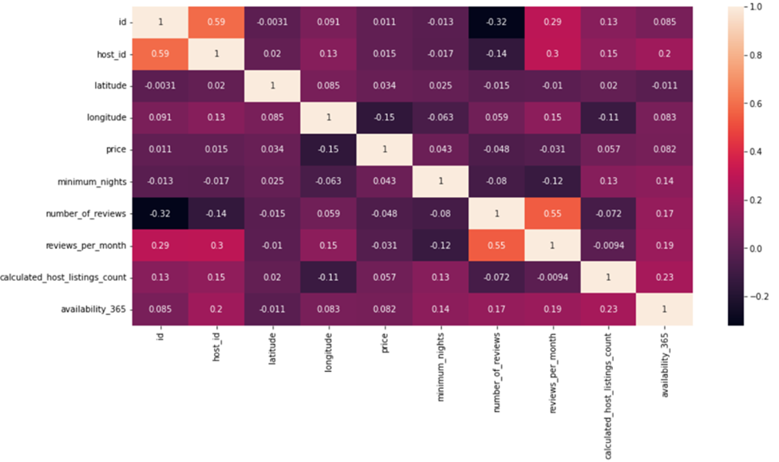
Correlation Heatmap
Observations :
There is a negative correlation between host id and number of reviews so we can say for a region where there are more number of hosts, the guests will have more option of booking that are available which will ultimately divides the number of reviews.
Price and number of reviews are negatively correlated to each other as lesser number of people will prefer the costly aboard.
Number of reviews and reviews per month have negative correlation with minimum nights, we can conclude that guest prefers flexibility of check-out.

Slide 10

Analysis of Airbnb dataset
To get the information out of our dataset we have performed different kind of analysis. Following are the analysis that has been done:
Univariate Analysis
Bivariate Analysis
Busiest host according to Number of reviews
Location wise Traffic and reason behind it
We will discuss all of the above points in detail in next slides.

Slide 11

Analysis of Airbnb dataset Continued…
Univariate Analysis :
Univariate analysis is a basic kind of analysis technique for statistical data.
Here the data contains just one variable and does not have to deal with the relationship of a cause and effect.
Moving to next page to show the analysis that is performed on individual features and the information that we got from it.

Slide 12
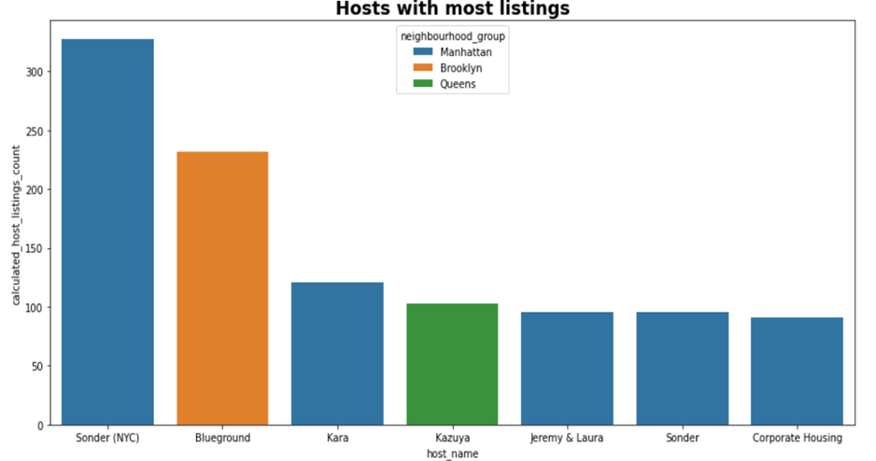
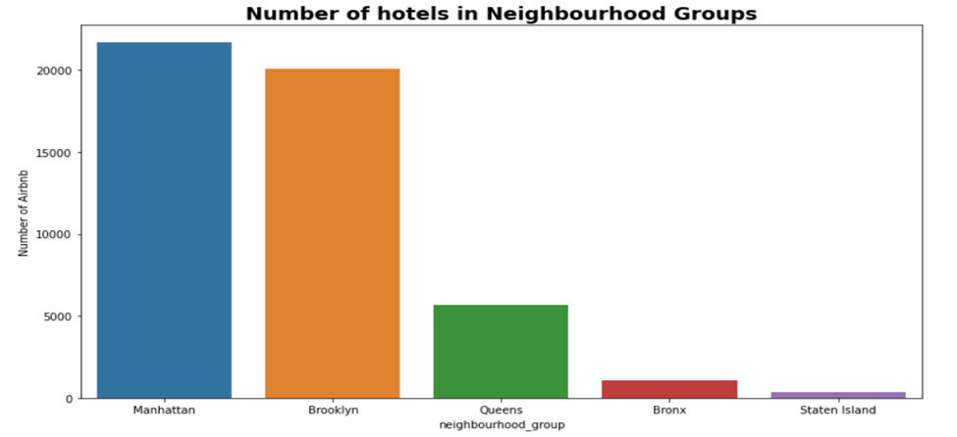
As we can see that Manhattan has maximum number of Airbnb listings and it is very popular since it is considered that Manhattan has almost 90% of attraction sites in NYC. On the other hand, Staten Island has least number of listings. This may be due to very less people know about Staten.
The top hosts on the basis of Airbnb listings.
We can see from the bar plot that Sonder(NYC) has maximum number of Airbnb listings.
The total number of Airbnb listings in different neighbourhood groups of NYC.
We can see that the Manhattan has the maximum number of listings and Staten Island has the least number of Airbnb listing.

Slide 13
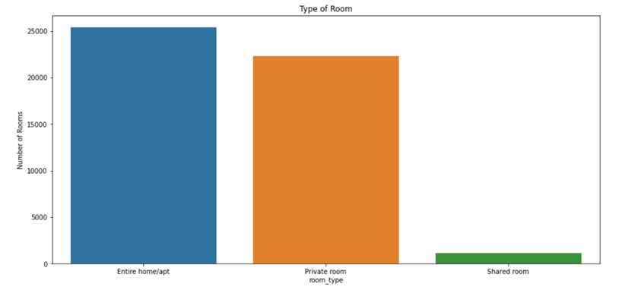
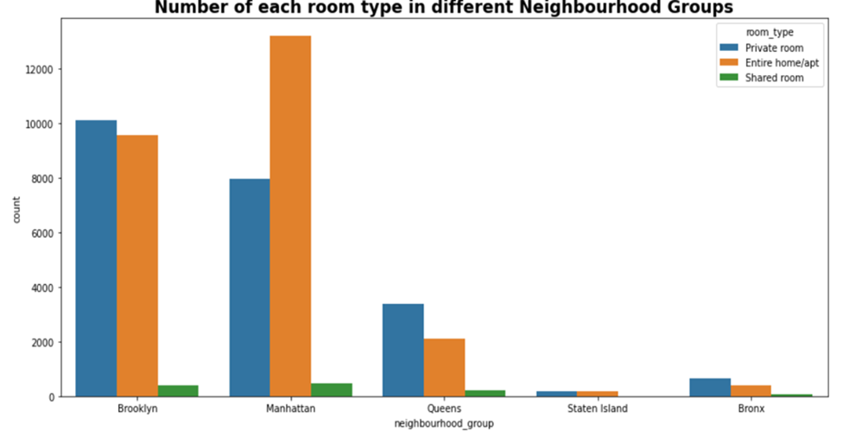
The share of Entire home/apt and Private rooms in New York city is almost 98% which shows that the customers want some privacy and that is why they are opting for these rooms. Shared rooms are for customers who don't have any privacy concerns or they don't have enough amount to pay for Entire home or Private rooms because the price of these rooms is comparably higher than the shared rooms.
Total Number of different room types in NYC.
We can see that Entire home/apt is highest and Shared room is lowest type of room in the NYC.
Number of different room types present in different neighbourhood groups of NYC.
Manhattan has maximum number of listings with Entire home/apt.

Slide 14

Analysis of Airbnb dataset Continued…
Bivariate Analysis :
By doing bivariate analysis, we will try to establish relationships between features like:
Location and price – for which location prices are higher or lower.
Locations and reviews – to see which location is receiving more number of reviews.
Number of reviews and price – to see the listing with which price range are getting more reviews.
Number of reviews and minimum nights – to see if number of reviews is dependent on minimum nights feature.
Navigating to next pages to demonstrate above points.

Slide 15
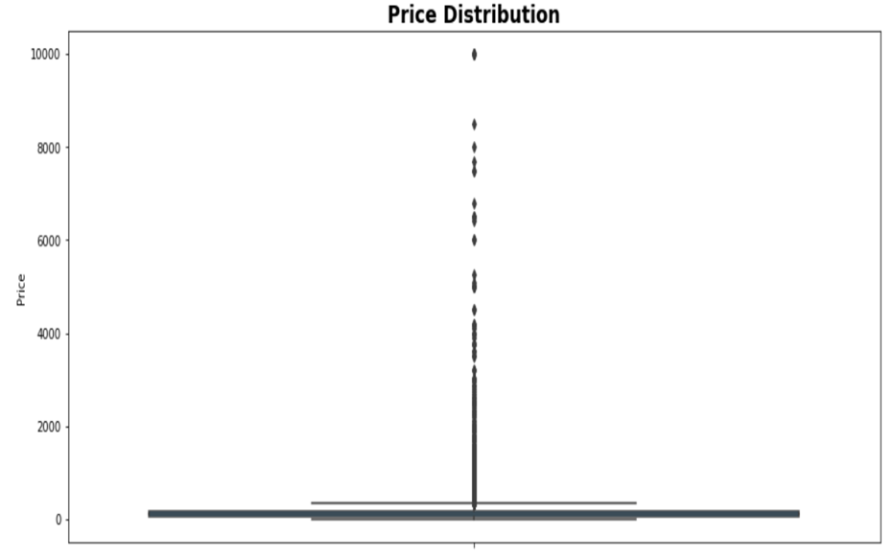
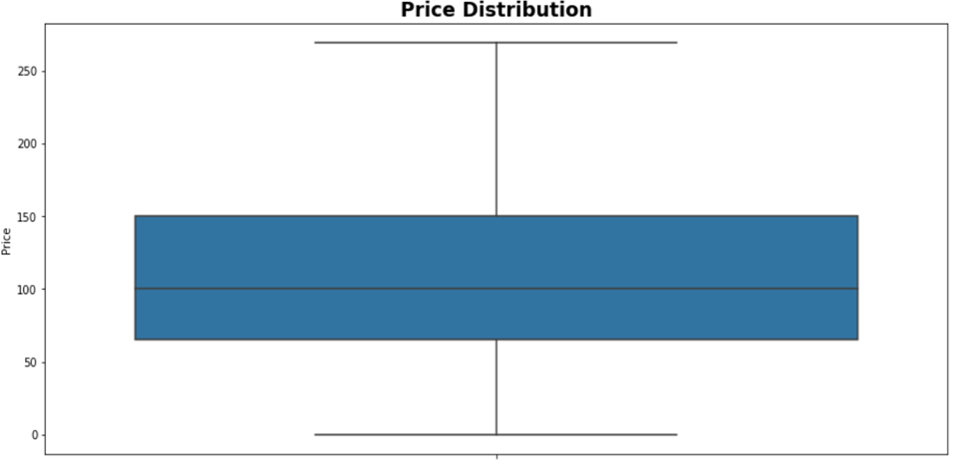
Location v/s Price
As expected there are outliers present in the data. In order to fix this, we will be using the quantile based flooring and capping.
The 10th percentile is 49 USD and the 90th percentile is 269 USD. Now, we can remove the values that don’t apply to the specified range i.e., set between 49 USD and 269 USD because the mean is skewed by outliers.
Price Distribution before the outliers are removed
Price Distribution after the outliers are removed

Slide 16
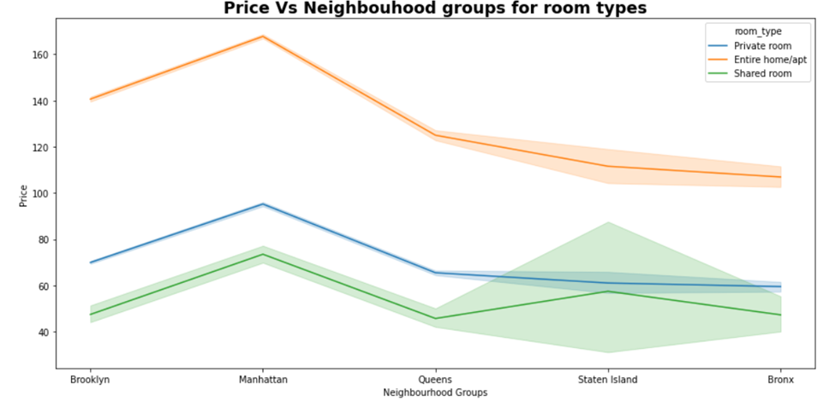
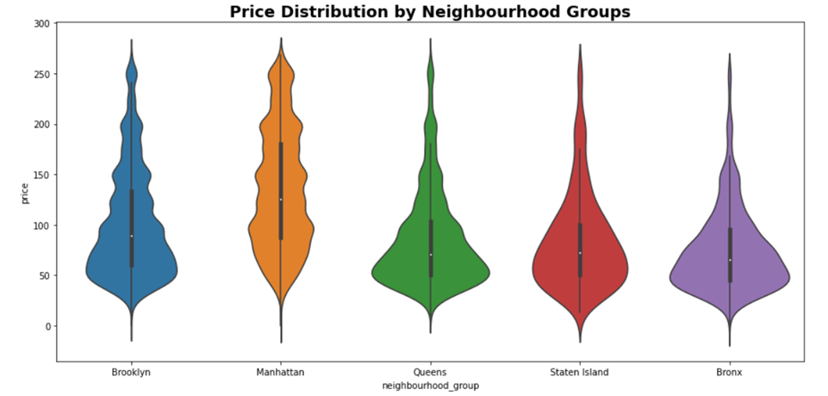
Location v/s Price
Below is line plot and violin plot showing the Price v/s Location analysis and Price distribution analysis after removing the outliers. We have following observations from the plots:
We can observe that, Manhattan has a higher price range and is the most expensive one. Brooklyn has the second-highest rental prices, while the Bronx appears as the most affordable one.

Slide 17
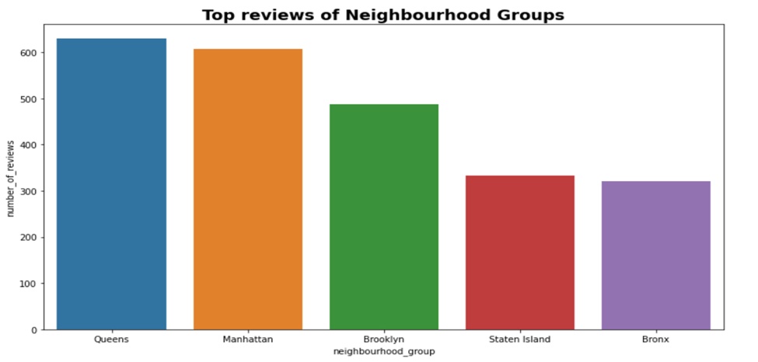
Location v/s Number of reviews
From the bar graph shown below, we can visualize that
The neighbourhood group with less number of Airbnb listing i.e., Queens is getting more number of reviews.
The neighbourhood groups with maximum listings count i.e., Manhattan and Brooklyn are getting lesser reviews than Queens.
Possible reasons for this result could be any of the following:
The hosts of the locations which has less number of listings has lesser number of listings associated to them, so they are able to cater to most of their guests and encourage them to give reviews.
There may be more corporate bookings in Manhattan or the high profile people are visiting Manhattan, and they probably do not give reviews most often.

Slide 18
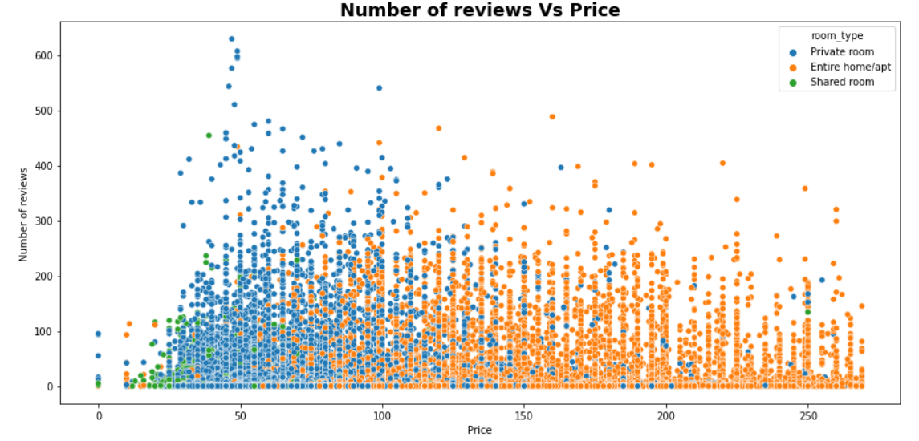
Number of reviews v/s Price
The above scatter plot shows the variation of number of reviews and price of different rooms types.
Private rooms are getting more number of reviews as compared to other two categories, it may be due to the private room types are less costly, so more people can afford it.

Slide 19
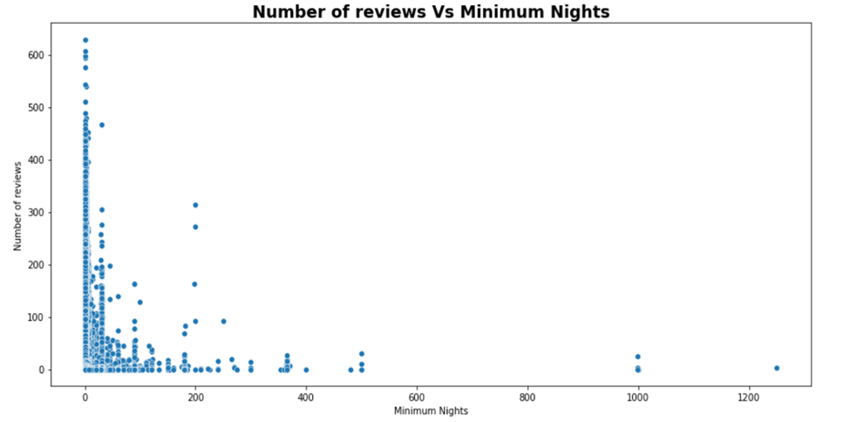
Number of reviews v/s Minimum Nights
The above scatter plot shows the variation of number of reviews and minimum nights stay.
Here we can see that guest are preferring the listings that has less minimum nights. This may be due to the fact that most of the people are visiting for shorter duration.

Slide 20

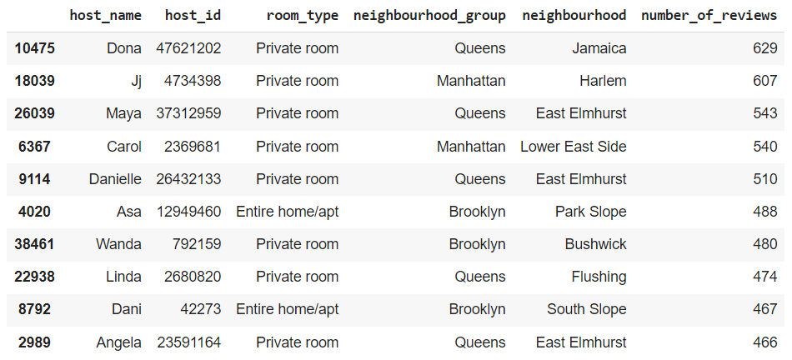
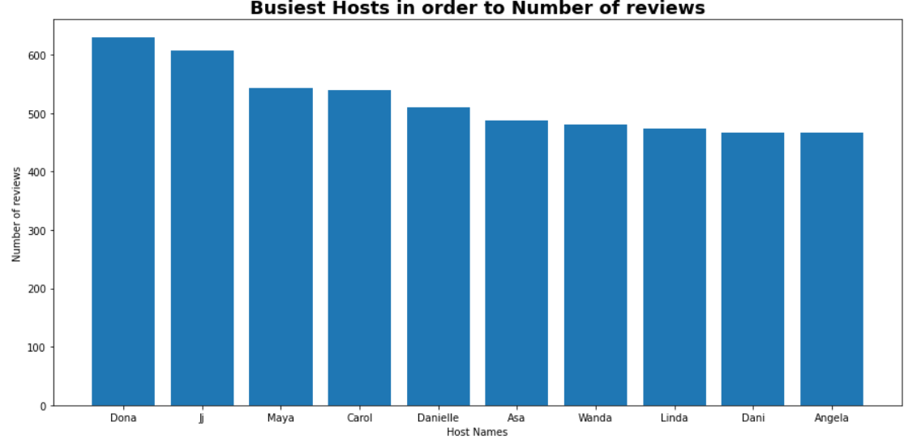
Analysis of Airbnb dataset Continued…
Busiest Hosts in order to Number of reviews :
From the above result, we can conclude that the Name of the busiest host is Dona having the host id number: 47621202 in Jamaica neighbourhood with 629 number of reviews.
Note: The busiest host is the person who got the most number of reviews i.e. people are frequently booking rooms at these hosts.

Slide 21
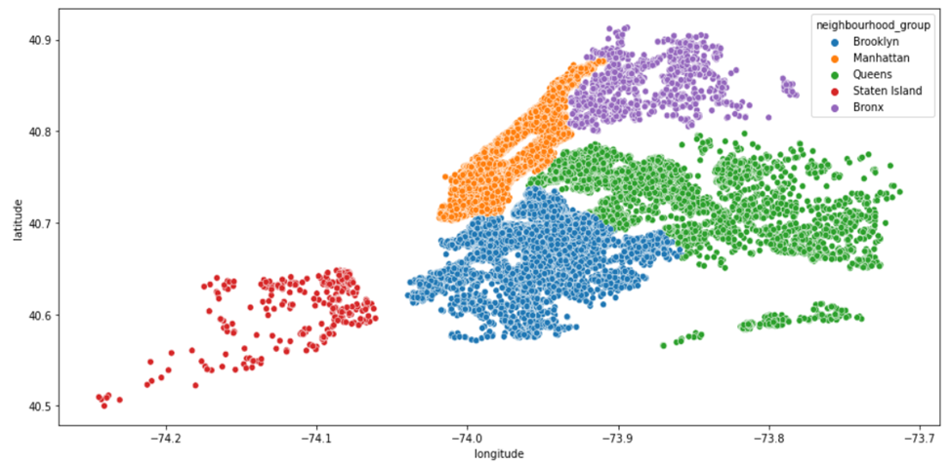
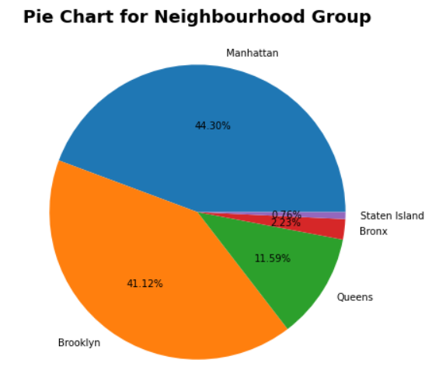
Analysis of Airbnb dataset Continued…
Location wise Traffic and reason behind it.
From the above two charts we can observe that Manhattan has the highest traffic among all five neighbourhood groups. Manhattan has more traffic probably because it is the most popular neighbourhood group of NYC and considered to have most of the popular attractions. In fact, most people believe Manhattan to be the synonym of NYC. Brooklyn comes second on the basis of traffic as it is considered to be the second most famous district of New York after Manhattan. Staten island has least because this location is least known.

Slide 22
Conclusion
By exploring the Airbnb dataset we have drawn out many information. Some of them are listed below:
Our Airbnb dataset has data from the five neighbourhood groups of NYC namely Manhattan, Brooklyn, Queens, Bronx and Staten Island.
Manhattan has maximum number of listings, this may be the case because Manhattan has almost 90% of tourists attractions all over the NYC. Some of them are Empire State Building, the Rockefeller Center, the surprising Chrysler Building, the fascinating Times Square, the controversial MoMA etc.
Brooklyn has second highest listings and Staten Island has the least.
Most of the hosts from Manhattan has multiple number of listings.
Most of the guests visiting Manhattan and Brooklyn are not giving reviews, it may be because more corporate bookings are happening in Manhattan and Brooklyn or the high profile people are visiting these locations, and they probably do not give reviews most often.
The neighbourhood group with less number of listings are receiving more reviews, the reason probably would be the hosts are able to cater to most of their guests and encouraging them to give reviews.
There are three categories of room types available which are: Entire home/apt, Private Rooms and Shared rooms. Out of these three Entire home/apt is very expensive and shared rooms are the least expensive.
Private rooms are mostly preferred over Entire home/apt because it is less costly and has less minimum nights dependency.

Slide 23
Tools Used
Google Colaboratory
Python
GitHub
Libraries imported:
Pandas
Matplotlib
Seaborn

Slide 24


