Slide 1

BRAIN TUMOR
CLASSIFICATION
Group 9 :
Anniket Jain
Oishi Saha
Santhoshi Priya G
Sivani Papini
V Sushant
Notes:
Priya

Slide 2
INTRODUCTION
A brain tumor is an abnormal mass of tissue in which cells grow and multiply uncontrollably.
Glioma is a common type of brain tumour in adults,treatment of which is surgical and demands adjuvant therapy for most of the circumstances.
They come in a variety of kinds and grades and are further classified as High Grade(which is cancerous) and Low Grade.

Slide 3


Business Statement
Diagnosing the grade of brain tumor beforehand and getting treated accordingly is a must.
Despite advances in medical image analysis and gliomas research, accurate diagnosis is still a challenge, which we hope to solve.

Slide 4
Solution Statement
Used BraTS 2019 dataset which contains 3D MRI medical images of glioma brain tumor.
We propose an “Point cloud classification with PointNet” for the classification and analysis , which would be of great help for radiologist.
Predicting and displaying if it is a low grade or high grade glioma using a web app.

Slide 5
RESEARCH DONE
CNN-LSTM: Cascaded Framework For Brain Tumour Classification
PointNet: Deep Learning on Point Sets for 3D Classification and Segmentation
Word-level Deep Sign Language Recognition from Video: A New Large-scale Dataset and Methods Comparison
Notes:
Sivani

Slide 6
SOLUTION WORKFLOW
Step 1
Step 2
Step 3
Step 4
Step 5
Data Understanding.
Data Preparation
Modeling : PointNet
ResNet
Model Evaluation
Deployment
Notes:
Data exploration : HGG+LGG
Data Preprocessing : was stored as NIfTI files. 3D image was converted into points and stored as numpy array
Modeling : PointNet & ResNet
Evaluation
Deployment

Slide 7
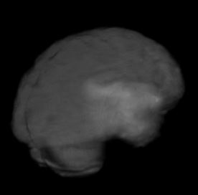
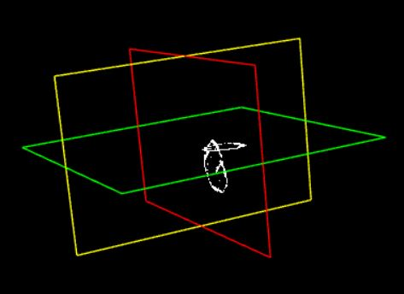
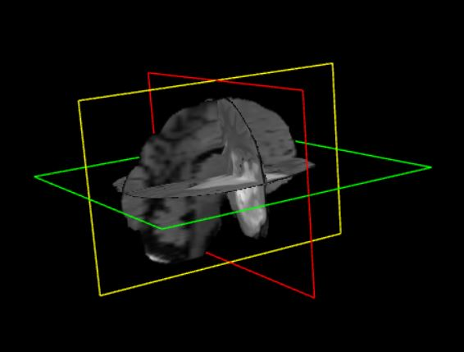
DATA UNDERSTANDING
Brain tumor images are stored as 3D NIfTI files which stores MRI scans of brain
Each tumor image is stored as a 240 x 240 x 155 integer array
335 such image are available in BraTS 2019 dataset labelled as LGG and HGG with 76 and 259 images respectively.
3D view of MRI scan - flair
Tumor segmented part
2D view of MRI image - flair

Slide 8
DATA PREPARATION
Each image was loaded and sampled into a point cloud.
Then added it to a standard python list and converted into a numpy array.
The number of points were set as 10000 with 2 classes and the dataset was parsed.
Split ratio : 70% - training
20% - validating
10% - testing
Processed numpy array :
[0.6041666666666666,
0.6166666666666667,
0.5290322580645161,
0.16183986371379896]
=> [x,y,z,grey scale value]

Slide 9
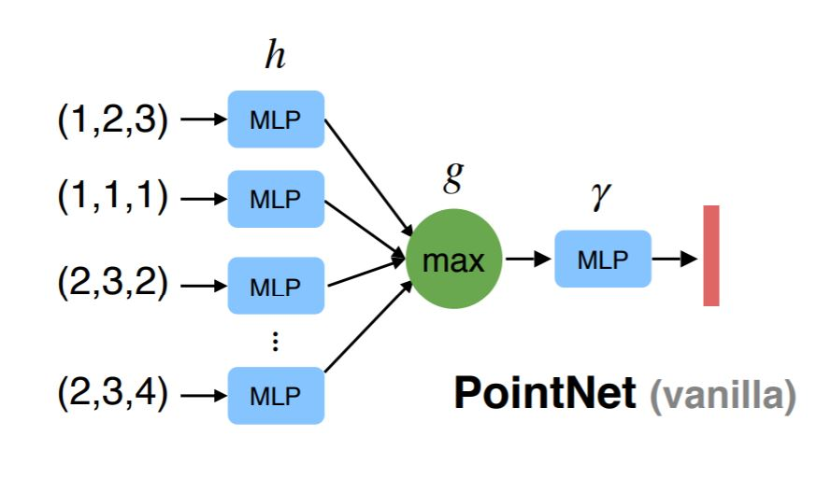
MODEL - POINT NET
PointNet takes raw point cloud data as input. It consists of two core components : a primary MLP network and a transformer net (T-net)
Points in a point cloud are fully described by its (x,y,z) coordinates and features
Notes:
Anniket

Slide 10
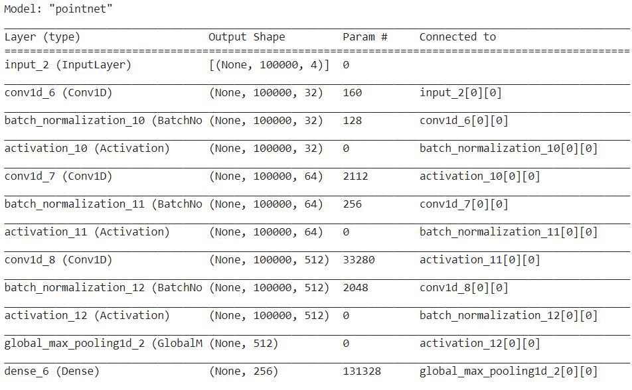
Small snippet of our model
A basic transformation-net(T-net) block was defined
We used a classification network
This network uses a shared MLP to map each of the ‘n’ points from three dimensions (x,y,z) to 64 dimensions, and this is again mapped to 1024 dimensions
Then max pooling is used to create a global feature vector.
Finally, a 3-layer fully-connected network is used to map those global feature vector to k output classification scores
In the main network, T-net blocks were dropped in layers in the graph

Slide 11
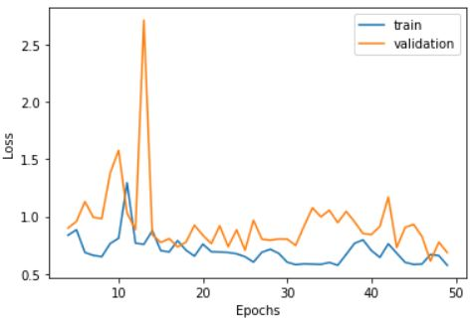
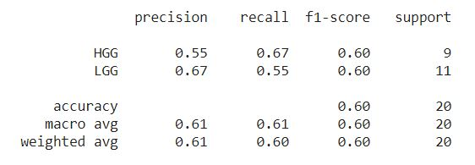
MODEL EVALUATION
Train Accuracy - 70.67% Test Accuracy - 60%
Plot of Training loss & Validation loss vs. Epochs
Classification Report
Notes:
Oishi

Slide 12
MODEL COMPARISON
Model | Train Accuracy (%) | Test Accuracy (%)
PointNet | 70.67 | 60.00
ResNet18 | 47.08 | 53.33
Meet Marcos.
We also implemented 3D-ResNet model based on 3D CNNs
From the above table, it is clear that PointNet model performs better than ResNet18

Slide 13
CONCLUSION
In this project, we proposed a deep neural network architecture - PointNet that directly consumes point cloud.
This network helps us to get an unified approach for 3D recognition task - object classification.
We also did theoretical analysis and visualizations towards understanding our model.
Notes:
Sushant
We propose a point cloud based pointnet architecture in our project.
This helps us to get a unified approach for classification of 3 Dimensional Brain MRI images, and can be expanded to other kinds of 3d classification tasks.
We have analysed visualisations on basis of various metrics for a better understanding of our model’s performance and also compared with some alternate approaches.

Slide 14
FUTURE ENHANCEMENT
Web App: Along with the grade of the tumor, it could also display the most feasible treatment method and doctor/hospital according to their location.
Model : We have tried point based network and 3D Convolutional layers based network. Further, Graph based neural networks can be used for for the same task.
Notes:
Sushant
We plan to expand the functionality of the deployed web application by adding suggestions for treatment method, doctor, hospitals according to location, etc.
We also wish to enhance results by trying out more novel architectures based on 3d convolutional layers, graph based neural networks, temporal networks, etc.

Slide 15
REFERENCE
[1] BraTS Dataset : https://www.kaggle.com/andrewmvd/brain-tumor-segmentation-in-mri-brats-2015
[2] David Griffiths, Point cloud classification using Point Net
[3] Luis Gonzales, An in-depth look at point net, April 2019
[4] R.Qi Charles, Hao Su, Mo Kaichun, Leonidas J. Guibas, PointNet : Deep Learning on Point Sets for #D Classification and Segmentation, IEEE 2017 CVPR
Notes:
Here are some notable references which have helped us for the project understanding and during building stage.

Slide 16
DEPLOYMENT

Slide 17
Thank You

