Slide 1
How your group communicated and what you learned about this
Abdurrahmaan Ahmed - AA1437

Slide 2
How we communicated
Tools: Whatsapp, Discord, MS Teams
We used WhatsApp for quick updates, Discord for detailed discussions, and MS Teams for official meetings and document sharing.
Weekly meetings & Daily updates
Weekly video calls kept us aligned, while daily text updates ensured no one fell behind.
Assigned roles for each user story
Each user story had a clear owner, preventing overlap and ensuring accountability.

Slide 3
Challenges
Conflicting schedules
Unclear instructions
Unequal participation
Clarity prevents confusion
Active Listening = better ideas
Flexibility is key
Lessons learned

Slide 4
Improvements for next time
Set clearer expectations
Use a task manager
Communication is a major success factor
Clear and consistent communication ensured everyone stayed aligned, deadlines were met, and challenges were resolved quickly.
Conclusion

Slide 5

Sushant Jasra Kumar sjk50 Something non-technical that we learned during the project
• initiative and shared responsibility within a team

Slide 6
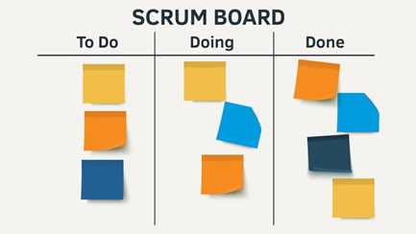


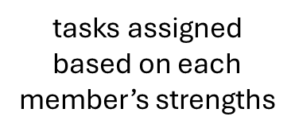
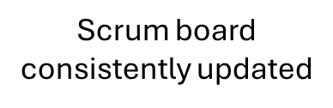

Examples of Teamwork

Slide 7
Explaining a technical challenge feature: Course Recommendation System
My user stories:
View dashboard
Course recommendations
Friendship system
Ali Ebtehaj
ae256

Slide 8

Two major challenges:
Challenge 1: Tracking Completed Courses
Do I need a new table in the database?
How can I keep track of courses that are completed?
How do I link courses to users?
Challenge 2: Designing the Recommendation Logic and coding it
Do I need to use an algorithm?
What data should influence recommendations?

Slide 9
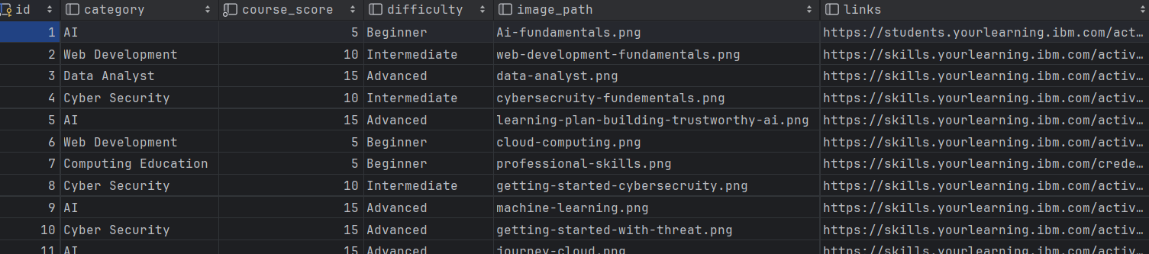
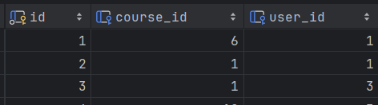
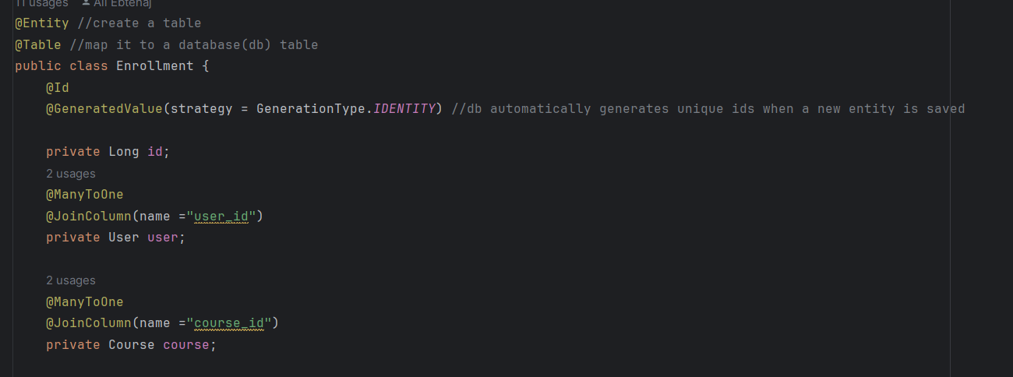
Figure 1
Solving challenge 1:
Step 1: Creating a course entity
Designs a new course entity that holds essential attributes such as title, category, and difficulty level(Figure 1)
This allows consistent data retrieval
Step 2: Many-to-Many design
Users can complete many courses, and each course can be completed by many users.
I implemented this with an Enrollment table that holds: User ID and Course ID (Figure 2,3)
Figure 2
Figure 3

Slide 10
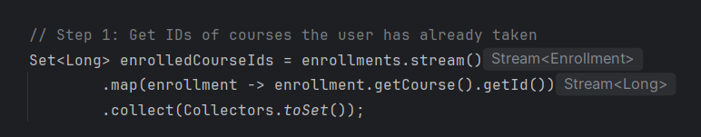
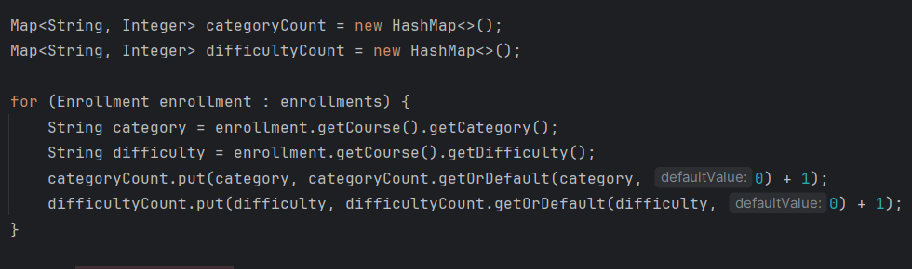
Figure 4
Solving challenge 2:
Step 1: Understand User Preferences
Figured can use difficulty and category as preference
Extracted the category and difficulty from each course. (Figure 5)
Counted frequency to find the most common category and difficulty. (Figure 5)
Figure 5

Slide 11
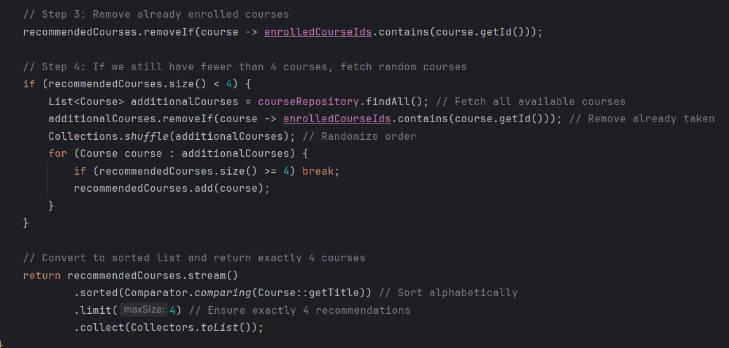
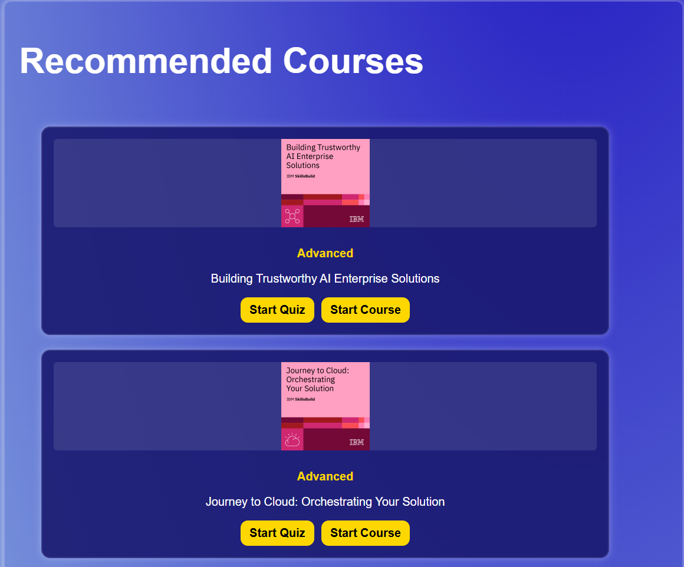
Figure 6
Figure 7
Solving challenge 2:
Step 2: Filter Out Taken Courses
Compared recommended course IDs to courses the user has already
Removed any duplicates (Figure 7)

Slide 12

Craig Long cl530
A specific software design choice for our web page

Slide 13
Responsiveness is key
Nearly everyone in the world owns a mobile device, so to capture that part of the tech industry we choose to adapt the website for other devices other than desktops.
During the second sprint we choose to make mobile and tablet views for the website.
This meant refining the view using CSS and JavaScript.

Slide 14
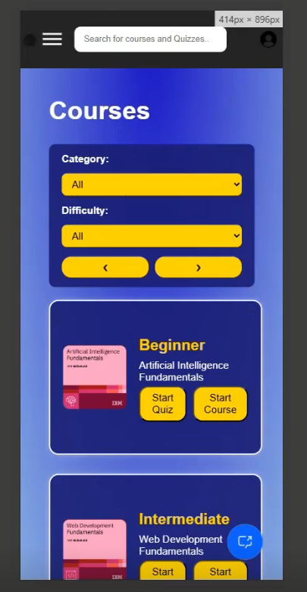
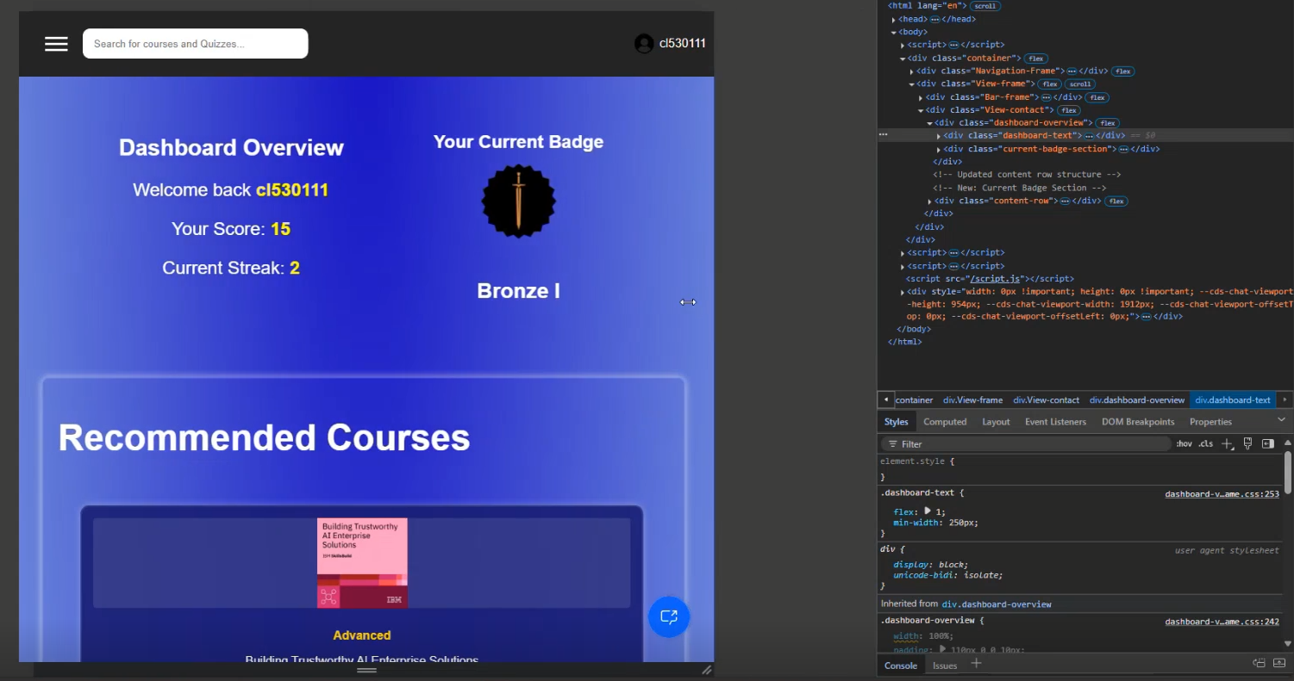
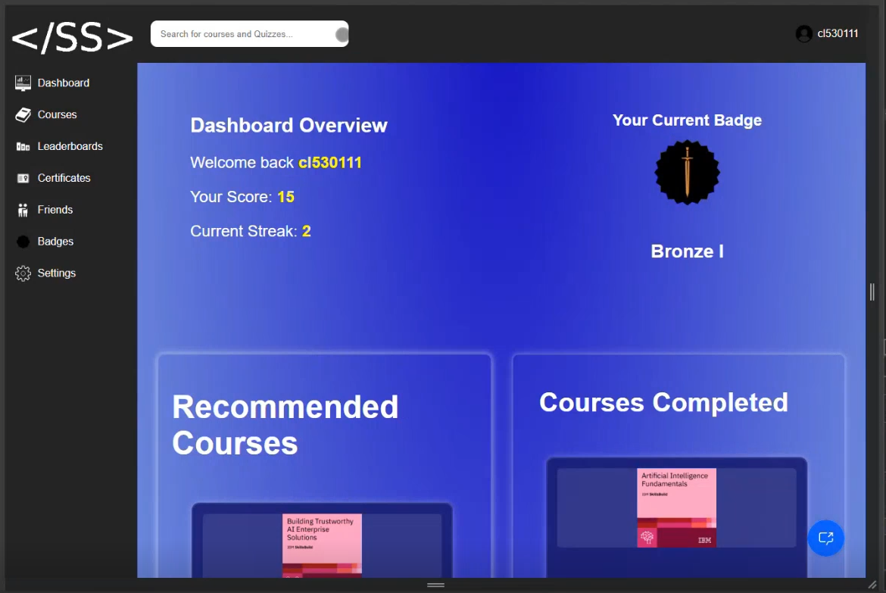
During Sprint two, I had to use developer mode on edge to simulate the websites' view.
To make the website I learnt to use media queries which improved our websites responsiveness and develop a hamburger menu.
Not only did this improve the design of our website but it expanded our target audience.

Slide 15
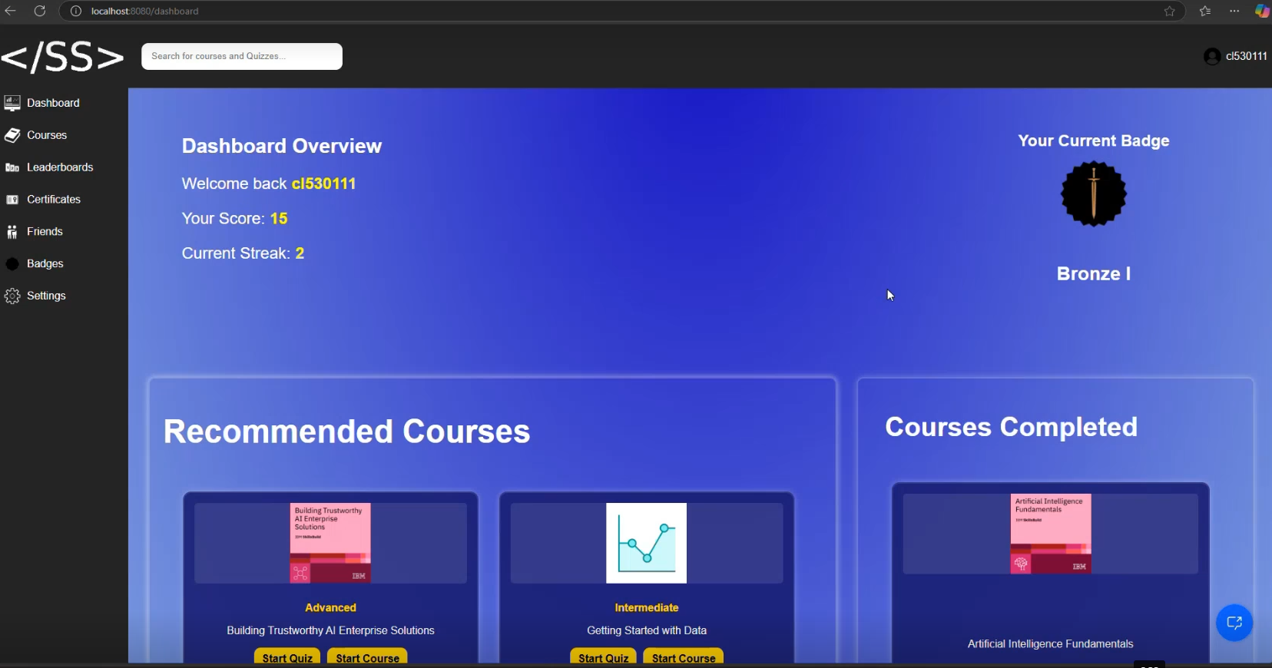
Another choice used for our website included creating the design theme across all pages
I suggested we stick to a blue theme with tints on yellow for contrast.
The main reason for a blue website is due to blue being associated with calmness, serenity, and trust. Of which people would be better trusting of the courses our website provides.

Slide 16
Social, Legal and Ethical Issues
Jasper Christensen
jc938@student.le.ac.uk

Slide 17
Security
User information is not encrypted during transit
The client should acquire an SSL certificate to ensure connections to the application are secure
Emails and names are stored in plain text; this poses a minor risk to users if there is a data breach

Slide 18
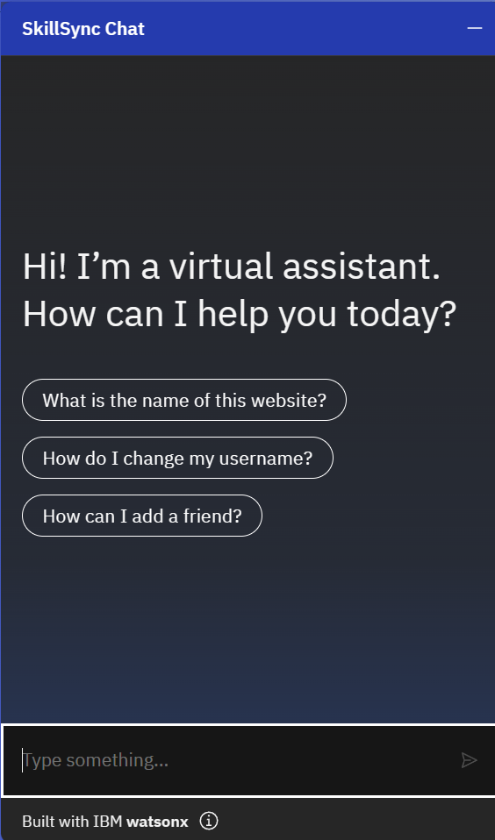
AI Use
We use an AI powered chatbot on the site
Although all answers are defined by us, the question given by the user may be interpreted incorrectly
This could give incorrect advice, and the user could lose trust
Example: SkillSync Chatbot

Slide 19
Accessibility
We implemented website responsiveness to allow our site to be used by people with limited access to devices
However, our site was not tested for accessibility, so it may be missing features like full keyboard navigation and labels for all elements
Means our site lacks inclusivity
This may cause legal issues with Web Content Accessibility Guidelines

Slide 20
Safety
Our website allows users to add friends
They can also have a username or profile picture which may contain harmful content
This means our site may be unsuitable for children without moderation

Slide 21
Future Development Plans​ Omar Farrag Of48@student.le.ac.uk

Slide 22
Future Development Plans
How ?
Quick Recap: What is SkillsSync objective? To gamify the learning experience in order to make it more engaging
Motivation: Why keep developing the app if it meets our requirements? To improve the user’s experience and address technical limitations (including Scalability)
NLP Marking System
Production Ready App

Slide 23
NLP Marking System
User submits clean text
At the moment we use multiple-choice questions to assess the user’s understanding of a certain course. The problem: With the rise of AI, those questions can be solved with no geinune effort. This leads to an influx of certifications awarded that do not reflect real competence. Solution: substitue mcq’s with essay style questions that are assesed using a NLP marking system. Benefits: 1. More accurate/geniune assessment
2. Scalabilty through automation; reduces human error
NLP checks course context
Analyze coherence and relevance
Score generation
LLM

Slide 24
Making SkillsSync Production Ready
Improve Stability: Implement unit tests, integration tests, and load tests to verify that various components work together. This ensures consistent performance.
Enhance Security:
Use OAuth2.0 for secure authentication.
Encrypt data at rest using AES encryption and in transit using TLS encryption.
Scalability and Maintainbility:
Our codebase will follow CI/CD pipelines using Jenkins to automate testing, builds and deployments.
Containerize the app using Docker and deploy it to AWS using services like ECS or EKS enabling high availablity and scalability.

