Slide 1





AI Chest Cancer
Assistant
Created by Team
Sushant Namurte
Arvind Dhage

Slide 2

About us
At AI Chest Cancer Assistant, we are dedicated to revolutionizing the way individuals and healthcare providers approach breast cancer detection, diagnosis, and care. Our platform leverages the latest advancements in artificial intelligence and machine learning to provide accurate, reliable, and timely support throughout every stage of the breast cancer journey.
Our mission is to empower patients and clinicians with innovative tools that enhance early detection, personalize treatment options, and streamline the monitoring process. With cutting-edge technology at its core, the AI Chest Cancer Assistant helps interpret complex imaging data, detect potential abnormalities, and provide actionable insights that can lead to better outcomes.

Slide 3

Problem Statement
Obtaining large, high-quality datasets of medical images (mammograms, ultrasounds, MRIs) and patient records is crucial for training AI models. However, medical data is often fragmented across different systems and may vary in quality, making it difficult to collect and standardize.

Slide 4

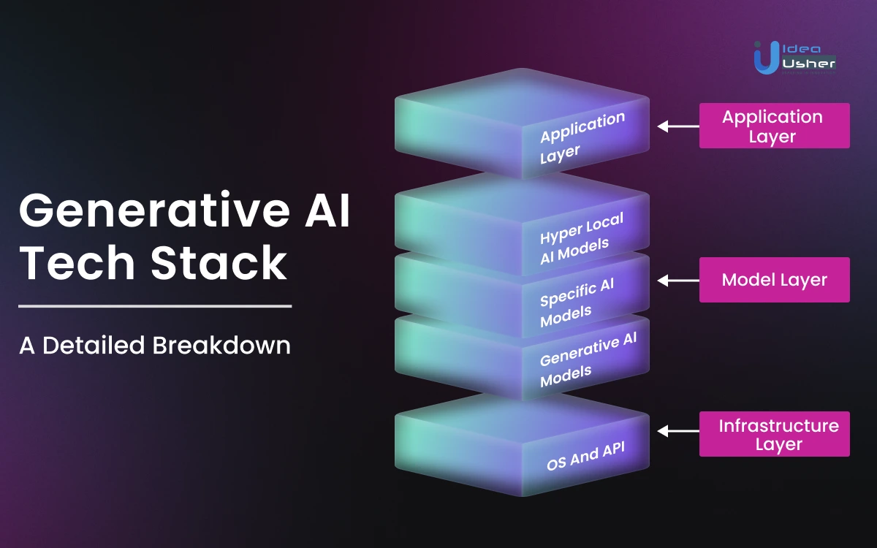
Tech Stack
Python
Streamlit
Gemini Ai

Slide 5
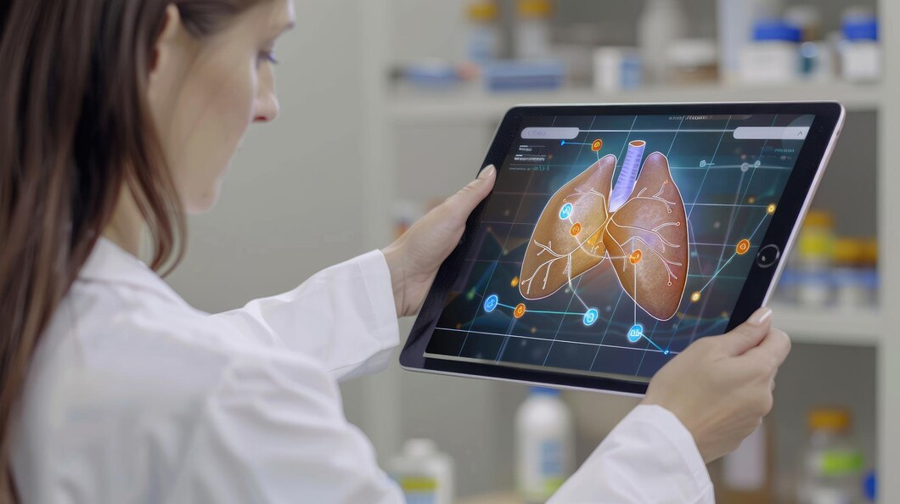
Our
Service
AI-Powered Early Detection
The AI Chest Cancer Assistant’s early detection system is designed to identify breast cancer at its earliest, most treatable stages. This feature uses advanced machine learning and deep learning algorithms.
Accurate Risk Assessment
The Accurate Risk Assessment feature of the AI Chest Cancer Assistant is designed to help both patients and clinicians understand the likelihood of developing breast cancer based on a combination of personal and clinical factors.
Treatment Planning Support
The Treatment Planning Support feature of the AI Chest Cancer Assistant helps oncologists and healthcare providers develop personalized and effective treatment strategies for breast cancer patients. By leveraging AI and data from millions of patient.

Slide 6
Thank You

