Slide 1

Leads Page - POC
Version 1.0

Slide 2

Text Color Code #f7f7f7
Text Color Code #f7f7f7
Text Color Code #c6e7e7
Text Color Code #01aaad

Slide 3
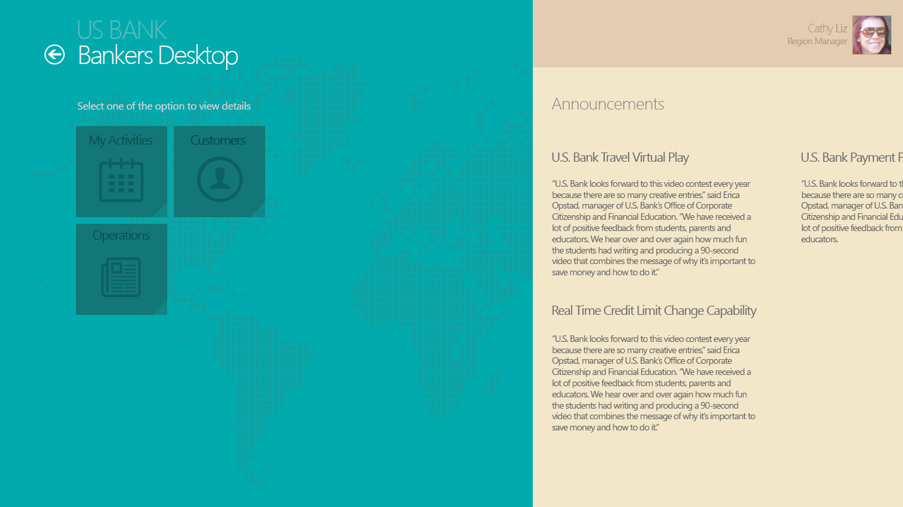
BG Color Code #e2cdb1
Text Color Code #f7f7f7
BG Color Code #f2e7c9
Text Color Code #d4d4d4
Text Color Code #8f8f8f
Color Code #137677
Text Color Code #0a5051
Text Color Code #6a6a6a
Text Color Code #6a6a6a
BG Color Code #01aaad

Slide 4
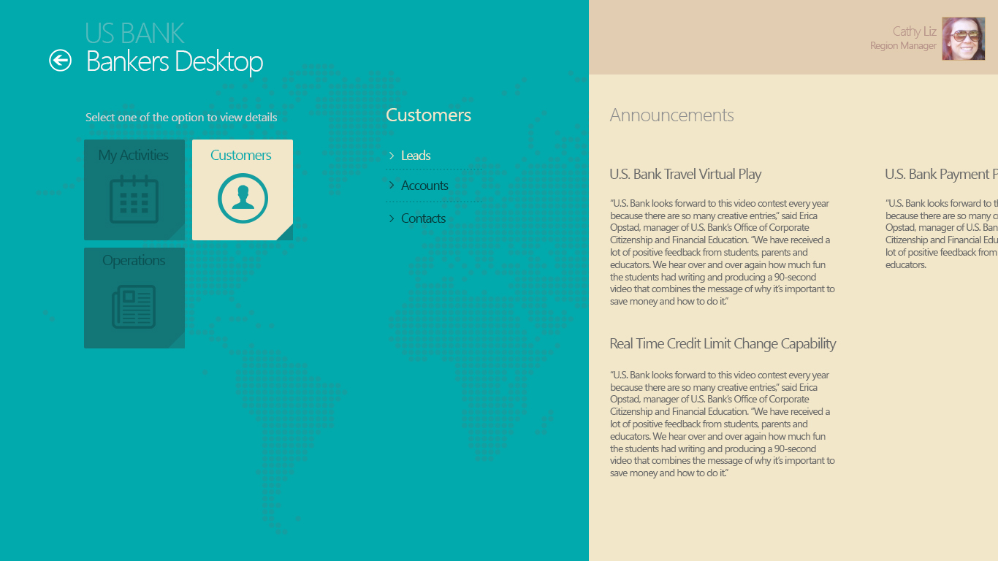

Text Color Code #01aaad
Text Color Code #f2e7c9

Slide 5
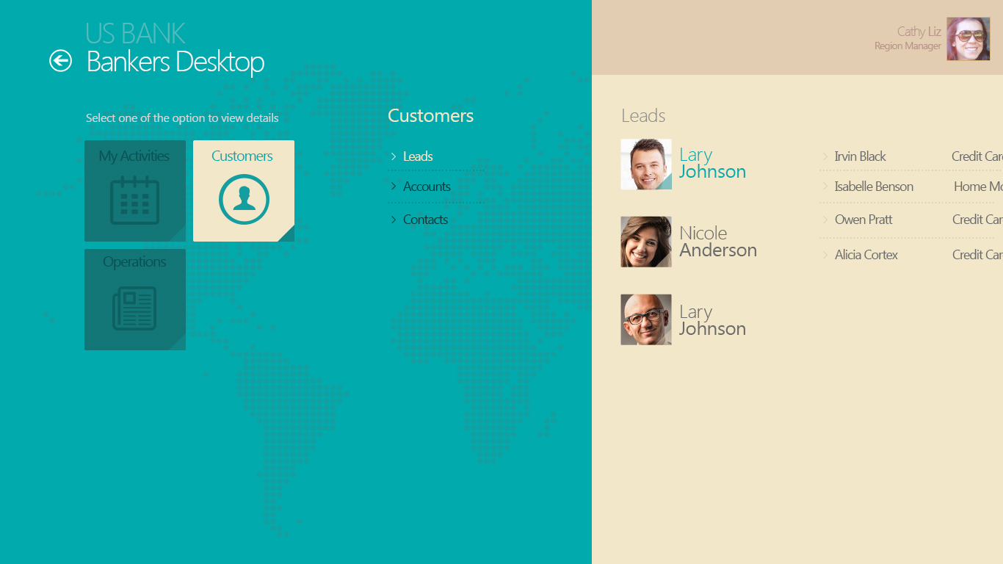
Text Color Code #01aaad
Text Color Code #083939
Text Color Code #6a6a6a

Slide 6
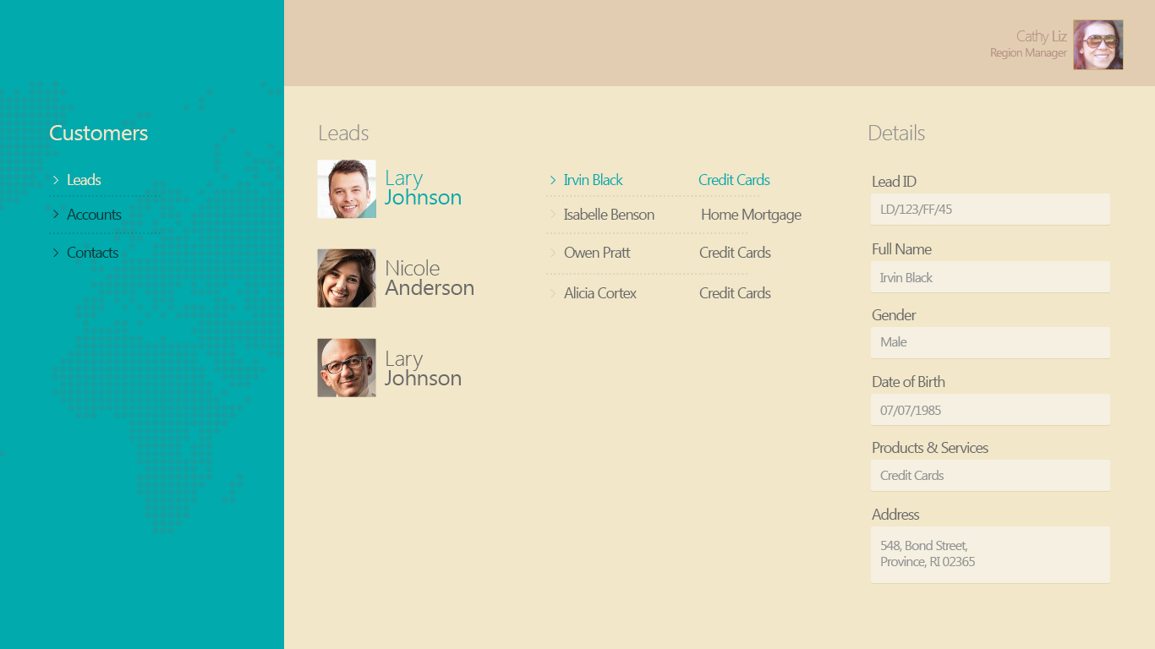
Text Color Code #6a6a6a
Text Color Code #959595
Text Color Code #6a6a6a

Slide 7
Leads Page - POC
Version 1.0

