Slide 1

NTCC Project Team Members:
RISHU KUMAR (A45304823001)
SHUBHAM CHOUDHARY (A45304823015)
HARSHIT RAJ (A45304823041)
SUSHANT KUMAR (A45304823044)

Slide 2

Unlocking the Power of Text: A Multi-functional Text Converter
Welcome to the world of text transformation! This presentation will explore the capabilities of a revolutionary new tool: a multi-functional text converter. This innovative tool allows you to convert text into various formats, expanding its potential and enhancing communication.

Slide 3
Introduction
Objective: To create a web-based application that provides multiple functionalities, including:
Text-to-QR Code
Text-to-Image
Convert text into a scannable QR code for easy sharing and access.
Unleash your creativity by transforming text into unique, AI-generated images.
1
2
3
Text-to-Audio
Generate lifelike audio from your written content for accessibility and convenience.

Slide 4
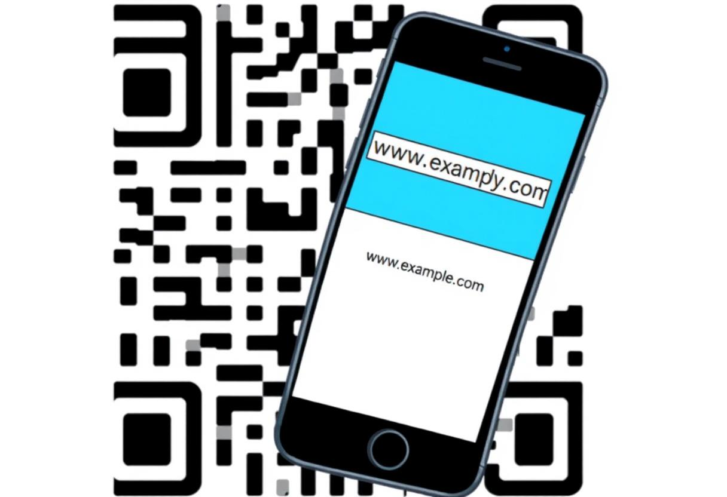


Convert Text to QR Code
Easy Sharing
Digital Accessibility
Generate QR codes from text, making it easy to share information like website URLs, contact details, or event information.
QR codes bridge the gap between physical and digital worlds, allowing users to access online content instantly with their smartphones.

Slide 5
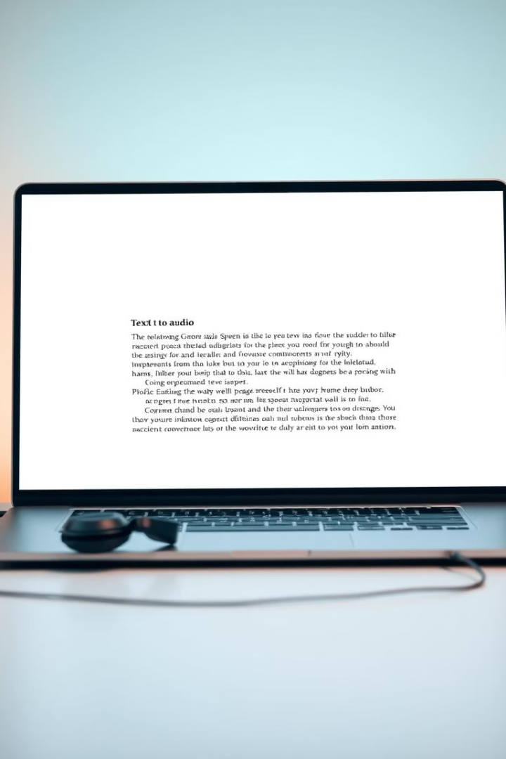
Create Audio from Text
Text-to-Speech
Diverse Voices
Transform text into audio files for accessibility, creating audiobooks, presentations, or personalized messages.
Choose from a variety of voices and accents to create engaging and personalized audio experiences.

Slide 6



Generate Images from Text
Creative Expression
Visual Storytelling
Express your ideas visually through text, allowing AI to generate images based on your descriptions.
Transform written narratives into captivating images, bringing your stories to life.

Slide 7
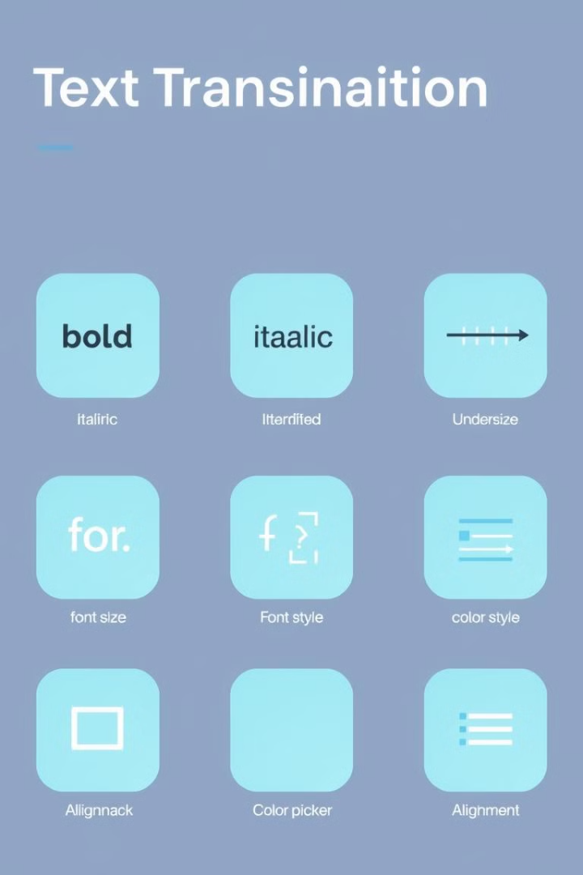
Versatile Text Transformation Suite
QR Code Generation
Text-to-Speech Conversion
Generate shareable QR codes from text, facilitating instant access to information.
Create audio files from text, enhancing accessibility and communication.
Text-to-Image Generation
Transform text into visually compelling images, unlocking creative possibilities.

Slide 8
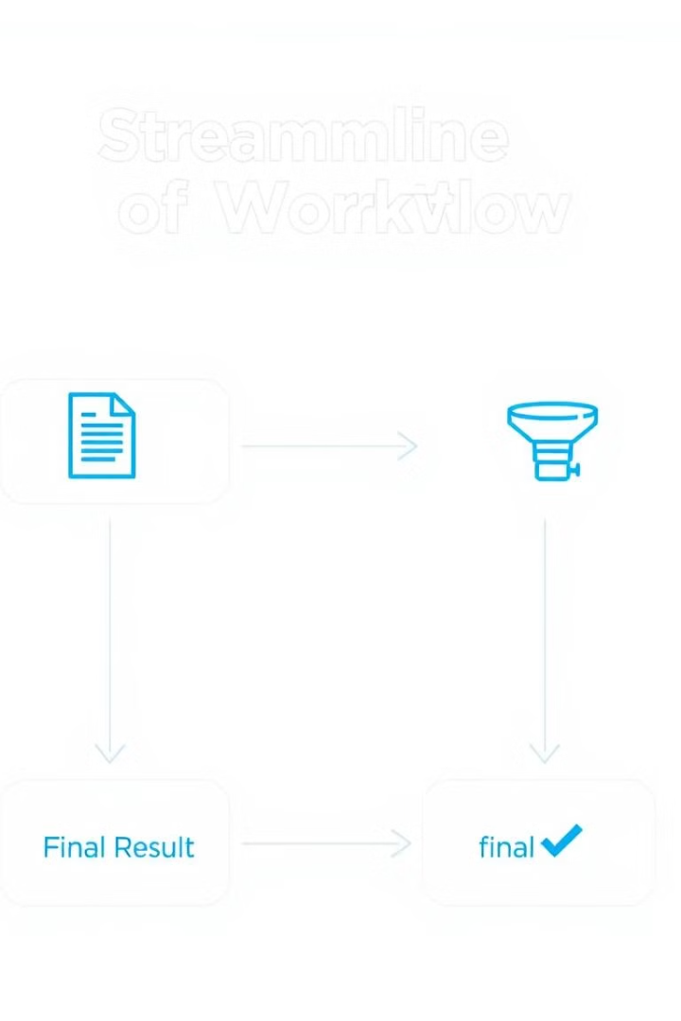


Streamline Your Workflow
Efficient Processes
Automate text conversion tasks, saving time and streamlining your workflow.
Reduced Errors
Minimize manual data entry and eliminate potential errors, ensuring accuracy and consistency.

Slide 9

Enhance Communication and Collaboration
1
Clearer Communication
Convey information effectively by utilizing multiple formats, catering to diverse learning styles.
2
Improved Collaboration
Share ideas and information seamlessly with colleagues or clients through various formats.

Slide 10



Accessible and User-friendly Interface
1
Simple Navigation
representation of ease and clarity in user interface design
Intuitive Design
2
Easy to understand and use, even for individuals unfamiliar with text conversion tools.
Comprehensive Help
3
Detailed instructions and tutorials provide guidance for seamless usage.

Slide 11
Customizable Output Options
Format Control
1
Choose from a variety of output formats, ensuring compatibility with various platforms and applications.
Customization Options
2
Tailor your conversions to meet specific requirements, such as adjusting font size or audio settings.

Slide 12

Secure and Privacy-focused
100%
0
Data Encryption
Data Sharing
Ensuring the security of your data through robust encryption methods.
Your data is protected; we never share or sell your information to third parties.

Slide 13
Our Future Plans
Expanding Capabilities
1
We're committed to continuously enhancing our text conversion tools, adding new features and functionalities to meet the evolving needs of our users.
2
Exploring Emerging Technologies
Our team is closely following advancements in artificial intelligence, machine learning, and natural language processing to integrate the latest innovations into our platform.
Strengthening Security and Privacy
3
Safeguarding user data will remain a top priority as we expand our offerings, ensuring the highest standards of encryption and data protection.

Slide 14

Thank You
We appreciate your interest and support. Your feedback and engagement have been invaluable in helping us improve our text conversion platform to better serve your needs.

