Slide 1
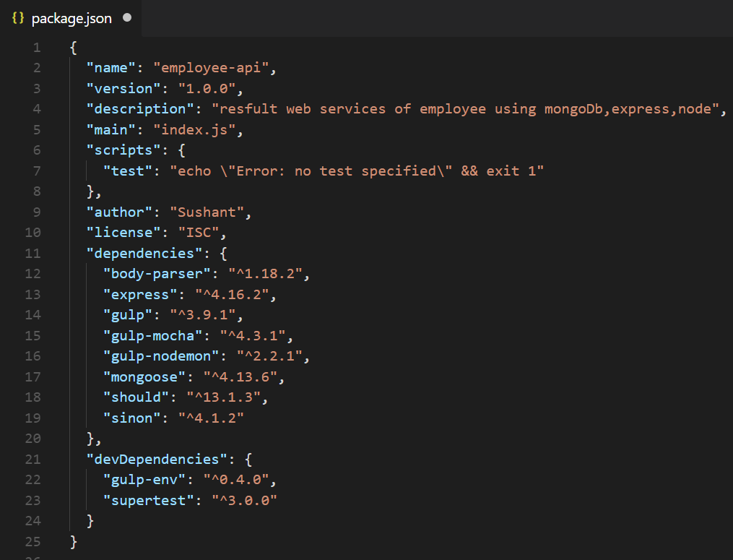
Name of the app, we will create CRUD on Employee entity for demonstration.
Dependencies used in the application
Node.js body parsing middleware.Parse incoming request bodies in a middleware before your handlers, available under the req.body property.
Express server dependency. Will be used run the app.
Task runner for the app.
Wrapper for the gulp to run mocha test cases.
automatically runs and restarts your app when there are changes in specific files. Note the difference with livereload: nodemon will restart the app, not reload the browser.
MongoDB dependency.
Should is an expressive, readable, framework-agnostic assertion library. The main goals of this library are to be expressive and to be helpful. It keeps your test code clean, and your error messages helpful.
Standalone and test framework agnostic JavaScript test spies, stubs and mocks.
Dev dependencies. Gulp-env will be used to set environment variables, supertest will be used to run integration tests.

