Slide 1
MIPI Display Serial Interface (DSI)
By
Appalanaidu Chintu

Slide 2
Features
Compliant with the following MIPI specification
Display Command set(DCS),Display Pixel interfae,D-PHY Verion.
Support for compressed image pixel data.
Hi_speed receive per lane(1.5Gbps),1 to 4 data lane.
Switching to and from Low Power and Ultra-low Power(ULPS) modes,
EOT,ECC,and CRC enable/disable mechanisms.
Generic command mode.
Video Mode support :wide range of display resolution and pixel format.
Burst mode and non-burst transfers.
AHB-Interface for register configuration.
15

Slide 3
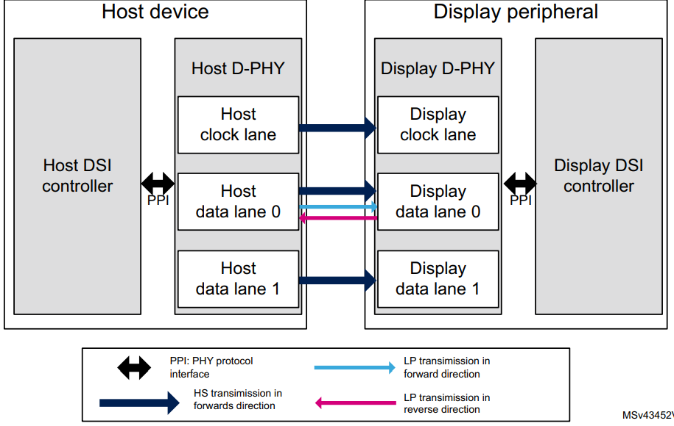
DSI host and display interface

Slide 4
System clocks
Clock Name | Description
ahb_clk | AHB interface clock for register and other
pix_clk | A clock must keep the pixel data and synchronization signals in order.
Dsi_clk | Mipi ip
Byte/bit clk | D-PHY generate
Pixel Clock Hz = HTOT * VTOT * FPS
HTOT = total line width = active pixels + HSYNC + HFP + HBP (pixels)
VTOT = total frame height = active lines + VSYNC + VFP + VBP (lines)
Bandwidth bps = Pixel Clock * Bits Per Pixel
Data Rate Per Lane bps = Bandwidth / number of data lanes

Slide 5
Display Resolutions
Resolution | Horizontal (width) | Vertical (lines)
QQVGA | 160 | 120
QCIF | 176 | 144
QCIF+ | 176 | 208
QVGA | 320 | 240
CIF | 352 | 288
CIF+ | 352 | 416
VGA | 640 | 480
WVGA | 800 | 480
SVGA | 800 | 600
HD | 1280 | 720
FULL_HD | 1920 | 1080

Slide 6
PHY configuration
The link is composed of one double data rate HS clock lane provided by the host processor and of one to four serial data lanes.
A minimal link configuration has one clock lane and one data lane. Each lane is composed of a pair of wires that are driven in low-swing differential mode during the HS transmissions and in single ended mode during the low-power mode.
The DSI communication can be made in the forward (host to display) or reverse (display to host) direction. All reverse direction communication (from display to host) is done in low-power mode and using data lane 0 only. In command mode systems, lane 0 is bidirectional, while in video mode systems it may be either unidirectional or bidirectional.
All other lanes are unidirectional and support a high-speed mode only.
8/21/2023
13

Slide 7
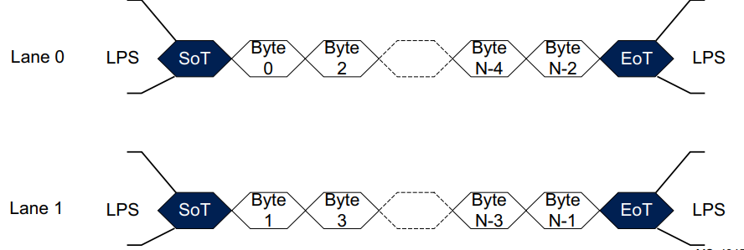
Data lane operating modes
There are four modes of operation: Control, High-Speed, Escape, and Ultra-Low Power State (ULPS). Data Lanes support all four modes but Clock Lanes only support Control, High-Speed, and ULPS mode. During normal operation, a Data Lane is in Control or High-Speed mode.
The mode is used to indicate the start and end of packet level data. The mode used is dependent on the architecture and capabilities of the host processor and application of the display.

Slide 8
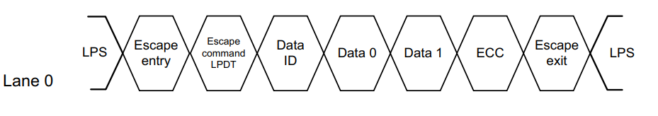
Short packet transmission in low-power mode
There are two signaling modes in the DSI physical layer:
• High-speed (HS) mode: used for fast data transmission where the lane signals are used in differential mode with speeds up to 1.5 Gbit/s.
• Low-power (LP) mode: used mainly for control purposes. The pair of signals of the lane may be driven independently in a single ended mode with a maximum transfer rate of 10 Mbit/s.

Slide 9
DSI operating modes
The DSI standard defines two basic operating modes for the DSI host and the DSI display: the command mode and the video mode.
Command mode:
By default command mode is enabled (3ch_offset ) dsi_ctrl5
display module that supports the command mode incorporates a controller and a frame buffer.
The host processor indirectly controls the activity at the display module by sending commands, parameters and data to the display controller
The command mode refers to an operation in which the transactions take the form of sending commands and data (as defined in the DCS specification) to a display module
8/21/2023
14

Slide 10
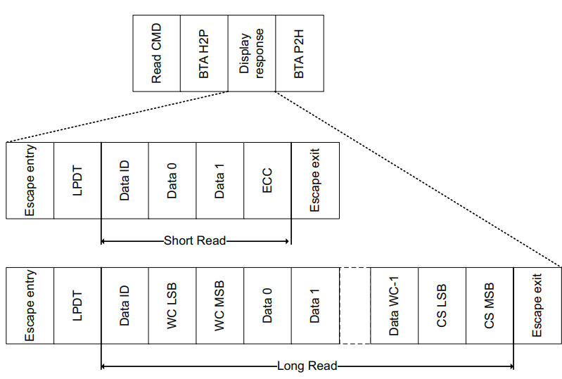
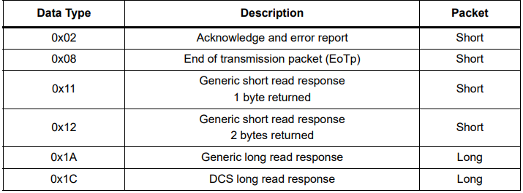
Reverse communication sequence
.

Slide 11
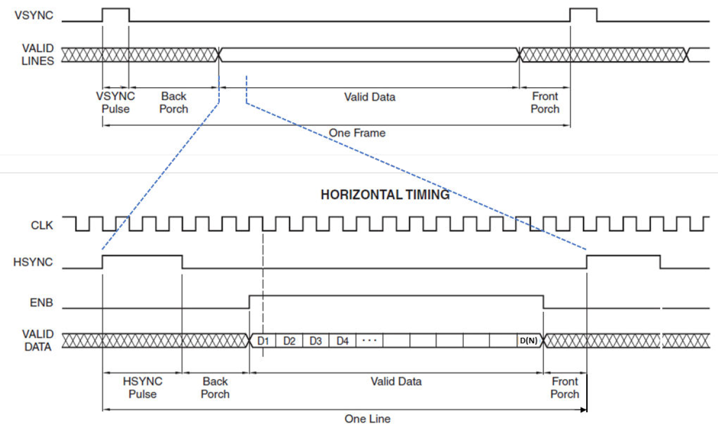
Verticle and horizontal timing relationship
Vertical and horizontal timing relationship
Vertical and horizontal timing relationship

Slide 12
Burst mode
In the video burst mode, RGB pixel packets are time-compressed, leaving more time during a scanline for LP mode (saving power) or for multiplexing other transmissions onto the DSI link.
In this mode, the entire active pixel line is buffered into a FIFO and transmitted in a single packet with no interruptions. This transmission mode requires that the DSI payload pixel FIFO has the capacity to store a full line of active pixel data inside of it.

Slide 13
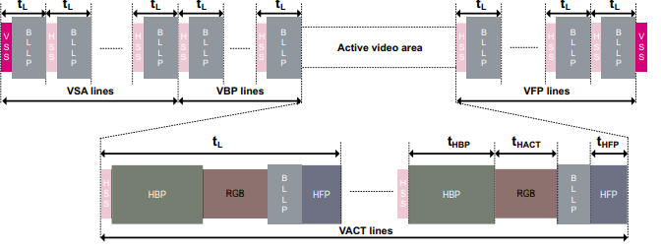
Burst mode
.

Slide 14
nonburst mode
When to use nonburst mode
The nonburst mode provides a better matching of rates for pixel transmission.
This mode enables: – Only a certain number of pixels to be stored in the memory and not requiring a full pixel line (fewer RAM requirements in the DSI host).
Operations with devices that support only a small amount of pixel buffering (less than a full pixel line).
Non-Burst Mode with Sync Pulses: It enables the peripheral to reconstruct original video timing, including sync pulse widths.
Non-Burst Mode with Sync Events: It is similar to above, but the accurate reconstruction of sync pulse widths is not required, so a single Sync Event is substituted.

Slide 15
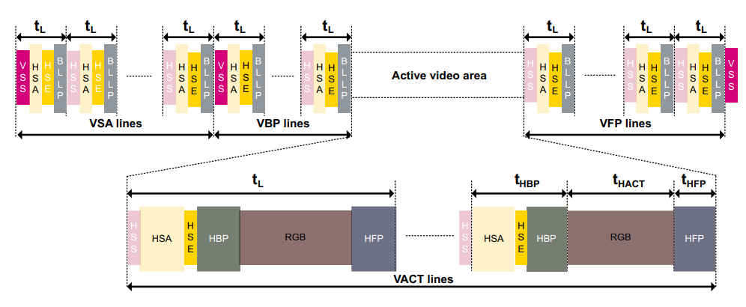
Nonburst mode with sync pulses
.

Slide 16
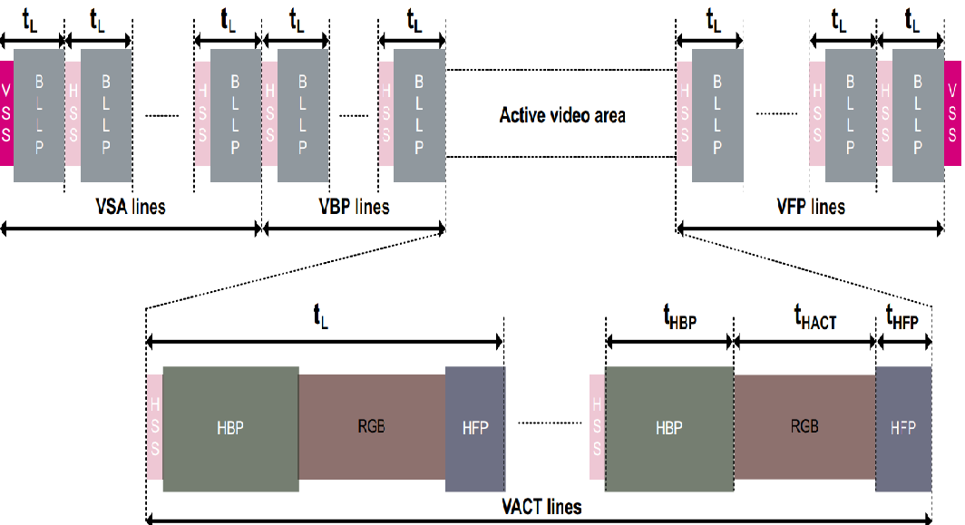
Nonburst mode with sync events
.

Slide 17
Long packet
The 32-bit packet header contains:
• 8-bit data ID.
• 16-bit word count that defines the length of the payload data in bytes.
• 8-bit ECC (error-correcting code) to protect the packet header.
The payload data contains application specific data.
It is mainly used to convey pixel data, or command parameters.
Its length is defined by the word count.
It may be between 0 and 65535 bytes in length.
The packet footer consists of a 16-bit checksum (CS).
It is calculated by the transmitter and used by the receiver to check whether the data has been received with no errors.
The minimum length of a long packet is 6 bytes with zero payload data.
• Four PH bytes.
• Two PF bytes.

Slide 18
The maximum length is 65541 bytes.
• Four PH bytes
• 65534 payload data
• Two PF bytes
Short packets are used for most Command Mode commands and associated parameters.
Other short packets convey events, such as, Hsync and Vsync edges. Because they are short packets, they can convey accurate timing information to logic at the peripheral.
Short packets are always 4 bytes in length including the ECC.
Short packets are also Packet Headers for long packets.

Slide 19
Data protection (ECC and checksum)
The DSI standard provides two data protection mechanisms: ECC and checksum.
1. Error-correcting code The error-correcting code (ECC) byte allows single-bit errors to be corrected and 2-bit errors to be detected.
The ECC represents a robust protection for short packets that are usually used in conveying critical information.
It is also a good protection for a long packet header that includes both the data identifier and the word count fields.
2. Checksum The payload data in long packets is protected with 16-bit checksum that can only indicate the presence of one or more errors in the payload.

Slide 20
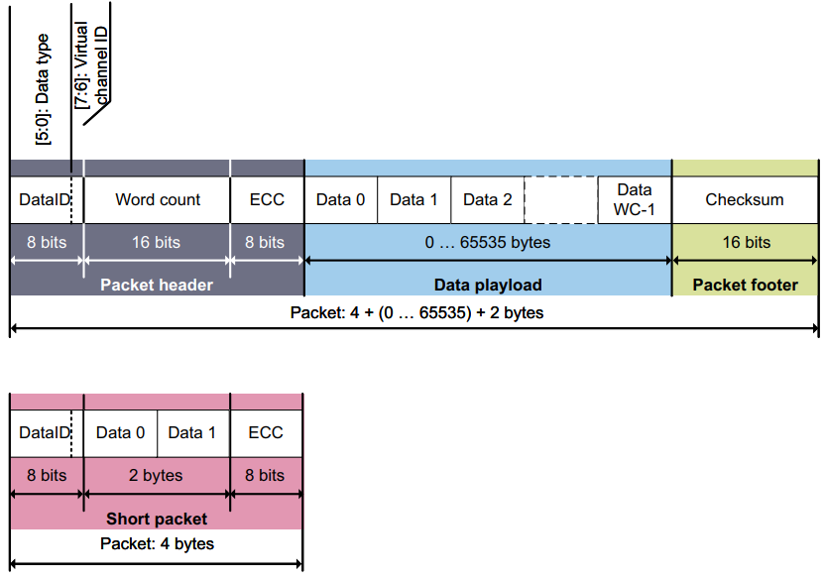
Short and long packet structures

Slide 21
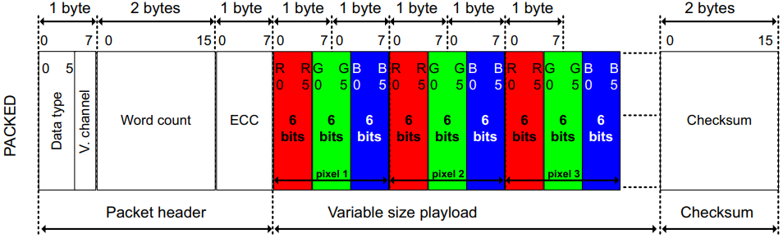
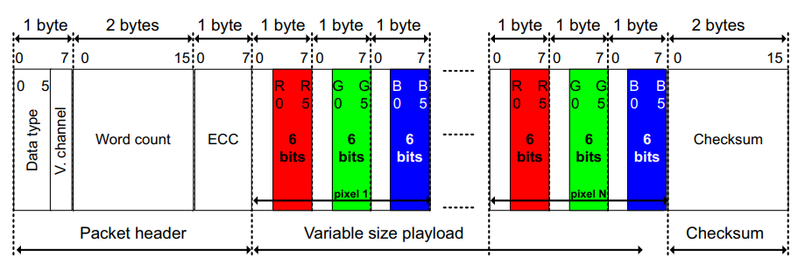
Packed pixel stream, 18-bit format, data type = (0x1E)
Loosely packed pixel stream, 18-bit format, data type = (0x2E)

Slide 22
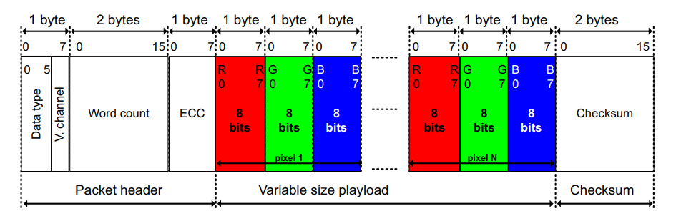
Packed pixel stream, 24-bit format, data type = (0x3E)
The packed pixel stream (PPS) packets are long packets used to transmit RGB image data formatted as pixels to a video mode display module.
The packet consists of the DI byte, a two-byte WC, an ECC byte, a payload of length WC bytes and a two-byte checksum

Slide 23
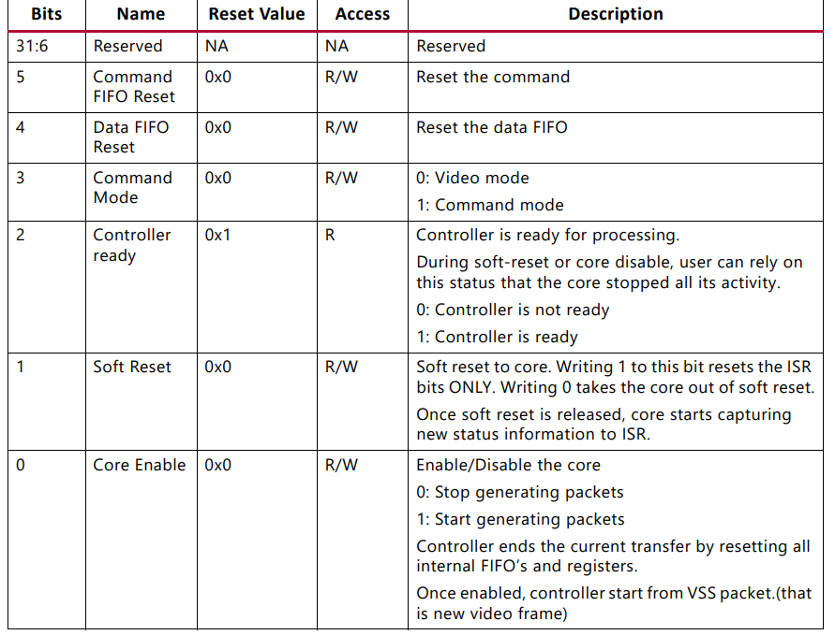
Configuration Register

Slide 24
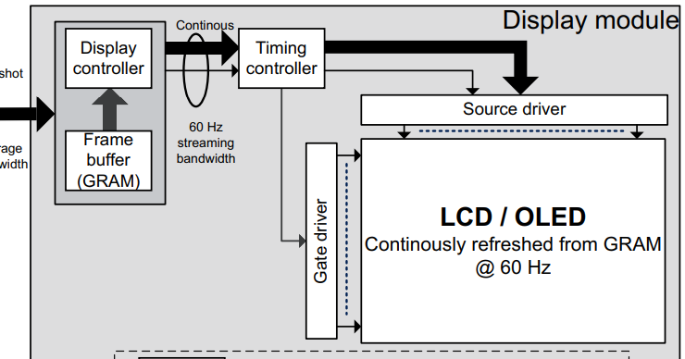
Display architecture with frame buffer and controller
8/21/2023
16

Slide 25
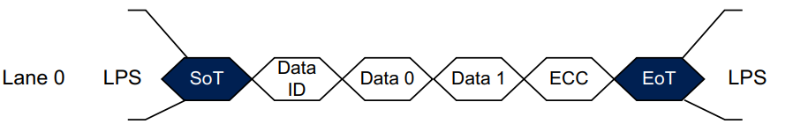
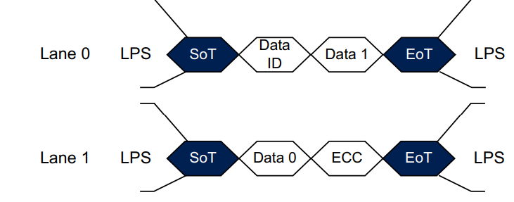
Short packet transmission in HS mode using data lane

Slide 26
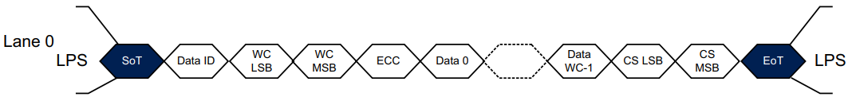
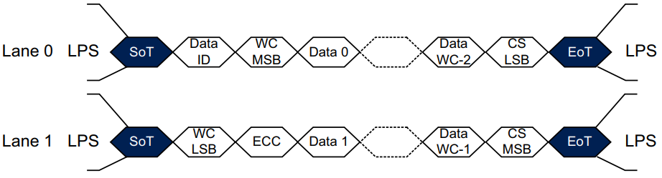
Long packet transmission in HS mode using data lane

Slide 27
THANKYOU

