Slide 1

Heart Disease Surveillance Exploratory Data Analysis
Analysis of U.S. Population-Level Cardiovascular Disease Data
(2004–2013)
Presented by: BVS Sushanth

Slide 2
About Me
Education B.Tech Graduate – August 2025
Core Interests Machine Learning • Data Analysis • Data Science • Real-world problem solving
Motivation Interested in using data to understand patterns, make predictions, and support smarter decisions in domains like healthcare, finance, and technology
Career Goal Preparing for roles as a Data Scientist / Machine Learning Engineer

Slide 3
Why Data Science?
Because data explains the world.
Every industry today generates massive data
Data Science turns raw data into meaningful insights
It helps solve real problems — from healthcare trends to fraud detection
I enjoy combining statistics, programming, and logic to discover hidden patterns
My Aim:
Build data-driven solutions that create measurable impact.

Slide 4
Agenda
Introduction to Project
Dataset Information
Data Cleaning & Preparation
Exploratory Data Analysis
Statistical InsightsKey Findings
Limitations & Future Work
Conclusion

Slide 5
INTRODUCTION
Cardiovascular disease is the #1 cause of death globally, accounting for ~18 million deaths per year
This project analyzes a Heart Disease Surveillance dataset collected from national healthcare surveys and Medicare-based reporting systems
The goal is to uncover demographic and temporal patterns in heart disease rates across the U.S. population
The main variable of interest is ‘Data_Value’ — the measured heart disease rate per demographic group

Slide 6
Why This Project?
Cardiovascular disease is one of the most critical and well-documented public health crises worldwide
The dataset is publicly available, validated, and widely used in epidemiological research
It allows analysis across multiple dimensions — time, age, gender, race, and disease type — making it ideal for EDA
Findings from this dataset can directly inform targeted public health policies for high-risk populations
Personal interest in applying data science techniques to real-world health problems

Slide 7
Dataset Information
Name: heart disease surveillance dataset
Source: national healthcare surveys, medicare-based reporting systems (CDC / public health databases)
Format: CSV (tabular)
Size: ~40,000+ rows, 29 columns
Coverage: united states, years 2004–2013
Granularity: population-level aggregates (not individual patient records)
Target variable: data_value — represents heart disease rate or prevalence

Slide 8
Dataset Information
Name: heart disease surveillance dataset
Source: national healthcare surveys, medicare-based reporting systems (CDC / public health databases)
Format: CSV (tabular)
Size: ~40,000+ rows, 29 columns
Coverage: united states, years 2004–2013
Granularity: population-level aggregates (not individual patient records)
Target variable: data_value — represents heart disease rate or prevalence

Slide 9
Understanding the Dataset
Column | Type | Description
Year | Integer | Year of observation (2004–2013)
LocationDesc | String | U.S. state or national level
Topic | String | Type of cardiovascular disease
Indicator | String | Measurement type (mortality, hospitalization, prevalence)
Break_Out_Category | String | Demographic category — Age, Gender, Race, Overall
Break_Out | String | Specific group within the category
Data_Value ⭐ | Float | Heart disease rate — main target variable
LowConfidenceLimit | Float | Lower bound of 95% confidence interval
HighConfidenceLimit | Float | Upper bound of 95% confidence interval
Each row represents one measurement for a specific year, location, demographic group, and disease type
Initial shape: 42,640 rows × 29 columns

Slide 10
Data Cleaning & Preparation
Missing Values:
‘PriorityArea2’ & ‘PriorityArea4’ → 100% missing → dropped
‘PriorityArea1’ & ‘PriorityArea3’ → 78% and 65% missing, no impact on analysis → dropped
‘Data_Value_Footnote’ & ‘Footnote_Symbol’ → 98.8% missing, just explanatory notes → dropped
‘Data_Value’ → 529 rows (1.2%) missing → rows removed (cannot estimate main variable)
‘Geolocation’ → 820 rows missing only for US national-level records → retained (structural missingness, not a data error)

Slide 11
Data Cleaning & Preparation
Duplicates:
Duplicated().Sum() = 0 → no duplicates found
Outliers:
Detected using boxplot and 99th percentile method
High values found for elderly and certain racial groups
Retained — medically realistic, represent real high-risk populations
Class Imbalance:
Some demographic groups and disease types appear more than others
Reflects real-world population statistics, not sampling bias — expected and meaningful

Slide 12
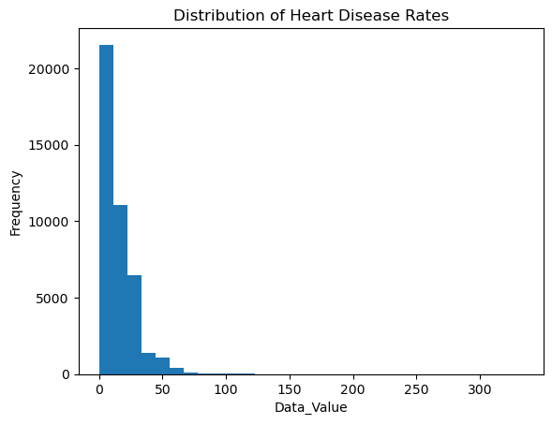
EDA: Univariate Analysis
Data_Value Distribution:
Distribution is right-skewed
Majority of values fall between 0–30
Extreme values exist up to ~95
Extreme values correspond to hospitalization rates in elderly populations
Skewness indicates most groups have moderate rates, but a few have very high disease burden

Slide 13
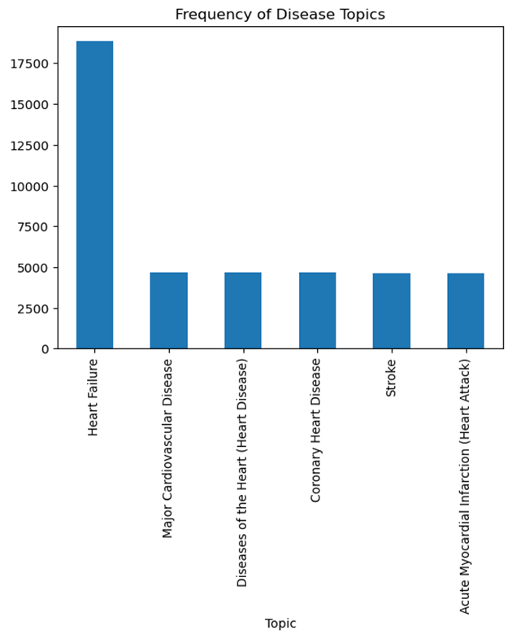
EDA: Univariate Analysis
Topic Distribution:
Major Cardiovascular Disease — most frequent
Heart Failure — second most frequent
Diseases of the Heart, Coronary Heart Disease, Stroke also present
Dataset heavily focused on cardiovascular conditions

Slide 14
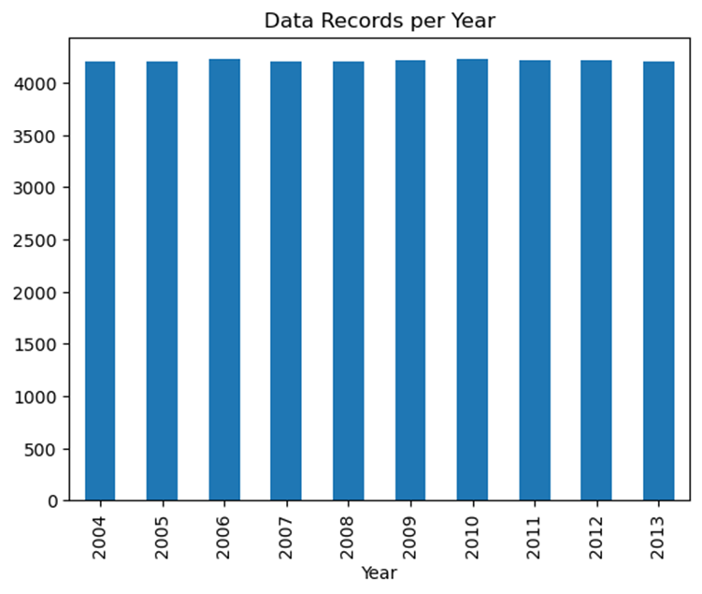
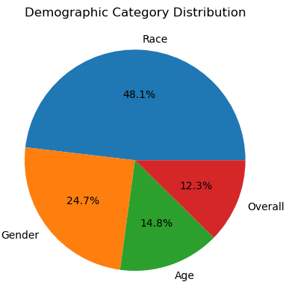
EDA: Univariate Analysis
Break_Out_Category Distribution:
Age, Gender, Race, Overall — roughly balanced across categories
Confirms dataset is structured for multi-demographic comparison
Year Distribution:
Data spans 2004–2013
Records fairly consistent across years, enabling time-series trend analysis

Slide 15
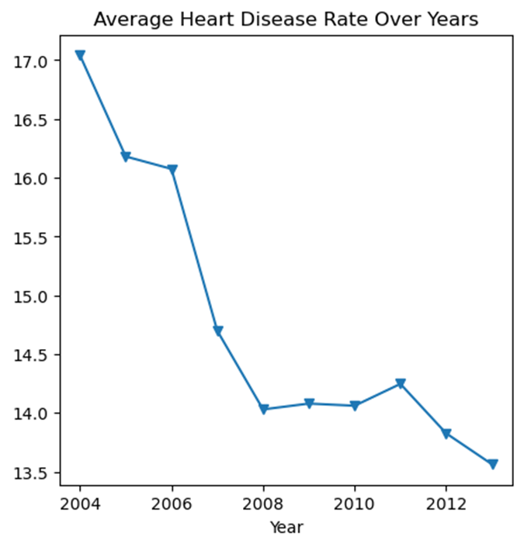
EDA: Bivariate Analysis
Year vs Heart Disease Rate:
Highest average rate in 2004 (~17)
Gradual decline to ~13.5 by 2013
Clear decreasing trend — likely due to improved healthcare, awareness programs, and preventive treatments

Slide 16
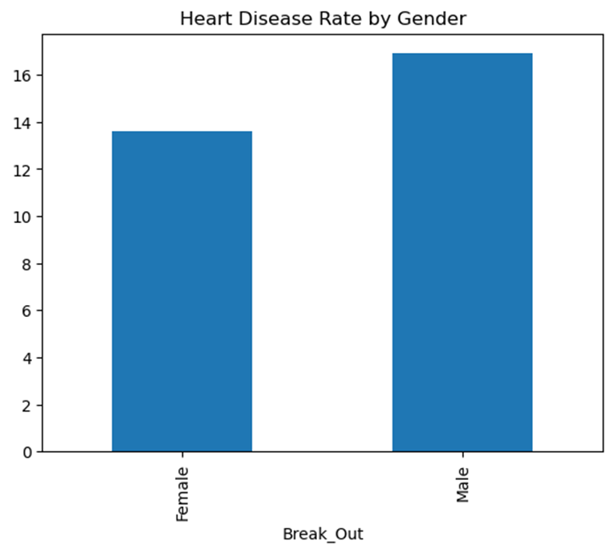
EDA: Bivariate Analysis
Gender vs Heart Disease:
Male → 16.90 average rate
Female → 13.61 average rate
Males have significantly higher rates
Reasons: higher lifestyle risk exposure, biological factors, delayed care-seeking behavior

Slide 17
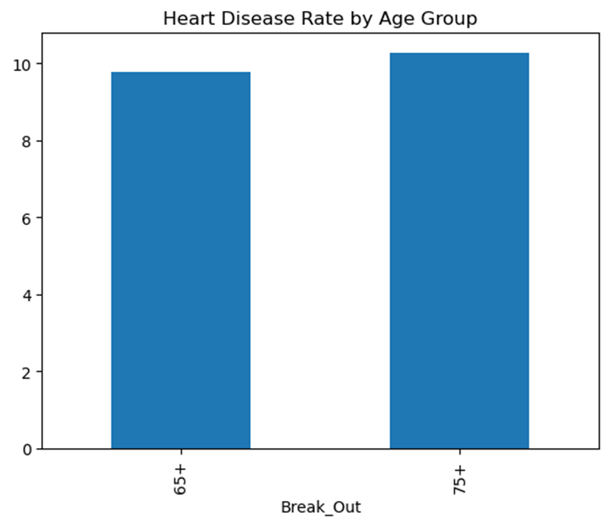
EDA: Bivariate Analysis
Age vs Heart Disease:
Risk increases consistently with age
75+ group shows highest average rate (10.26)
65–74 group second highest (9.78)
Consistent with established medical evidence

Slide 18
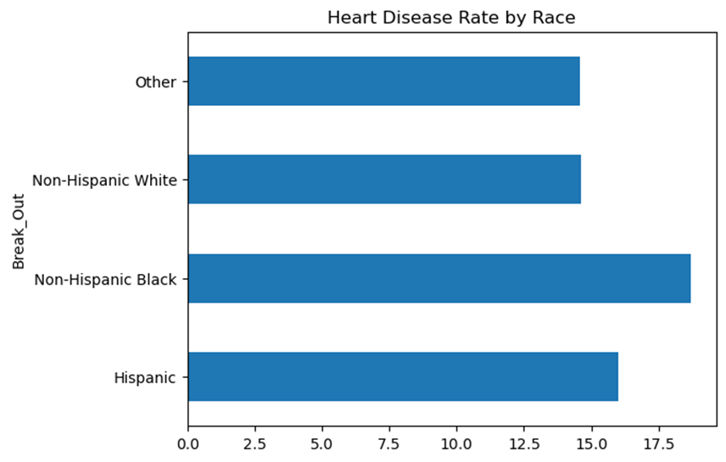
EDA: Bivariate Analysis
Race vs Heart Disease:
Non-Hispanic Black → 18.71 (Highest)
Hispanic → 16.01
Non-Hispanic White → 14.61
Other → 14.58
Significant racial disparities exist — major public health observation

Slide 19
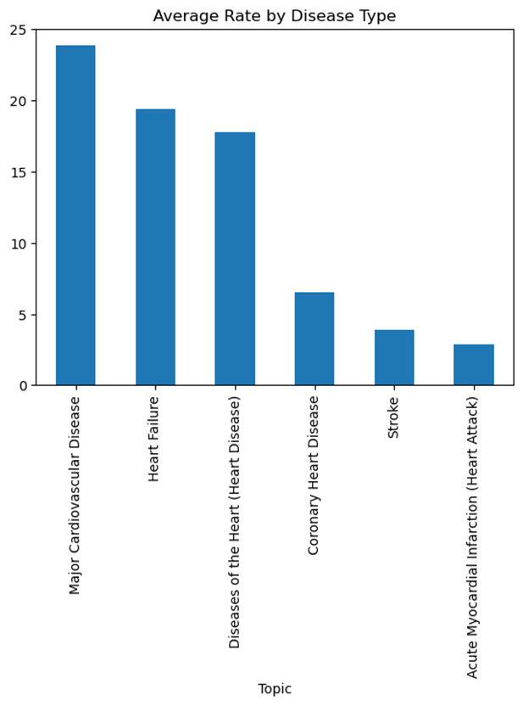
EDA: Bivariate Analysis
Topic vs Heart Disease Rate:
Major Cardiovascular Disease → 23.84
Heart Failure → 19.43
Diseases of the Heart → 17.76
Coronary Heart Disease → 6.54
Stroke → 3.91

Slide 20
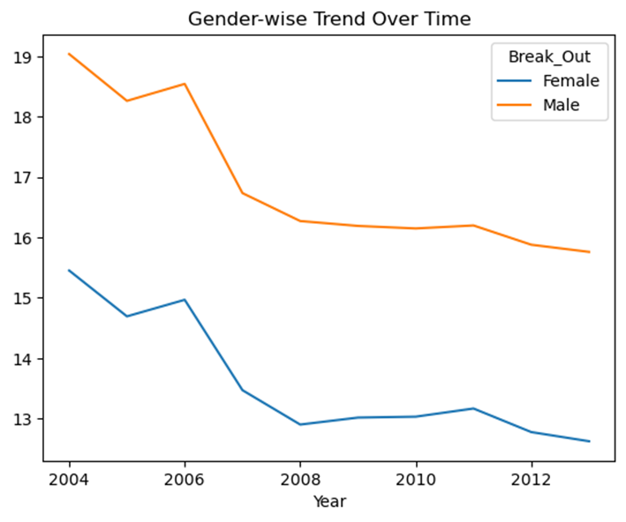
EDA: Multivariate Analysis
Gender Trend Over Time:
Both male and female rates decline from 2004–2013
Males consistently remain higher throughout all years
Gender disparity persists even as overall rates improve

Slide 21
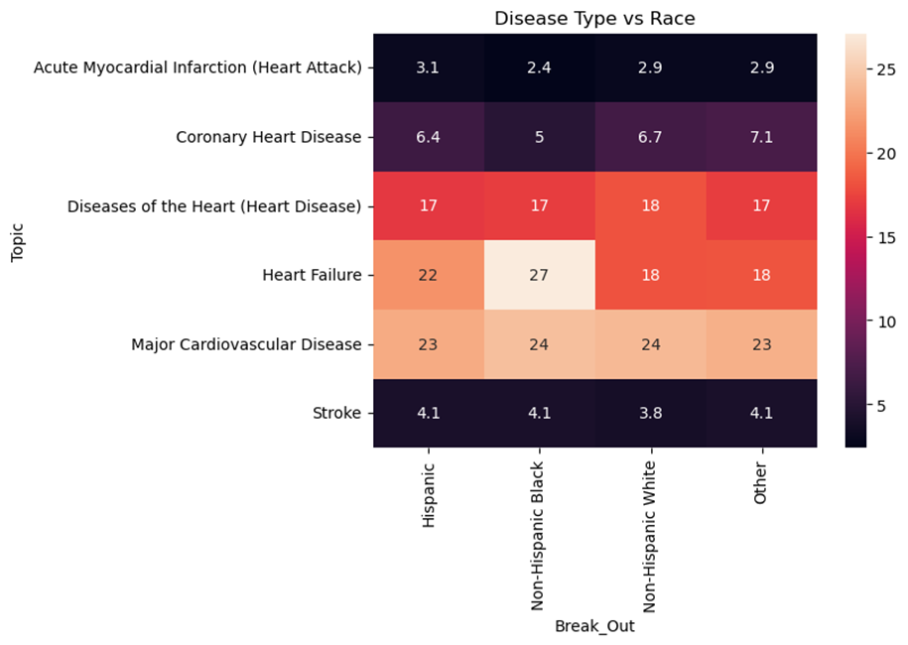
EDA: Multivariate Analysis
Topic vs Race Heatmap:
Certain races show higher burden for specific disease types
Non-Hispanic Black population shows elevated rates especially for heart failure
Highlights inequality patterns across disease categories

Slide 22
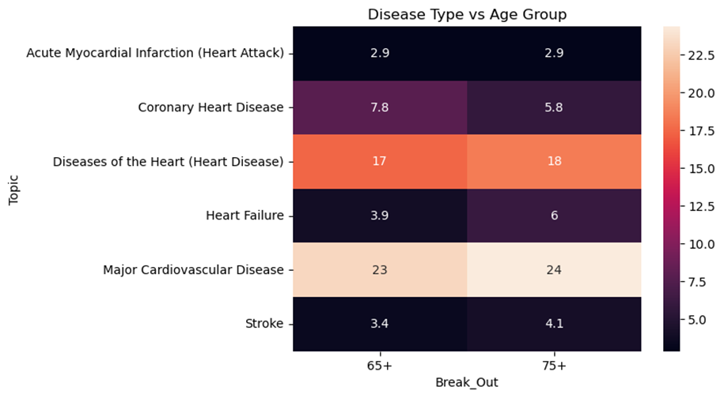
EDA: Multivariate Analysis
Age + Disease Type Interaction:
Heart failure hospitalization increases dramatically for the 75+ age group
Younger age groups show much lower rates across all disease types
Age is a strong predictor of disease severity

Slide 23
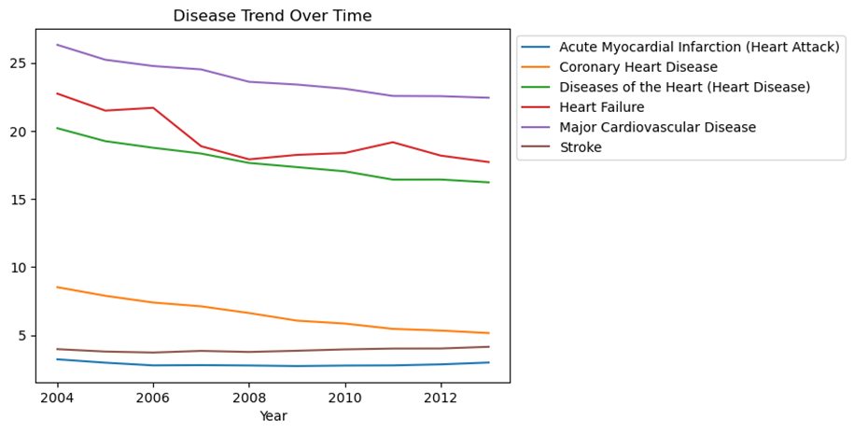
EDA: Multivariate Analysis
Year + Topic Trend:
Major CVD shows gradual decline over years
Stroke shows smaller variation — more stable across years
Heart failure remains relatively high throughout the period
Some diseases are improving faster than others

Slide 24
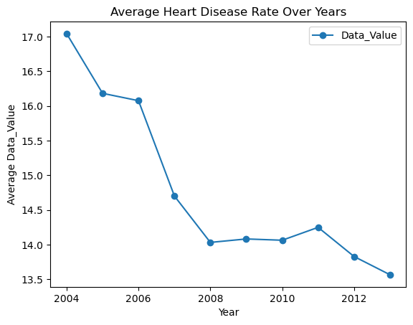
Pivot Table: Year vs Heart Disease Rate
 | Data_Value
Year
2004 | 17.042388
2005 | 16.181479
2006 | 16.075450
2007 | 14.699738
2008 | 14.030495
2009 | 14.080408
2010 | 14.061923
2011 | 14.247708
2012 | 13.827335
2013 | 13.564265
Average heart disease rate declined from ~17 in 2004 → ~13.5 in 2013
Consistent downward trend across years
Shows improvement in cardiovascular healthcare

Slide 25
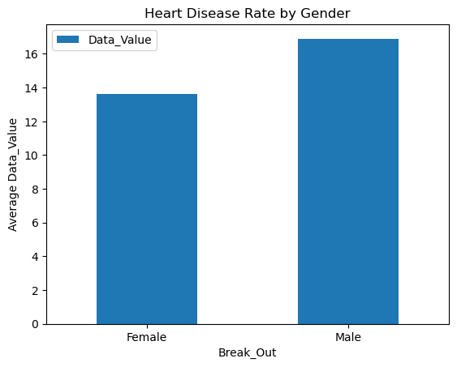
Pivot Table: Gender vs Heart Disease
 | Data_Value
Break_Out
Female | 13.610365
Male | 16.903769
Male average rate → 16.9
Female average rate → 13.6
Males consistently show higher disease risk

Slide 26
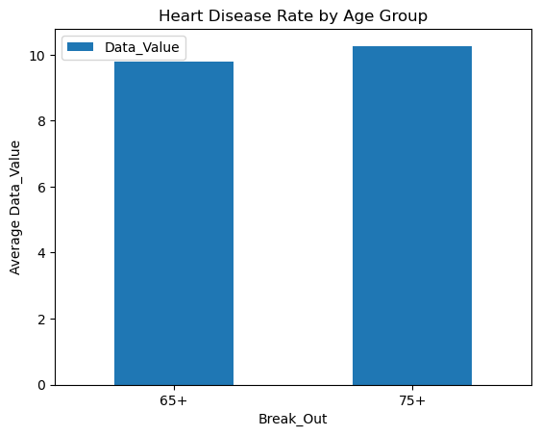
Pivot Table: Age Group vs Heart Disease
 | Data_Value
Break_Out
65+ | 9.776603
75+ | 10.264519
Risk increases with age
75+ age group → highest rate
Elderly populations need regular screening

Slide 27
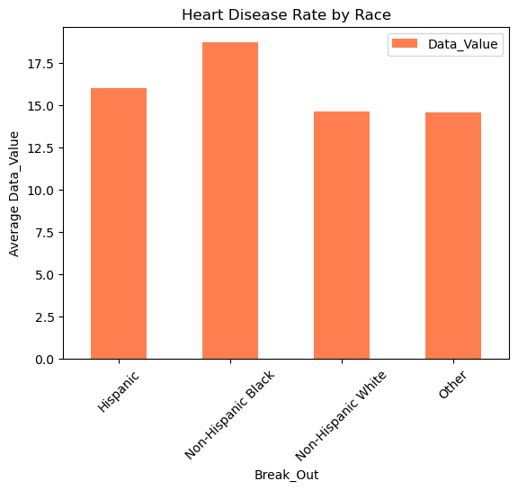
Pivot Table: Race vs Heart Disease
 | Data_Value
Break_Out
Hispanic | 16.011383
Non-Hispanic Black | 18.706664
Non-Hispanic White | 14.611481
Other | 14.585802
Non-Hispanic Black population → highest rate
Shows significant racial health disparities
Indicates need for targeted healthcare programs

Slide 28
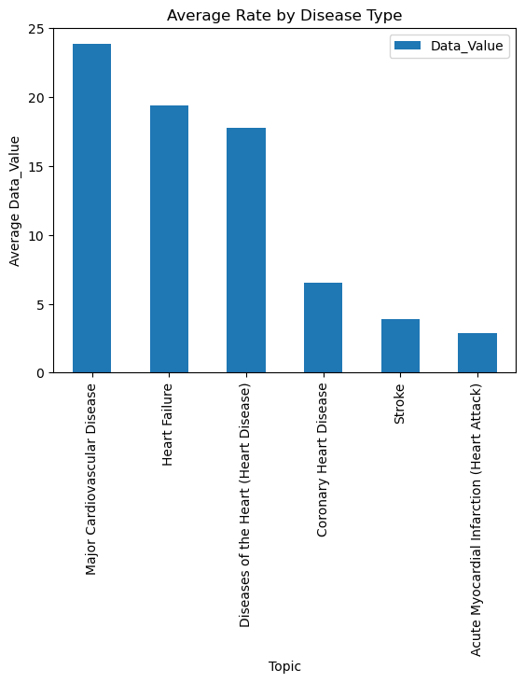
Pivot Table: Age Group vs Heart Disease
 | Data_Value
Topic
Major Cardiovascular Disease | 23.837062
Heart Failure | 19.430285
Diseases of the Heart (Heart Disease) | 17.756052
Coronary Heart Disease | 6.544387
Stroke | 3.911025
Acute Myocardial Infarction (Heart Attack) | 2.873127
Major CVD → highest rate
Heart Failure → second highest
Stroke & CHD → lower rates

Slide 29
Pivot Table: Topic vs Year Trend
Major cardiovascular disease shows gradual decline.
Stroke shows smaller variation.
Heart failure remains relatively high.
Topic | Acute Myocardial Infarction (Heart Attack) | Coronary Heart Disease | Diseases of the Heart (Heart Disease) | Heart Failure | Major Cardiovascular Disease | Stroke
Year
2004 | 3.228017 | 8.519658 | 20.185897 | 22.724826 | 26.305769 | 3.973002
2005 | 2.983224 | 7.892241 | 19.237901 | 21.479905 | 25.213062 | 3.797624
2006 | 2.785466 | 7.395064 | 18.753632 | 21.685216 | 24.752137 | 3.725910
2007 | 2.805640 | 7.116274 | 18.330128 | 18.867272 | 24.502991 | 3.847323
2008 | 2.778308 | 6.626496 | 17.640385 | 17.903682 | 23.595085 | 3.768817
2009 | 2.737229 | 6.067167 | 17.333691 | 18.232080 | 23.392275 | 3.857143
2010 | 2.772786 | 5.853433 | 17.024839 | 18.370048 | 23.083761 | 3.956438
2011 | 2.785097 | 5.462876 | 16.416239 | 19.159617 | 22.557051 | 4.017241
2012 | 2.861039 | 5.338362 | 16.421581 | 18.179514 | 22.541026 | 4.022511
2013 | 2.993506 | 5.156897 | 16.216026 | 17.705319 | 22.425482 | 4.145591

Slide 30
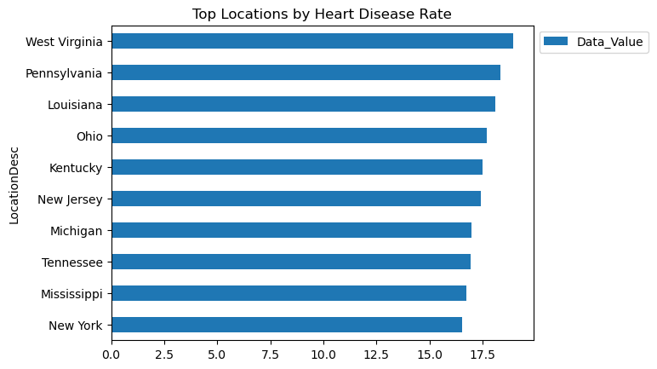
Pivot Table: Location vs Disease Rate
Some states show higher heart disease rates
Geographic inequality exists
Important for state-level health policy planning

Slide 31
Pivot Tables Insights
Pivot Table Summaries
Dimension | Group | Avg Rate
Gender | Male | 16.90
Gender | Female | 13.61
Race | Non-Hispanic Black | 18.71
Race | Hispanic | 16.01
Race | Non-Hispanic White | 14.61
Age | 75+ | 10.26
Topic | Major CVD | 23.84
Topic | Heart Failure | 19.43
Key Takeaways:
Heart disease rates decreased steadily from 2004 to 2013 — indicating healthcare progress
Males consistently show higher rates than females across all disease types
Elderly populations carry the highest risk burden
Non-Hispanic Black populations show disproportionately high disease rates
Heart failure and Major CVD are the most critical disease categories
Geographic inequality exists — some states show significantly higher disease burden

Slide 32
Key Insights
1
Heart disease risk increases significantly with age — 75+ group shows highest burden
2
Male population has ~24% higher cardiovascular disease rates than females
3
Non-Hispanic Black population has the highest disease burden (18.71) — significant racial health disparity
4
5
Overall heart disease rates declined from ~17 in 2004 to ~13.5 in 2013Some disease types improved faster than others — Stroke shows more stability than CVD
Heart failure (19.43) and Major CVD (23.84) are the most severe disease categories
6
Outliers retained — they represent real high-risk groups, not errors
7
Geographic inequality exists — certain U.S. locations have noticeably higher rates
8
Gender disparity in heart disease rates persists consistently across all observed years
9
Public health interventions have measurably reduced cardiovascular disease trends over time

Slide 33
Conclusion
This EDA of heart disease surveillance data revealed important demographic and temporal patterns in U.S. cardiovascular health
Elderly populations and males face significantly higher heart disease risk across all disease categories
Non-Hispanic Black populations show the highest cardiovascular burden — a critical health equity issue requiring targeted intervention
Heart failure and Major Cardiovascular Disease contribute most to hospitalization and mortality rates
Encouragingly, heart disease rates showed a clear declining trend from 2004 to 2013, indicating progress in healthcare, awareness, and prevention
These findings emphasize the need for targeted public health programs focused on high-risk demographic groups
Continued monitoring, early screening programs, and preventive care are essential to further reduce the cardiovascular disease burden

Slide 34

THANK YOU

