Slide 1


230+ Countries
6 Datasets
GLOBAL ENERGY & EMISSIONS ANALYSIS
15 Queries
PROJECT
A SQL-driven study of energy production, consumption, emissions, GDP & population across 230+ countries.
Trend & Ratio Analysis
ENERGYDB

Slide 2




Project Overview & Objectives
What is this project?
ENERGYDB is a relational MySQL database built to store and analyse global energy and climate data across 230+ countries. Six real-world CSV datasets are normalised into a structured schema enabling complex SQL queries for trend analysis, per-capita ratios, and global comparisons.
Design Schema
Trend Analysis
Ratio Analysis
Global Compare
Normalised relational tables with FK constraints on country
Year-over-year changes using LAG & window functions
Per-capita, per-GDP & emission intensity metrics
Rankings, emission shares & cross-country benchmarking

Slide 3
Dataset Overview —
Six Source CSV Files
country_3
230 rows
emission_3
3,517 rows
Columns: Country, CID
Columns: country, energy_type, year, emission, per_capita_emission
consum_3
5,281 rows
production_3
5,297 rows
Columns: country, energy, year, consumption
Columns: country, energy, year, production
gdp_3
1,000 rows
population_3
1,001 rows
Columns: Country, year, Value
Columns: countries, year, Value
Total: ~16,326 rows | Time span: 2000 – 2024 | Countries: 230+ | Import tool: MySQL Import Wizard

Slide 4
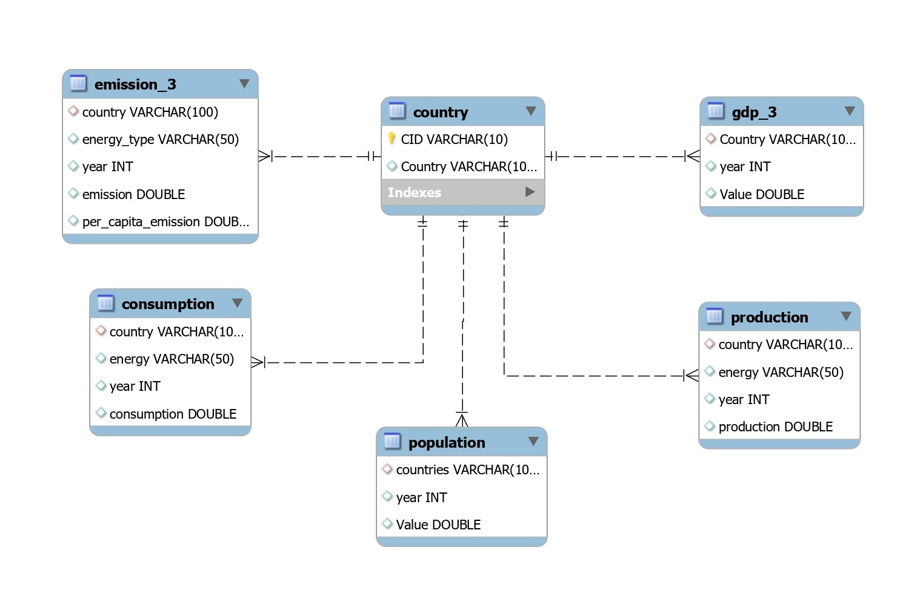
Database Schema & Relationships

Slide 5
General & Comparative Analysis
1. Total emission per country — most recent year
SELECT country, SUM(emission) AS total_emission
FROM emission_3
WHERE year = (SELECT MAX(year) FROM emission_3)
GROUP BY country ORDER BY total_emission DESC;
💡 SUM needed — multiple energy_type rows per country
2. Top 5 countries by GDP — most recent year
SELECT Country, Value AS gdp FROM gdp_3
WHERE year = (SELECT MAX(year) FROM gdp_3)
ORDER BY gdp DESC LIMIT 5;
💡 No SUM — one GDP row per country per year
3. Energy production vs consumption by country & year
SELECT p.country, p.year, p.energy,
SUM(p.production), SUM(c.consumption)
FROM production p
JOIN consumption c ON p.country=c.country
AND p.year=c.year AND p.energy=c.energy
GROUP BY p.country, p.year, p.energy;
💡 3-key JOIN: country + year + energy type

Slide 6
Which Energy Types Contribute Most to Emissions?
Coal
41%
Dominant; Asia-Pacific economies
Oil Products
31%
Transport & industrial sectors
Natural Gas
21%
Cleaner but rising demand
Others
7%
Biofuels, flaring, waste
GROUP BY energy_type ORDER BY SUM(emission) DESC

Slide 7
Trend Analysis Over Time
Uses LAG() — MySQL 8.0+
PARTITION BY isolates country
NULLIF prevents ÷ 0
Avg Yearly Per-Capita
(MAX - MIN per_capita)
/ (COUNT(DISTINCT year) - 1)
→ avg_yearly_change
Key Insight
GDP Trend / Country
YoY Global Emissions
Emissions dipped visibly ~2009 (financial crisis) & ~2020 (COVID-19) — confirming economic activity directly drives energy demand.
Value - LAG(Value)
OVER (PARTITION BY Country
ORDER BY year)
SUM(emission) -
LAG(SUM(emission))
OVER (ORDER BY year)

Slide 8
Ratio & Per Capita Analysis
1. Emission-to-GDP Ratio
2. Energy Consumption / Capita
SUM(emission) / NULLIF(gdp, 0)
SUM(consumption) / NULLIF(population, 0)
Measures carbon intensity of economic output
Lifestyle & industrial energy demand indicator
3. Production / Capita
4. Consumption / GDP
SUM(production) / NULLIF(population, 0)
SUM(consumption) / NULLIF(gdp, 0)
Self-sufficiency of a country's energy supply
Highlights energy-intensive vs efficient economies
5. GDP Growth vs Prod. Growth
LAG(production) OVER
(PARTITION BY country ORDER BY year)
Proxy for economy ↔ energy output correlation

Slide 9
Global Comparisons
Top 10 by Population & Emissions
Countries That Reduced Per-Capita Emissions Most
SELECT p.countries, p.Value AS pop,
SUM(e.emission) AS total_emission
FROM population p
JOIN emission_3 e ON p.countries=e.country
AND p.year=e.year
WHERE p.year=(SELECT MAX(year) FROM population)
GROUP BY p.countries, p.Value
ORDER BY pop DESC LIMIT 10;
SELECT country,
MIN(per_capita_emission) AS earliest,
MAX(per_capita_emission) AS latest,
MIN - MAX AS reduction
FROM emission_3
WHERE year >= (SELECT MAX(year)...) - 10
GROUP BY country
HAVING reduction > 0
ORDER BY reduction DESC LIMIT 10;
Global Emission Share (%) by Country
Global Average GDP, Emission & Population / Year
SELECT country,
SUM(emission),
ROUND(
SUM(emission)*100.0 /
SUM(SUM(emission)) OVER (),
2) AS emission_share_pct
FROM emission_3
GROUP BY country
ORDER BY emission_share_pct DESC;
SELECT g.year,
AVG(g.Value) AS avg_gdp,
AVG(e.total_emission) AS avg_emission,
AVG(p.Value) AS avg_population
FROM gdp_3 g
JOIN (...sum subquery...) e ...
JOIN population p ...
GROUP BY g.year ORDER BY g.year;

Slide 10
Key SQL Concepts Used in This Project
Subquery
JOIN
WHERE year = (SELECT MAX(year) FROM ...)
JOIN population p ON p.countries = e.country AND p.year = e.year
Dynamically isolates the most recent year
Links records across multiple tables
LAG()
NULLIF()
LAG(Value) OVER (PARTITION BY Country ORDER BY year)
SUM(emission) / NULLIF(gdp, 0)
Compare this year vs previous year's value
Prevents divide-by-zero runtime errors
SUM + GROUP BY
Window Function
SUM(emission) ... GROUP BY country, year
SUM(emission)*100 / SUM(SUM(emission)) OVER ()
Aggregates multi-row energy data per entity
Global % share without a self-join

Slide 11
Alternative Approaches & When to Choose
CTE (WITH clause)
✓ When to choose:
Use when the same derived result is needed multiple times in one query, or for improved readability.
vs Subquery
✗ When to avoid:
Avoid for simple one-time lookups — a subquery is shorter and equally fast.
Self-JOIN
✓ When to choose:
Use on MySQL versions below 8.0 where LAG() is unavailable.
vs LAG() Window Function
✗ When to avoid:
Avoid on MySQL 8.0+ — LAG() is faster (single scan) and far more readable.
Correlated Subquery
✓ When to choose:
Use when you need to explicitly pin exact first/last year values per country for precision.
vs MIN/MAX Aggregation
✗ When to avoid:
Avoid if data is clean and MIN/MAX ranges are reliable — correlated subqueries are slower.

Slide 12



Key Insights & Findings
~41%
Top 3
↓ Trend
Coal's Emission Share
Highest Emitters
European Per-Capita
Coal is the single largest CO₂ source globally, driven by Asia-Pacific industrial growth.
China, USA & India account for 50%+ of global emissions consistently across all recent years.
Several EU countries steadily reduced per-capita emissions despite continued GDP growth.
2020 Dip
5×+
GDP ≠
COVID Impact Visible
Production > Consumption
Decoupling Observed
Measurable drop in consumption & emissions in 2020 — sharp recovery by 2022 confirmed.
Major oil-producing nations export far more than they consume domestically.
High-GDP economies (Germany, Japan) show falling emission-to-GDP ratios — growth decoupling.

Slide 13

THANK YOU!!

