Slide 1

Predicting and Analysing the finest Airbnb Hotel
Presented by
P Sushanth Kumar
UMBC

Slide 2
Introduction
Airbnb is an American company that operates an online marketplace for lodging, primarily home stays for vacation rentals, and tourism activities.
There are 2 data sets we will be working in this Project, this data sets with combined size of 414.32 are acquired from the Kaggle.
Fist one is listing data, where Airbnb data for 250,000+ listings in 10 major cities, including information about hosts, pricing, location, and room type will be provided.
The second data set provides the review information on particular listing by certain customer, with over 5 million historical reviews is been used in this project.
In this project, we will be extracting the numerous insights and its effects on an Airbnb hotel and will be discovering the algorithms which can accurately analyse and the understand the data.
In this process we perform various operation starting from user defined function to graphs.
UMBC

Slide 3
Framework of the Project
Setup of ‘pyspark’ and required packages
Cleaning the data 1
(Imputation, StringIndexer, pipeline,UDF)
Gaining insights on the data w.r.t its features
Import the datasets
Visualisation
Vector Assembler
Graph Creation from data 1 and data 2
Selecting Features (Chi Square)
In degree and out degree metrics
Page rank
Implementing Classification Models
Finding the best model of analysing the data
UMBC

Slide 4
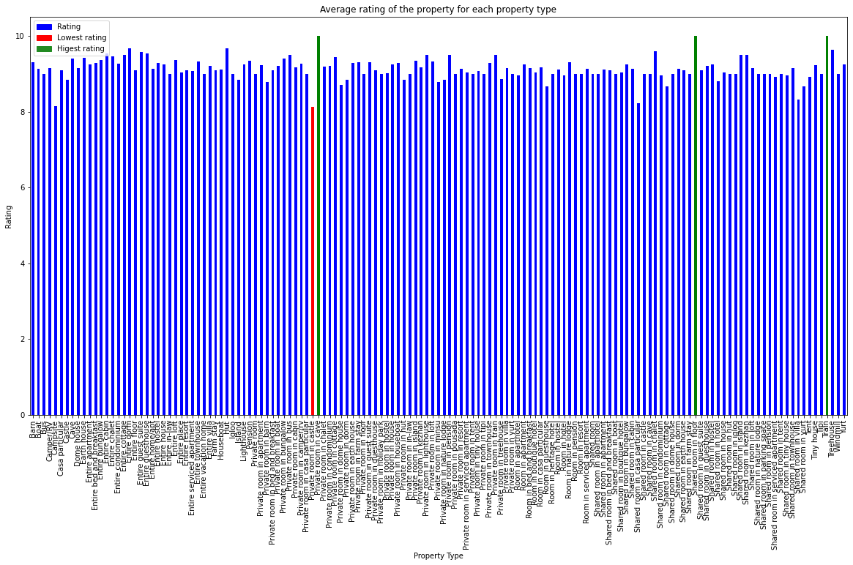
Insights
This Graph represents the average rating given to hotels of certain property.
As we can see from the graph the green bars represents the hotels with best rating and red one with the worst.
UMBC

Slide 5
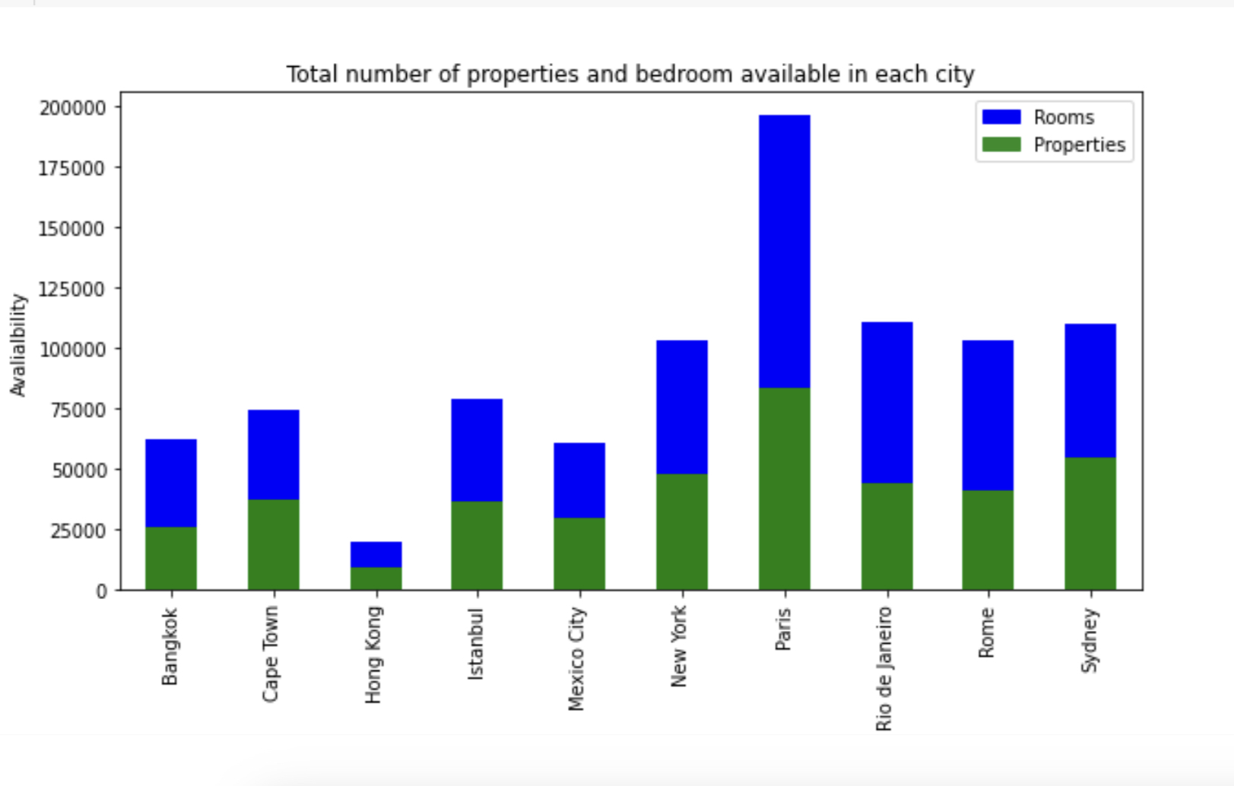
Insights
This Graph represents the accommodations available in each city w.r.t the hotels and room present in it.
As we can see from the graph the Airbnb has most hotels and rooms in Paris.
UMBC

Slide 6
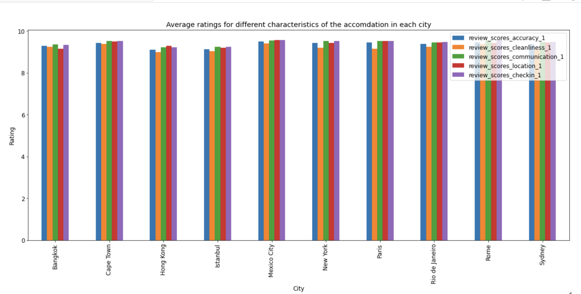
Insights
This graph represents the mean rating of different kinds based on city they are present.
As we can see Paris, Sydney and Cape Town hotels reviews are best w.r.t communication, location and checking.
UMBC

Slide 7
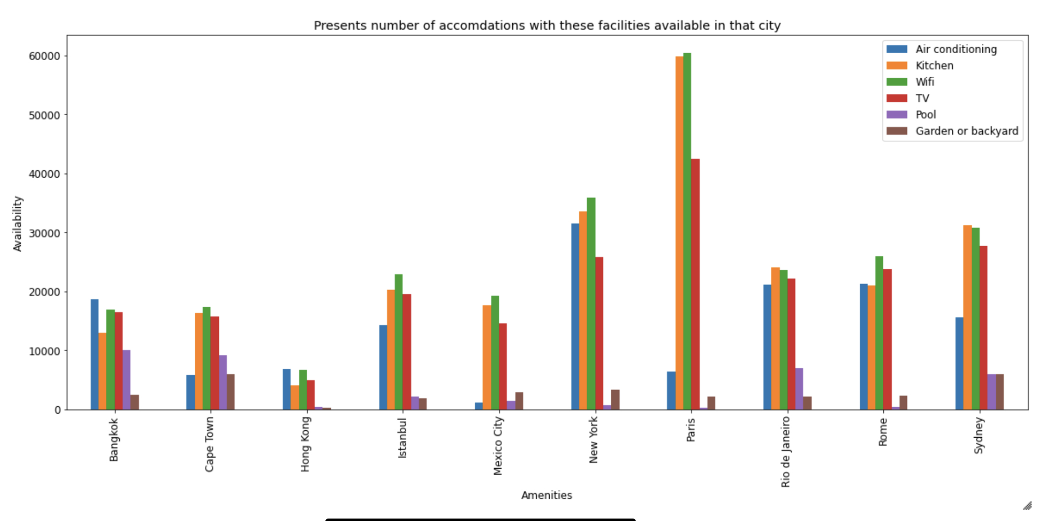
Insights
This Graph represents the number of hotels with the facilities represented in certain city.
As we can see from the graph that Bangkok has most hotels with pools.
UMBC

Slide 8
Machine Learning: Frame work
Cleaned Data
Logistic Regression
Dropping all non numeric columns
Naive Bayes Classification
Splitting the data
(Random Split)
Accuracy
(Multi class Classification Evaluator)
Decision Tree Classifier
Creating vector column
(Vector Assembler)
Random Forest Classifier
Feature Selection
(Chi Square Selector)
GBT Classifier
UMBC

Slide 9
Machine Learning: Results
From the results we can say that Decision Tree and GBT Classifier are best models for this data set.
While Naïve Bayes has the least accuracy with respect to this model.
Model
Logistic Regression
Naïve Bayes
Decision Tree
Random Forest
GBT
Accuracy
47.30%
34.50%
63.60%
61.48%
63.41%
UMBC

Slide 10
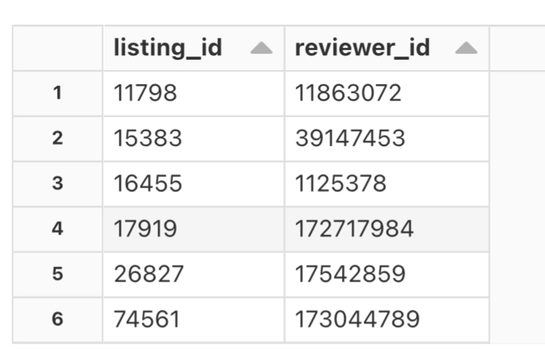
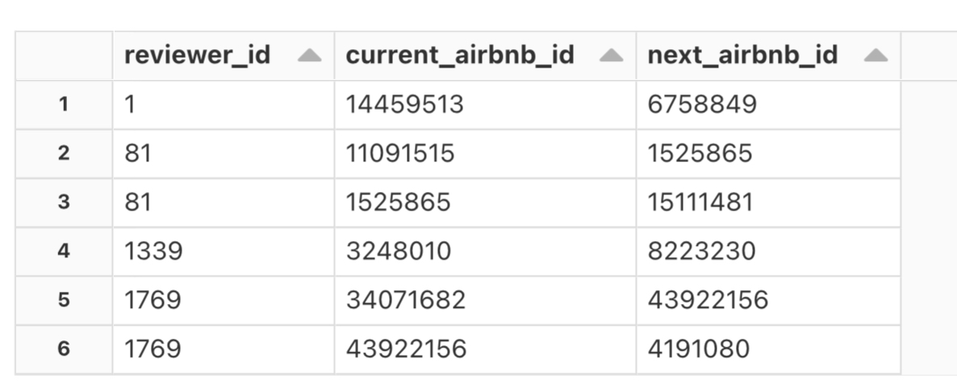
Graph Creation
I converted the 2nd data set features of ‘listing_id‘ into a pair of consecutive elements based on ‘reviewer_id’, which finally resulted in ‘current_airbnb_id’ and ‘next_airbnb_id’ columns.
Then I combined the 1st data set having listing columns and the resulting data set and created a graph.
UMBC

Slide 11
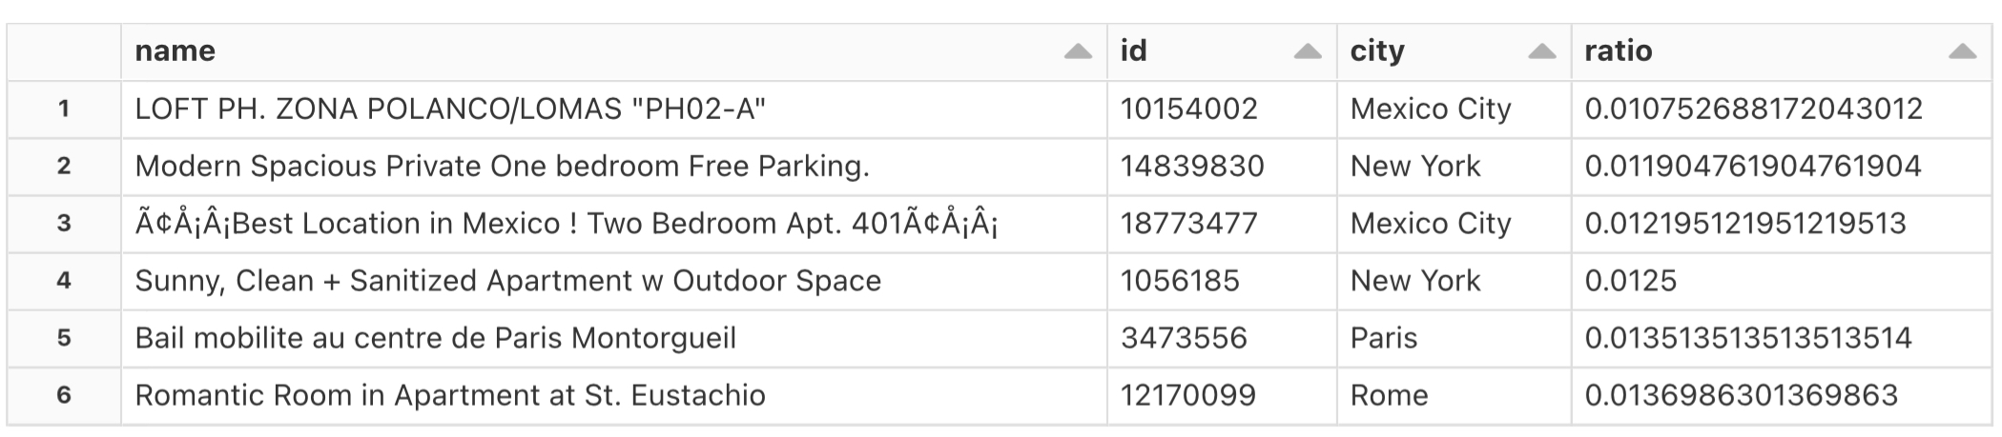
Graph Processing: Out-Degree Metrics
This table provided the hotels, which customers most prefer when they experience an Airbnb hotel before.
After experiencing an Airbnb hotel, the customer are choosing the below hotels the most.
UMBC

Slide 12
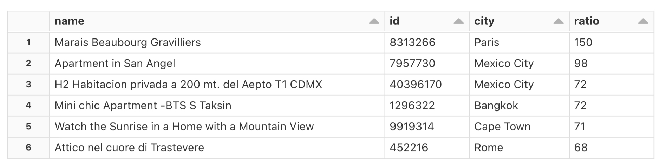
Graph Processing: In-degree metrics
This table provided the hotels, which customers go first to experience after going to the next.
Before experiencing an Airbnb hotel, the customer are choosing the below hotels to go first.
UMBC

Slide 13
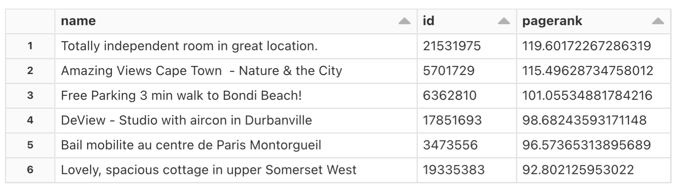
Graph Processing: Page Rank
The Airbnb hotels present in the table are the most important hotels based on Page rank value generated from the graph processing.
The page rank value is generated by finding the number of links passing through the graph and the quality of the link attached to it.
UMBC

Slide 14

UMBC

