Slide 1
Technical Backend

Slide 2

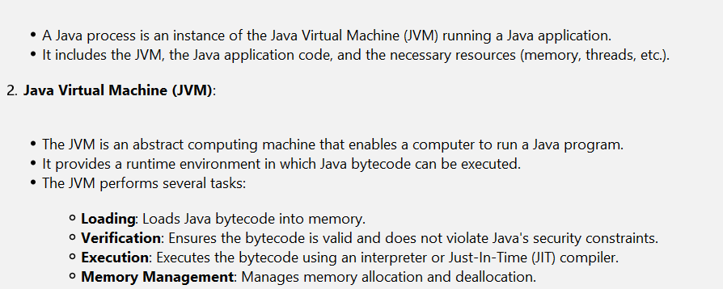
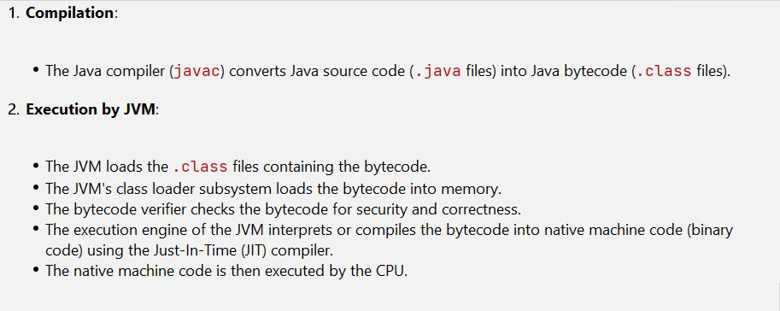
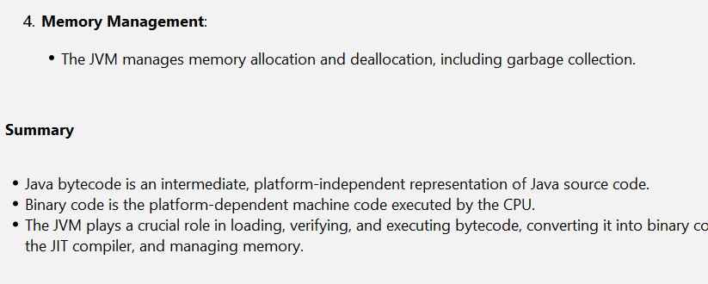
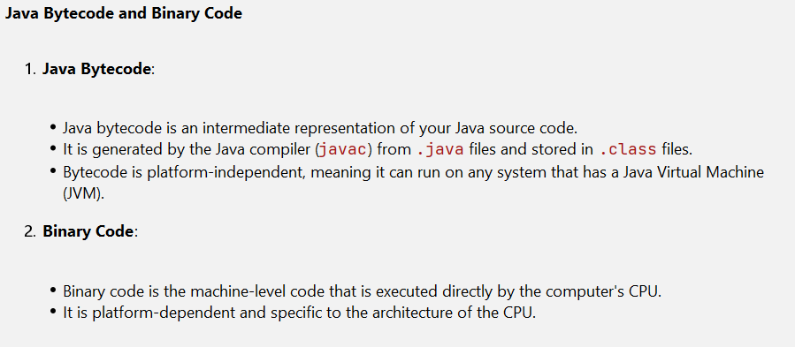
Java process & JVM

Slide 3
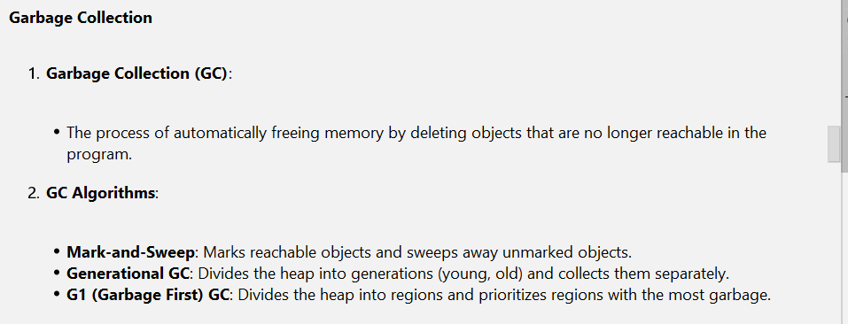
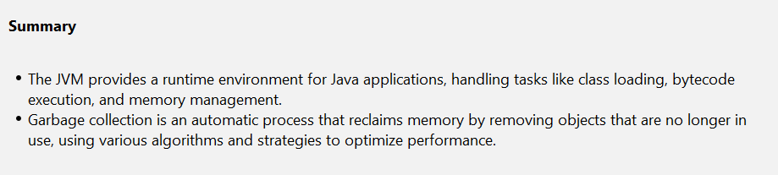
Garbage collection
details

Slide 4
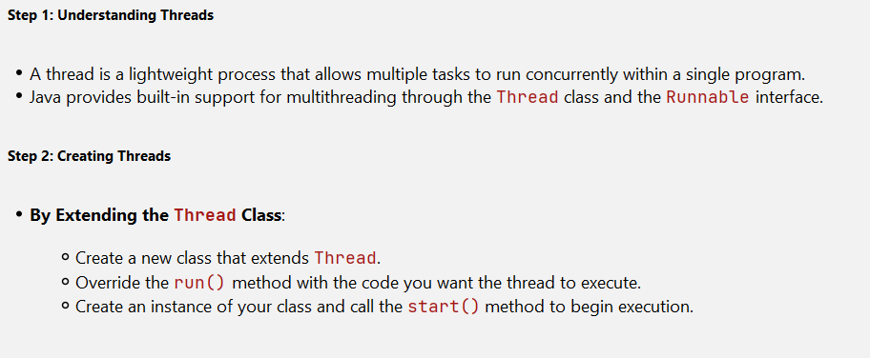
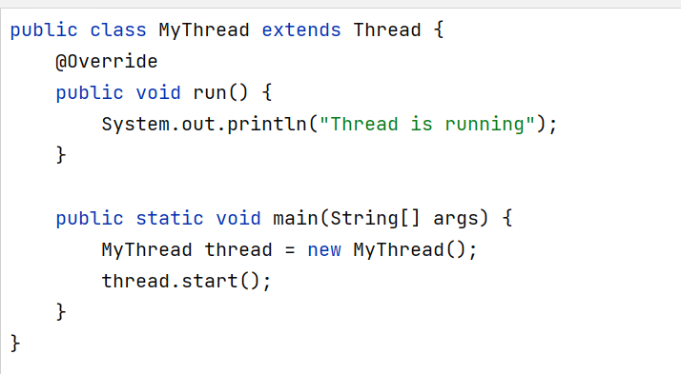
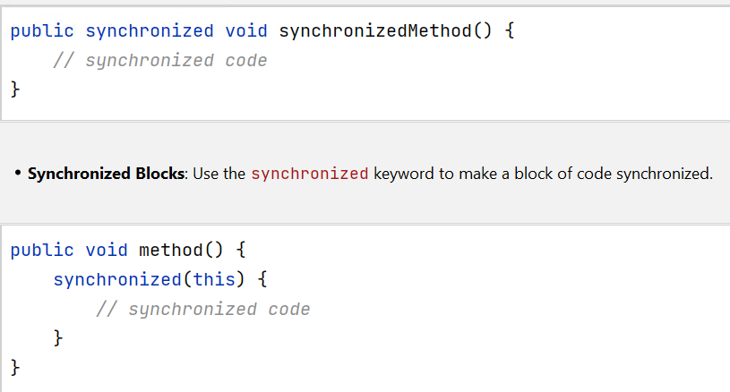
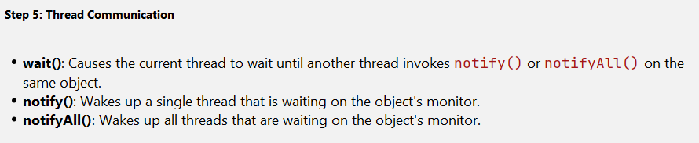
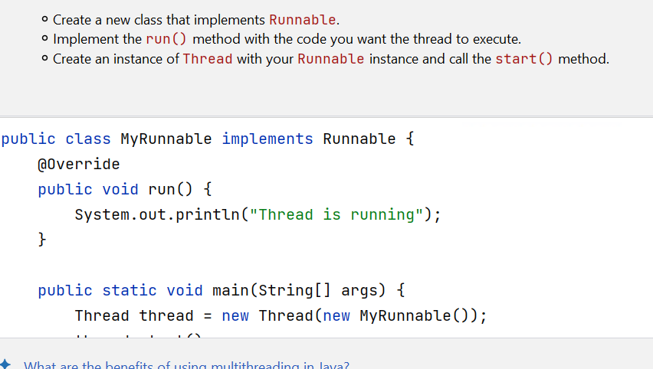
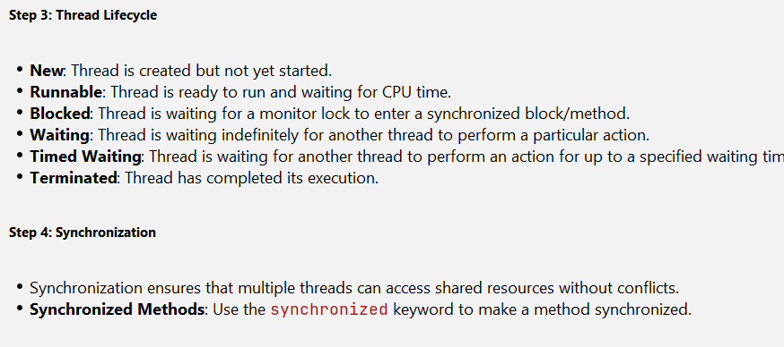
Multithreading
concepts

Slide 5
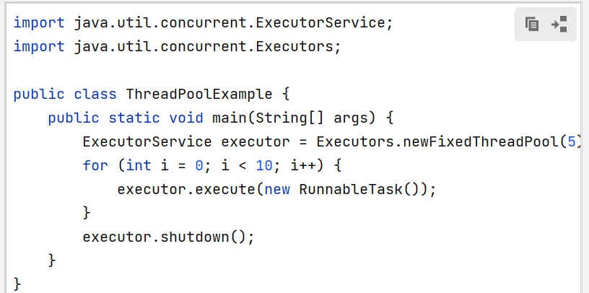
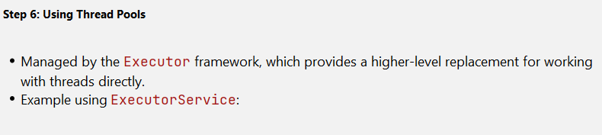
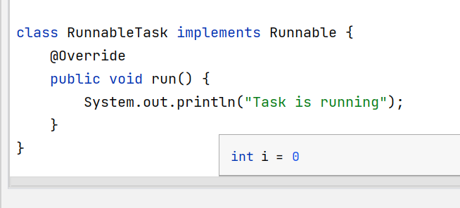
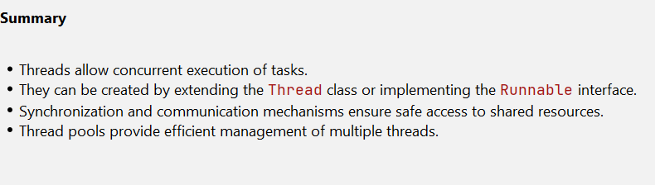
Executor
.

Slide 6
Contents
Java8 Features
Spring boot application and configuration
Spring Rest
Spring Data JPA
Swagger
Junit & SonarQube
Microservice Architecture
Scaling
Auto Scaling
Resilience
Load balancer
SAGA pattern
API Gateway
Spring cloud & config
PCF

Slide 7
Java8 Features
Oracle released a new version of Java as Java 8 on March 18, 2014. It includes various upgrades to the Java programming, JVM, Tools and libraries.
Functional Interface
Lamba Expressions
Optional
Stream API
LocalDateTime
Etc.

Slide 8
Functional Interface
An interface which consists of only one abstract method.
It consists of Default, Static & Overridden methods.
@FunctionalInterface annotation is used to declare the interfaces.
@FunctionalInterface
Interface play{
String playSomething(String cricket, int x);
}

Slide 9
Lambda Expressions
Used to provide the implementation of created interface abstract method which has Functional Interface .
No need to define the method again to providing the implementation
Instead lamba expression can be used directly and returns the body.
Helps to iterate, filter & extract the data from the collection.
Removes the boilerplate code and simplifies the code.
(arguments) -> referenceObject{
Return “body”
};

Slide 10
Optional
It is a public final class and used to deal with NullPointerException in Java application
It’s consists of null or one element
If provided element is null it returns null otherwise if returns the value.

Slide 11
Stream API
Collection of objects
Enables to perform filter, map & Sorting by iterating the list and returns the predicted.
.filter have the predicate which is already predefined and returns the Boolean value
List<T> listB = listA.stream()
.filter(p-> x*x)
.map(p->x)
.collect(Collector.toList());

Slide 12
LocalDateTime
Represents the date & time
Formats the date and time
Formats the current date and time as follows
YYYY-MM-DD-HH-MM-SS

Slide 13
Spring boot application and configuration
Used to develop web apps and microservices.
@SpringBootApplication used to mark the configuration class to declare one or more bean methods
Excludes Xml files and helps to reduce the boilerplate code.
Logging, properties, dependencies, repositories, jars etc.. Will be handled.
Maven or gradle both build tools can be used.
Used to create HTTP web applicatins in tomcat & jetty servers.

Slide 14
Spring REST
Used to create and build Restful web services
It performs the web operations like GET, POST, PUT, DELETE using Api
Enables the Data JPA and performs the APIs

Slide 15
Spring Data JPA
Easy to implement JPA based repositories and CRUD repositories
Behaves as a data access object between DAO interfaces and Database and stores the data
JPQL and Native Query will be used to operate SQL queries in JPA
It includes @Entity, @Repository, @Service, @RestController annotations for the REST Api implementation

Slide 16
Swagger
Documentation provided by APIs
Open API file will be generated for any end point
Describes the structure of APIs defined in REST Apis

Slide 17
Junit & SonarQube
Mockito Junit is an open-source testing framework for java unit testing
Developers can Mock the process and create testcases/test suite by using Mockito
It ensures that application runs according to the specification
It Gives reassurance for the developers that their programs has been tested for bugs and make it error-free
SonarQube gives an overview of the overall health of our source code by measuring code quality and code coverage
Javacoco dependencies should be added to enable sonarqube action
Whatever the test suite has been written that measures by the SonarQube

Slide 18
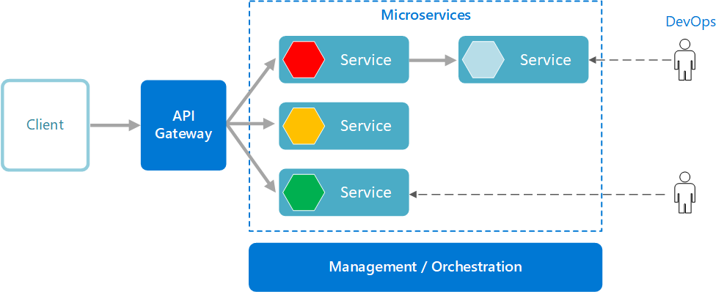
Microservice Architecture
Microservices are an approach where the collection of services has been developed and communicate over well-defined APIs.
Loosely coupled
Overcomes the complexity over the tightly coupled monolithic applications by defining independent services by using lightweight APIs

Slide 19
Microservices Architecture
Collection of independent services
Independently developed & deployable
Loosely coupled
High Reliability
Apart from monolithic, each service can be developed, deployed & scaled without affecting the others

Slide 20
Scaling
Used to increase or decrease the load across multiple instances
Scale up & scale down can be done based on the requirements to handle the load
When demand goes up, we want increase our resources
When demand goes down, we want to decrease our resource to save cost
Services can be scaled using 2 types
1) Vertical Scaling(scale up)
2) Horizontal Scaling(scale out)

Slide 21
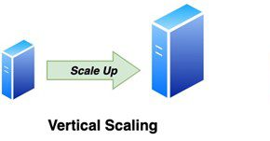
Vertical Scaling(scale up)
Increases the capacity of existing machine by adding more loads
Involves on the increasing the resources(CPU, RAM, memory, disk, etc..) of an existing microservice to handle additional load
Downtime may cause as all loads are processed on a single machine

Slide 22
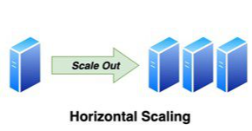
Horizontal Scaling(scale out)
Adding more machines with the same capacity for an existing services
Adding or reducing the number of virtual machines

Slide 23
Auto Scaling
Automated approach to increase or decrease the memory, capacity & resources they have allocated
By the auto scaling, when demand goes up, capacity of instances or load will be increased based on the condition
When demand goes down, capacity of instances or load will be decreased

Slide 24
Resilience in microservices
A microservice needs to be resilient to failures and must accept
Ability to recover from failure and continues the operation
If some service is failing or stopped, service must be either retry or provide circuit breaker and make sure of resilience
This can be achieved in 2 ways
1) Retry
2) Circuit breaker

Slide 25
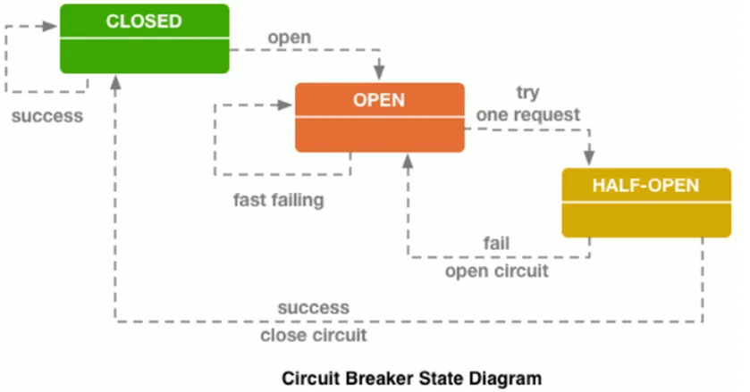
Circuit Breaker pattern
Monitors the communication between the services and tracks the error
When a service request fails repeatedly, the circuit breaker opens and cut off the communication
When it is open, it monitors the communication traffic and if service is successful, it closes

Slide 26
Load Balancer
Used to distribute Incoming traffic across multiple instances created
It ensures that no single instance is affected with too much traffic
Request will be sent to all the instances to handle the load
If one instance is failed, other instances will be available to respond
Ribbon(client-side load balancer) provides control over the service instances

Slide 27
API Gateway
Single Entry point for clients
Instead of calling services independently, client calls the API Gateway which forwards the call to respected services
API communication between client and services
Client can send the Request to the API Gateway then particular request goes to relevant service

Slide 28
Microservices saga pattern
It is a way to manage data consistency across microservices in distributed scenarios
Sequence of transaction that updates each service and gives the event or message to trigger the next transaction
The next transaction is initiated based on event’s outcome
If one transaction fails, saga executes and sends event to the previous transaction, and it should be rolled back
Compensating the transaction

Slide 29
Spring cloud & config
Provides an HTTP resource based API for external configuration
External configurations might be YAML or properties file
@EnableConfigServer is the annotation used to enable config server
External configuration file can be handled over the services

Slide 30
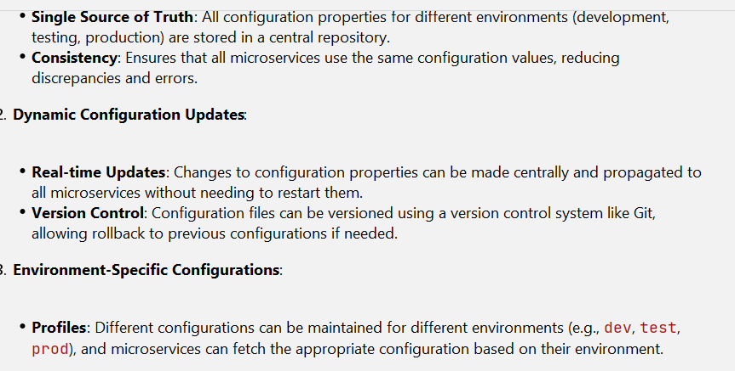
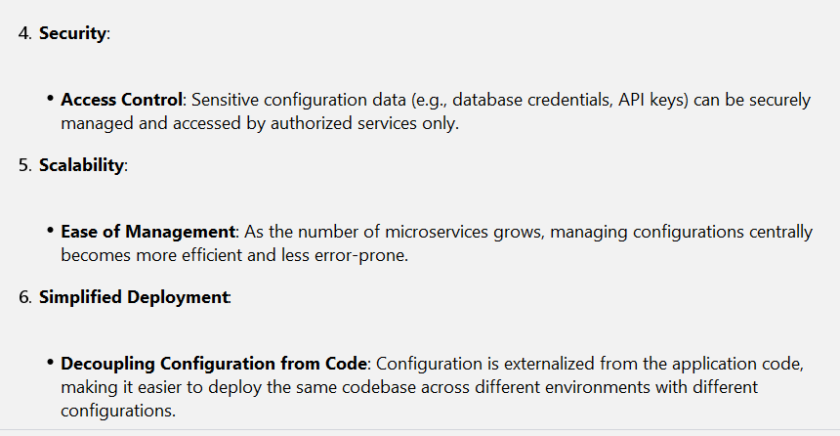
Spring cloud & config

Slide 31
PCF (Pivotal Cloud Foundry)
Basically, Cloud Foundry is an open-source platform on which developers can build, run, deploy & scale the applications
Moreover, PCF is an open-source cloud foundry platform which deploys the apps and deliver the experience to end users
Includes the new features
Continuous Delivery and deployment

Slide 32
Production-ready Features
Spring boot actuator provides production ready environments for spring boot applications.
Used to monitor and manage the application when MTP(move to production) happens by specific jms feed or http endpoints.

Slide 33
THANK YOU

