Slide 1
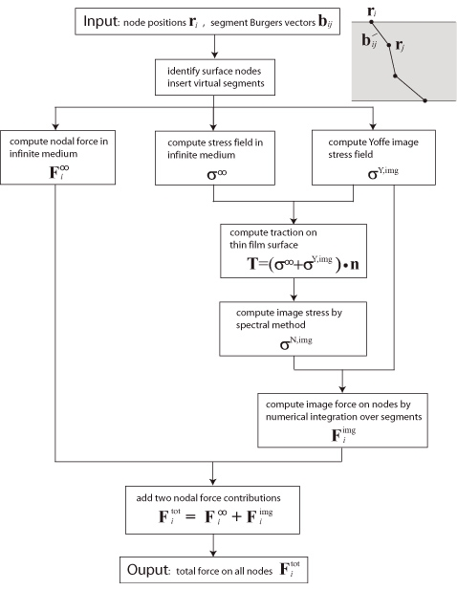
Figure 6 from Modelling dislocations in a free-standing thin film
Christopher R Weinberger et al 2009 Modelling Simul. Mater. Sci. Eng. 17 075007 doi:10.1088/0965-0393/17/7/075007

