Slide 1

Agentic RAG Chatbot for Multi-Format Document QA using MCP
Coding Round Project Submission
Technical Implementation for AI/ML Systems Role
October 2025 N.Sushanth

Slide 2
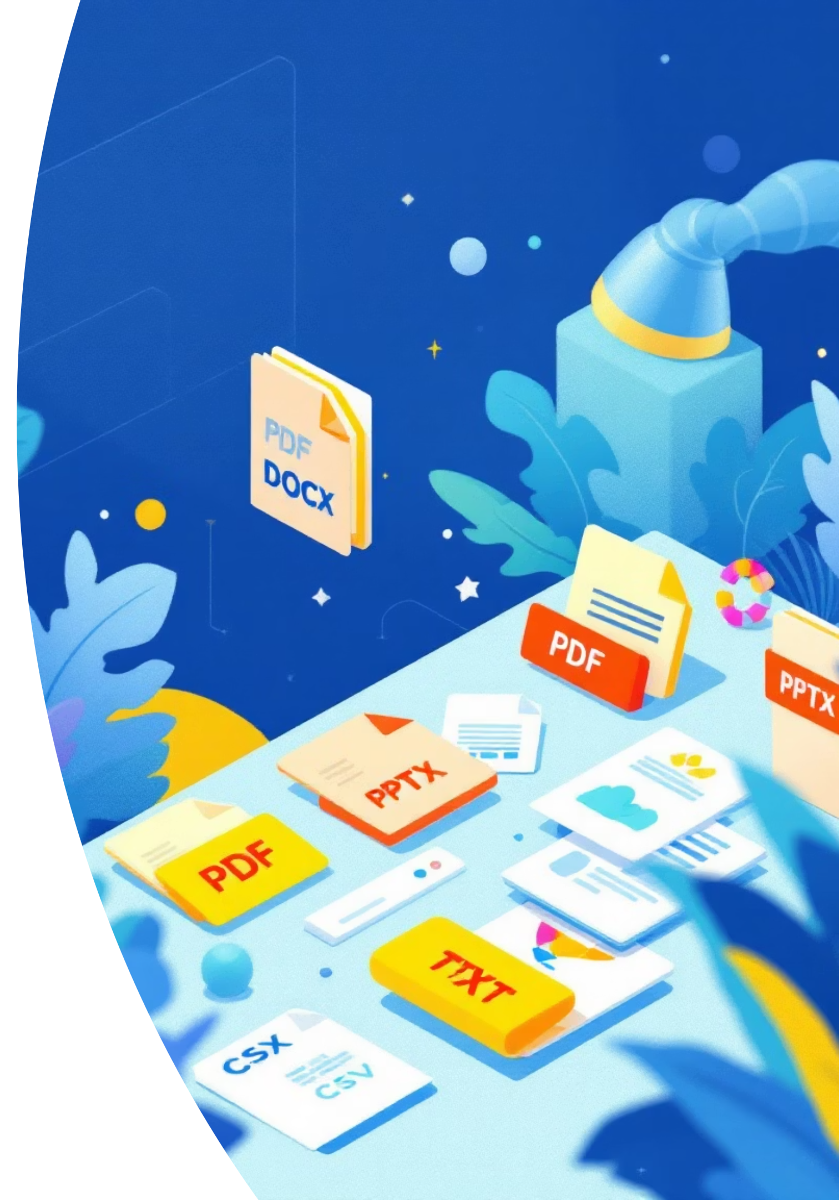
Problem Statement & Requirements
Multi-Format Support
Agentic Architecture
Build an intelligent RAG chatbot capable of processing and answering queries from uploaded documents across multiple file formats: PDF, DOCX, PPTX, CSV, and TXT files.
Implement a distributed agent system using Model Context Protocol (MCP) for structured communication between specialized components handling document ingestion, retrieval, and response generation.
Conversational Intelligence
Deliver context-aware, conversational responses that maintain coherence across multi-turn conversations while providing source attribution for transparency and verification.

Slide 3
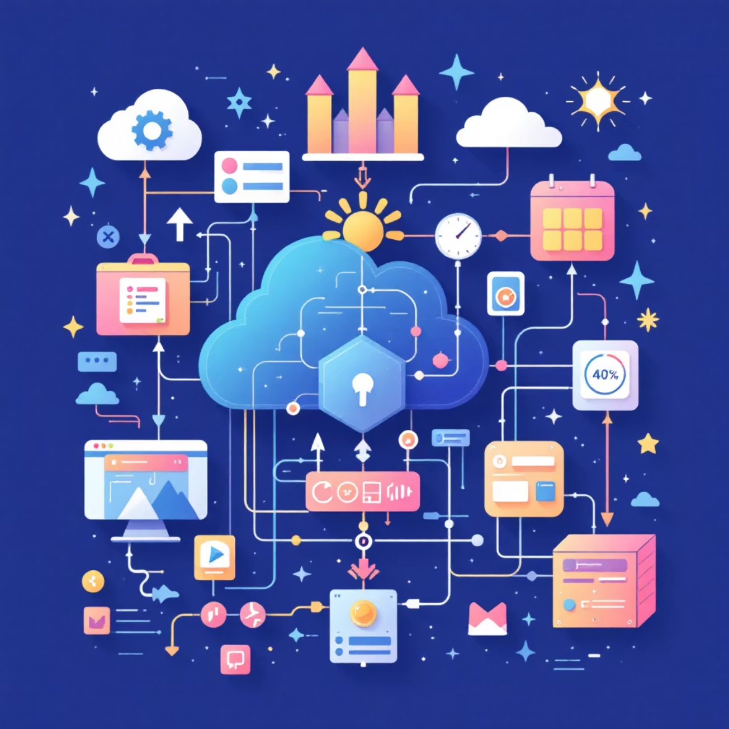
System Architecture Overview
Frontend Layer
Streamlit-based user interface providing intuitive file upload capabilities and real-time chat interaction. The interface maintains conversation history and displays source attributions for each response.
Backend Services
FastAPI-powered backend orchestrating three specialized agents:
IngestionAgent - Parses documents and generates embeddings
RetrievalAgent - Performs semantic search with reranking
LLMResponseAgent - Generates contextual responses using Gemini
Data Infrastructure
ChromaDB serves as the persistent vector store, while Google Gemini 2.5 Pro handles both embedding generation and response synthesis. MCP ensures structured, type-safe communication between all components.

Slide 4
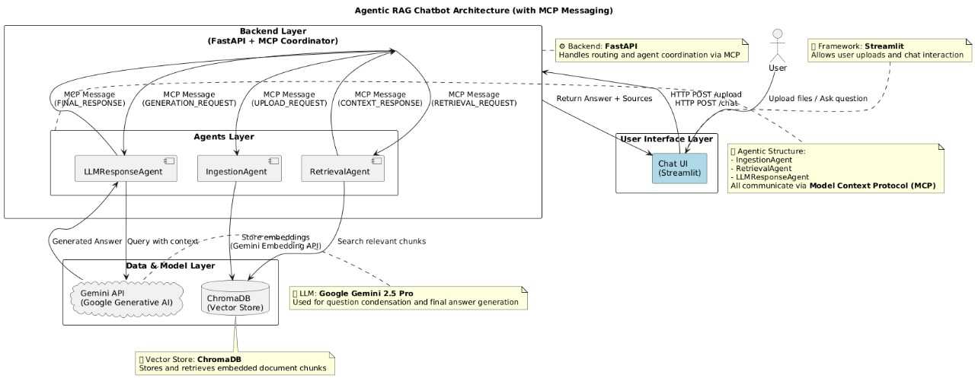

Slide 5

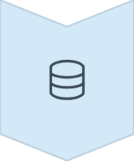



MCP Message Flow & Communication Protocol
Document Upload
User uploads documents through Streamlit UI, triggering MCP message to IngestionAgent for processing and embedding generation.
Vector Storage
Documents are parsed, chunked, and embedded using Gemini embedding model, then stored persistently in ChromaDB with metadata.
Query Processing
CoordinatorAgent receives user question and sends structured MCP message to RetrievalAgent for semantic search and context retrieval.
Response Generation
LLMResponseAgent receives context via MCP CONTEXT_RESPONSE message and generates final answer using Gemini with source attribution.
Example MCP Message Structure
{ "sender": "RetrievalAgent", "receiver": "LLMResponseAgent", "type": "CONTEXT_RESPONSE", "payload": { "query": "What KPIs were tracked?", "context": ["Slide 3: revenue growth...", "Doc: Q1 summary..."] }}

Slide 6
Technology Stack & Implementation Details
Layer
Technologies & Tools
Frontend
Streamlit for rapid UI development with file upload and chat components
Backend
FastAPI for high-performance async API endpoints and request handling
Agents
Python with LangChain for document processing, Pydantic for type validation
Vector DB
ChromaDB for persistent vector storage with metadata filtering capabilities
LLM
Google Gemini 2.5 Pro API for both embeddings and text generation
Protocol
Custom MCP implementation using Pydantic schemas for type-safe messaging

Slide 7
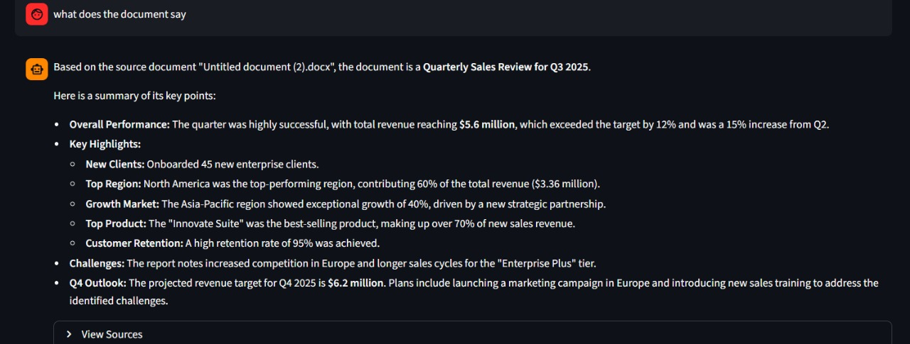
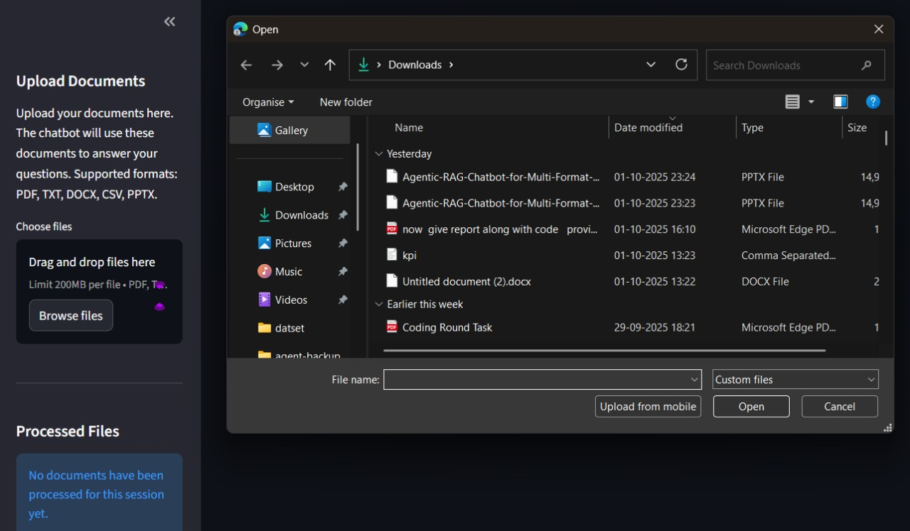
User Interface & Interaction Flow
Document Upload Interface
Interactive Chat Experience
Contextual Response Display
Real-time conversation interface displaying AI responses with clear source attributions. Users can ask follow-up questions while maintaining conversation context.
Each response includes relevant document excerpts, source file names, and confidence indicators, enabling users to verify information accuracy and explore source materials.
Intuitive sidebar allowing users to upload multiple documents simultaneously. Progress indicators show processing status and successful ingestion confirmation.

Slide 8
Technical Challenges & Engineering Solutions
Lost in the Middle Problem
Conversational Context
Challenge: The retrieval system worked for general queries but failed on metadata or references, as vector search prioritized body text while ignoring document edges.
Challenge: The chatbot lacked memory, so it could not handle follow-up questions and lost the context of previous conversations.
Solution: I used multi-query expansion to capture diverse chunks and re-ranking to prioritize the ones directly answering the user’s query.
Solution: I added a condense question step that rewrites follow-ups into complete standalone queries using the chat history, ensuring accurate retrieval.
Architecture & API Communication
Dependency Conflicts
Challenge: Separating frontend (Streamlit) and backend (FastAPI) introduced state and communication issues, like session mismatch and connection failures.
Challenge: Frequent version mismatches between libraries caused Import Errors and broke connections to Gemini models.
Solution: I used st.session_state to maintain session IDs and wrapped all API calls in error handling for reliable communication.
Solution: I enforced strict dependency control with requirements.txt and applied targeted upgrades alongside test scripts to isolate issues.

Slide 9

Future Enhancements & Project Deliverables
Planned Improvements
Complete Deliverables
Comprehensive GitHub repository with full source code
Open-Source LLM Integration: Replace Gemini with Mistral or Llama 3 for cost optimization and enhanced privacy
Detailed README with setup and deployment instructions
Technical presentation (this document)
User Management System: Implement authentication, user sessions, and document access controls
Optional 5-minute demonstration video showcasing architecture, code walkthrough, and live application demo
Performance Optimization: Add Redis caching layer for faster retrieval and response times
Production Deployment: Deploy on Hugging Face Spaces, Render, or AWS with auto-scaling capabilities
Additional Features
Real-time collaboration and document sharing
Advanced analytics and usage metrics
Custom embedding fine-tuning for domain-specific knowledge
Project demonstrates advanced understanding of agentic architectures, RAG implementation, and production-ready system design patterns essential for AI/ML systems engineering roles.

