Slide 1


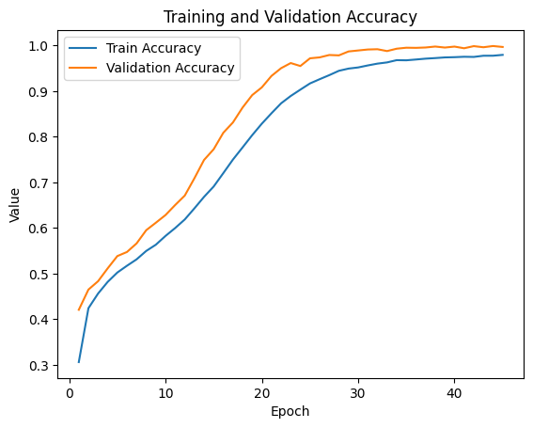
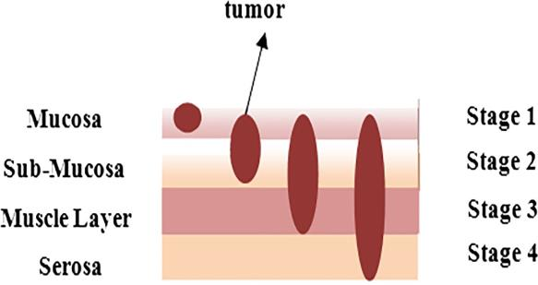
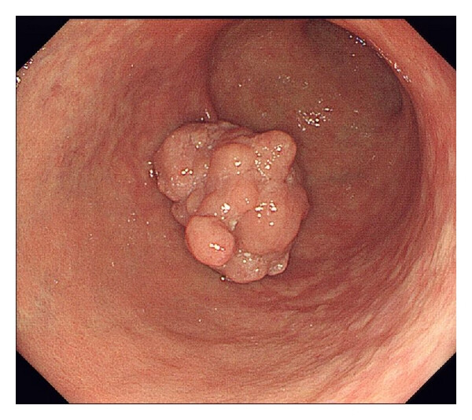
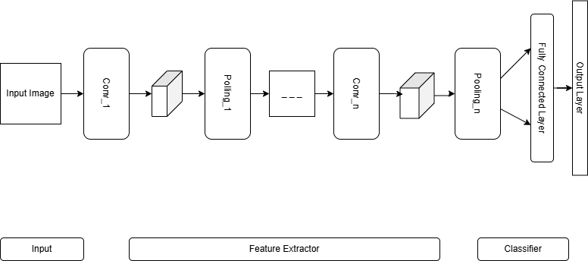
Enhancing Gastric Cancer Classification Using Optimised CNN Architecture.
REPLACE THIS BOX WITH YOUR ORGANIZATION’S
HIGH RESOLUTION LOGO
Y Sushanth Reddy , M Revanth
Vel Tech Rangarajan Dr. Sagunthala R&D Institute of Science and Technology.
Abstract
Results
Gastric cancer has always been a major cause of cancer-related mortality globally, where classification plays a vital role in improving patient health outcomes. Recent progresses in deep learning models, especially in Convolutional Neural Network (CNN), have demonstrated improved potential in image analysis of different healthcare-related areas, though problems still exist in optimizing deep models due to overfitting complications and computational costs. Therefore, in this study, a more efficient framework in classifying gastric cancers using optimized CNN models is provided to enhance classification accuracy without compromising models' efficiency. The proposed model utilizes various architectural optimizations that are essential to efficiently learn the discriminative features for gastric endoscopic and histopathological images. Moreover, experiments are performed using benchmark gastric cancer images to evaluate and validate that the proposed optimized CNN outperforms other conventional CNN and state-of-the-art approaches regarding various performance measures like accuracy, sensitivity, specificity, and F1 score.
The performance of the suggested optimized architecture for a CNN was better compared to the performance of other architectures for a CNN and current state-of-the-art methods for classifying gastric cancer cases. From the experimental results obtained on the test dataset for classifying gastric cancer cases, the optimized model showed good results in terms of classification accuracy.
Finally, the comparative analysis showed that, under identical conditions of training and testing, the proposed model performed better than baseline CNN architectures, such as standard CNN deep learning models. The improvements can be attributed to the optimized feature extraction capability and effective regularization strategies incorporated into the network architecture.
Fig Chart 2. Comparison of Training and Validation Accuracy.
Introduction
Gastric cancer is one of the most prevalent and deadly malignancies worldwide, accounting for a significant proportion of cancer-related morbidity and mortality. Despite advances in clinical diagnosis and treatment, the prognosis of gastric cancer patients remains poor, primarily due to late-stage detection.
In the last few years, artificial intelligence and deep learning methods have been identified as effective tools to carry out automated image analysis in medicine. Among these methods and tools, convolutional neural networks have attracted substantial interest in image classification problems.
In order to address these challenges, research on the optimization and customization of various CNN models to achieve a suitable balance between efficiency and performance is ongoing. Architectural optimization techniques have also been employed to boost the efficiency, robustness, and discriminability of the models.
Additionally, in this manuscript, an enhanced framework for the classification of gastric cancer is provided based on an innovative design for a CNN framework that effectively extracts important feature information from medical images concerning gastric patients.
Discussion
Based on the experimental results provided in this study, it can be validated that the optimized CNN model has a potential to enhance the classification performance of gastric cancers using deep learning models in comparison to other models traditionally used in practice.
The remarkable performance of this proposed model can be depicted through various optimized architecture strategies implemented in this study.
Compared with the current CNN architectures, the proposed model has generated improved performance within the same experimental conditions. These findings indicate that optimization of the model with regard to gastric images has played a crucial role.
Fig 1. Stages of Gastric Cancer.
Methods and Materials
Methods
The proposed gastric cancer classification approach employs an optimized convolutional neural network (CNN) architecture trained on annotated gastric medical images. The dataset was preprocessed by resizing all images to a uniform resolution, normalizing pixel intensity values, and enhancing image quality to improve feature visibility.
Materials
Dataset Description, Data Preprocessing, Optimized CNN Architecture, Model Training, Performance Evaluation Metrics, Comparative Analysis.
Fig 3. Cancer Cells of Gastric Cancer
Fig 4. Architecture diagram of Gastric Cancer.
Conclusions
This work presented an optimized CNN architecture for the classification of gastric cancer, which promises further accuracy, efficacy, and robustness as compared to existing models. It can be observed from the results presented that the approach holds promises regarding the feature extraction abilities of the designed model. There exists great promise regarding the use of the presented model for the diagnosis of gastric cancer.
Acknowledgments
References
Y. SUSHANTH REDDY, M. REVANTH
Vel Tech Rangarajan Dr. Sagunthala R&D Institute of Science and Technology
Email: VTU22734@veltech.edu.in
Phone:
Iizuka et al. (2020) proposed a deep CNN model for whole-slide gastric histopathology classification. Their method achieved over 90% accuracy using weakly supervised learning on large histopathological datasets.
Kanavati et al. (2021) created an endoscopic cancer classification system, which achieved better performance by applying EfficientNet transfer learning to small data sets.
Jang et al. (2021) created a CNN model that performs automated seg- mentation of gastric carcinoma pathological subtypes through analysis of whole-slide images. The research demonstrates that CNNs can perform detailed classification of gastric lesions.
Bhardwaj and his team published their research in 2024, which intro- duced advanced CNN models for gastric cancer diagnosis through trans- fer learning with EfficientNetB6 and DenseNet169 and hyperparameter optimisation. Their model achieved up to 99.88% accuracy in endoscopic image classification.
Ren, Y., Han, J., Luo, F. (2023). Explainable CNN framework for endo- scopic gastric lesion detection using Grad-CAM visualisation. Medical Physics, 50(5), 3221–3235.

