Slide 1
KL UNIVERSITY • BACHUPALLY CAMPUS, HYDERABAD
Department of Computer Science & Engineering
Retail Sales Forecasting
A machine-learning system that analyzes historical retail sales and forecasts future demand using time-series features and a Random Forest model.
PRESENTED BY
UNDER THE GUIDANCE OF
G. Bharadwaj Reddy [2520030533]
P. Sushanth Reddy[2520030576]
Dr.Raghavendra
Department of CSE
KLH Bachupally Campus
B.Tech II Year | Minor Project Review | Academic Year 2026–27 | Date: [Presentation Date]
Notes:
Model template - Minor Project review presentation for B.Tech II year. Replace every placeholder in angle brackets. Title slide: speak for 30 seconds - greet the panel, state the title, introduce the team and the guide. Do not read the slide word for word.

Slide 2
AGENDA
Contents
1
Introduction & Forecasting Domain
7
Methodology & Modules
2
Problem Statement & Motivation
8
Tools and Technologies
3
Literature Survey
9
Work Completed / Demo
4
Research Gap Identified
10
Timeline & Review Plan
5
Objectives of the Project
11
Expected Outcome & Conclusion
6
Proposed System Architecture
12
References
Dept. of CSE | KL University, Bachupally Campus
2
Notes:
Keep the agenda to one slide. In a 10-12 minute review, spend the most time on literature survey, objectives and work completed.

Slide 3

SECTION 1
Introduction & Forecasting Domain
HISTORICAL SALES DATA
Date • Store • Category • Sales
↓
FEATURE ENGINEERING
Calendar + Lag + Rolling Averages
↓
FORECAST MODEL
Random Forest Regression
↓
FUTURE SALES ESTIMATES
What is the domain?
Domain: Retail Analytics & Time-Series Forecasting
Retail sales forecasting estimates future sales from historical observations to support inventory, staffing and business planning.
Why is it relevant today?
Retailers need to anticipate changing demand, weekly patterns and seasonal peaks to reduce overstocking and stockouts.
Where does your project sit?
Our prototype analyzes daily sales by store and product category, creates calendar and lag features, and predicts future sales using a Random Forest regression model.
PROJECT SUMMARY
The project combines Python-based data processing, a Random Forest forecasting pipeline and a Streamlit dashboard for historical trends, model evaluation and future sales estimates.
Dept. of CSE | KL University, Bachupally Campus
3
Notes:
60-90 seconds. Start broad (the domain), end narrow (your specific task). Avoid definitions copied from Wikipedia - the panel will ask for the source.

Slide 4
SECTION 2
Problem Statement & Motivation
PROBLEM STATEMENT
Retail businesses may struggle to estimate future demand from historical sales, making inventory and operational planning less reliable when trends and seasonality are not considered.
1
2
3
Who is affected?
What is the cost of the problem?
Why solve it now?
Poor forecasts can contribute to excess inventory, stockouts, missed sales and inefficient allocation of resources.
Historical point-of-sale data can be analyzed with forecasting models and presented in dashboards that make trends and estimates easier to inspect.
Retail store managers and inventory planners need dependable estimates of upcoming sales for each store and product category.
Dept. of CSE | KL University, Bachupally Campus
4
Notes:
The problem statement must be ONE sentence. If you need two sentences, the scope is too wide for a minor project. The panel's first question is usually: who exactly benefits?

Slide 5
SECTION 3
Literature Survey
S.No | Author & Year | Title / Technique Used | Dataset / Tools | Key Findings | Limitation / Gap
1 | Hyndman & Athanasopoulos (2021) | Forecasting: Principles and Practice | Time-series forecasting methods | Explains trend, seasonality, evaluation and forecast workflow. | Method choice and accuracy depend on the data and context.
2 | Makridakis et al. (2018) | Statistical and ML forecasting methods | Forecasting competitions / method comparison | Highlights the need to compare forecasting methods empirically. | No single method performs best for every dataset.
Dept. of CSE | KL University, Bachupally Campus
5
Notes:
Do not read the table aloud. Speak about the trend: what most papers did, what results they reached, and what all of them left unsolved. Row 1 is a worked example - delete it and put your own paper there.

Slide 6
SECTION 4
Research Gap Identified
GAP 1
Basic summaries show past sales but do not directly estimate future demand.
OUR PROJECT ADDRESSES
GAP 2
The prototype organizes daily sales by store and category, engineers calendar and lag features, trains a Random Forest regressor, evaluates predictions on a chronological holdout set, and presents forecasts and error metrics in a dashboard.
Forecasting models can be difficult to assess without a time-ordered test set and clear error metrics.
GAP 3
Sales trends, calendar patterns and store/category differences need to be brought together in an accessible workflow.
Dept. of CSE | KL University, Bachupally Campus
6
Notes:
This is the slide that separates a good review from an average one. State 2-3 gaps only, and make sure each one maps to a paper you listed.

Slide 7
SECTION 5
Objectives of the Project
To prepare sales data: Load daily records, validate dates and sales values, and summarize sales by store and product category.
1
To build a forecasting model: Engineer calendar, lag and rolling-average features and train a Random Forest regression model.
2
To evaluate predictions: Use a chronological train/test split and calculate MAE, RMSE and WAPE without training on future observations.
3
To deliver an interactive dashboard: Display sales trends, forecasts and actual-versus-predicted results, with CSV export.
4
Dept. of CSE | KL University, Bachupally Campus
7
Notes:
Avoid vague verbs - study, understand, analyse. Use build, classify, detect, compare, deploy. Four objectives is the right number for a minor project.

Slide 8
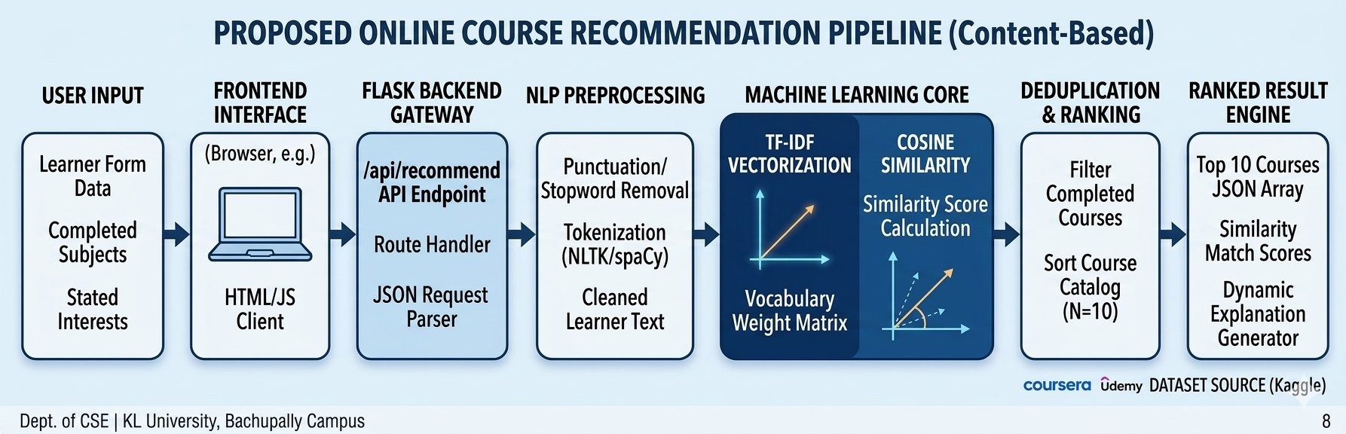
SECTION 6
Proposed System Architecture
DATA INPUT
DATA PREPROCESSING & FEATURES
FORECASTING MODEL
OUTPUT & EVALUATION
• Daily sales CSV with date, store, category and sales.
• Demonstration dataset currently uses synthetic values.
• Parse dates and numeric sales values; remove invalid records.
• Create day/week/month fields, lagged sales and rolling averages.
• Train a Random Forest regressor using earlier observations.
• Predict sales for each selected store/category series.
• Forecast daily sales for a selected store/category.
• Evaluate later dates using MAE, RMSE and WAPE.
• Parse dates and numeric sales values.
• Remove invalid or missing required records.
• Sort observations chronologically.
Workflow: CSV → validation and cleaning → exploratory analysis → calendar/lag features → chronological train/test split → Random Forest model → future forecasts and error metrics → Streamlit dashboard and CSV export.
Key implementation detail
The prototype uses Python, Pandas, scikit-learn and Streamlit. The included CSV is synthetic demonstration data; real retail data must be used before claiming real-world forecasting accuracy.
Dept. of CSE | KL University, Bachupally Campus
8
Notes:
Walk the panel through the diagram left to right in under a minute, naming the input and the output first. Be ready to say where your contribution sits.

Slide 9
SECTION 7
Methodology & Modules
1
Module 1 - Data Loading & Exploration
2
Module 2 - Feature Engineering
The CSV contains date, store, category and sales fields. The workflow checks required columns, parses dates, removes invalid values and visualizes overall and category-level sales trends.
Calendar features capture day-of-week and seasonal timing. Lag features (1, 7, 14 and 28 days) and rolling means summarize recent sales history.
3
Module 3 - Model Training & Evaluation
4
Module 4 - Dashboard & Forecasting
A Random Forest regressor is trained on the earlier 80% of each series and evaluated on the later 20%. MAE, RMSE and WAPE summarize holdout errors.
Frontend/dashboard: Streamlit with Plotly charts
Data/model: Pandas and scikit-learn
The user selects a store, category and forecast horizon, views predictions and downloads forecast values as CSV.
Dept. of CSE | KL University, Bachupally Campus
9
Notes:
One module per team member works well - it also answers the panel question 'who did what'.

Slide 10
SECTION 8
Tools and Technologies
SOFTWARE
HARDWARE / PLATFORM
Language: Python
Data processing: Pandas, NumPy
Machine learning: scikit-learn RandomForestRegressor
Visualization: Plotly and Matplotlib
Dashboard: Streamlit
Data format: CSV
Development environment: VS Code / Google Colab
Dependencies: requirements.txt
Platform: Windows / Linux / macOS
Runtime: Python 3.10+ recommended
RAM: 4–8 GB recommended
Execution: Local Streamlit web app
Browser: Chrome, Edge or Firefox
Data source: Included synthetic retail sales CSV
Future extension: Replace with verified real-world retail history
Dept. of CSE | KL University, Bachupally Campus
10
Notes:
Name versions where you know them. If you have a GitHub repository, show the link here - it is strong evidence of real work.

Slide 11
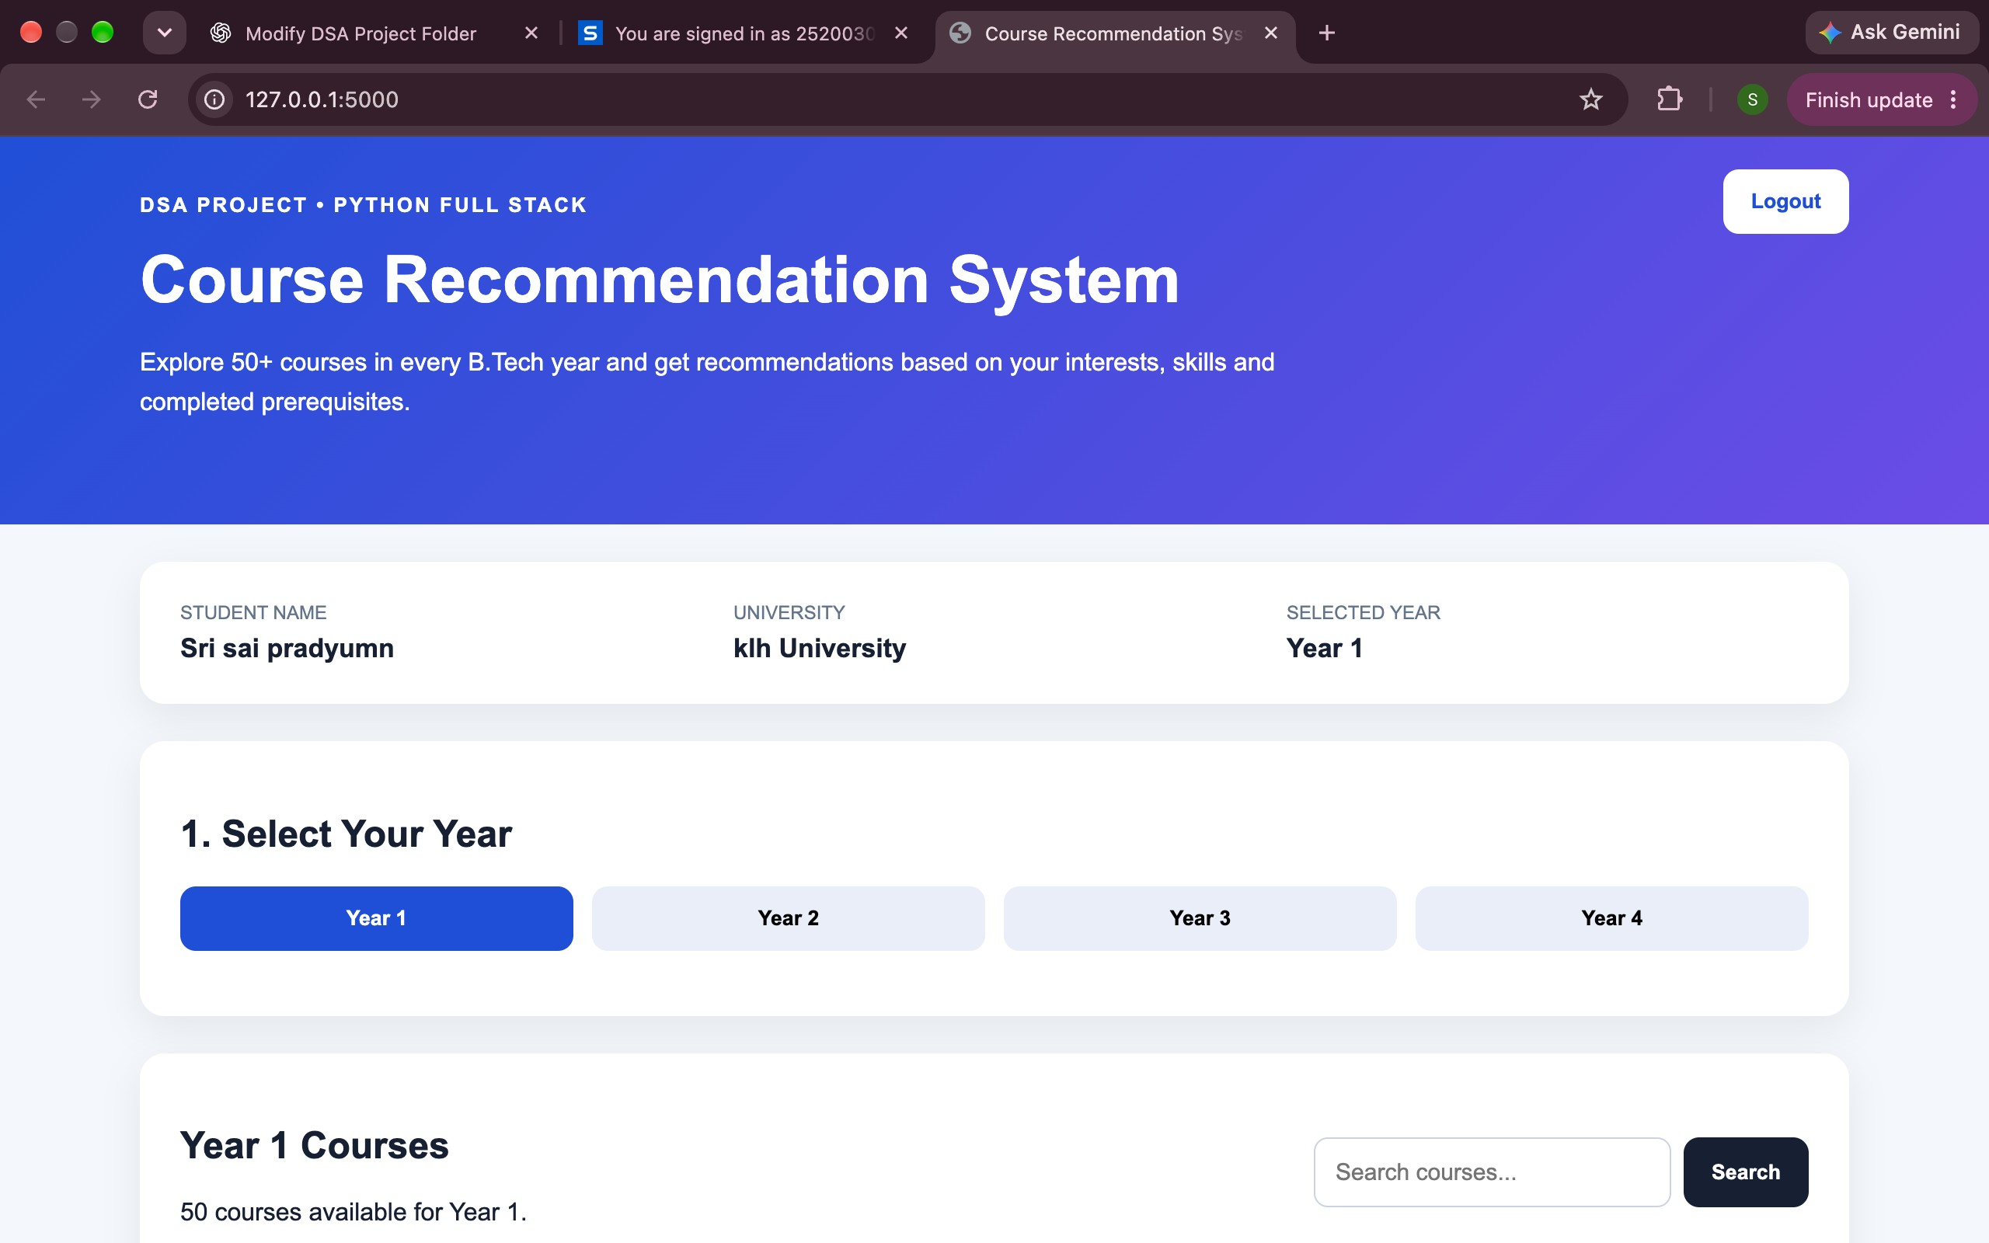
SECTION 9
Work Completed / Demo
Retail sales CSV & schema
Prepared (synthetic)
DEMO FEATURES
• View total and average daily sales
• Compare category sales and monthly trends
• Select store and product category
• Forecast sales for 7–90 days
• Inspect MAE, RMSE and WAPE on a holdout set
• Compare actual vs predicted sales
• Download forecast and filtered data as CSV
Data cleaning & EDA workflow
Implemented
Feature engineering pipeline
Implemented
Random Forest training workflow
Implemented
Interactive Streamlit dashboard
Implemented
Evaluation on real retail data
Pending
Dept. of CSE | KL University, Bachupally Campus
11
Notes:
Be honest about status. Panels reward accurate self-assessment and penalise claims that fall apart under one question.

Slide 12
SECTION 10
Timeline & Review Plan
Phase 1
Phase 2
Phase 3
Final
Data Preparation
Model Development
Dashboard Integration
Validation
Create calendar and lag features
Train a Random Forest regressor
Use a chronological train/test split
Calculate MAE, RMSE and WAPE
Connect data and model to Streamlit
Build trend and forecast charts
Add store/category/horizon controls
Enable CSV download
Test with real historical retail data
Compare with a simple baseline model
Review errors across categories
Prepare final demo and report
Define forecast target and project scope
Inspect the CSV schema and date coverage
Clean missing and invalid records
Explore store, category and time trends
Dept. of CSE | KL University, Bachupally Campus
12
Notes:
Adjust week numbers to your academic calendar. Showing a plan for the remaining weeks is what the panel wants to hear at Review 1.

Slide 13
SECTION 11
Expected Outcome & Conclusion
DELIVERABLE
MEASURABLE TARGET
BEYOND THE LAB
A web-based retail analytics dashboard for exploring sales history, forecasting future daily sales and downloading forecast results.
Evaluate the model on dates excluded from training using MAE, RMSE and WAPE. No real-world accuracy claim is made until the model is tested on verified retail data.
The system can support demand planning by helping users inspect historical patterns and compare estimated future sales across stores and product categories.
CONCLUSION
Retail Sales Forecasting uses historical daily sales and engineered time-series features to estimate future demand. The Random Forest model and Streamlit dashboard provide an end-to-end prototype for analysis, prediction and evaluation. Future work includes validation on real retail data, comparison with seasonal-naive and other forecasting methods, and adding promotions, prices, holidays and inventory information.
Dept. of CSE | KL University, Bachupally Campus
13
Notes:
Do not introduce anything new here. The conclusion restates the problem, the gap and the promise - nothing else.

Slide 14
SECTION 12
References
[1] R. J. Hyndman and G. Athanasopoulos, Forecasting: Principles and Practice, 3rd ed., OTexts, 2021.
[2] S. Makridakis, E. Spiliotis and V. Assimakopoulos, “Statistical and Machine Learning forecasting methods: Concerns and ways forward,” PLOS ONE, vol. 13, no. 3, 2018.
[3] L. Breiman, “Random Forests,” Machine Learning, vol. 45, pp. 5–32, 2001.
[4] F. Pedregosa et al., “Scikit-learn: Machine Learning in Python,” Journal of Machine Learning Research, vol. 12, pp. 2825–2830, 2011.
[5] Streamlit documentation, “Build data apps in Python,” https://docs.streamlit.io/.
[6] Project prototype: Retail Sales Forecasting — Python, Pandas, scikit-learn and Streamlit.
Dept. of CSE | KL University, Bachupally Campus
14
Notes:
Use Google Scholar's 'Cite' option and pick MLA/IEEE, then fix the formatting by hand. Never cite a blog, a YouTube video or a paper you have not opened.

Slide 15
Thank You
Team: [Team Number] | Guide: [Guide Name] | Dept. of CSE, KLH Bachupally Campus
Notes:
Keep the deck open on the architecture slide during questions - most panel questions point back to it.

