Slide 1
Estimation of co2 emissions FROM vehicles

Slide 2
Names
Sushanth Salpala - 1002166736
Sai Prasanna Rachakonda - 1002090739
Priyanka Aramadaka - 1002117658
Harshitha Kunchakuri - 1002111389

Slide 3
CONTENTS
Problem Statement
Motivation
Objective
Methodology
Model Exploration
Evaluation Criteria
PCA Results
Results
Project Outcomes and their Significance

Slide 4
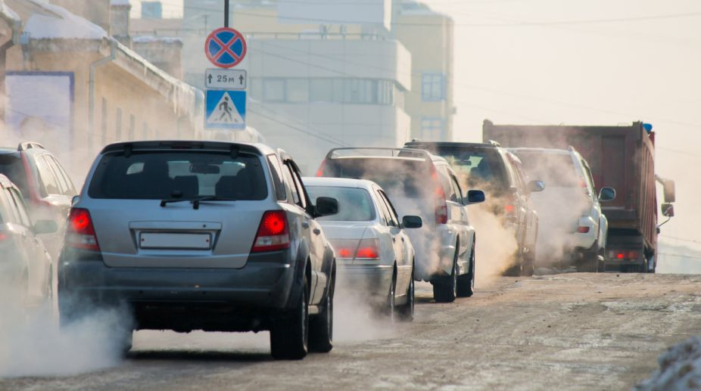
Problem Statement
Vehicles release a large amount of carbon dioxide into the air during operation, leading to CO2 emissions.
The transportation sector is the primary contributor to CO2 emissions, with vehicles playing a significant role.
Solutions to the problem of vehicle CO2 emissions include enhancing vehicle efficiency, adopting alternative fuels, and advancing low or zero-emission vehicle technologies.

Slide 5
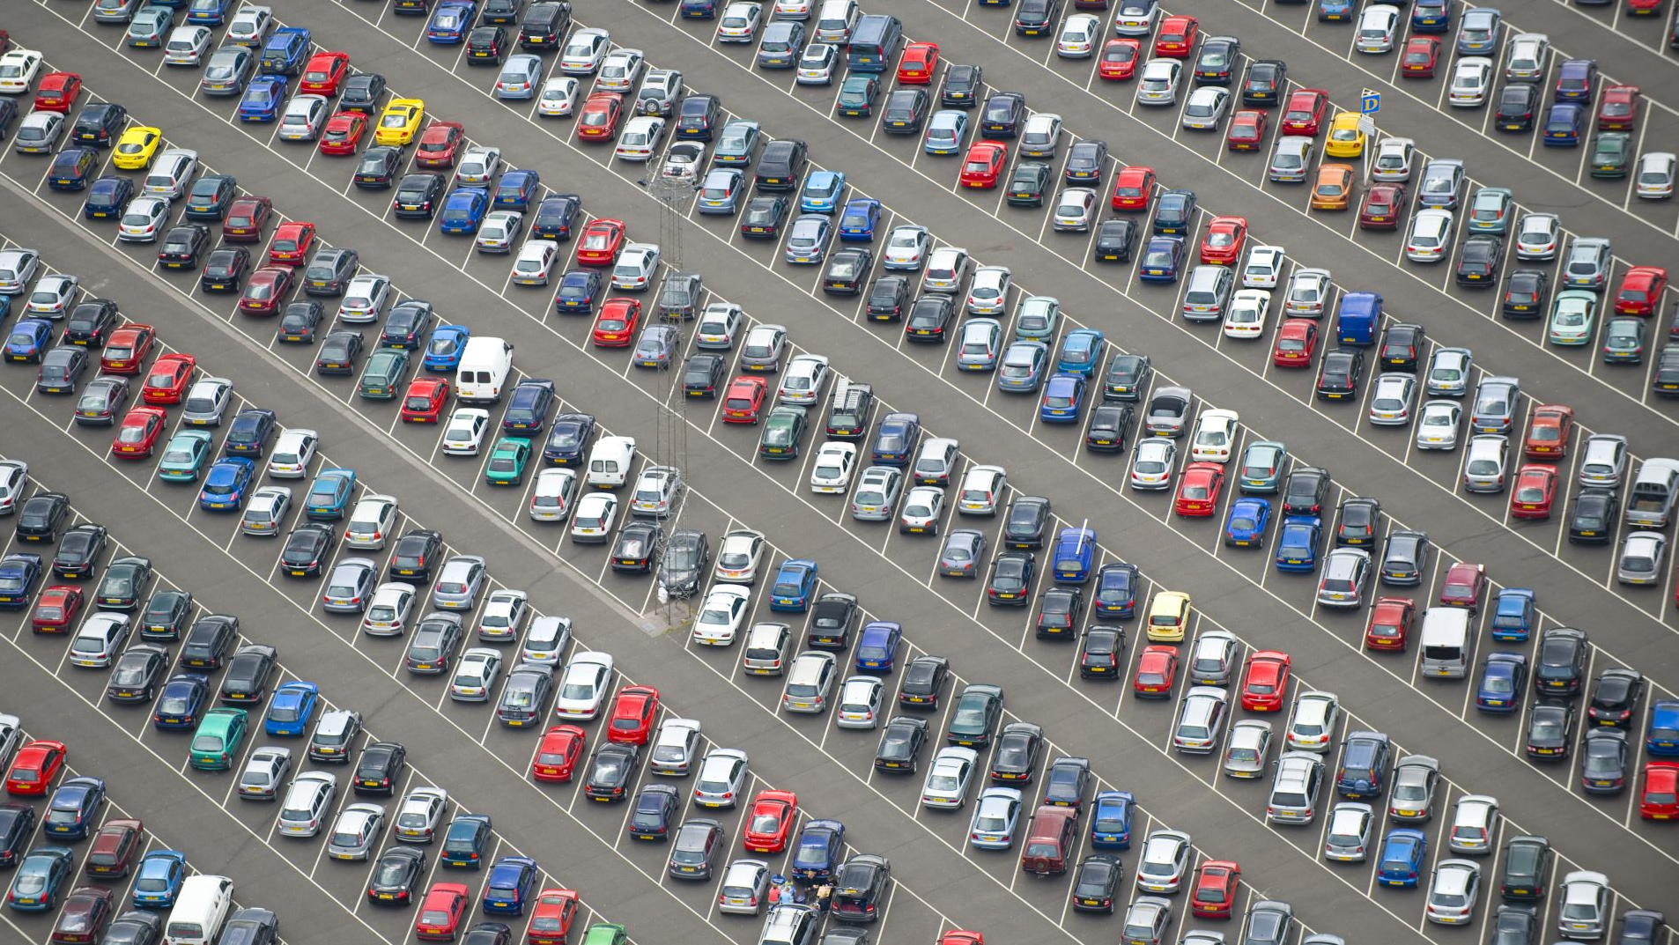
MOtivation
To address the pressing issue of carbon dioxide emissions from vehicles
Recognizing the substantial contribution of vehicles to environmental pollution
Urgent need to mitigate CO2 emissions from vehicles for a sustainable future
Project aims to tackle CO2 emissions through efficiency improvements, alternative fuels adoption, and zero-emission technology development

Slide 6
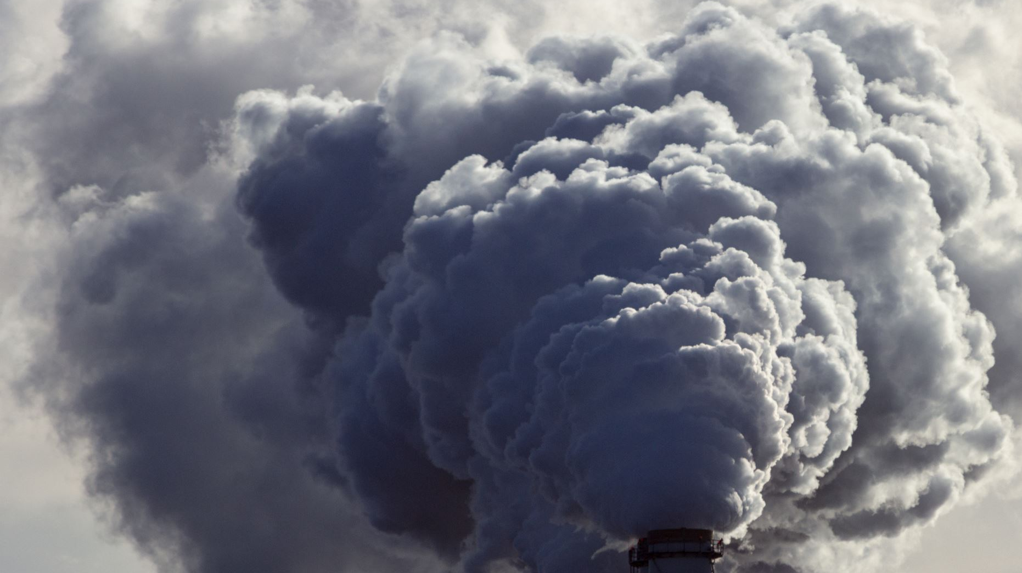
objective
Project’s primary aim is to predict the quantity of Carbon Dioxide emissions emitted by a vehicle, relying on its attributes like make and model, vehicle age, engine size and type, fuel category, and additional variables.
The objective is to construct a model capable of precisely predicting CO2 emissions and uncovering patterns or correlations that can guide efforts to decrease emissions.
Moreover, this model could serve fleet managers, environmental agencies, and researchers in comprehending the environmental consequences of vehicle fleets and implementing essential measures to mitigate them.

Slide 7
METHODOLOGY
Data
Exploratory Data Analysis
Transform Features
Perform PCA
Train Regression Models on PCs
Train Regression Models on Original Data
Evaluate Models
Select Best Model
Insights and Recommendation

Slide 8

MODEL EXPLORATION
Linear Regression:
Establishes a linear relationship between predictors and target variable using a linear equation.
Purpose is to find the most suitable line representing the relationship.
Advantages:
Easy to understand and simple.
Coefficients can be easily interpreted.
Capable of predicting target values based on predictors.
Disadvantages:
Assumes linear relationship between target and predictors.
Susceptible to multicollinearity.
Sensitive to outliers.

Slide 9
MODEL EXPLORATION
k-Nearest Neighbors (KNN) Regressor:
Predicts the value of a new data point by averaging the values of its k-nearest neighbors.
Advantages:
Easy to understand and simple.
Non-parametric algorithm.
Can handle both categorical and continuous variables.
Disadvantages:
Sensitive to the number of neighbors and choice of distance metric.
Requires a large training set for accurate predictions.
Susceptible to outliers and sensitive to feature scale.

Slide 10
MODEL EXPLORATION
Decision Tree Regressor
Creates a decision tree structure using predictors and assigns a continuous value to leaf nodes.
Advantages:
Works well in high-dimensional data.
Less sensitive to outliers compared to other regression algorithms.
Can use non-linear kernel functions.
Disadvantages:
Tends to overfit training data.
Prone to instability with small changes in training data.
Biased towards features with more levels, leading to potential inaccuracies.

Slide 11
MODEL EXPLORATION
Support Vector Regressor (SVR)
Identifies the hyperplane that best fits the data while maximizing margin between closest data points and hyperplane.
Advantages:
Easy to understand, interpret, and visualize.
Non-parametric algorithm.
Can handle non-linear relationships.
Disadvantages:
Tends to overfit training data.
Prone to instability with small changes in training data.
Biased towards features with more levels, leading to potential inaccuracies.

Slide 12
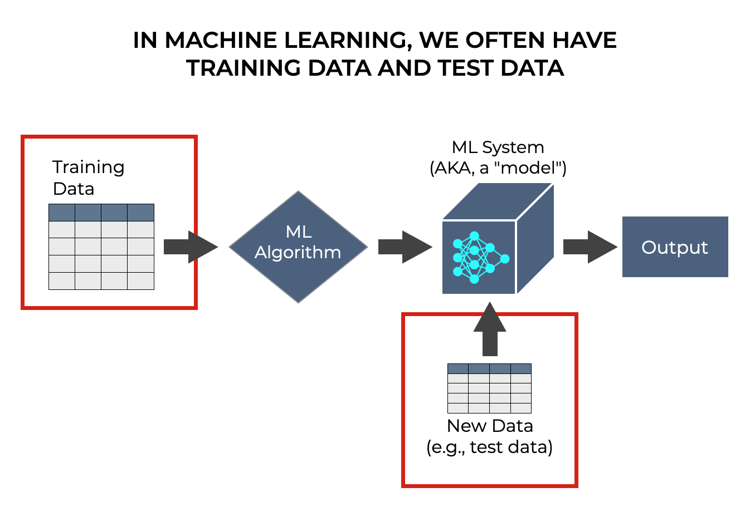
MODEL EVALUATION CRITERIA
T
To evaluate the effectiveness of our model, we partitioned our dataset into two segments: a training set encompassing 75% of the data, and a distinct test set holding the remaining 25%.
We utilized the training set to train our model and subsequently assessed its performance by applying it to the distinct test set.

Slide 13
RESULTS
Model | R2 Score | Adjusted R2 | RMSE | MAE
Linear Regression_PCA | 0.9032 | 0.9029 | 18.1910 | 11.4629
KNN Regressor_PCA | 0.9896 | 0.9896 | 5.9474 | 1.9754
Decision Tree Regressor_PCA | 0.9128 | 0.9125 | 17.2654 | 10.1384
Support Vector Regressor_PCA | 0.8555 | 0.8551 | 22.2196 | 8.6581
Linear Regression | 0.9920 | 0.9919 | 5.2383 | 3.0748
KNN Regressor | 0.9943 | 0.9943 | 4.4091 | 1.8234
Decision Tree Regressor | 0.9472 | 0.9467 | 13.4353 | 8.8842
Support Vector Regressor | 0.8804 | 0.8793 | 20.2178 | 9.1711

Slide 14
Existing results
Model | R_Squared | RMSE | MAPE | MBE | rRMSE | MABE
ANN | 0.886 | 20.243 | 0.067 | 12.333 | 8.253 | 16.51
SVM | 0.889 | 19.991 | 0.064 | 10.449 | 8.15 | 15.734
SVM_tuned | 0.858 | 22.544 | 0.071 | 10.399 | 9.191 | 17.585
DNN | 0.89 | 19.885 | 0.064 | 11.992 | 8.107 | 15.814
DecisionTree | 0.99 | 5.928 | 0.014 | 3.097 | 2.417 | 3.5
DecisionTree_tuned | 0.99 | 5.971 | 0.015 | 3.081 | 2.434 | 2.694
RandomForest | 0.99 | 5.982 | 0.014 | 3.116 | 2.438 | 3.538
RandomForest_tuned | 0.99 | 5.92 | 0.015 | 3.085 | 2.414 | 3.612
GradientBoostingRegressor | 0.993 | 4.867 | 0.015 | 2.925 | 1.984 | 3.639
GBClassifier_tuned | 0.993 | 4.939 | 0.015 | 3.045 | 2.014 | 3.745
XGBoostRegressor | 0.993 | 4.907 | 0.015 | 2.907 | 2 | 3.69
XGClassifier_tuned | 0.993 | 4.895 | 0.014 | 3.063 | 1.995 | 3.633

Slide 15
Comparison
The comparison between the existing and new model results clearly shows that the new models perform better overall.
They consistently have higher R-squared values, which means they're better at explaining the data.
Their RMSE and MAPE values are lower, indicating they're more accurate in predicting outcomes.
The Linear Regression and KNN Regressor models in the new set stand out for their exceptional performance.
The fact that the new models have been fine-tuned adds to their effectiveness in making predictions.
Overall, these findings highlight the significant improvement in predictive accuracy and reliability offered by the new models.

Slide 16

PROJECT OUTCOMES AND THEIR SIGNIFICANCE
Our developed model provides a practical tool for estimating a vehicle's carbon dioxide emissions based on its characteristics.
Valuable for vehicle manufacturers, fleet managers, and policymakers to make informed decisions.
Supports the development of more fuel-efficient vehicles and promotes low-emission technologies.
Enables individuals and organizations to consider both fuel efficiency and environmental impact when purchasing vehicles.

Slide 17
REFERENCES
Ramlah Abdulmalik, Gautam Srivastava; Forecasting of Transportation-related CO2 Emissions in Canada with Different Machine Learning Algorithms, Advances in Artificial Intelligence and Machine Learning; Research 3 (3) 1295-1312 Received 10-05-2023; Accepted 27-07-2023; Published 4-08-2023.
Al-Nefaie AH, Aldhyani THH. Predicting CO₂ Emissions from Traffic Vehicles for Sustainable and Smart Environment Using a Deep Learning Model. Sustainability. 2023; 15(9):7615. https://doi.org/10.3390/su15097615.
Rao C., Zhang Y, Wen J, Xiao X, Goh M. Energy Demand Forecasting in China: A Support Vector Regression-Compositional Data Second Exponential Smoothing Model. Energy.2023;263:125955.
Josephine PK, Prakash VS, Divya KS. Supervised Learning Algorithms: A Comparison. Kristu Jayanti Journal of Computational Sciences (KJCS). 2021:1-12.
Junepyo, C.; Park, J.; Lee, H.; Chon, M.S. A Study of Prediction Based on Regression Analysis for Real-World CO₂ Emissions with Light-Duty Diesel Vehicles. Int. J. Automot. Technol. 2021, 22, 569–577.
Nguyen H, Bui XN, Bui HB, Cuong DT. Developing an XGboost Model to Predict Blast-Induced Peak Particle Velocity in an Open-Pit Mine: A Case Study. Acta Geophys. 2021;69:1743-1755.

Slide 18
THANK YOU

