Slide 1

ASTROSAGE
Call Center Operations
Analytics Report
DEC 2023 – JAN 2024
BY SUSHANT KUMAR
05-06-2026

Slide 2
Problem Statement
The Trigger
High website traffic generating massive volume of calls & chats
The Friction
Operational bottlenecks leading to poor customer experiences
The Impact
Failing to convert interactions into top-tier service—hurting revenue
Completion Rate:
Only 19.7%
6/15/2026

Slide 3
Key Objectives
●
Low Completion
Only 19.7% sessions completed (5,535/28,027)
●
Calls > Chat
Calls drive 78.7% of ₹2.14L total revenue
●
Top Earner Risk
"Ruchi" dominates; over-reliance on few astrologers
●
Mid-Week Peaks
Wednesdays & Fridays see highest traffic
●
Poor Ratings
Avg 3.8/5, and 7,256 sessions left unrated
6/15/2026

Slide 4
Data Overview
28,027 Sessions • 19.7% Completion • ₹2.14L Revenue • Dec 2023 – Jan 2024
SNAPSHOT
ANALYTICAL APPROACH
Calls (78.7%) dominate
60+ active astrologers
Avg rating: 3.8/5
Gurucool leads: 72.2%
Top earner: Ruchi (₹1,536)
Analyzed 28K+ records by type, revenue, ratings & trends. Segmented by platform & day-of-week. Used charts to identify splits & patterns. Focused on gaps & dependencies.
6/15/2026

Slide 5
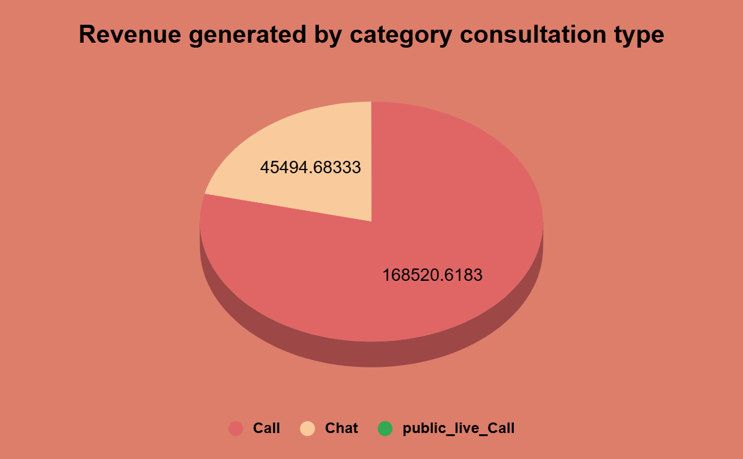
Sum of Amount by Call & Chat
KEY INSIGHTS
Call consultations generate the majority of revenue (₹168.5K), significantly outperforming other consultation types.
Chat consultations contribute ₹45.5K, representing a smaller share of total revenue.
Revenue is heavily dependent on Call consultations, making it the key revenue-driving service.
6/15/2026

Slide 6
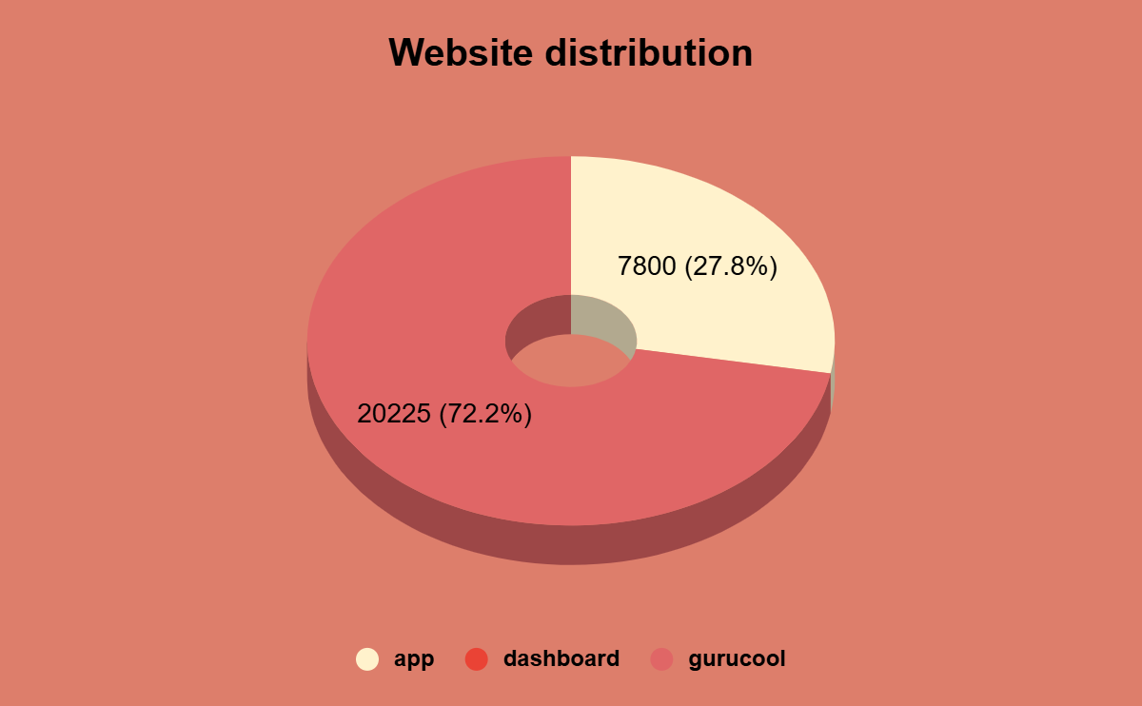
Website Distribution
KEY INSIGHTS
Dashboard is the primary traffic source, contributing 72.2% of total interactions.
App contributes 27.8% of total traffic, significantly lower than Dashboard.
User engagement is heavily concentrated on the Dashboard platform, indicating it is the preferred access channel.
6/15/2026

Slide 7
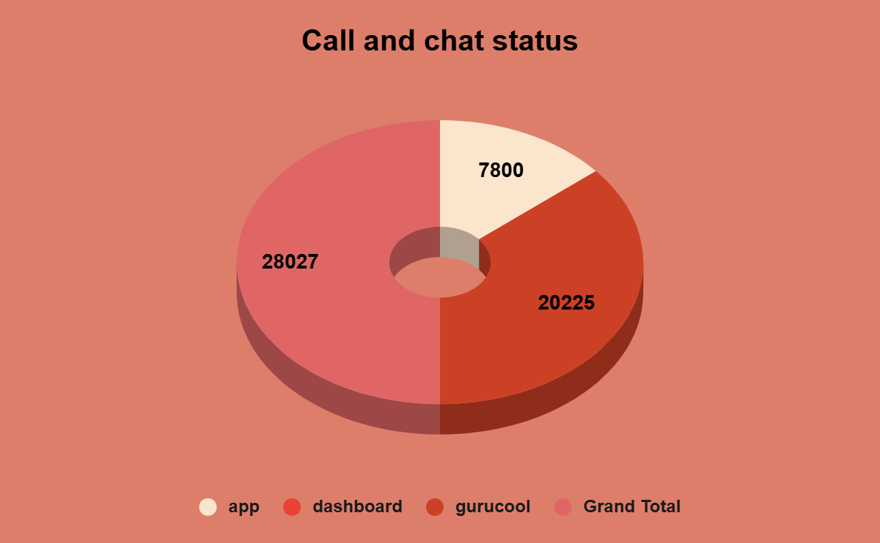
Call and Chat Status
KEY INSIGHTS
Grand Total contributes the largest share with 28,027 interactions.
Dashboard channel records strong engagement with 20,225 interactions.
App channel has the lowest contribution with 7,800 interactions.
6/15/2026

Slide 8
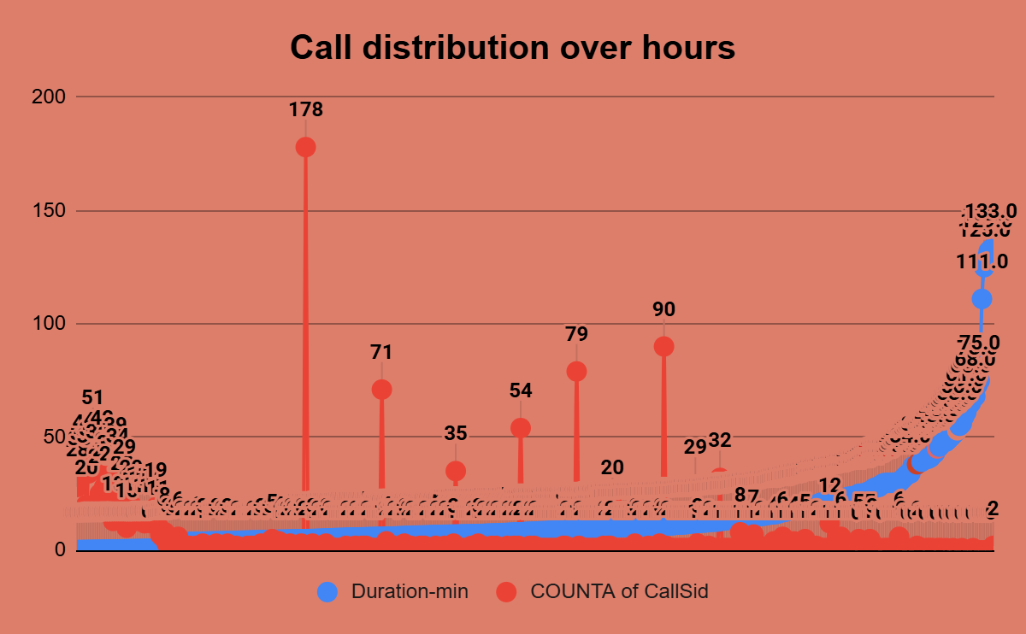
Call Distribution Over Hours
KEY INSIGHTS
Peak call volume occurs in a single hour with 178 calls, indicating the busiest period of the day.
Call activity is concentrated during specific hours, while most hours experience relatively low volumes.
Significant fluctuations in hourly calls suggest varying customer demand throughout the day.
6/15/2026

Slide 9
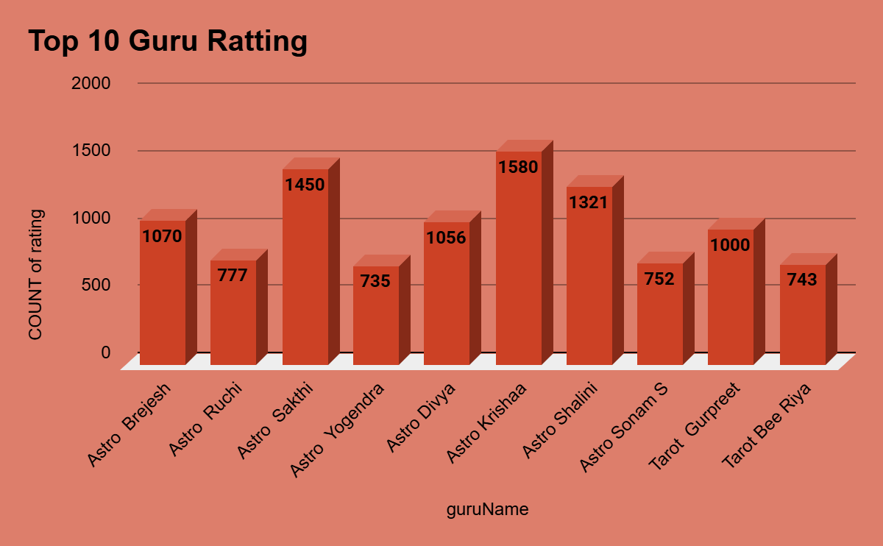
Top 10 Guru Ratting
KEY INSIGHTS
Astro Krishna leads with the highest rating count (1,580).
Top 3 gurus (Krishna, Sakhi, Shalini) dominate user ratings.
Astro Yogendra, Tarot Bee Riya, and Sonam S have the lowest rating counts among the top 10
6/15/2026

Slide 10
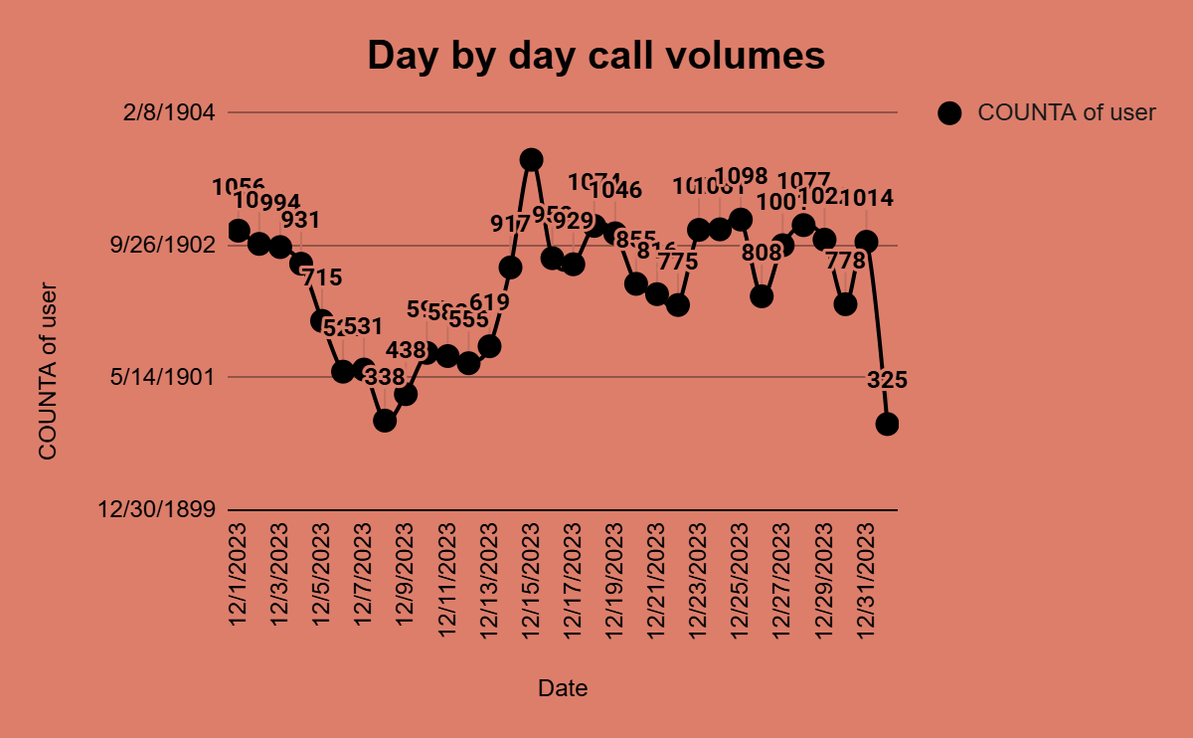
User Activity by Date
KEY INSIGHTS
High Fluctuation: Volumes vary from 138 to 1,098 calls.
Peak December 2023: Highest activity over 1,000 calls.
Lowest May 1901: Minimum at ~138 calls.
6/15/2026

Slide 11
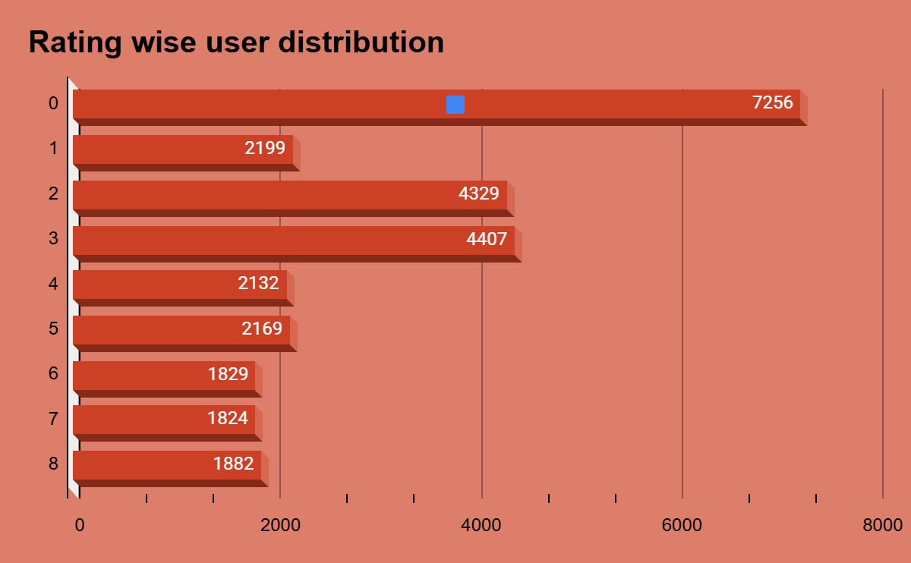
Rating Wise User Distribution
KEY INSIGHTS
Rating 0 Dominates: 7,256 users with zero rating (majority).
Mid-Range Peak: Ratings 2-3 have 4,329-4,407 users (second highest).
Higher Ratings Low: Ratings 6-8 have lowest counts (~1,800 users each).
6/15/2026

Slide 12
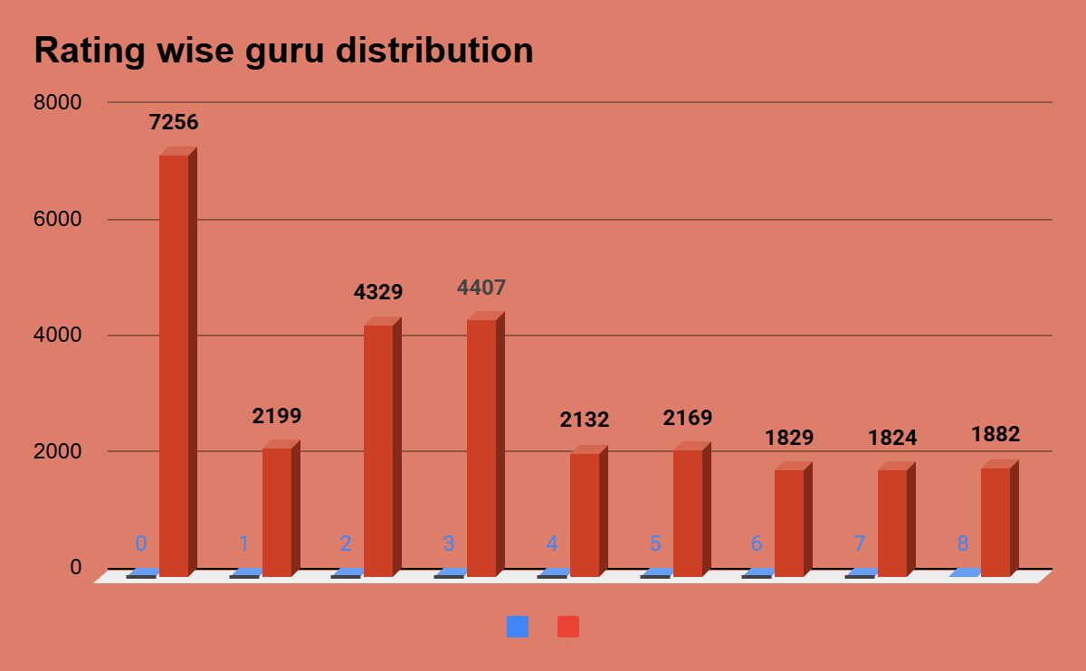
Rating Wise Guru Distribution
KEY INSIGHTS
Rating 0 Highest: 7,256 gurus with zero rating (dominant).
Ratings 2-3 Second: 4,329-4,407 gurus concentrated here.
Blue Category Minimal: Blue bars negligible across all ratings.
6/15/2026

Slide 13
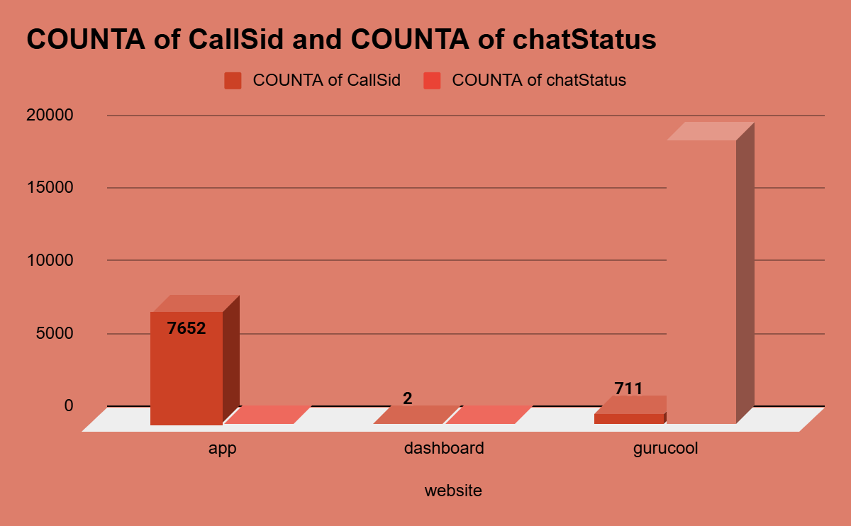
Website Distribution - Call/Chat Status
KEY INSIGHTS
Gurucool Dominates: chatStatus reaches ~19,000 (highest overall).
App High CallSid: 7,652 calls on app platform.
Dashboard Minimal: Lowest activity across both metrics.
6/15/2026

Slide 14
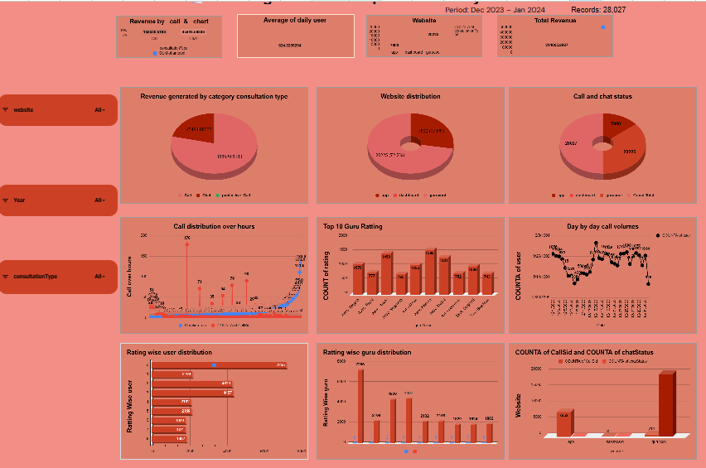
Dashboard
6//26

Slide 15
Key Recommendations
01
Improve Astrologer Quality
Targeted training to boost ratings above 3.8/5
02
Boost Completion Rate
Better engagement strategies to improve from 19.7%
03
Enhance Peak Day Staffing
Increase availability on Thursdays & Fridays
04
Expand Rating System
Increase post-session prompts and incentivize feedback
6/15/2026

Slide 16
Conclusion
Platform Performance:
28,027 sessions with 19.7% completion—consistent growth across Dec 2023–Jan 2024
Revenue Driver:
Calls at 78.7% indicate critical need for capacity and astrologer investment
Operational Priority:
Gurucool dominance (72.2%) & Thursday–Friday peaks demand better scheduling
Growth Focus:
Low ratings (3.8/5) & engagement gaps require quality training and feedback systems
6/15/2026

