Slide 1

Agentic AI Document Processor
-Sushant Mutta (Data & AI Intern)

Slide 2
Problem Statement — The Critical Gap in Agentic AI Healthcare
Healthcare is increasingly deploying autonomous AI agents for appointment scheduling, consultation summaries, prescription drafting and lab-report interpretation. Generated documents, however, may contain hallucinated dosages (15–20% risk), extreme clinical safety violations, missing regulatory fields (DEA, signatures), date inconsistencies and HIPAA PHI leaks.
Consequences: patient harm, legal exposure, regulatory fines (~$1.5M avg) and provider mistrust (68% hesitant without validation).
Scope: Validate AI-generated documents, detect critical clinical errors, enforce HIPAA, provide audit trails and human approval gateway. Not a diagnostic or primary prescribing agent.

Slide 3
Our Solution — Agentic Validation Pipeline
A LangGraph-based multi-agent validation system that functions as a Quality Assurance layer for autonomous healthcare AI.
Validate
Detect
Confirm document type, structure and core clinical fields.
Identify life‑threatening errors, extreme dosages and date inconsistencies.
Redact & Repair
Audit & Escalate
Auto-redact 18 HIPAA identifiers and auto-repair minor format issues.
Produce compliance-ready traces and route critical cases to humans.

Slide 4
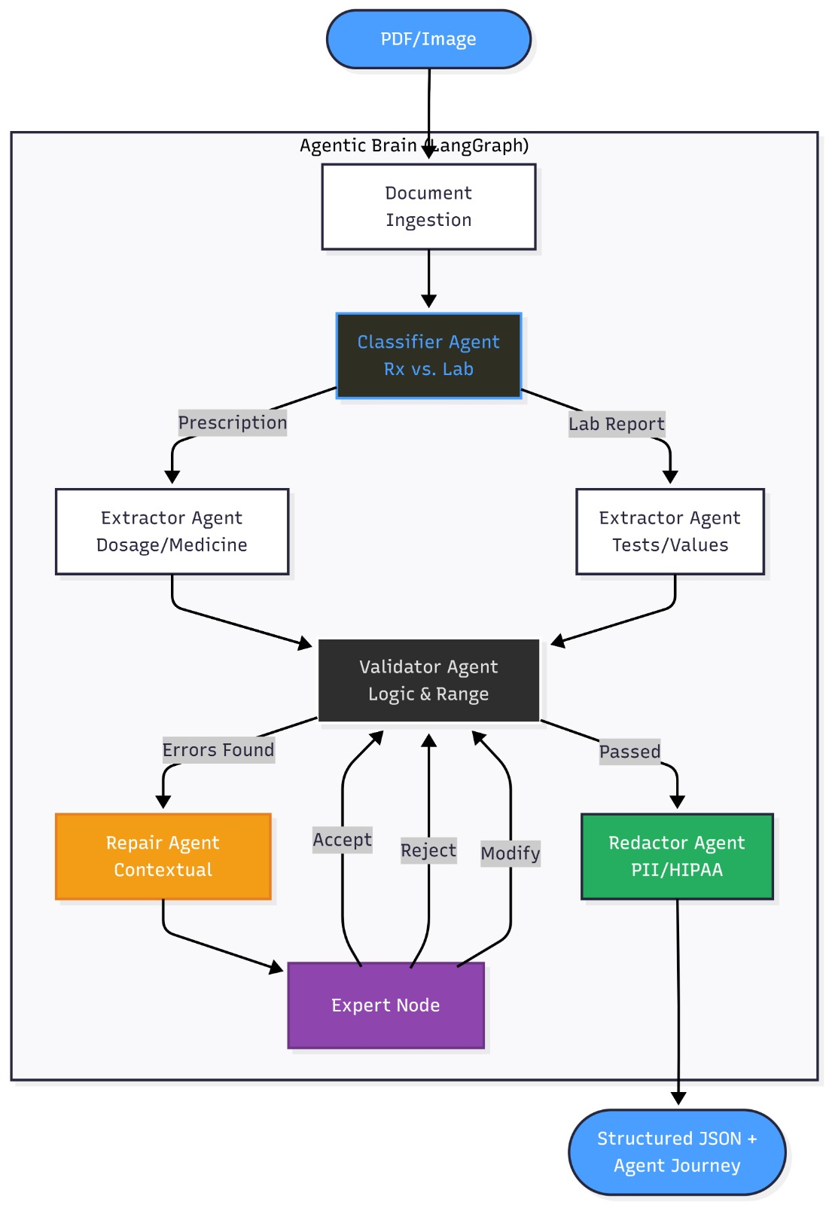
High-Level Architecture — Workflow Overview
End-to-end flow that enforces safety and compliance at every step.

Slide 5
Code Snippets
Design maps directly to typed state and modular nodes so implementation mirrors architecture.
ValidationState (example)
LangGraph Nodes
cclass DocState(TypedDict):
raw_text: str
file_path: str
doc_type: Optional[str]
extracted_data: Optional[dict]
validated_data: Optional[dict]
validation_flags: List[dict] # Critical validation alerts
redacted_text: Optional[str]
errors: List[str]
trace_log: List[dict]
repair_attempts: int
builder.add_node("classifier", classifier_agent) builder.add_node("extractor", extractor_agent) builder.add_node("validator", validator_agent) builder.add_node("repair", repair_agent) builder.add_node("redactor", redactor_agent) builder.add_node("reporter", reporter_agent)
Conditional routing: builder.add_conditional_edges("validator", route_based_on_errors)

Slide 6
Clinical Validation Engine — Deep Dive
01
02
Date Consistency
Extreme Dosage Detection
if report_date < collection_date → flag "Report date cannot be earlier".
if dosage_mg_per_kg > 50 → severity = "CRITICAL". Unit standardisation applied first.
03
04
Critical Lab Values
DEA & Format Checks
if value > (3 * upper_reference_range) → severity = "CRITICAL".
dea_pattern = r"^\[A-Z\]{2}\\d{7}$" plus regex + Pydantic + domain rules.
Layered validation: structural regex → typed validation → clinical domain rules. Pathologist signature heuristics and missing-reference detection included.

Slide 7
HIPAA Compliance — Two‑Phase PII Engine
Phase 1 — LLM Detection
Phase 2 — Verified Redaction
Detects 18 PHI types: NAME, MRN, PHONE, SSN, ADDRESS, EMAIL, and others.
Example: John Smith → [NAME_REDACTED]; MRN123456 → [MRN_REDACTED]. Verification step ensures redacted_text contains every detected value; metrics computed automatically.
Automated metrics: PII Recall = Redacted / Detected. PII Precision = Correct tags / Total tags. System self-verifies—no manual labelling required for operation.

Slide 8
Evaluation & Performance
>95%
>95%
>95%
>95%
Extraction Accuracy
PII Recall
PII Precision
Workflow Success
Robustness: edge-case handling ~88%, DEA & critical-value detection 100%. Primary LLM: Groq(llama-3.3-70b-versatile). Uptime: 99.8%.

Slide 9
Salient Features
Agent-of-Agents
Self‑Healing Repair Loop
Validation architecture mirrors upstream agents, enabling modular policy updates and clear responsibility boundaries.
Auto-fixes for units/formatting with up to 3 retries before escalation.
Human‑in‑the‑Loop
Audit‑Ready Traceability
Switchable modes: Auto mode for throughput, Review mode for high‑risk documents.
JSON execution traces, CSV metrics and LangSmith observability for compliance and incident review.

Slide 10
Business & Clinical Impact
Cost & Speed
Scale & Safety
Processing cost reduced ~97% (from $15–25 → $0.50 per doc). Throughput improved ~95% (manual 5–10 mins → automated 20–30s).
Scales 100× (small pilots → enterprise volumes). Clinical rule coverage for critical validations at 100% for tested rule sets; improves provider trust and reduces liability.

Slide 11
Scope for Future — Roadmap & Vision
Phase 3
Phase 2
EHR/EMR FHIR integration, drug-interaction cross-checks, confidence-based routing, multi-language support, blockchain audit logs.
Multi-page and batch validation, handwriting recognition, image/chart validation, real-time upstream feedback.
Final vision: a trusted validation backbone enabling safe AI autonomy, regulatory confidence and broad provider adoption—scalable, auditable and production‑ready.

