Slide 1
Topic: Proving the Benefit of using Recycled Plastic by Knapsack Algorithm
Roll No. 16010121106
16010121119
16010121121

Slide 2
Problem Statement
Proving the Benefit of using Recycled Plastic by Knapsack Algorithm.
Knapsack Algorithm will help us give an optimized outcome of both problem and solution vividly.
We will give out statistics and a knapsack optimal solution in which we will get to know how recycling of plastic from plastic waste will cost less than generating new one from its raw material cost
From this a clear picture mindset of recycling the plastics rather than generating new will come out which will help to prevent Plastic Pollution thereby helping in contribution to Plastic Waste Management

Slide 3
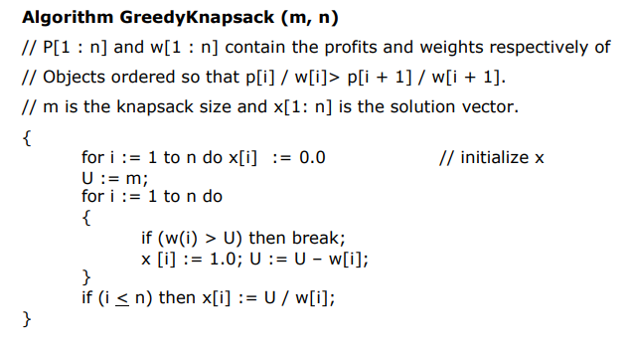
Knapsack Algorithm

Slide 4
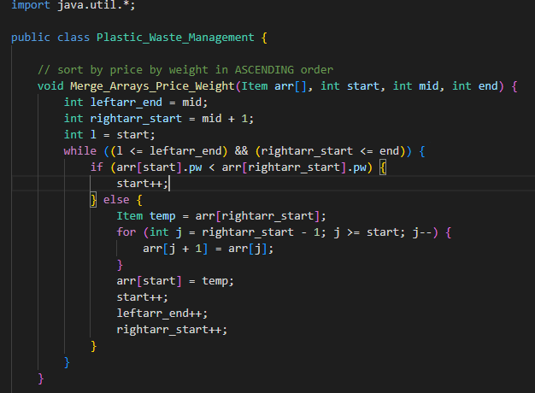
Implementation

Slide 5
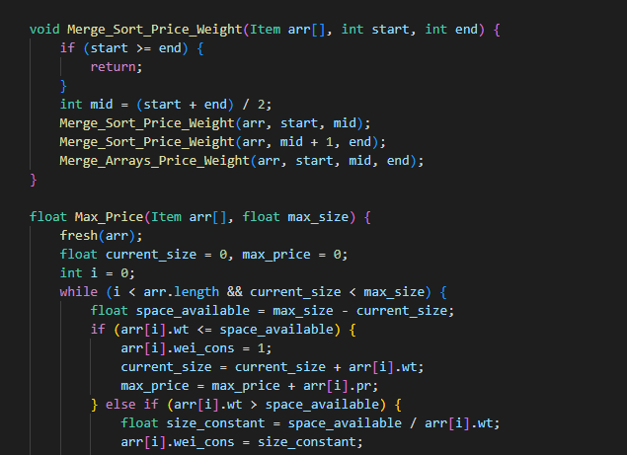
Implementation

Slide 6
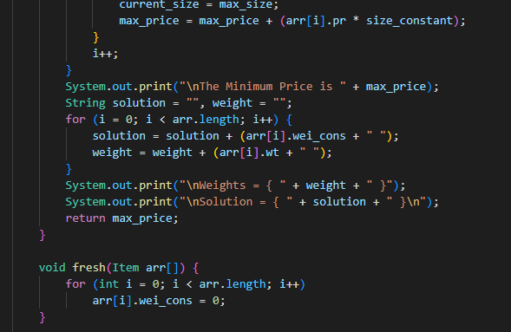
Implementation

Slide 7
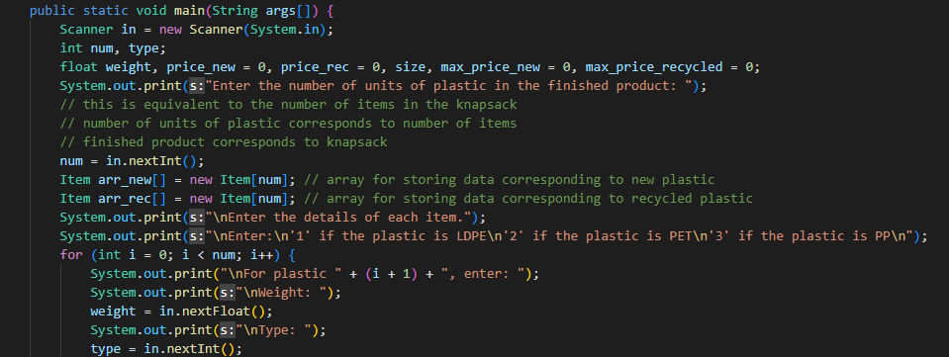
Impementation

Slide 8
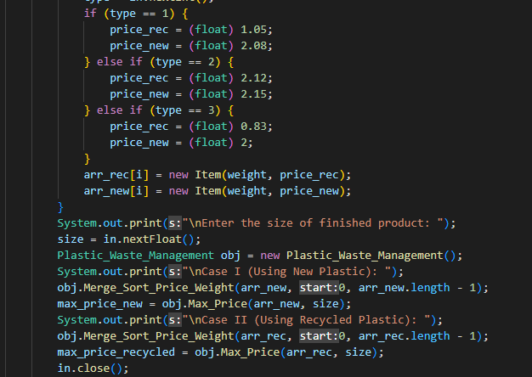
Implementation

Slide 9
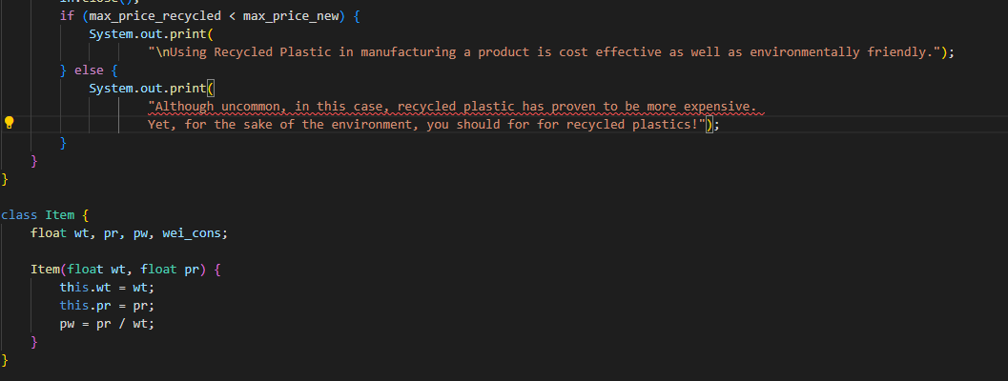
Implementation

Slide 10
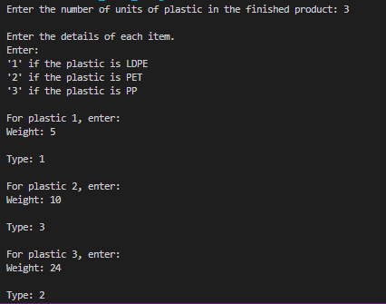
Output

Slide 11
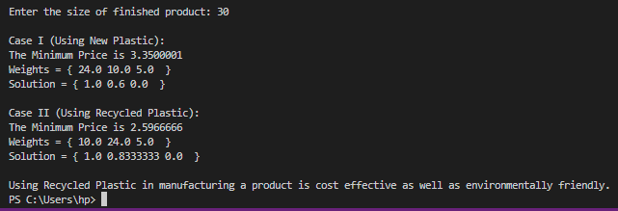
Output

Slide 12
Conclusion
We carried out some problems using the knapsack algorithm and compared fresh plastic and recycled plastic to achieve results.
We compared the prices by keeping the same weights of each of them and solved it using Knapsack Algorithm.
We concluded that compared to fresh plastic, recycled ones are comparatively cheaper and could help beat plastic problems.

Slide 13
Conclusion
In order to reduce the waste plastic problem what we can do is to adopt the principles of waste prevention.
Waste prevention undoubtedly needs to be a central theme of social responsibility.
Plastic Waste management is turning out to be major concerns for everyone and this methodology can be useful to control the usage of plastic and beat the plastic pollution.

