Slide 1


OOPM IA-2
16010121119 Sahil Nagarkar
16010121121 Sushant Nair

Slide 2
HOSTEL MANAGEMENT SYSTEM
Problem Statement
OOPM Features used
Implementation Details
Result

Slide 3
Problem Statement
Hostel Management System: To accept student details from user and to allot rooms to students based on hostel capacity. This program also allows you to add or delete a record and then display the final result.

Slide 4
OOPM Features Used
Inheritance: Inheritance in Java is a mechanism in which one object acquires all the properties and behaviors of a parent object. It is an important part of OOPs (Object Oriented programming system). The idea behind inheritance in Java is that you can create new classes that are built upon existing classes.
Vectors: Vector is like the dynamic array which can grow or shrink its size. Unlike array, we can store n-number of elements in it as there is no size limit.

Slide 5
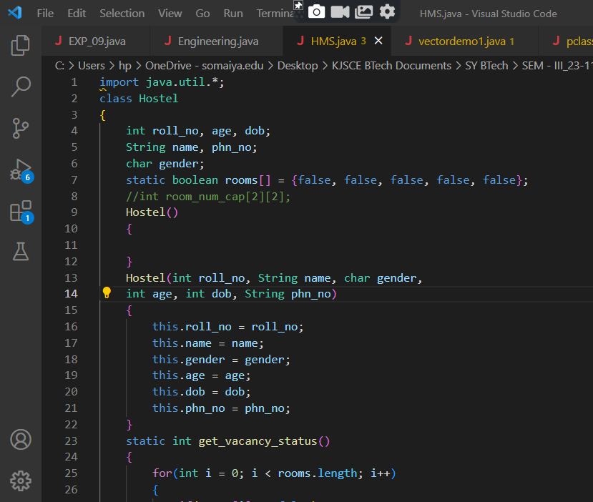
IMPLEMENTATION DETAILS

Slide 6
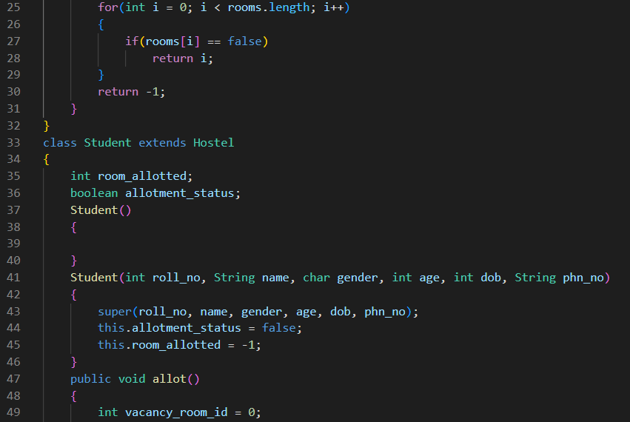

Slide 7
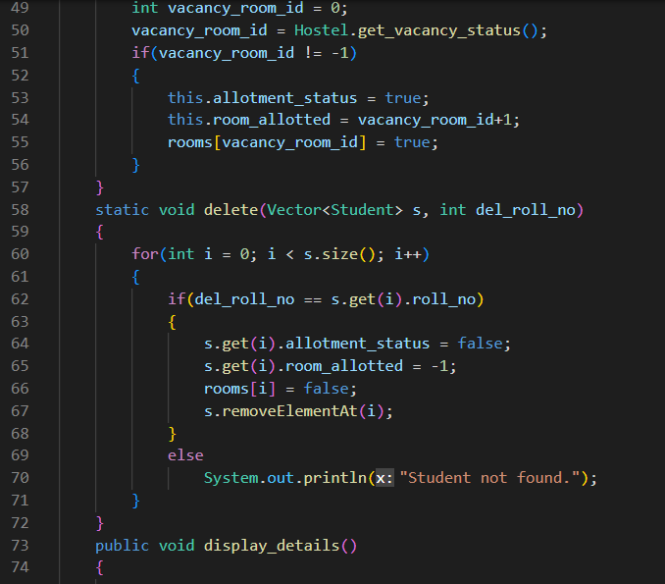

Slide 8
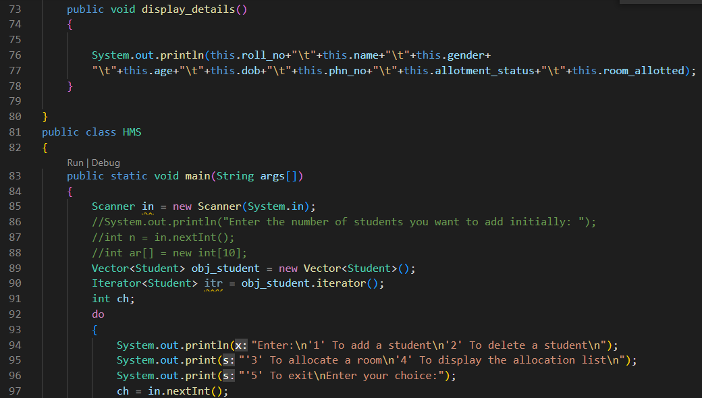

Slide 9
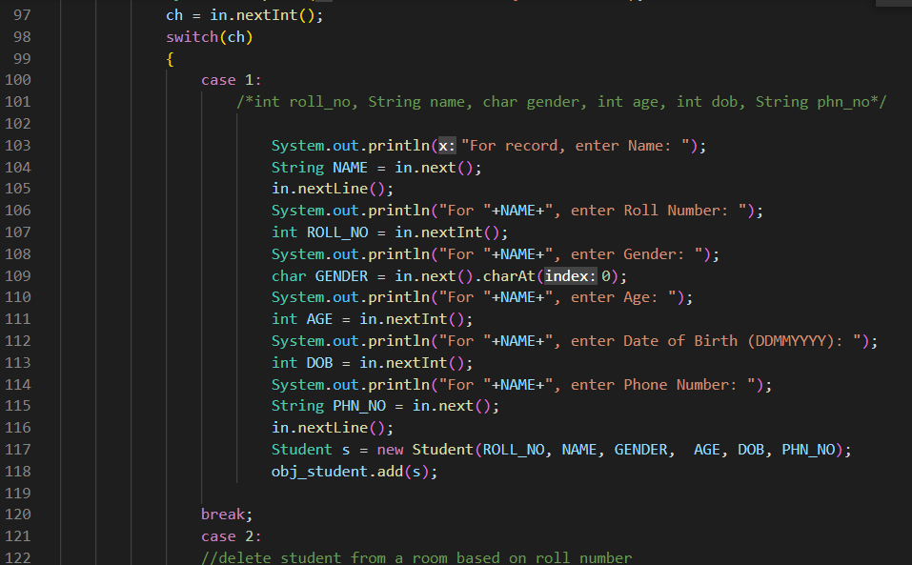

Slide 10
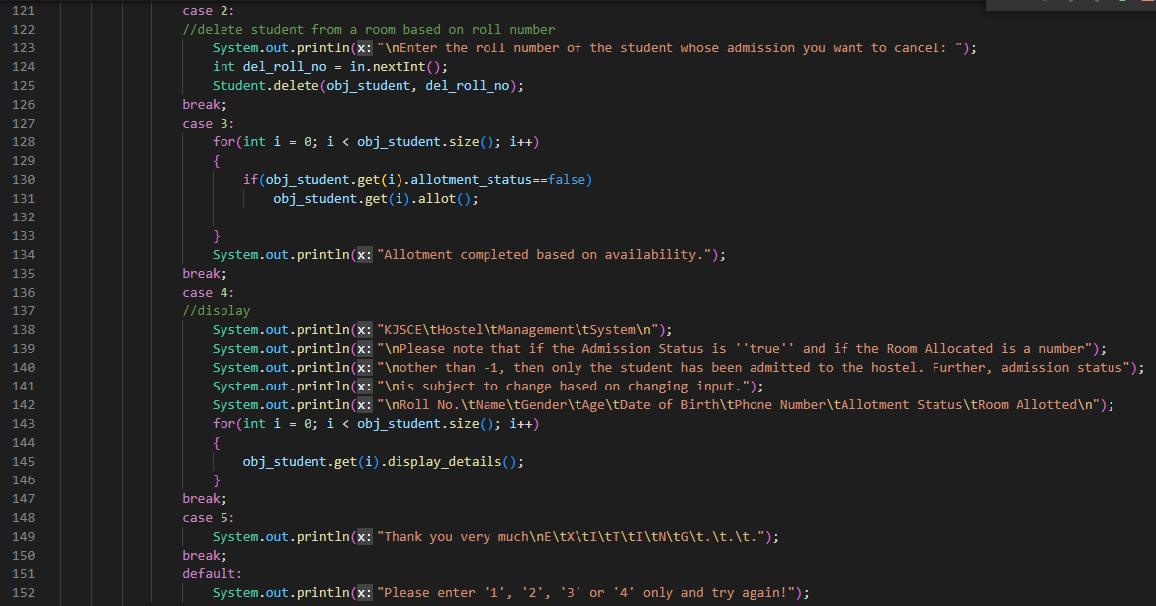

Slide 11
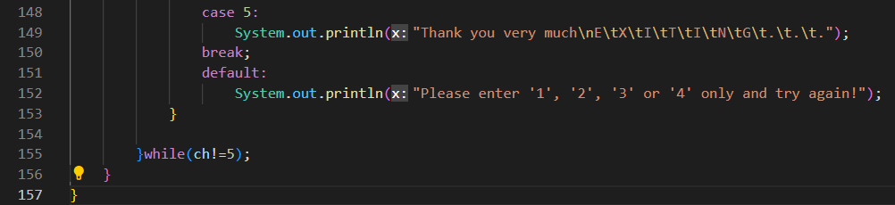

Slide 12
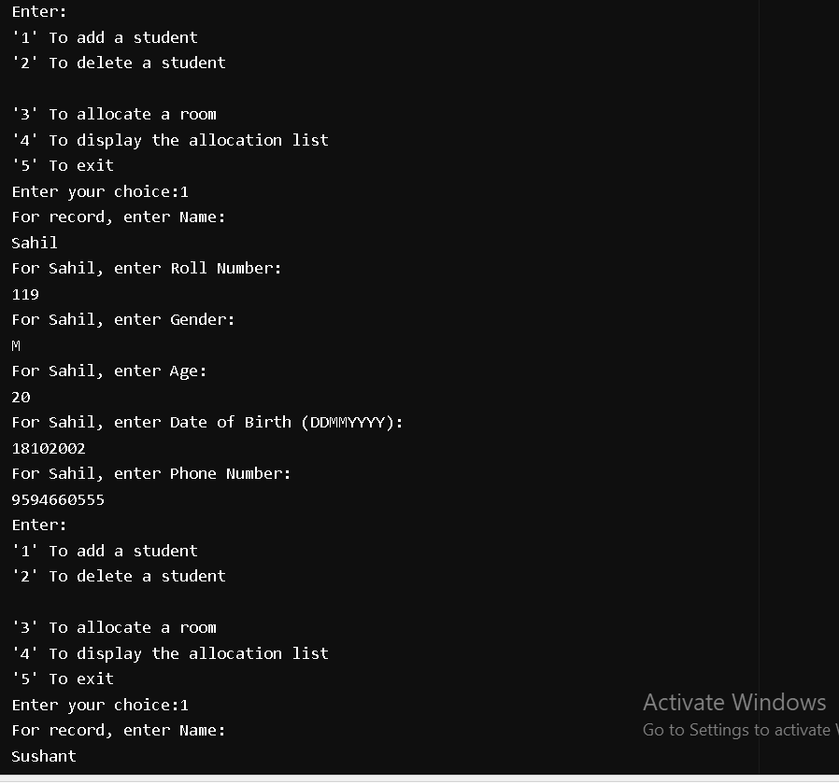
RESULT

Slide 13
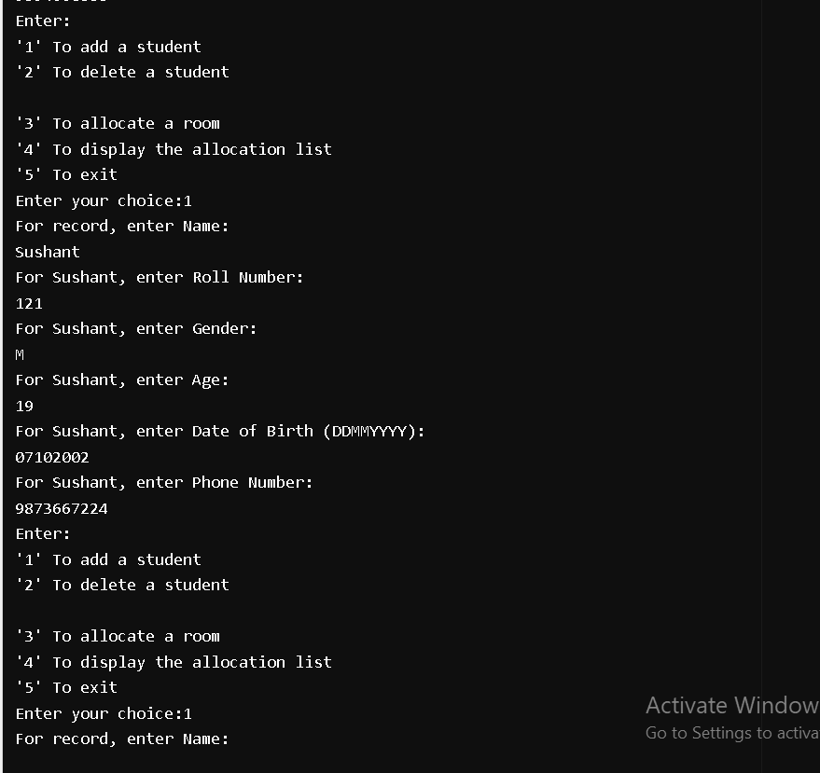

Slide 14
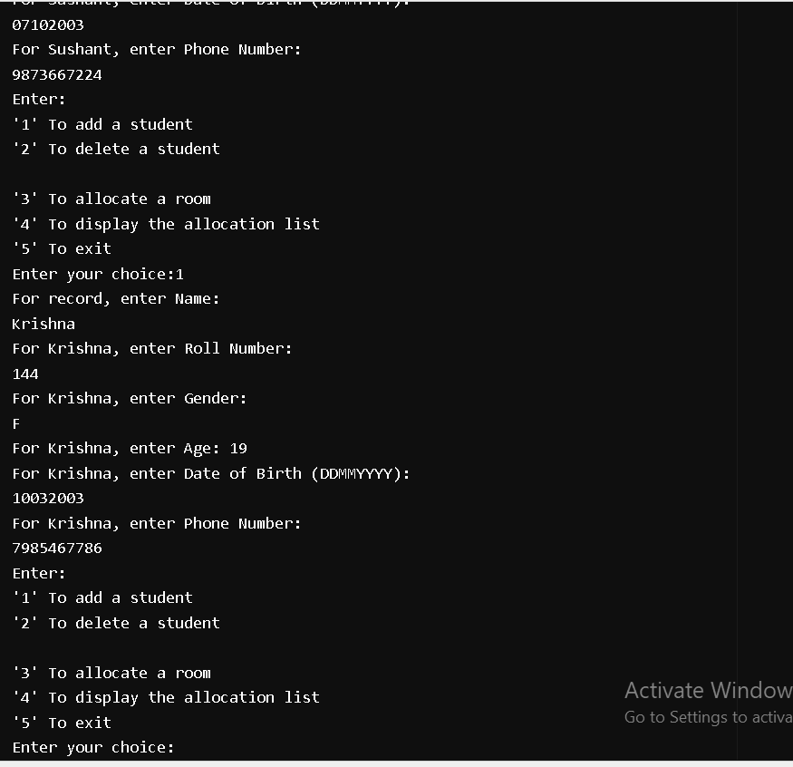

Slide 15
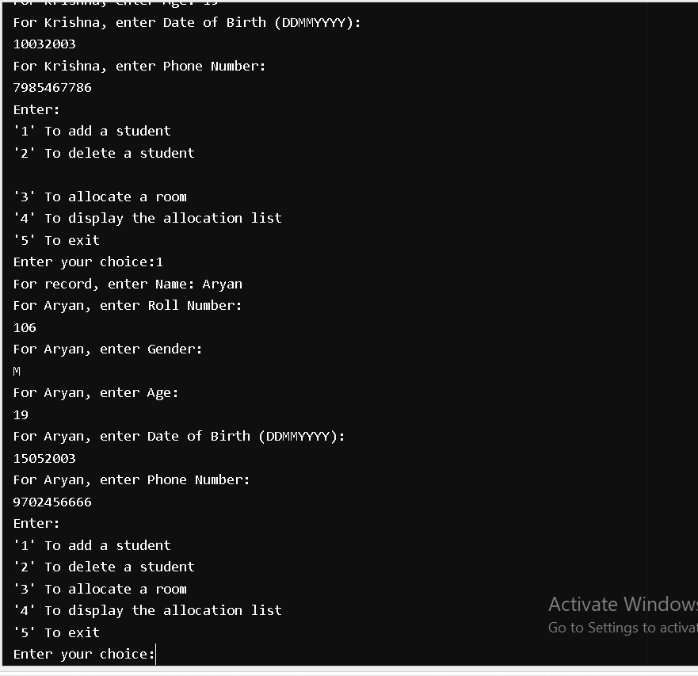

Slide 16
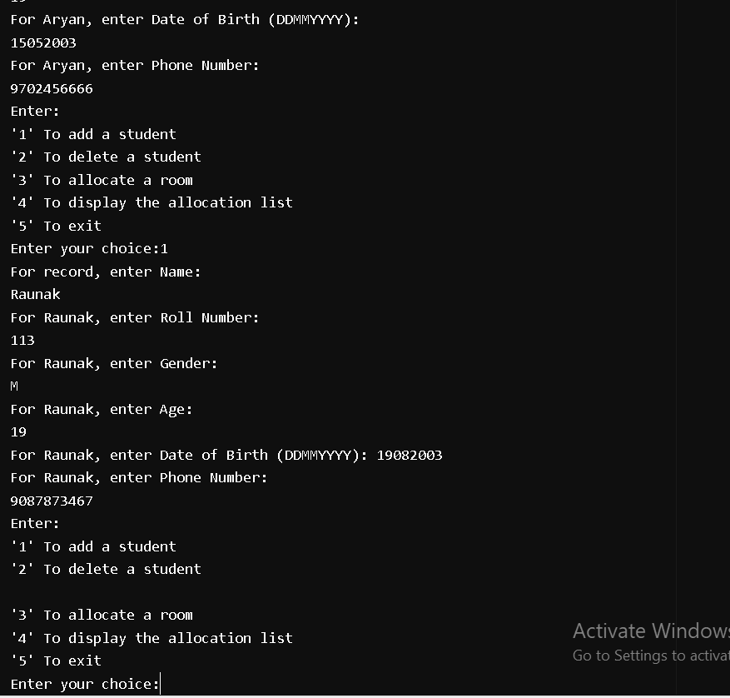

Slide 17
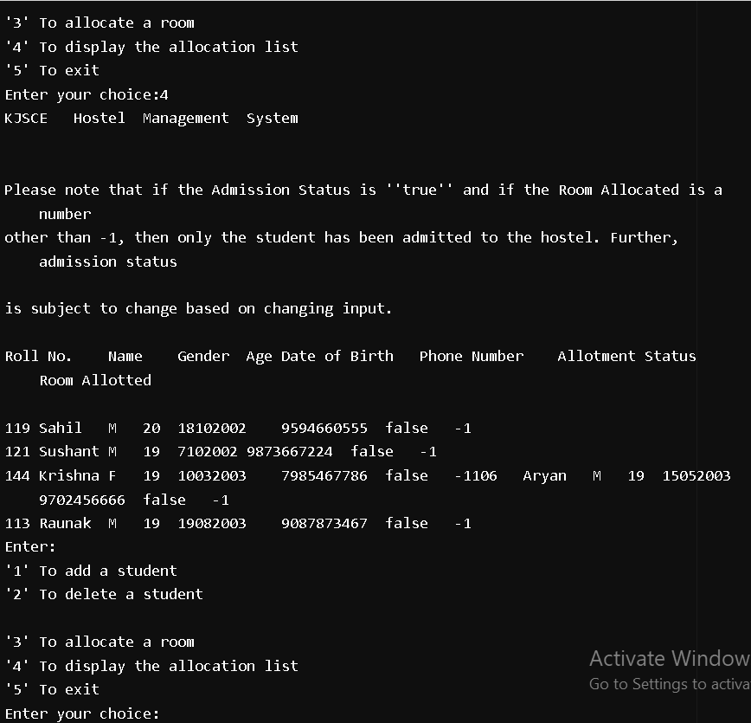

Slide 18
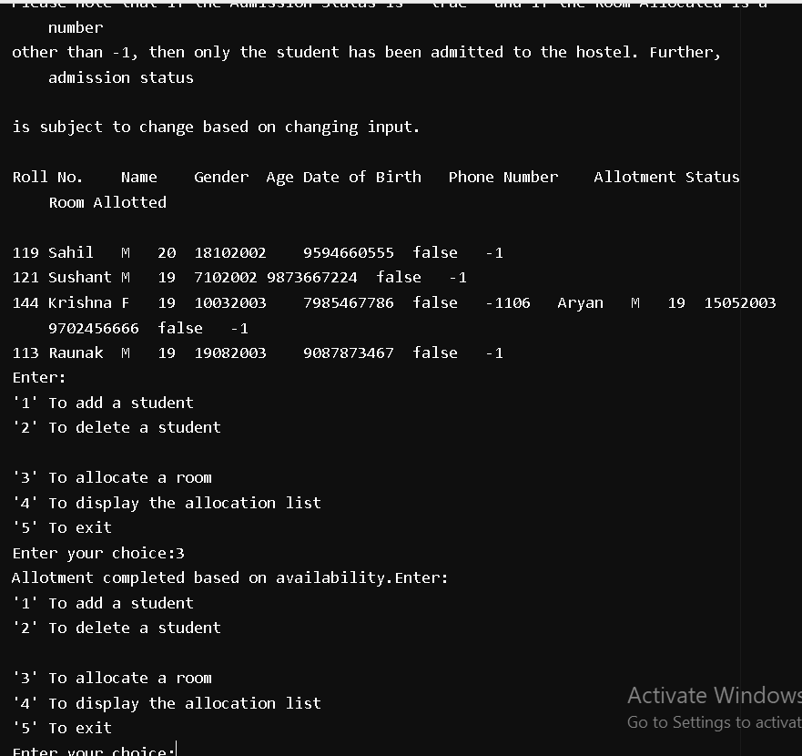

Slide 19
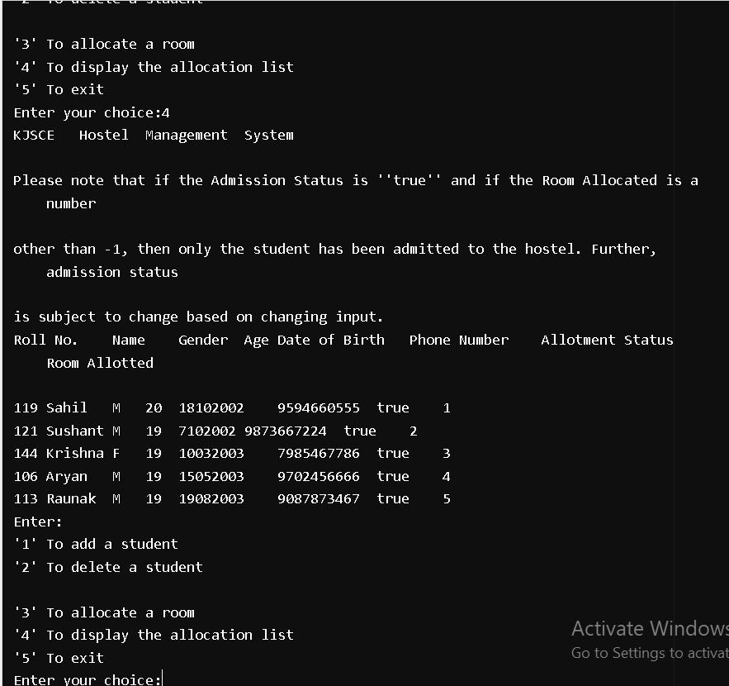

Slide 20
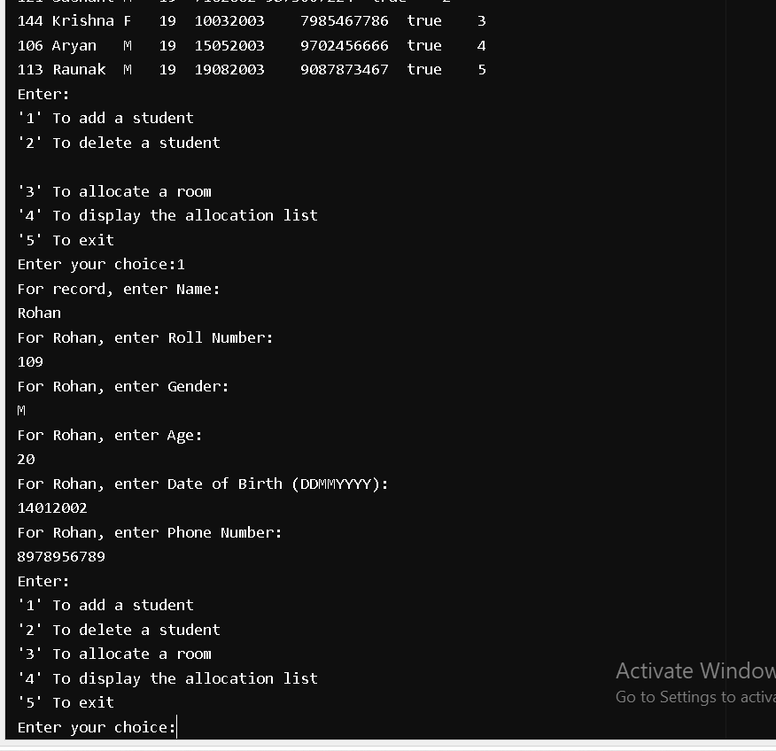

Slide 21
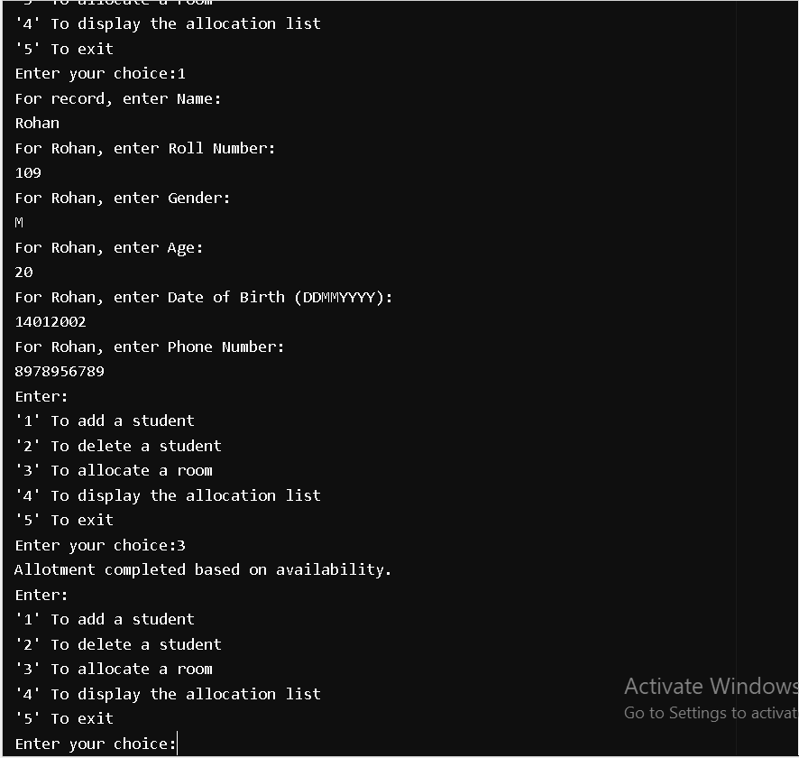

Slide 22
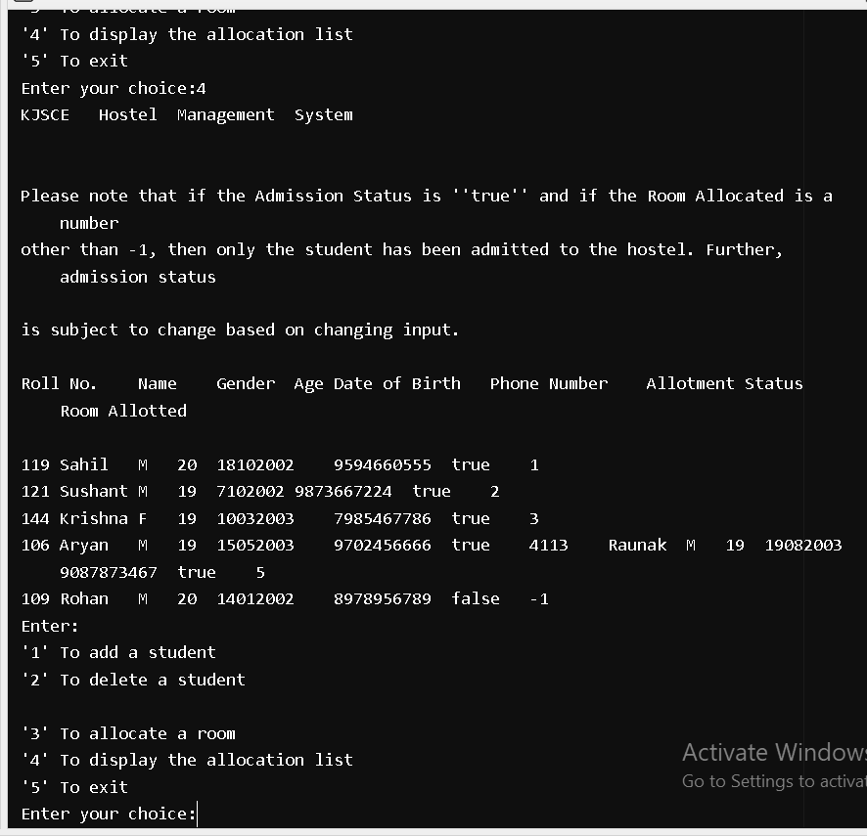

Slide 23
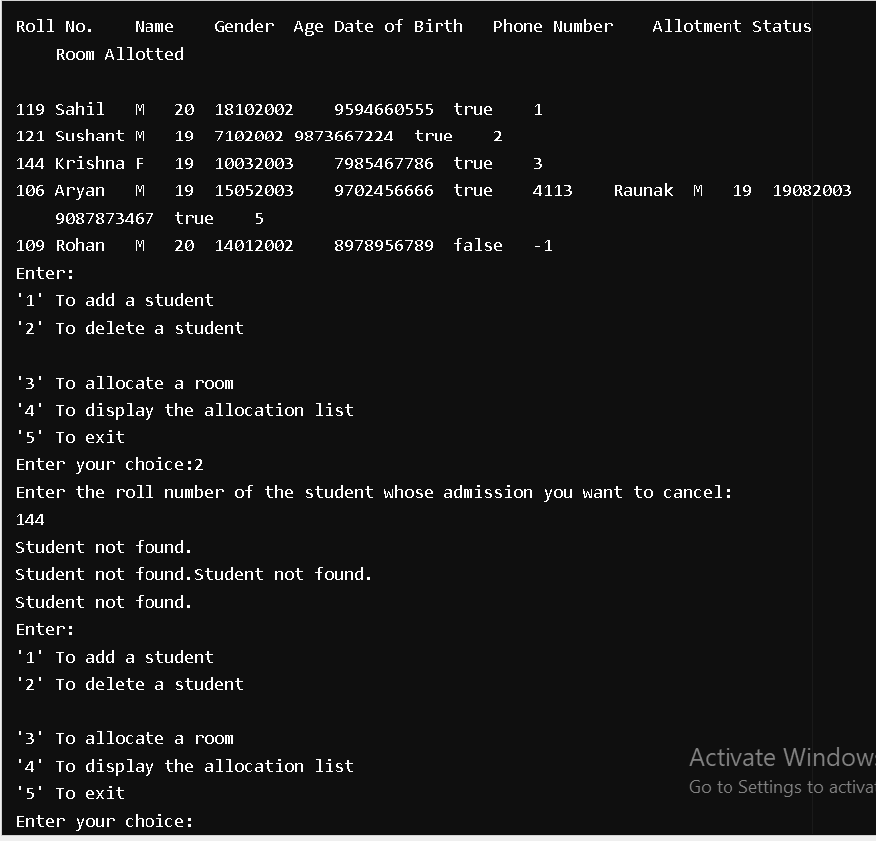

Slide 24
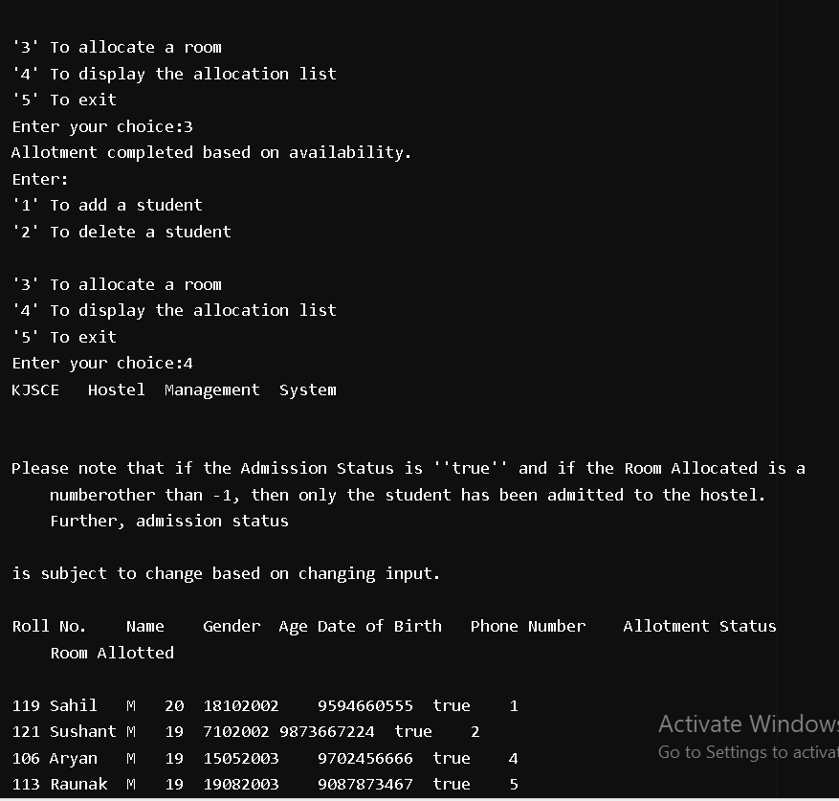

Slide 25
