Slide 1

US Diabetes Readmission Prediction
Shushant Nirantar
Rohan Shukla
sniranta@iu.edu
roshukla@iu.edu

Slide 2
Motivation
10% of the people in United States have diabetes
Almost 34 million of the United States population have pre-diabetes
More than 1.5 million people in United States are diagnosed with diabetes every year
7th leading cause of death.

Slide 3
Dataset
Data Source:
Center for Clinical and Translational Research, Virginia Commonwealth University
de-identified abstract of the Health Facts database (Cerner Corporation, Kansas City, MO)

Slide 4
Dataset
Represents 10 years (1999-2008) of clinical care at 130 US hospitals and integrated delivery networks
74 million unique encounters corresponding to 17 million unique patients, was undertaken to provide such an assessment and to find future directions which might lead to improvements in patient safety

Slide 5
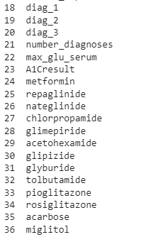
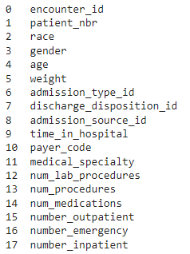
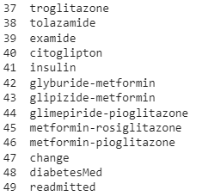
Dataset Attributes

Slide 6
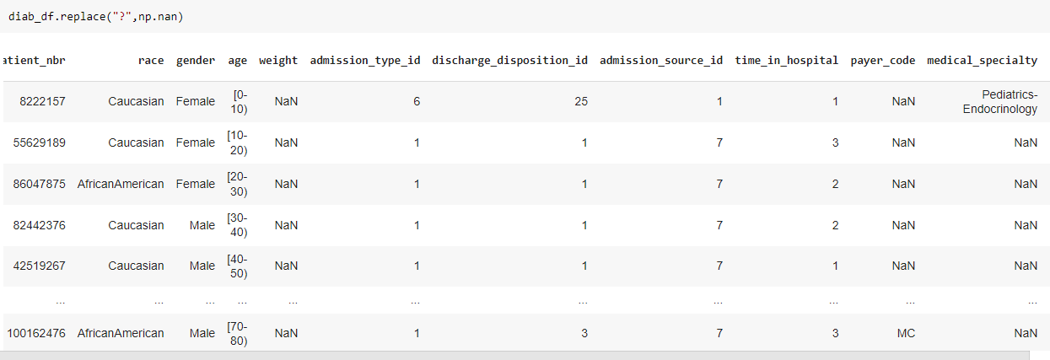
Data Preprocessing
Checking missing values:

Slide 7
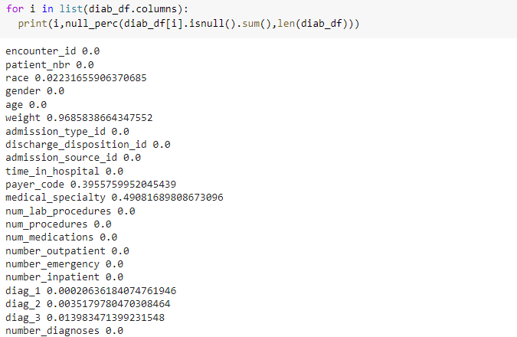
Data Preprocessing
Checking missing values:

Slide 8
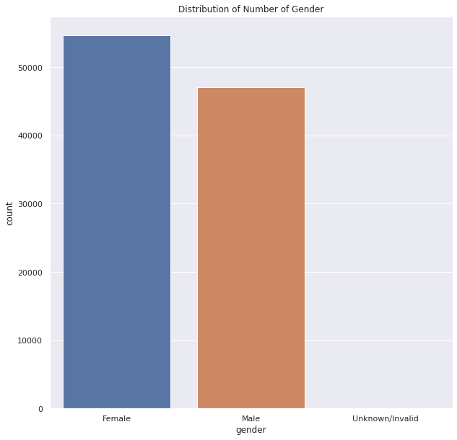
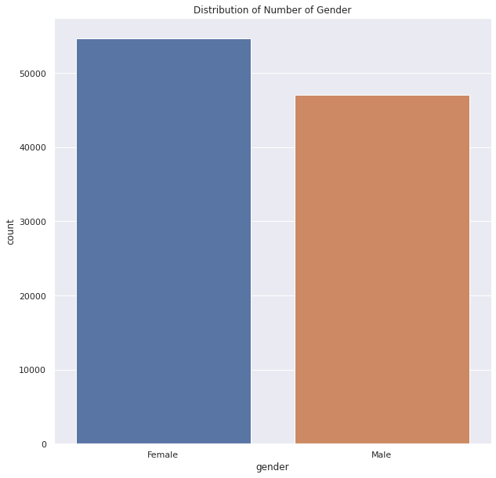
Exploratory Data Analysis
Checking each attributes and cleaning them

Slide 9
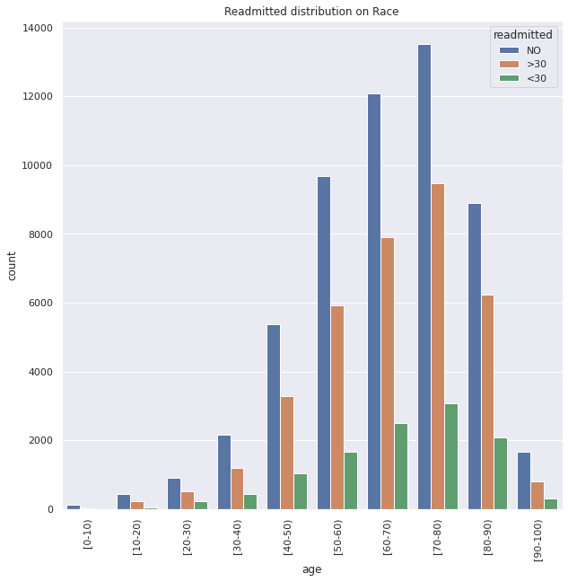
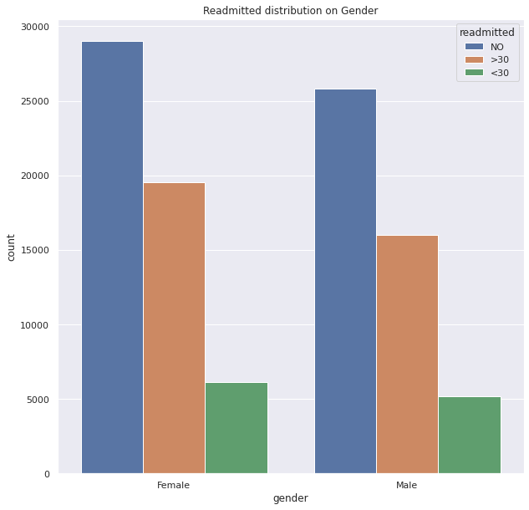
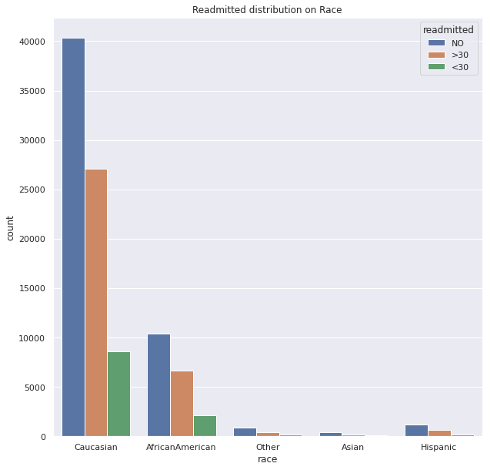
Exploratory Data Analysis
Checking each attributes and the proportion of target counts in each

Slide 10
Data Modelling
We run the model on various train-test splits and other various parameters for the following classification algorithms:
RandomForest
Vanilla DecisionTree
Adaboost
Bagging

Slide 11
Data Modelling
Target Classes | RandomForest | Vanilla DecisionTree | Adaboost | Bagging
2 | 0.8865 | 0.8228 | 0.8859 | 0.8811
3 | 0.5846 | 0.5213 | 0.5867 | 0.5762

Slide 12
Future Work
We aim to improve our existing models for better classification of readmission rates
We also aim try the neural network algorithms on the current dataset.

Slide 13
References
Beata Strack, Jonathan P. DeShazo, Chris Gennings, Juan L. Olmo, Sebastian Ventura, Krzysztof J. Cios, and John N. Clore, “Impact of HbA1c Measurement on Hospital Readmission Rates: Analysis of 70,000 Clinical Database Patient Records,” BioMed Research International, vol. 2014, Article ID 781670, 11 pages, 2014.
Ostling, S., Wyckoff, J., Ciarkowski, S.L. et al. The relationship between diabetes mellitus and 30-day readmission rates. Clin Diabetes Endocrinol 3, 3 (2017). https://doi.org/10.1186/s40842-016-0040-x
Soh JGS, Wong WP, Mukhopadhyay A, et al Predictors of 30-day unplanned hospital readmission among adult patients with diabetes mellitus: a systematic review with meta-analysis BMJ Open Diabetes Research and Care 2020;8:e001227. doi: 10.1136/bmjdrc-2020-001227

Slide 14
THANK YOU

