Slide 1
Skill Development Lab
(Oral Examination)
Cricket Players’
Squad Recommendation
System
Presented by-
Sushant Sabnis(TE)
Aniket Shirke(TE)
Anand Sonawane(TE)
Adesh Somwanshi(TE)

Slide 2
Our Main Aim :
To fascilitate the selection procedure of cricket players
To provide an insight for the Coach and the team management
To visualize the abilities of players in the form of ratings

Slide 3
What we did?
Step 1: Collected the statistical data (raw data) of cricket players
Step 2:Formulated a statistical model for converting the
Raw-Data into the comparable ratings
Step 3: Implemented the Statistical model as a system by using Python as our major tool

Slide 4
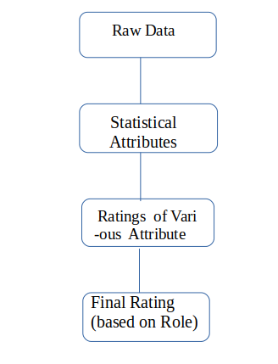
How we did it?
We calculated various statistical attributes for diffferent playing roles.
Then, for each attribute we computed the rating of the player which gives the ranking of the player for that particular attribute.
After this,for a particular playing role and its respective attributes’ rating,we calculated the final rating for that particular player,playing for that particular role.
And on the basis of those final ratings,we’ve selected the players.

Slide 5
What is the system’s output?
1.Squad of 15 players
2.Summary of stastistical data and statistical attributes of the selected players
3.Visualization of ratings of various attributes of each category(playing role)

Slide 6
What we could add to this system?
1. A suitable machine learning algorithm can be introduced for doing predictions on the basis of opponents’ players squad
2.A module consisting of weather and pitch reports can be added
3.Modules for different format of the Cricket can be created and integrated together

Slide 7
THANK YOU!

