Slide 1
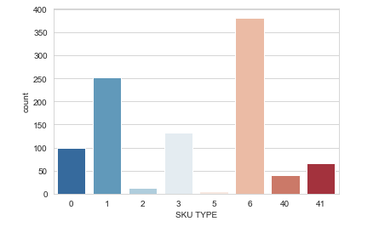
EXPLORATORY DATA ANAYSIS
Datasets:
TEM_MERCH_MASTERFILE_TestData
2. Sales Sample Data

Slide 2
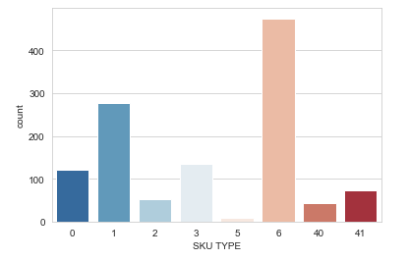
Graph shows the maximum SKU TYPE used. Maximum SKU TYPE USED IS SKU 6 .

Slide 3
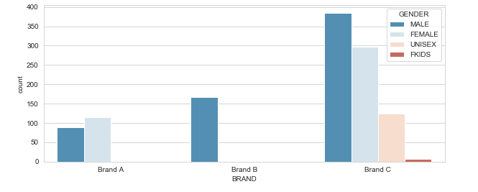
Graph shows the count of sales for each Brand
1)Brand C is the most sold brand of watches for all the genders.
2)Brand B is only used by males.
3)Brand A is more preferred by females than males.
#Brand C is unisex, ultimate Brand for all genders
Brand vs the Total count

Slide 4
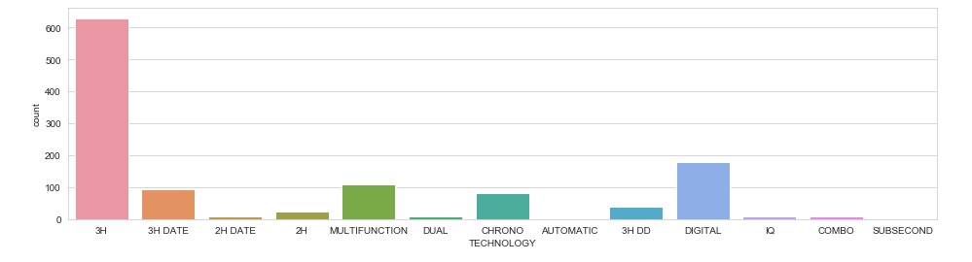
3H Technology is most used among all the other technologies

Slide 5
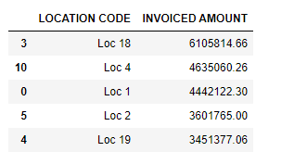
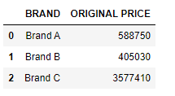
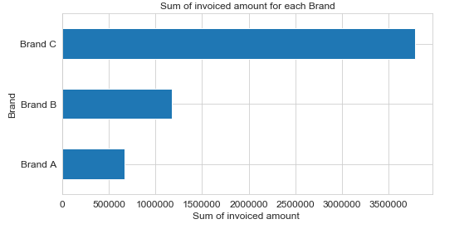
1) Location 18 has highest invoiced amount 2) Brand c has highest total amount

Slide 6
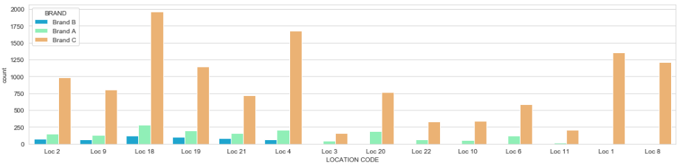
This graph shows that *Brand A in Loc18 is most sold brand. *Brand B is not preferred in Loc 1 and Loc 8. *Brand C is sold in Loc 2, 18, 19, 21 and 4.

Slide 7
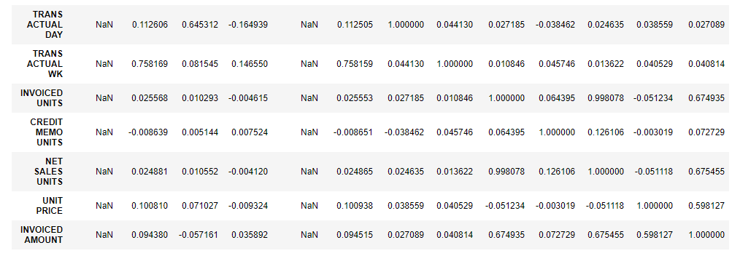
Correlation Table
This shows Invoice amount is dependent on
*NET SALES UNIT =0.67 5
*INVOICED UNITS=0.674
*UNIT PRICE=0.59

Slide 8
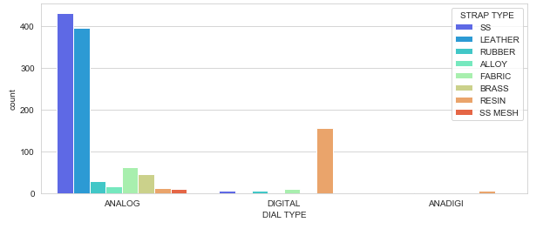
This plot shows *In ANALOG dial type SS and LEATHER is most preferred strap type. * RESIN is most preferred strap type *In ANADIGI only RESIN strap type is used .

Slide 9
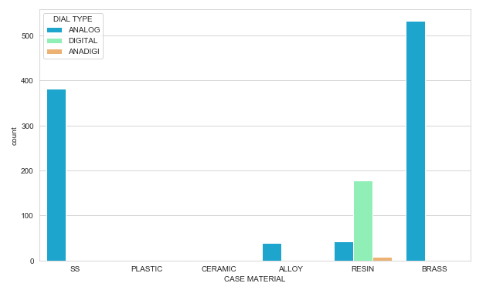
This plot shows *Brass case material is most used for Analog Dial Type *Resin case material is used for Digital Type.

Slide 10
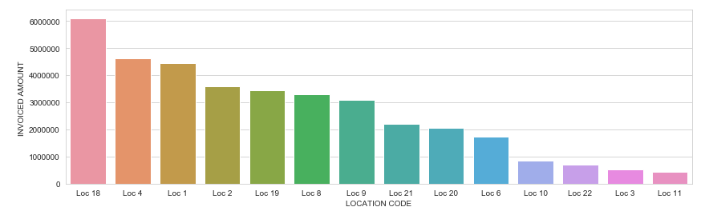
Using this graph we can understand which location to Target the most Loc 18, Loc 4, Loc 1, Loc 2, etc.

Slide 11
Solutions To Optimize The Business
We can target the sales in Locations in order Loc18, 4, 1, 2, 19 .
We can manufacture more items of of Brand C for males since it is most sold brand and Brand A for females.
Watches that uses 3H technology are most sold.
SKU TYPE 6 is most preferred type.
Watches of case material Brass and case shape round should be preferred .
Analog Dial type is most used .

Slide 12
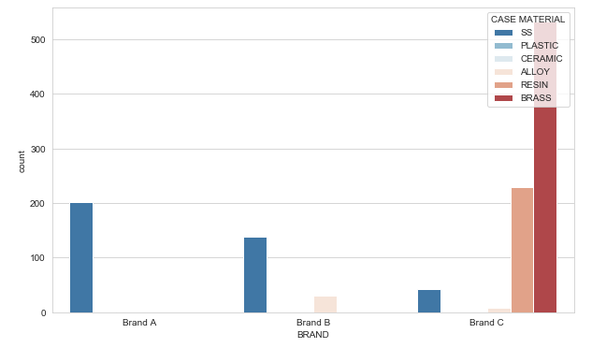
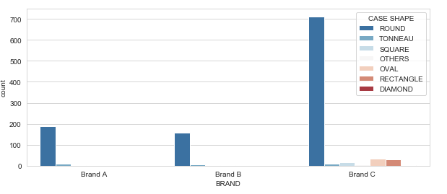
Clustering OF Brand 1. By CASE SHAPE 2. By CASE MATERIAL

Slide 13
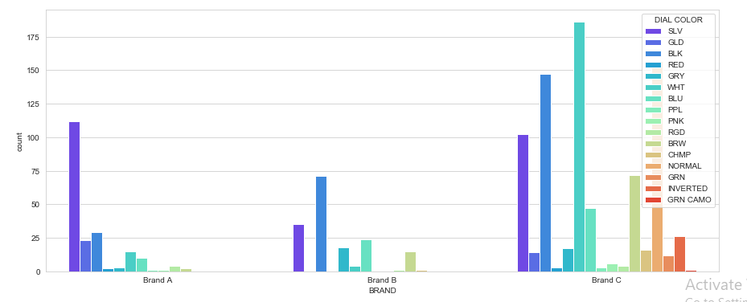
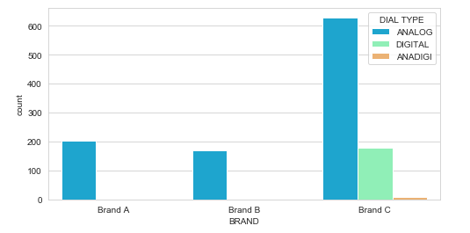
Clustering OF Brand 1. By DIAL COLOR 2. By DIAL TYPE

