Slide 1

Credit Card Fraud Detection: Capstone Project.
-sushant singh

Slide 2
AGENDA
Objective
Background
Key Insights
Cost Benefit Analysis
Appendix:
o Data Methodology

Slide 3
OBJECTIVE
To stop the huge losses that are being incurred due to frauds and a manual credit card fraud detection system.
To decrease losses due to credit card payment fraud for both merchants and issuing banks.
To increase revenue opportunities for merchants.

Slide 4
Background
Multiple visual to view the different trend in the data.
To detect frauds early and stop losses Machine Learning model has been built.
A cost benefit analysis is also been done.

Slide 5
Data Understanding
Data has 1852394 rows and on dropping one irrelevant column it make it 22 columns.
It contains a total of 18,52,394 transactions, out of which 9,651 are fraudulent transactions.
The given data has no null values
The data set is highly imbalanced, with the positive class (frauds) accounting for 0.52% of the total transactions.

Slide 6
Exploratory Data Analysis
Derived time, days and years from transaction time column.
Converted datatypes into required format.
Most females use more credit cards than males.
According to the data Sunday and Monday are the days of week which have highest card transaction.
50% of our customers are from age group 35-55.
Minimum age of customer is 14 and Maximum age of customer is 96.
Highest number of transactions happened in the month of December where as lowest happened in February.

Slide 7
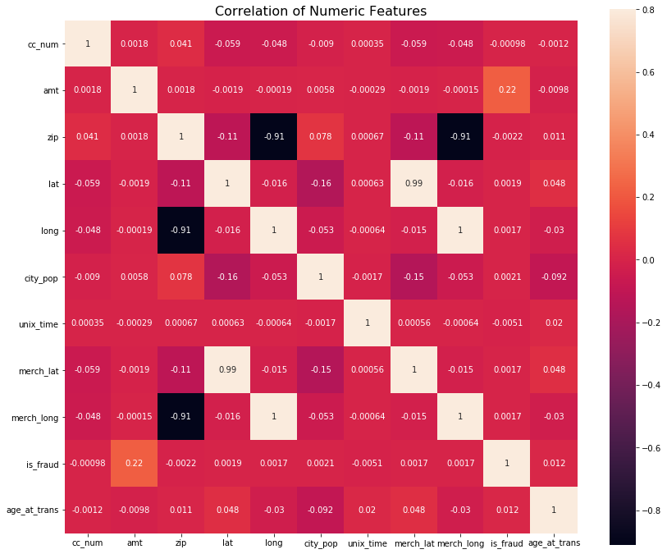
Correlation heatmap
No highly correlated numeric data.

Slide 8
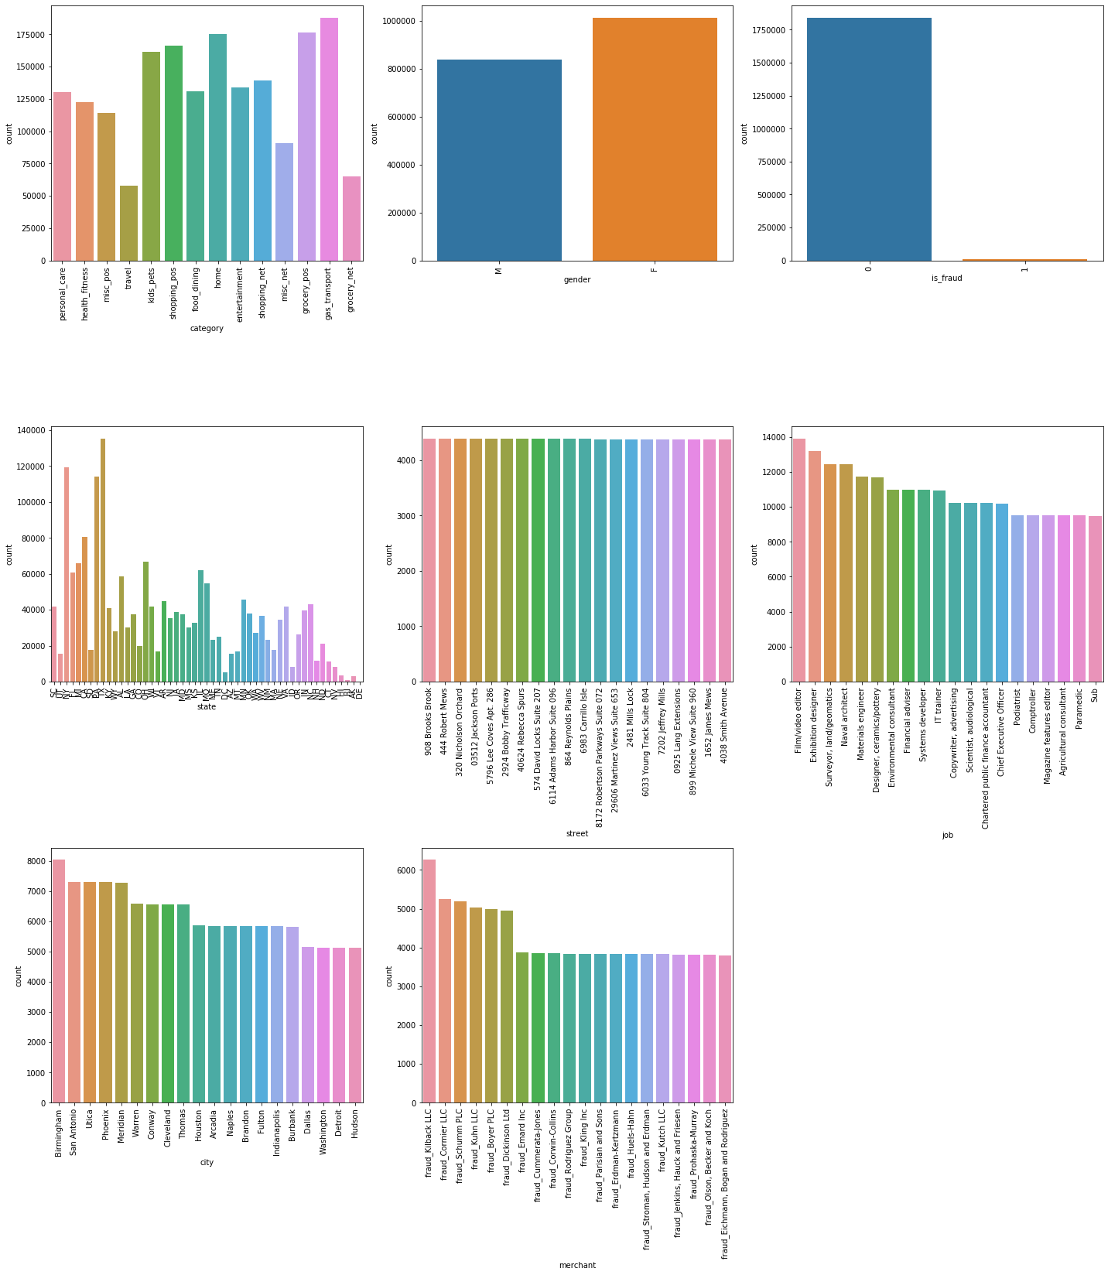
EDA-Univariate/Bivariate Analysis
Female vs male users fraud vs non-fraud Transaction category
There are more female users than male users.
We can see the data is highly imbalanced.
There are five categories whose transactions are higher than 150000

Slide 9
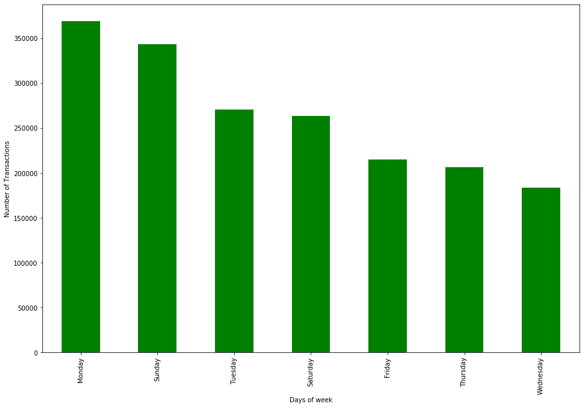
Distribution of transactions made on days of week
Sunday and Monday are two days of week when most of the transactions take place.

Slide 10
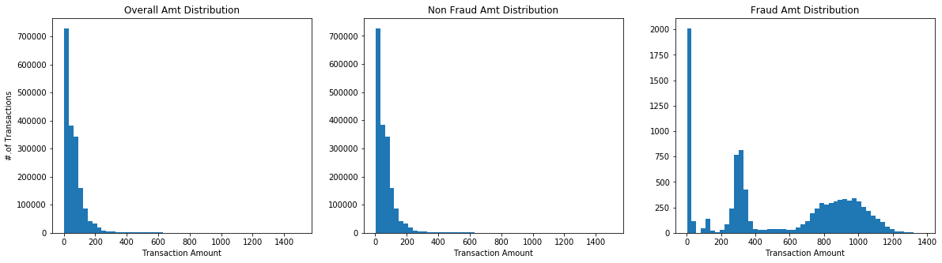
Distribution of amount
Fraud Transaction mean is way higher than non-fraud transaction.
Mean of Non Fraud Transactions: 67.6
Mean of Fraud Transactions: 530.6

Slide 11
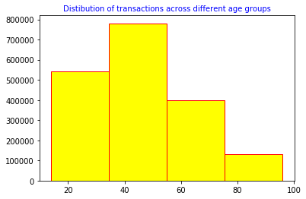
Fraud among different age groups
Maximum of the transactions are made by the people in age group 35-55 approximately.

Slide 12
Key Insights
Transaction amount, category and gender are the most important variables.
Gas and transport, grocery and shopping are the top three categories.
Current Losses
77,183 credit card transactions per month.
402 fraudulent transactions per month.
$ 530.66 amount per fraud transaction.
Total costs incurred from fraud transactions is $ 213,392.22.
After Model Deployment
1720 fraudulent transactions detected by the model.
$1.5 cost to provide customer support to these transactions that is $ 2,580.38 in total.
68 fraudulent transactions not detected by model which amounts to $ 35,908.09 loss.
Total cost incurred after new model deployment is $ 38,488.46.
Final savings after new model deployment is $174,903.76 that is reduction in losses by ~82%.

Slide 13
Appendix: Data Methodology
Different type of model where built on top of data dataset.
Class imbalance adjusted using Oversampling technique.
Due to extensive computational times when using Grid Search Cross Validation manual hyper parameter tuning was done.
Among the three used model building techniques decision trees and random forest techniques gives the best results.
Decision Tree model and Random forest model has the highest recall and accuracy.

