Slide 1
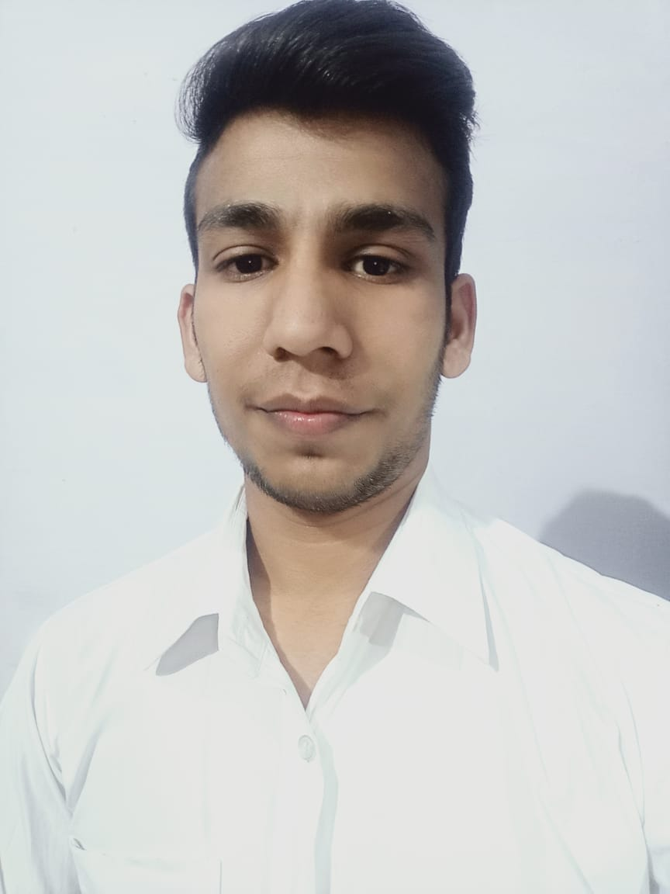



SUSHEEL KUMAR
Analyst/Software Engineer
BACHELOR OF TECHNOLOGY
Computer Science Engineering
2017-2021
Skills Java
Spring Boot
Spring MVC
MERN Stack
NodeJS
MongoDB
DatabaseL
No SQL database – MongoDB
Web Technologies
HTML5
CSS3
Bootstrap
Javascript
Angular
AddOns
Github
Maven
Postman
Additional skills
Problem Solving
Quick Learner
Team management
MUMBAI
SUSHEEL.KUMAR@CAPGEMINI.COM
+91 9780095932
A4
Eager to work in a team of dedicated people and serve a key role in the enhancement and development of the project.
Software Engineer who is Strong in design and integration with intuitive problem-solving skills. Passionate about implementing and launching new projects.
Ready to learn new technologies and implement them to further improve my knowledge.
Has working knowledge on Angular and Java Microservice Development using Spring framework on an intermediate level.
https://github.com/susheel1688/Resume.git
Deals And Coupons:
Completed end to end case study of Deals and Coupons along with JWT authentication, Swagger and payment testing. . Material-UI and ANGULAR used for user interface.
HTML CSS JAVASCRIPT for web developers at DEGREED
Completed this course with 96.5% and Designed responsive Restaurant website using HTML5 CSS3 ANGULAR.
linkedin.com/in/susheel-kumar-471312197

