Slide 1
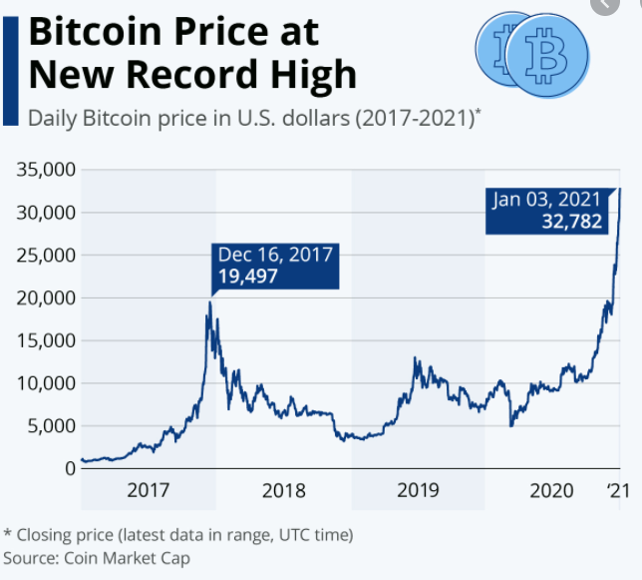
Crypto Market Analysis
Rishey, Theodore, Robby, Susheel

Slide 2
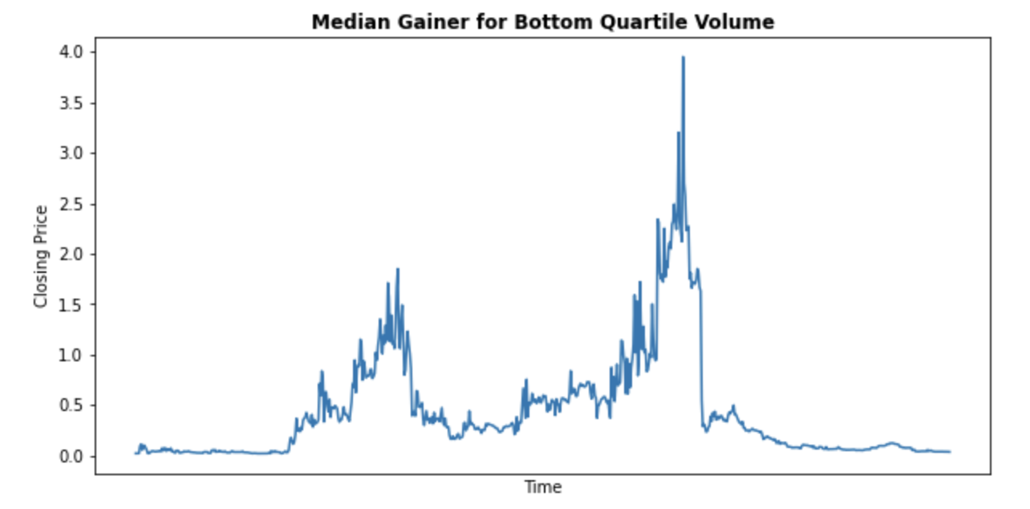
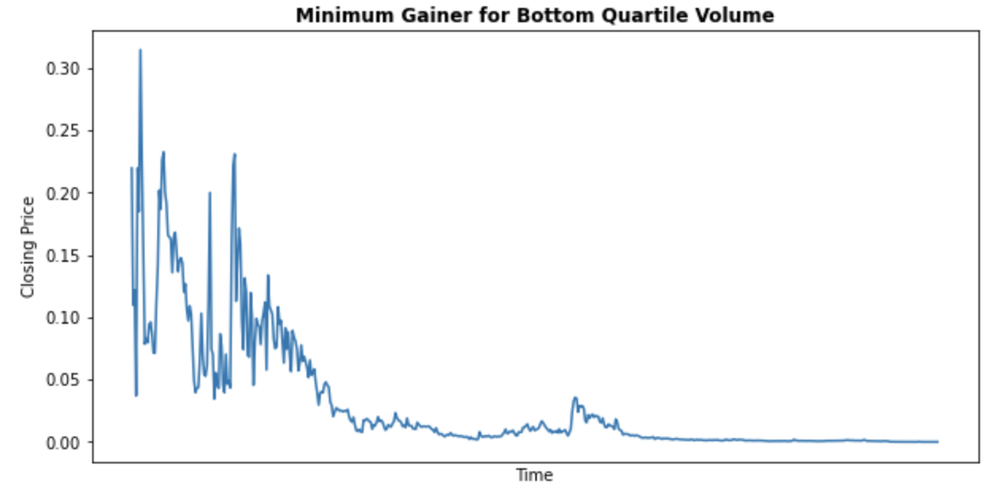
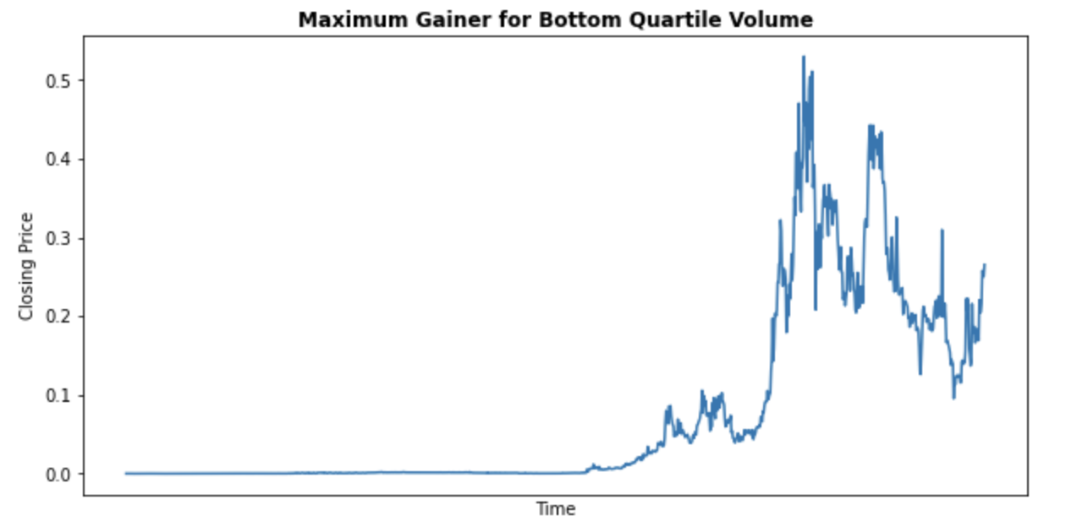
We graphed the Minimum, Median, and Maximum gainers for bottom quartile volumes, top quartile volumes, bottom quartile market caps, and top quartile market cap cryptos. This shows us the average price fluctuations over the time period in the dataset, which will allow us to find the average returns among these crypto groups.

Slide 3
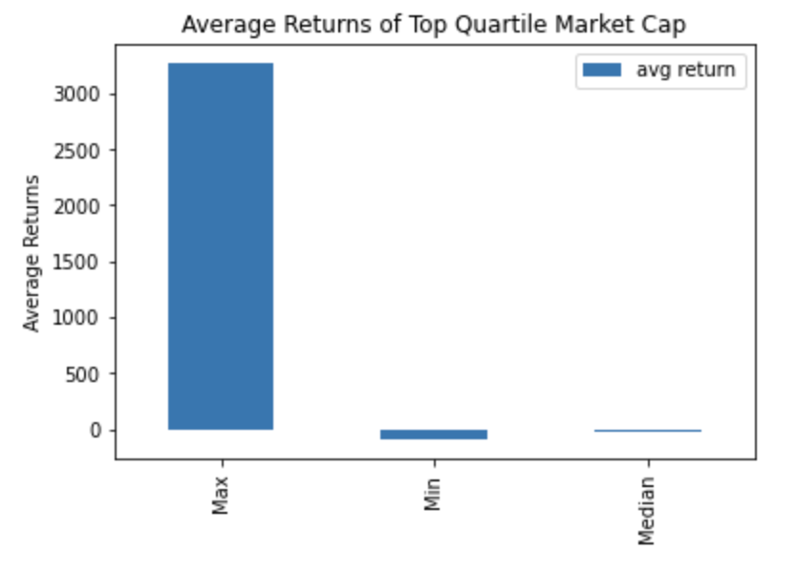
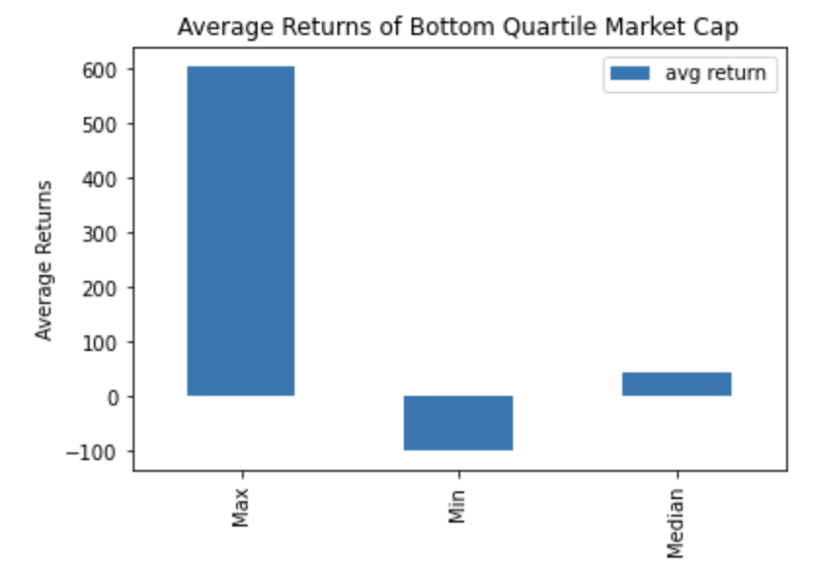
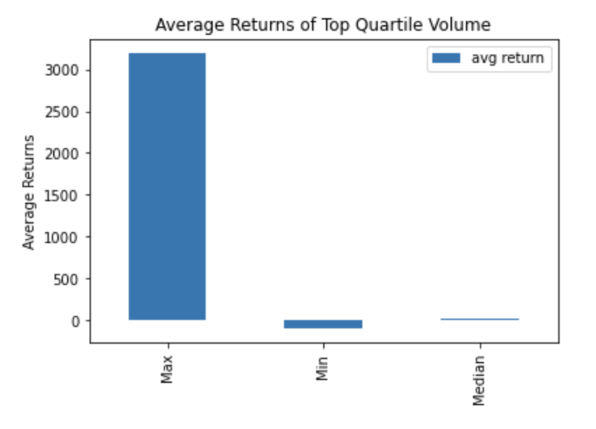
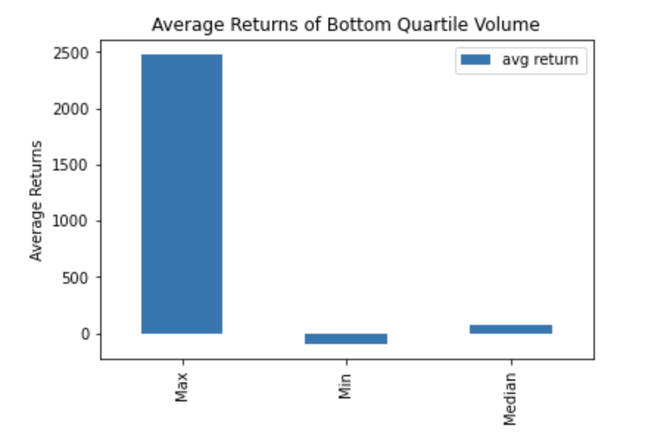
Bottom quartile market cap cryptos offer the safest investment, though top quartile volume and market cap cryptos deliver highest payout.

Slide 4
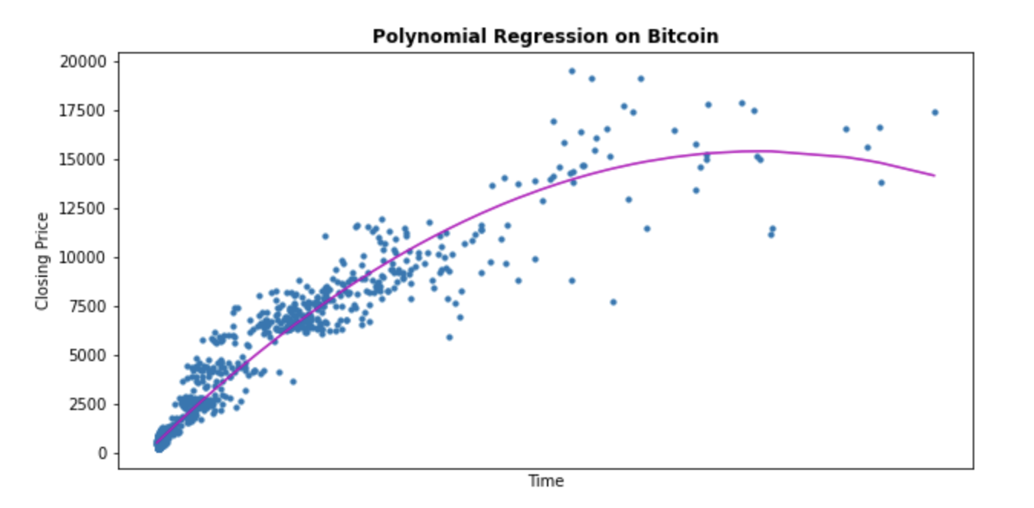
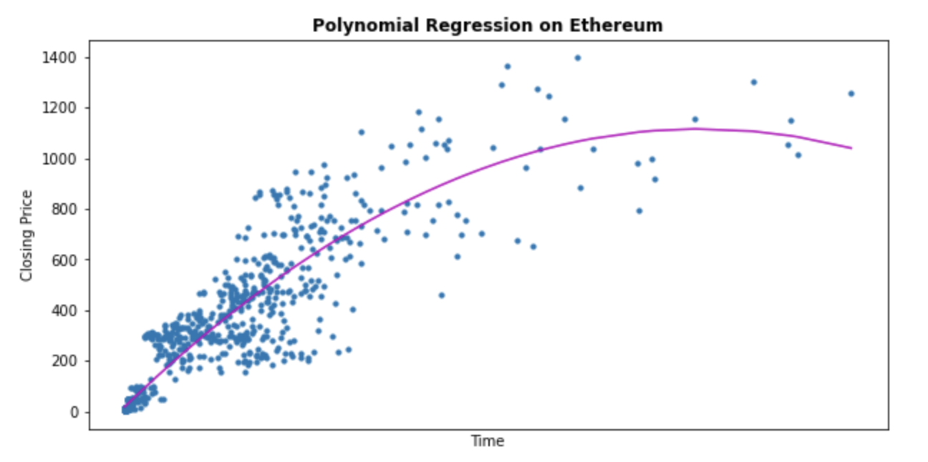
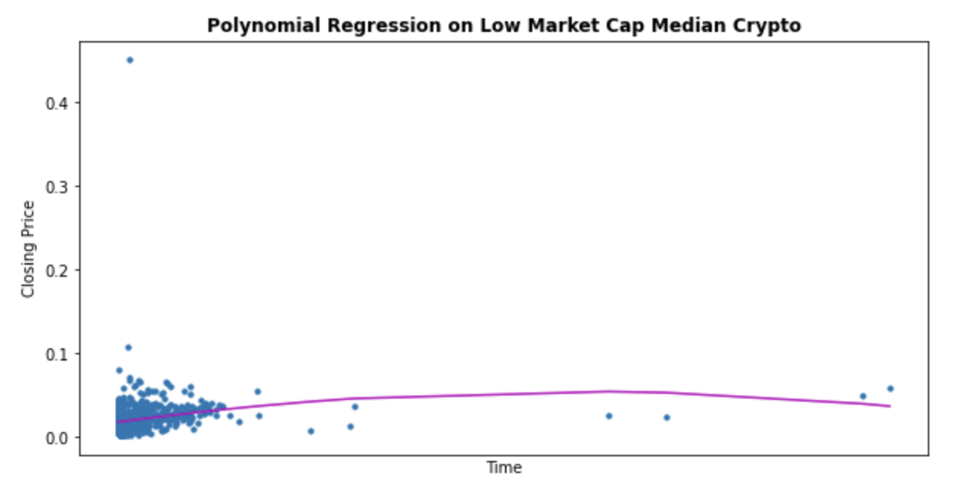
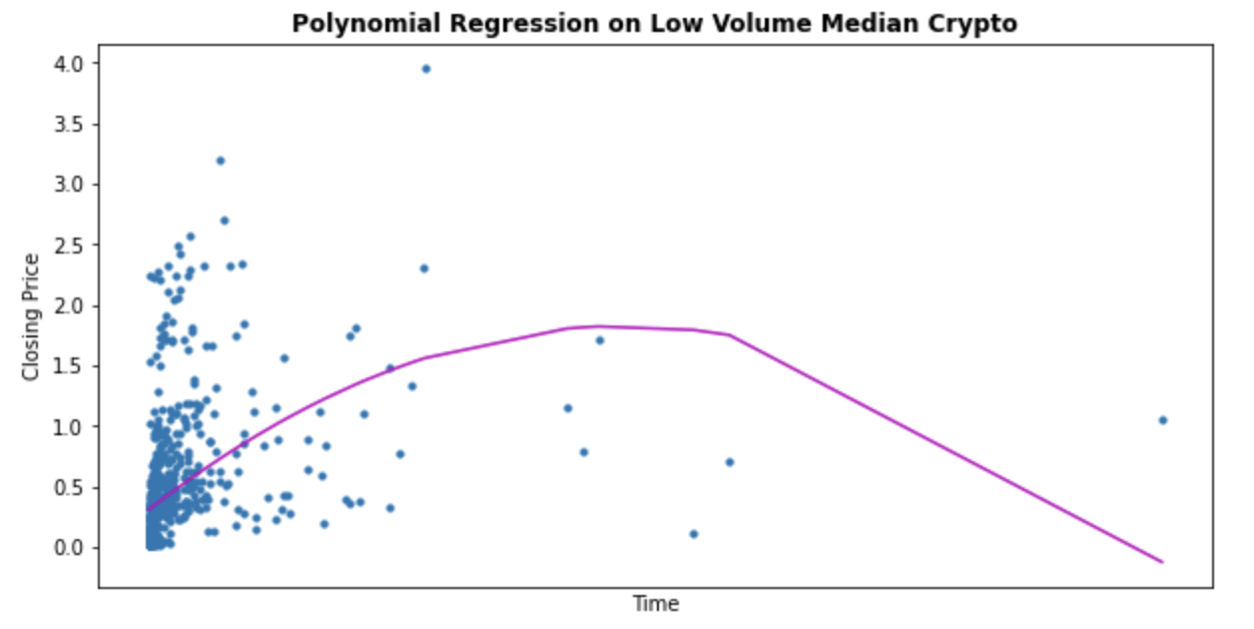
For high frequency trading, BTC and ETH (proxies for high volume/market cap cryptos) are the easiest to predict and thus most applicable.

