Slide 1
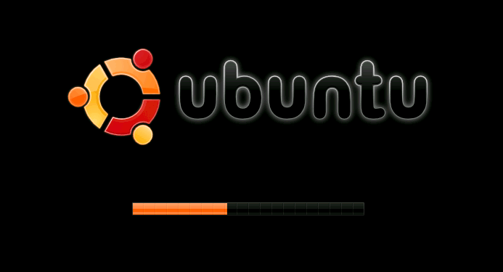

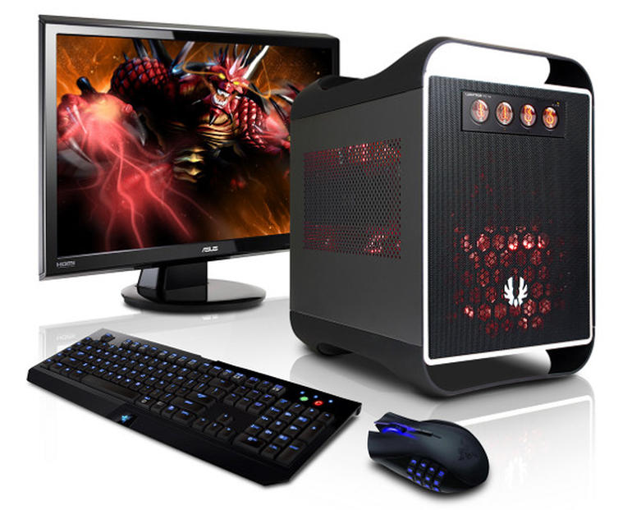
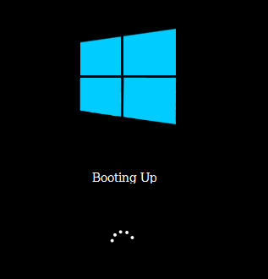


Slide 2
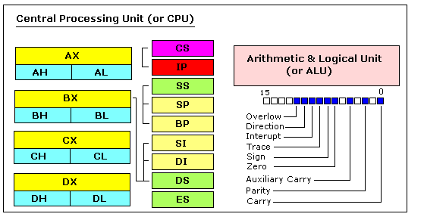
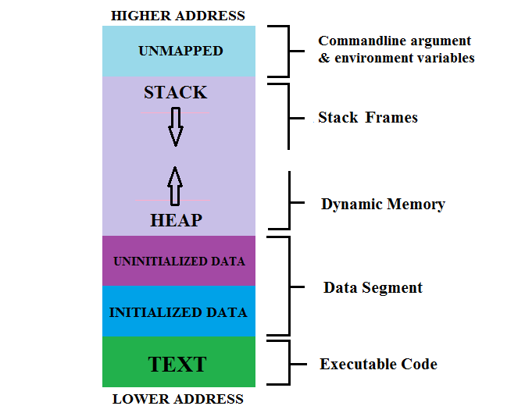
Prerequisite : 8086 Microprocessor and Process Memory Map

Slide 3
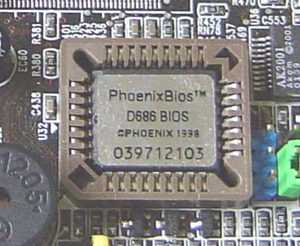
Powering Up : Reset
Powering on Reset
Physical address =(CS<<4) + IP
=0xFFFF0
First Instruction fetched from location 0xFFFF0
Processor in real mode
Limited to 1 MB addresses
No protection; no privilege levels
Direct access to all memory
No multi-tasking
First instruction is at right on top of accessible memory
should jump to another location
Every register initialized to 0 except
CS=0xF00, IP=0xFFF0
Inaccessible memory (RAM)
0x100000
First instruction
0xFFFF0
BIOS
0xF0000
0

Slide 4
Powering Up : Reset
Powering on Reset
Present in a small chip connected to the processor
- FLASH/EPROM
Does the following
Power on self test
Initialize video card and other devices
Display BIOS screen
Perform brief memory test
Set DRAM memory parameters
Configure plug & play devices
Assign resources (DMA channels & IRQs)
Identify the boot device
Read sector 0 from boot device into memory location 0x7c00
jump to 0x7c00
Every register initialized to 0 except
CS=0xF00, IP=0xFFF0
BIOS

Slide 5
Powering Up : Reset
Powering on Reset
Sector 0 in the disk called Master Boot Record (MBR)
Contains code that boots the OS or another boot loader
Copied from disk to RAM (@0x7c00) by BIOS and then begins to execute
Size 512 bytes
446 bytes bootable code
64 bytes disk partition information (16 per)
2 bytes signature (0xAA55)
Every register initialized to 0 except
CS=0xF00, IP=0xFFF0
BIOS
MBR Execution
Typically, MBR code looks through partition table and loads the bootloader (such as Linux or Windows )
Or it may directly load the OS

Slide 6
Powering Up : Reset
Powering on Reset
Every register initialized to 0 except
CS=0xF00, IP=0xFFF0
N sector disk drive. Each sector has 512 bytes
BIOS
Sector 0 MBR
Sector 1
Sector 2
Sector 3
Sector N-1
MBR Execution
Code (440 bytes)
DS (4 bytes)
Null (4 bytes)
Partition table( 64 bytes 16 bytes for each
Signature (2 bytes)

Slide 7
Powering Up : Reset
Powering on Reset
Every register initialized to 0 except
CS=0xF00, IP=0xFFF0
Loads the operating system
May also allow the user to select which OS to load in case dual boot
Other Jobs done
Disable interrupt
Setup GDT
Switch from real mode to protected mode
Read operating system from disk
BIOS
MBR Execution
Bootloader
The bootloader may be present in the MBR (sector 0) itself

Slide 8
Booting Linux
Powering on Reset
Every register initialized to 0 except
CS=0xF00, IP=0xFFF0
BIOS
Three stage of grub
stage 1 : 446 bytes boot.img
stage 1.5: core.img
stage 2 : load kernel
MBR Execution
Bootloader (GRUB)

Slide 9
Booting Linux
Powering on Reset
Every register initialized to 0 except
CS=0xF00, IP=0xFFF0
Kernel is loaded into memory
Kernel initiates itself needs to mount the root(/)file system
How the Linux Kernel access the LKM for mounting the root (/) file system, which are present on the root file system itself?
BIOS
/boot/initrd.img uncompressed and loaded
Content of initrd file serve as temporary root file system
Kernel executes pivot_root command
Kernel initialize schedular PID = 0
Fork and execute /sbin/init
/lib/system/systemd
/bin/systemd
MBR Execution
Bootloader (GRUB)
Kernel Initialization

Slide 10
Booting Linux
Powering on Reset
Every register initialized to 0 except
CS=0xF00, IP=0xFFF0
The system vs init :
Older Linux distro( Ubuntu14, Debian6, RHEL6, CentOS6)
Newer Linux distro (Ubuntu15.04, Debian7, RHEL7, CentOS7)
Fast Booting
Init (run-level) system (targets)
0: poweroff poweroff.target
1: rescue rescue.target
2: multi-user(w/o nw) multi-user.target
3: multi-user(nw) multi-user.target
4: unused
5: graphical graphical.target
6: reboot reboot.target
BIOS
MBR Execution
Bootloader (GRUB)
Kernel Initialization

Slide 11
Bonus

Slide 12
Multiprocessor Booting
One processor designated as ‘Boot Processor’ (BSP)
designation done by either Hardware or BIOS
All other processors are designated AP (Application Processors)
BIOS boots the BSP
BSP learns system configuration
BSP triggers boot of other AP
Done by sending an Startup IPI (inter processor interrupt) signal to the AP

Slide 13



