Slide 1
Flight Search Web AppLication

Slide 2
Company Profile
CMM(i) level 5 Maturity
Provides technology services , product engineering, analytical services.
Healthy work environment
Clients: BMW,RBI, American Banking, NetEnt, Lufthansa

Slide 3
Introduction
Objective: To enable user to search flights as per his needs and enables the admin to update details
Present State of Art
Need to make the request manually by calling the Flight Search operator.
Inconvenient and requires more staff to reach clients for their bookings and enquiries
Proposed Software
This application is to be used for on-line search of the available flights.

Slide 4
Description
The basic goal is to:
Provide the on-line registration facility for the new Customers.
Maintain the accuracy of the database.
Provide security features from the unauthorized access.
Generate the forms dynamically according to the requirement of the admin user.
Print the list of the flights requested by user.
Update the flight details.

Slide 5
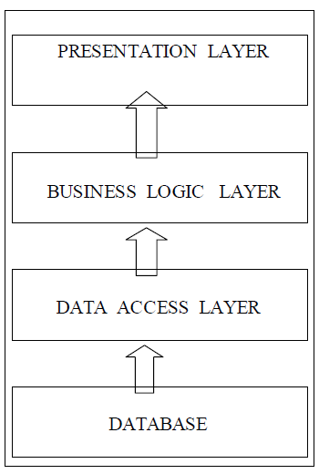
Design Architecture

Slide 6
Data Access Layer
Handle all the database activity implemented by Hibernate Framework(ORM ).
Business Logic Layer
Provides all the business logic to implement the system.
User Interface Layer
Contains all the web pages as well as user interactions with the system. These pages are developed using jsp’s and spring tag library.

Slide 7
Software Interfaces
Operating System : Microsoft Windows 7
Database : MySQL5
Java : SDK/JRE 1.7 or higher
Web Server : Apache Tomcat 7
IDE : Apache Eclipse 4.3
Object Relational Mapping : Hibernate 4
Framework : Spring 4
Browser : Any standard browser

Slide 8
Modules
The application is formed of following modules
Login and Registration
Flight Management
CSV importer
DB management
Searching and listing
Uploading(static and dynamic)
Extra functionalities : Logging.

Slide 9
Use Case Diagram

Slide 10
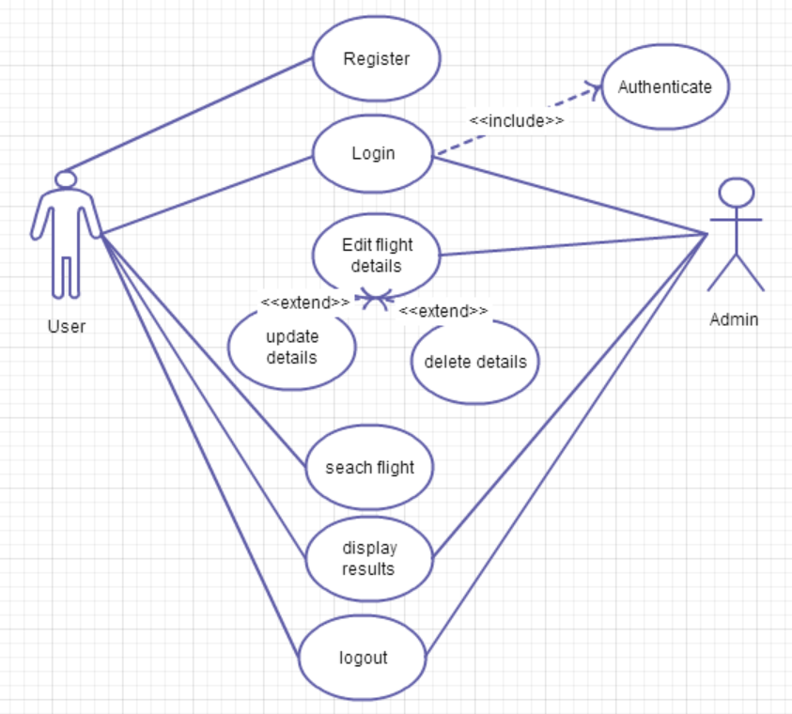
Import files

Slide 11
Entity Relationship Diagram

Slide 12
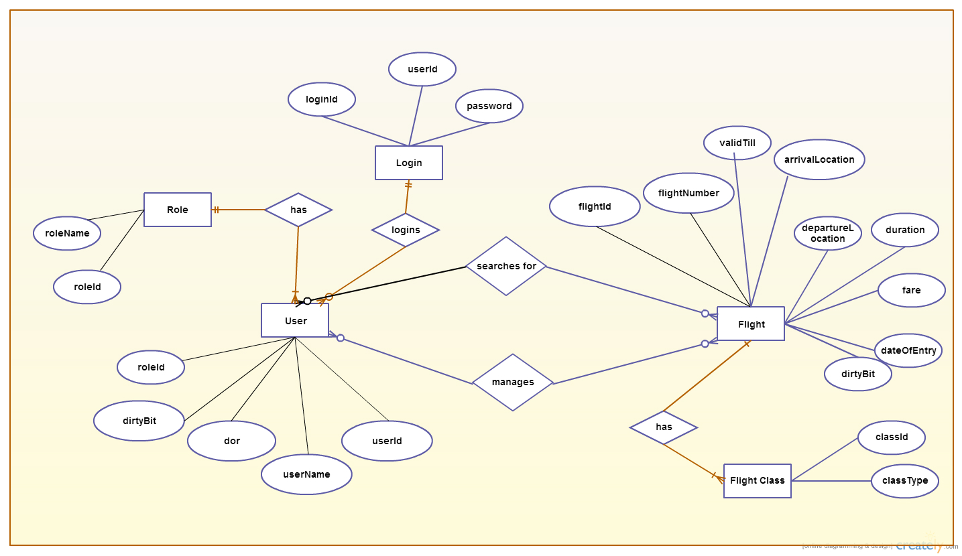

Slide 13
Data Flow Diagram

Slide 14
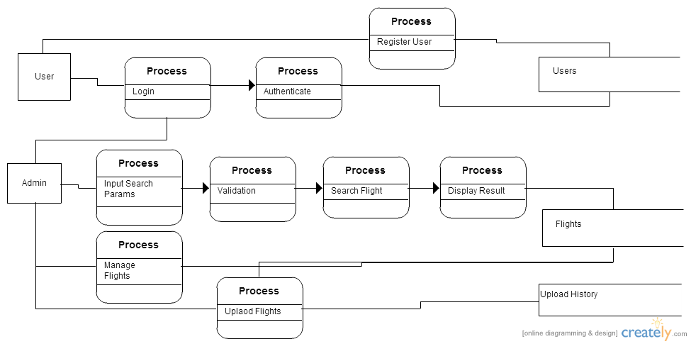
DFD Level 1

Slide 15
State Transition Diagram

Slide 16
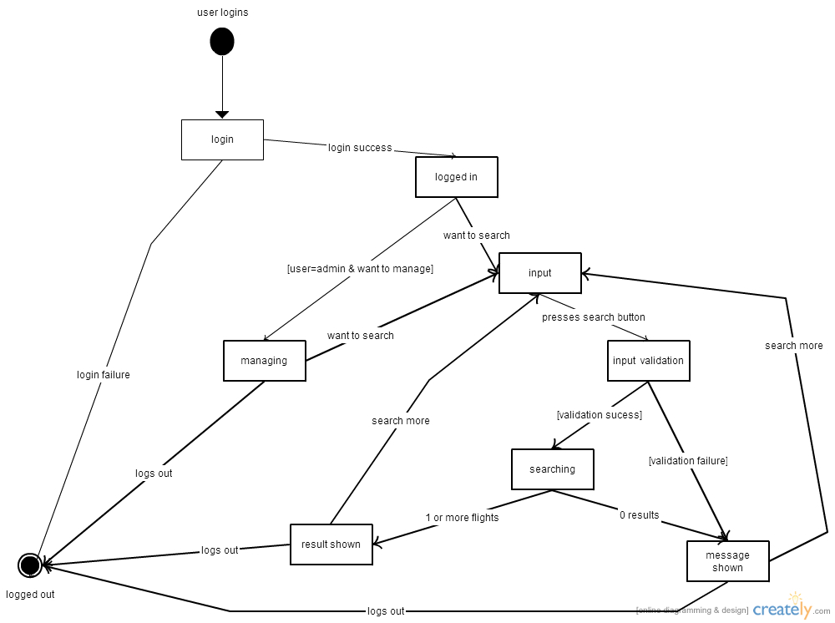

Slide 17



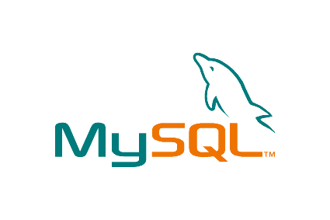



Technologies Used

Slide 18
Maven
Making the build process easy
Providing a uniform build system
Providing quality project information
Providing guidelines for best practices development
Allowing transparent migration to new features

Slide 19
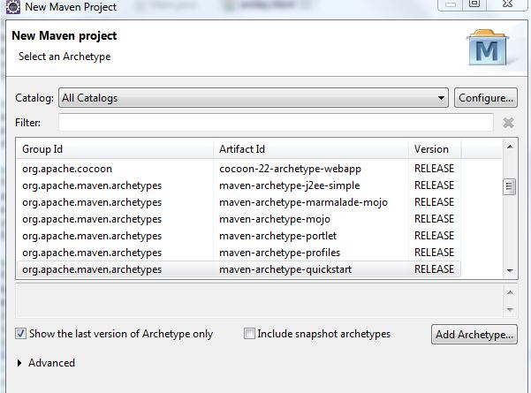
Select Maven Project

Slide 20
Hibernate
Mapping Java classes to database tables using XML files or annotations.
Provides simple APIs for storing and retrieving Java objects directly to and from the database.
For any change in Database or in any table only need to change XML file properties.
Abstract away the unfamiliar SQL types and provide us to work around familiar Java Objects.
Manipulates Complex associations of objects of your database.

Slide 21
DAO modules with Hibernate

Slide 22
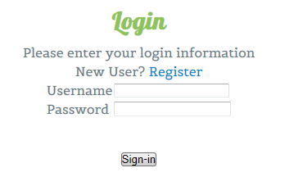
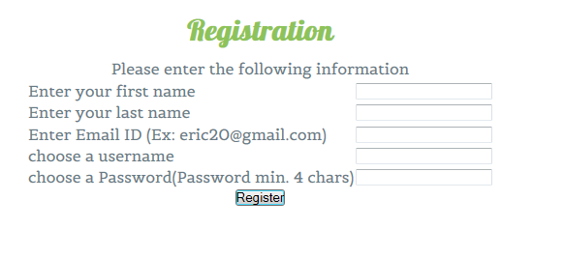
Login And Registration

Slide 23
Acceptance Test Cases –Login
Test Data for Login:
User name = {Empty, Valid Username, Invalid Username}
Password = {Empty, Valid Password, Invalid Password}

Slide 24
Acceptance Test Cases - login
S.No | User name | Password | Expected O/P
1 | Empty | Invalid/ Valid | Error Message
2 | Invalid/ Valid | Empty | Error Message
3 | Empty | Empty | Error Message
4 | Invalid | Invalid | Error Message
5 | Valid | Invalid | Error Message
6 | Invalid | Valid | Error Message
7 | Valid | Valid | Login Successful

Slide 25
Acceptance test cases - signup
Test Data for New User Signup:
Email = {Empty, Valid, Invalid}
Username= {Empty, Existing, Valid}
Password = {Empty, Valid Password, Invalid Password}
Confirm Password = {Empty, ! = Password, = Password}
Security Answer= {Empty, Valid}

Slide 26
Acceptance test cases - signup
S.No | Username | Password | Confirm Password | Email | Security Question | Security Answer | Expected O/P
1 | Empty/ Exiting | X | X | X | X | X | Error Message
2 | X | Empty | X | X | X | X | Error Message
3 | X | X | Empty/ Diff from Password | X | X | X | Error Message
4 | X | X | X | Empty/ Invalid | X | X | Error Message
5 | X | X | X | X | X | X | Error Message
6 | X | X | X | X | X | Empty | Error Message
7 | Valid | Valid | Valid | Valid | Valid | Valid | New user
X = any value

Slide 27
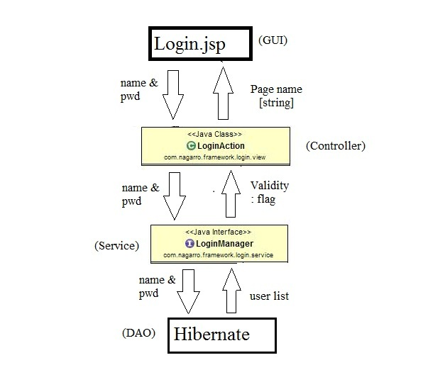
Implementation flow diagram

Slide 28
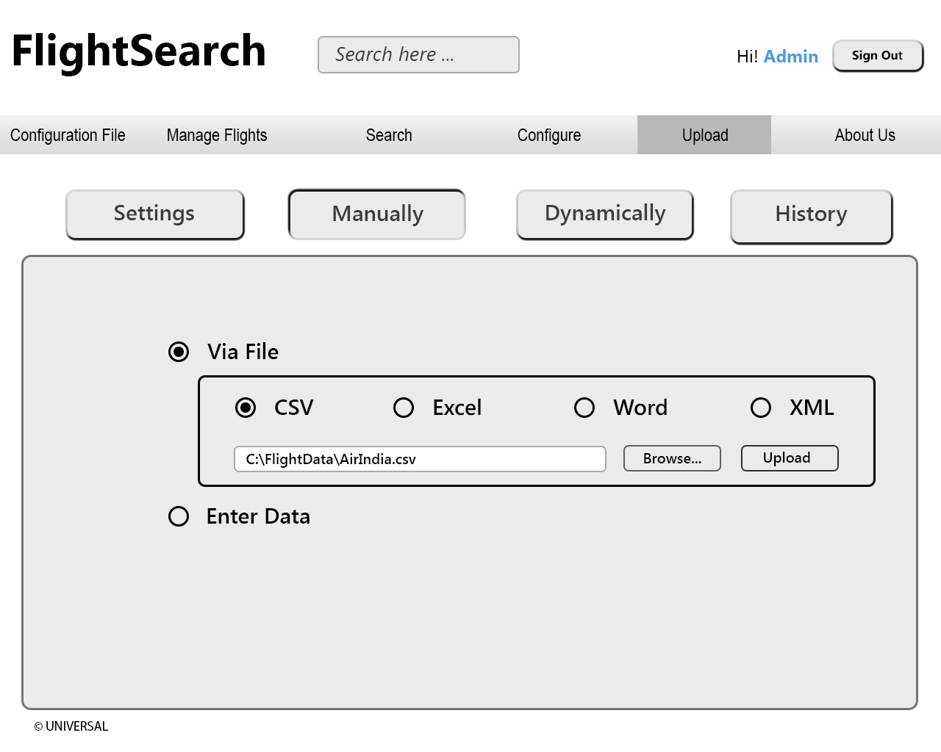
Flight Operations: Upload via File

Slide 29
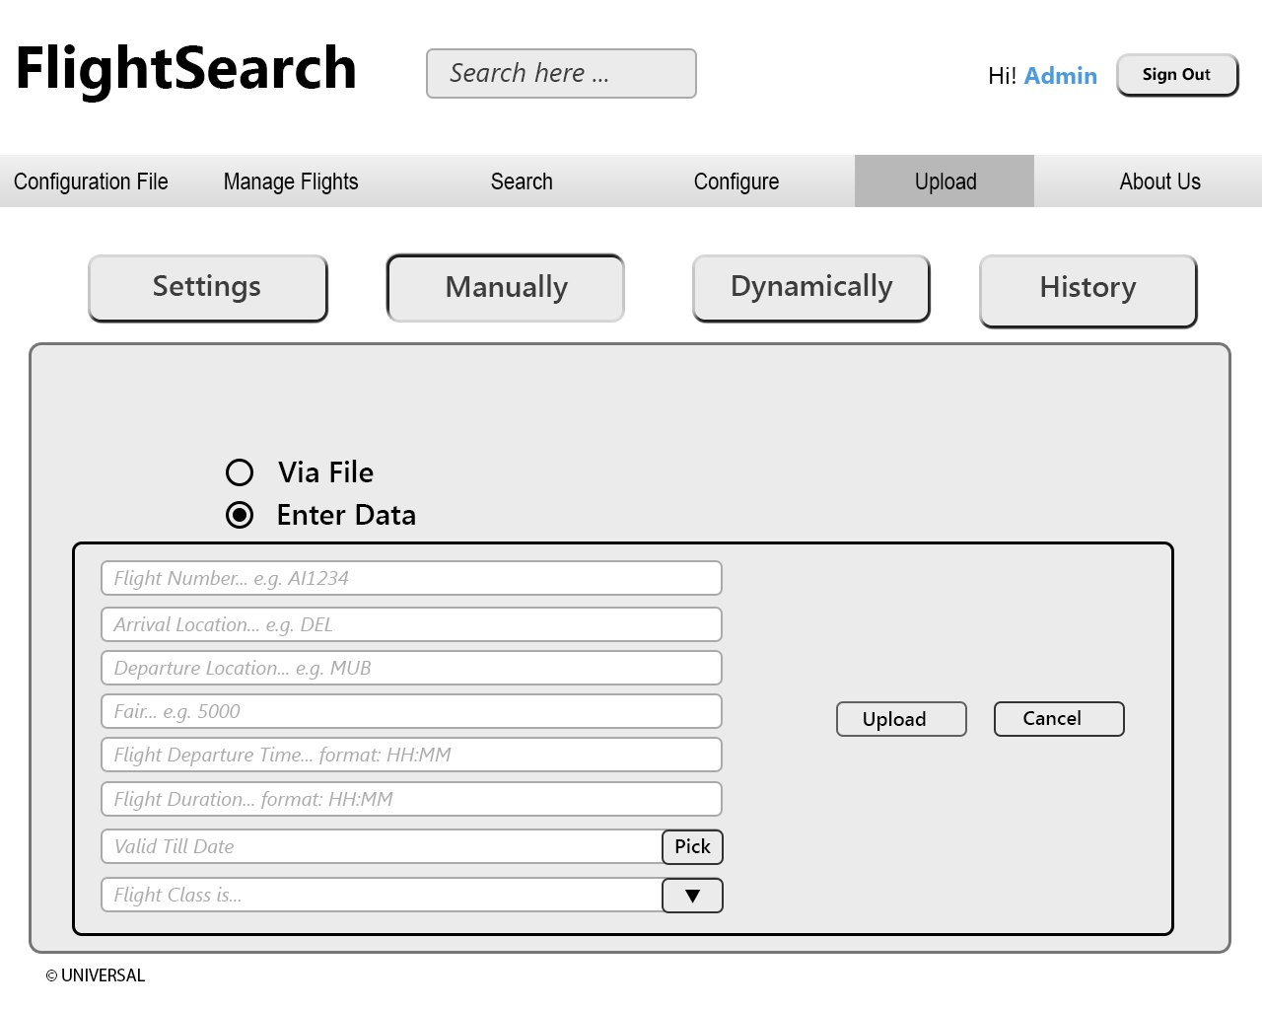
Add new Flight

Slide 30
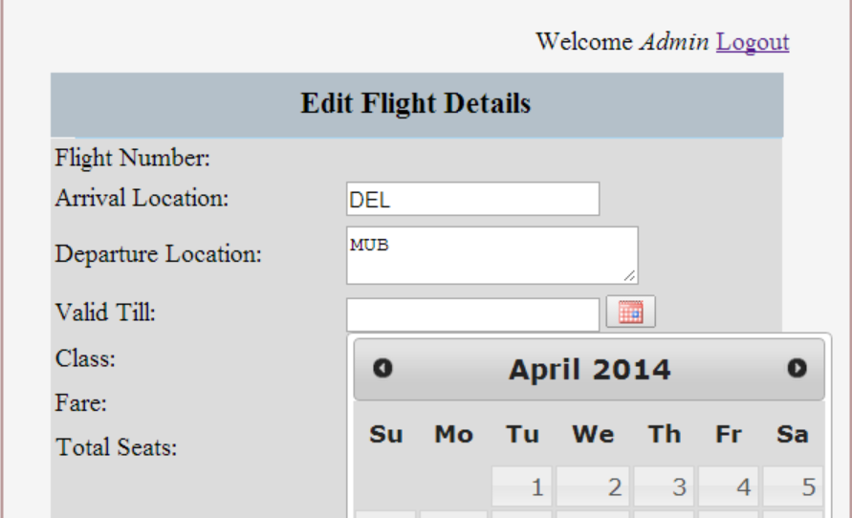
Edit Flight Detail

Slide 31
Delete Flight
Manage Flights
Upload
Edit
Edit Flight
Delete Flight
Delete
Cancel

Slide 32
About Spring
Spring is the most popular application development framework for enterprise java
Developers use this framework to create high performing, easy testable, reusable code.

Slide 33
Benefits of Using Spring Framework
Following is the list of few of the great benefits of using Spring Framework:
• Spring enables developers to develop enterprise-class applications using POJOs. The benefit of using only POJOs is that you do not need an EJB container product such as an application server but you have the option of using only a robust servlet container such as Tomcat or some commercial product.
• Spring is organized in a modular fashion. Even though the number of packages and classes are substantial, you have to worry only about ones you need and ignore the rest.
• Spring does not reinvent the wheel instead, it truly makes use of some of the existing technologies like several ORM frameworks, logging frameworks, JEE, other view technologies.

Slide 34
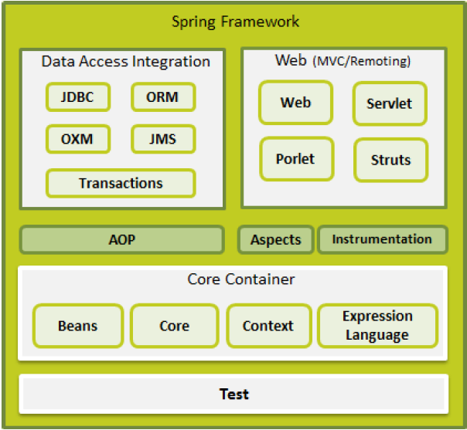

Slide 35
Spring famous for:
The technology that Spring is most identified with are Dependency Injection(DI) and Aspect oriented programming(AOP).

Slide 36
Dependency Injection (DI)
When writing a complex Java application, application classes should be as independent as possible of other Java classes to increase the possibility to reuse these classes and to test them independently of other classes while doing unit testing. Dependency Injection helps in gluing these classes together and same time keeping them independent.
Here the dependency part translates into an association between two classes. For example, class A is dependent on class B. Now, let's look at the second part, injection. All this means is that class B will get injected into class A by the DI.
Dependency injection can happen in the way of passing parameters to the constructor or by post-construction using setter methods.

Slide 37
Aspect Oriented Programming(AOP)
The functions that span multiple points of an application are called cross-cutting concerns and these cross-cutting concerns are conceptually separate from the application's business logic. There are various common good examples of aspects including logging, declarative transactions, security, and caching etc.
In AOP the unit of modularity is the aspect .
DI helps you decouple your application objects from each other, AOP helps you decouple cross-cutting concerns from the objects that they affect.
AOP allows you to define aspects and pointcuts to cleanly decouple code that implements functionality that should be separated.

Slide 38
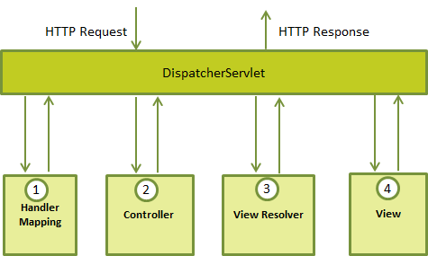
Spring request handling workflow
Notes:
Following is the sequence of events corresponding to an incoming HTTP request to DispatcherServlet:
1)After receiving an HTTP request, DispatcherServlet consults the HandlerMapping to call the appropriate Controller.
2)The Controller takes the request and calls the appropriate service methods based on used GET or POST method. The service method will set model data based on defined business logic and returns view name to the DispatcherServlet.
3)The DispatcherServlet will take help from ViewResolver to pickup the defined view for the request.
4)Once view is finalized, The DispatcherServlet passes the model data to the view which is finally rendered on the browser.

Slide 39
Logging
SLF4J with Log4j.
The Simple Logging Facade for Java (SLF4J) serves as a simple facade or abstraction for various logging frameworks, such as java.util.logging, logback and log4j.
SLF4J allows the end-user to plug in the desired logging framework at deployment time.

Slide 40
Snapshots

Slide 41
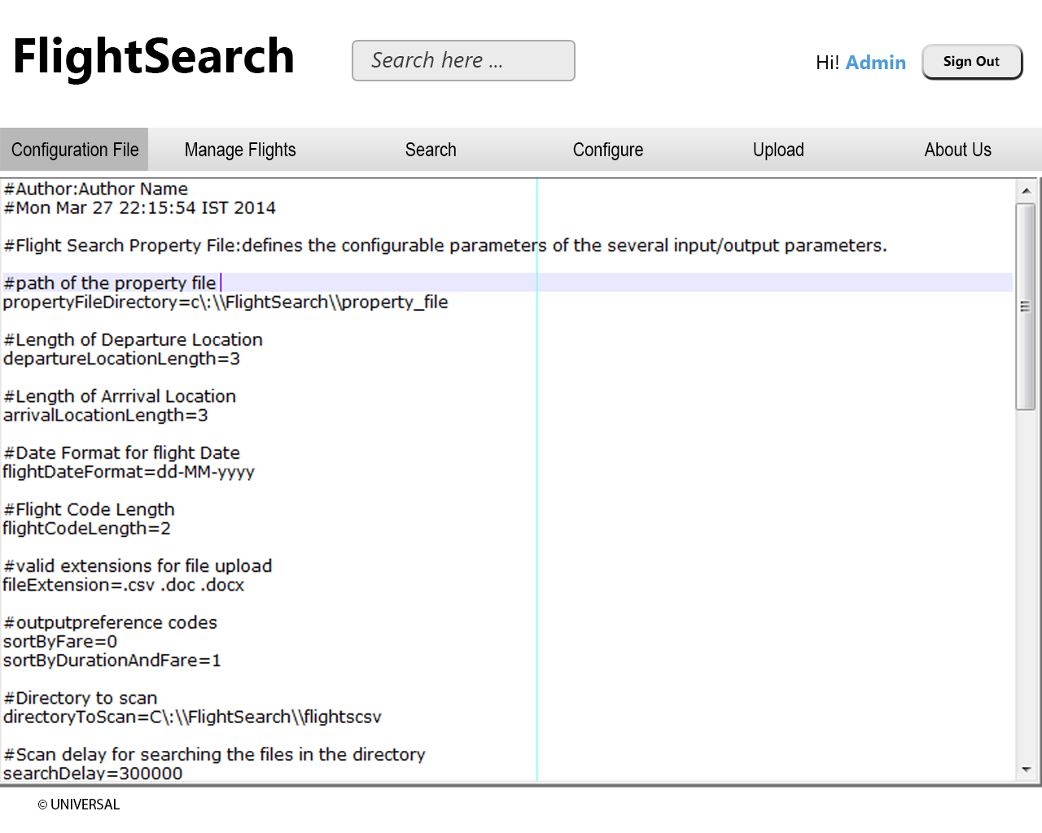
Editing Configuration File

Slide 42
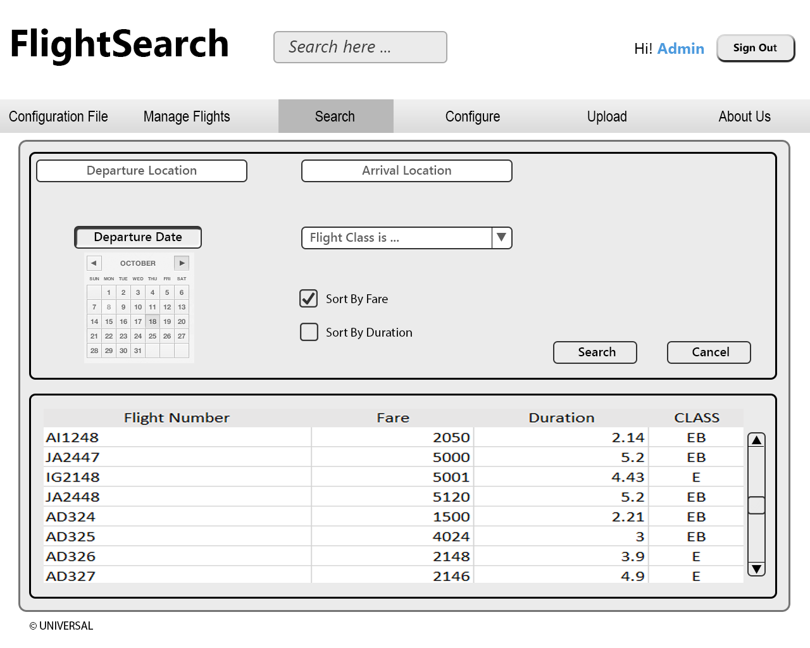
Search

Slide 43
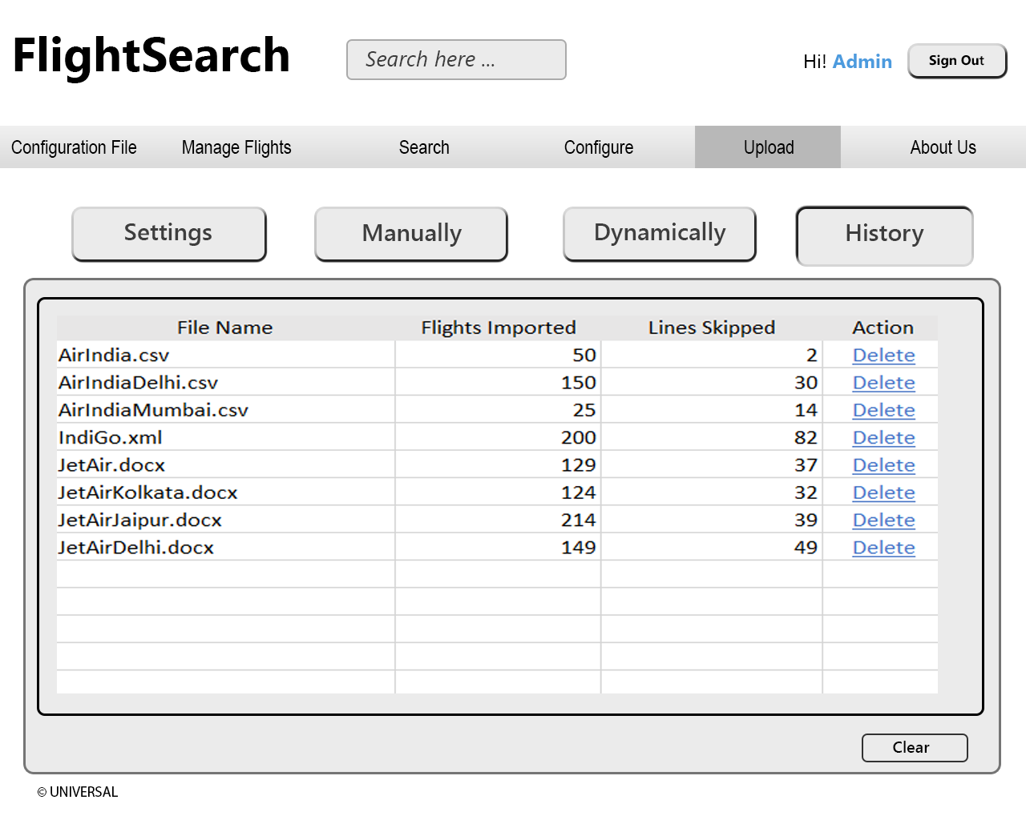
Upload History

Slide 44
Future Scope
We can enhance the system to implement it with flight booking system, along with payment gateways.
A facility can be provided for new administrator registration. As the data increases, more administrators will be required.

Slide 45
Future Scope
We can enhance the system to implement it with flight booking system, along with payment gateways.
A facility can be provided for new administrator registration. As the data increases, more administrators will be required.

Slide 46
References
Books:
Head First Design Patterns by Kathy Sierra and Bert Bates © 2009
Head First Hibernate by Bryan Basham ,Kathy Sierra and Bert Bates © 2009
Head First Java by Kathy Sierra and Bert Bates © 2009
Head First Servlets and JSP by Bryan Basham ,Kathy Sierra and Bert Bates © 2009
Java 6 Programming Black Book ,New Ed by Kogent Solution Inc © 2009
Sun Certified Programmer for Java 6 Study Guide by Kathy Sierra and Bert Bates © 2009

Slide 47
Websites:
http://www.javabeginner.com/learn-java/introduction-to-java-programming
http://www.roseindia.net/jsp/
http://www.roseindia.net/servlets/
http://www.roseindia.net/jdbc/
http://www.roseindia.net/mysql/
http://www.roseindia.net/javascript/
http://www.roseindia.net/html/
http://www.roseindia.net/web-application-server/tomcat
http://www.vaannila.com/spring/spring-tutorial/spring-tutorial.html
http://www.vaannila.com/struts-2/struts-2-tutorial/struts-2-tutorial.html
http://www.vaannila.com/hibernate/hibernate-tutorial/hibernate-tutorial.html

Slide 48
Thank You

