Slide 1
PSCS_143-Mental health and well-being surveillance, assessment and tracking solution among children.
PIP4004 Capstone Project
Review-1
Batch Number: ISR-G03
Roll Number | Student Name
Susheeth G | 20211ISR0036
Ritish N | 20211ISR0047
Vidyashree BN | 20211ISR0039
Mithali S Anand | 20211ISR0082
Tejashwini BA | 20211ISR0040
Under the Supervision of,
Dr.Murali Parameswaran
Professor
School of Computer Science and Engineering
Presidency University
Name of the Program: B.TECH. INFORMATION SCIENCE &ENGINEERING (AI AND ROBOTICS)
Name of the HoD: Dr. Zafar Ali Khan
Name of the Program Project Coordinator: Dr.Afroz Pasha
Name of the School Project Coordinators: Dr. Sampath A K / Dr. Abdul Khadar A / Mr. Md Ziaur Rahman

Slide 2
Introduction
The proposed model/software aims to assess and improve the mental health of students by identifying potential issues and providing tailored solutions.It will utilize questionnaires, AI-based analysis, or psychological models to evaluate students' mental well-being based on their responses and behavior patterns.
The software will recommend personalized strategies, such as mindfulness exercises, counseling resources, and self-improvement techniques, to help students cope with stress and anxiety.
By addressing mental health challenges, the model will contribute to a healthier academic environment, enhance students' emotional resilience, and improve overall productivity and well-being.

Slide 3
Problem Statement
Title : Mental health and well-being surveillance, assessment and tracking solution among children.
Problem Statement Number: PSCS_143
Problem Description: The aim of the project is to develop a software-based solution for assessing, tracking, and improving the mental health of students. It will utilize smart education technologies to provide automated mental health assessments and continuous monitoring. The system will generate reports and insights to help educators, parents, and mental health professionals intervene effectively. It will also offer self-help resources and expert consultation options for students in need. Ultimately, the project aims to create a supportive environment that enhances students' emotional well-being and academic performance.
Category (Hardware / Software / Both) : Software
Difficulty Level: Complicated

Slide 4
Github Link
The Github link provided should have public access permission.
Github Link
https://github.com/susheeth1/MindSight

Slide 5
Proposed Method
User Interaction: The process begins with the user taking the DASS-21 test, which collects responses related to stress, anxiety, and depression.
Data Collection: The responses are sent to the backend system for processing, ensuring secure storage and handling of user data.
Processing & Analysis: Machine learning models analyze the responses, classifying mental health conditions based on predefined criteria. Various models like Random Forest, SVM, and Logistic Regression may be used for accurate classification.
Results & Reports: Insights from the analysis are displayed to the user, providing a summary of their mental health status, including potential risk levels and recommendations.

Slide 6
Literature Review
Paper Name | Authors | Publication | Technique and Primary result | Diadvantages
Prediction of Public Mental Health by using Machine Learning Algorithms | Ch.M.H. Saibaba, K V K Alekhya, K Yeshwanth, Praveen Tumuluru | IEEE | Data Science & Machine Learning. Introduces a new framework for mental health professionals to use data science for psychological health challenges. | Lacks implementation details. No specific evaluation metrics provided.
Mental Health Prediction using Natural Language Processing | R. Ranjana, T. Subha, K. L. Sreenidhi and K. Akshaya, 2022 | 2022 International Conference on Applied Artificial Intelligence and Computing (ICAAIC) | NLP (SWIVEL & Neural Networks). Uses a pre-trained NLP model to assess mental health and notify users if they need professional help. | Limited dataset scope. Ethical/privacy concerns in mental health prediction.

Slide 7

Paper Name | Authors | Publication | Technique and Primary result | Diadvantages
Predicting Mental Health Problems with Personality, Behavior, and Social Networks | Dongyu Zhang, Teng Guo, Shiyu Han, et al., 2021 | IEEE International Conference on Big Data (Big Data) | Neural Network-based Model. Integrated personality, behavior, and social networks to predict mental health problems in students. | Limited to college students. Requires extensive data collection.
A Mobile Application for Campus-Based Psychosocial Wellness Program | R Ranjana, T Subha, K L Sreenidhi, KB Akshaya, 2016 | 7th International Conference on Information, Intelligence, Systems & Applications (IISA) | Mobile Application for Mental Health Designed an app to provide mental health first aid and peer counseling for students while ensuring anonymity. | May not replace professional counseling. Effectiveness depends on user engagement.
Prediction of Personality for Mental Health Detection using Hybrid Deep Learning Model | M. K. I. Zim, M. A. Hanif and H. Kaur, 2024 | 2024 IEEE International Conference on Interdisciplinary Approaches in Technology and Management for Social Innovation (IATMSI) | K-Nearest Neighbors (KNN), Recurrent Neural Networks (RNN). KNN achieved 96.6% accuracy in predicting mental illness. - RNN detected 78.9% of early mental health symptoms based on behavioral changes. | Limited dataset diversity affects real-world generalization. RNN struggles with long-term dependencies in behavior prediction.

Slide 8
Paper Name | Authors | Publication | Technique and Primary result | Diadvantages
Prediction of Public Mental Health by using Machine Learning Algorithms | Ch.M.H. Saibaba, K V K Alekhya, K Yeshwanth, Praveen Tumuluru | 2022 Second International Conference on Artificial Intelligence and Smart Energy (ICAIS) | Supervised Learning, Data Science Methods. AI improved early detection of mental health issues. Highlighted the importance of data-driven mental health solutions. | Requires complex data preprocessing. Ethical concerns around privacy and data handling.
Modeling Mental Health: Advances in Predictive Science towards Proactive Health Care | Nithya Jayakumar, Reshma N | 2024 IEEE International Conference on (Insert Exact Conference Name) | Machine Learning Classification (SVM, Neural Networks), Systematic Literature Review, Provided a comprehensive review of ML techniques for mental health prediction. - Classified disorders like schizophrenia, bipolar disorder, and OCD. | Lacks experimental validation on real-world datasets. Challenges in personalizing mental health predictions.

Slide 9
Paper Name | Authors | Publication | Technique and Primary result | Diadvantages
Application of Machine Learning to Predict Mental Health Disorders and Interpret Feature Importance | Yifan Li, 2023 | 2023 3rd International Symposium on Computer Technology and Information Science (ISCTIS) | Random Forest, Grid Search. Achieved 79.78% accuracy using Cross Gradient Booster for mental health disorder prediction. | Focuses on feature importance rather than real-time prediction. Model may be biased based on dataset limitations.
Mental Health Analysis of Employees using Machine Learning Techniques | Sujal BH, Neelima K, Deepanjali C, Bhuvanashree P, Kavitha Duraipandian, Sharanya Rajan | 2022 14th International Conference on Communication Systems & Networks (COMSNETS) | Decision Trees, Logistic Regression, Random Forest, Identified workplace stressors affecting employees’ mental health. Showed significant impact of company policies and mental health history. | Bias in self-reported data reduces accuracy. Lacks real-time monitoring capabilities for employees.

Slide 10
Dataset
Dataset Overview: Depression (DASS-21) and Emotional Reactivity (ERS) – Indonesian Sample
Title: Data Set of Depression (DASS 21) and Emotional Reactivity (ERS) – Indonesian
DOI: 10.17632/sk27t97ymb.1
Published: April 26, 2024
Contributors: Moondore Ali, Esther Widhi Andangsari, Wahyu Syahputra, Greta Paramita, Ade Kemala
Institution: Bina Nusantara University
Funding: International Research Grant from Bina Nusantara University (No: 029/VRRTT/III/2023)
License: Creative Commons CC BY 4.0

Slide 11
DASS-21 (details)
📋 Description
This dataset comprises responses from an Indonesian population to two psychological assessments:
Depression Anxiety Stress Scales (DASS-21):
Sample Size: 746 participants
Subscales: Depression, Anxiety, Stress
Emotion Reactivity Scale (ERS):
Sample Size: 438 participants
Subscales: Sensitivity, Intensity, Persistence

Slide 12
DASS-21 (details)
The DASS-21 dataset contains 746 rows (participants) and 32 columns, including demographic details and responses to 21 DASS items. The ERS dataset has 438 rows and 26 columns, covering emotional reactivity components like sensitivity, intensity, and persistence, along with demographic info.

Slide 13
Objectives
A web-based application to assess and analyze children's mental health, helping parents and teachers to monitor their well-being.
Provide insights about stress, anxiety, and depression levels using machine learning models like Random Forest, SVM, and Logistic Regression.

Slide 14
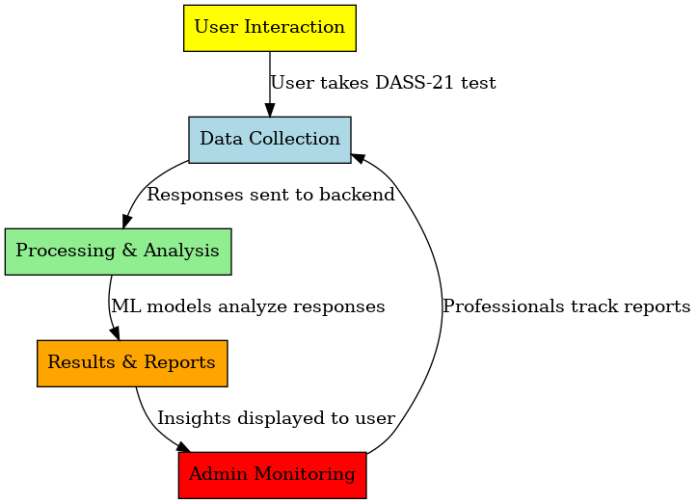
Methodology
User Interaction: The process begins with the user taking the DASS-21 test, which collects responses related to stress, anxiety, and depression.
Data Collection: The responses are sent to the backend system for processing, ensuring secure storage and handling of user data.
Processing & Analysis: Machine learning models analyze the responses, classifying mental health conditions based on predefined criteria. Various models like Random Forest, SVM, and Logistic Regression may be used for accurate classification.
Results & Reports: Insights from the analysis are displayed to the user, providing a summary of their mental health status, including potential risk levels and recommendations.
Admin Monitoring: Mental health professionals track reports and monitor trends to provide further assistance, ensuring the reliability and effectiveness of the system.

Slide 15
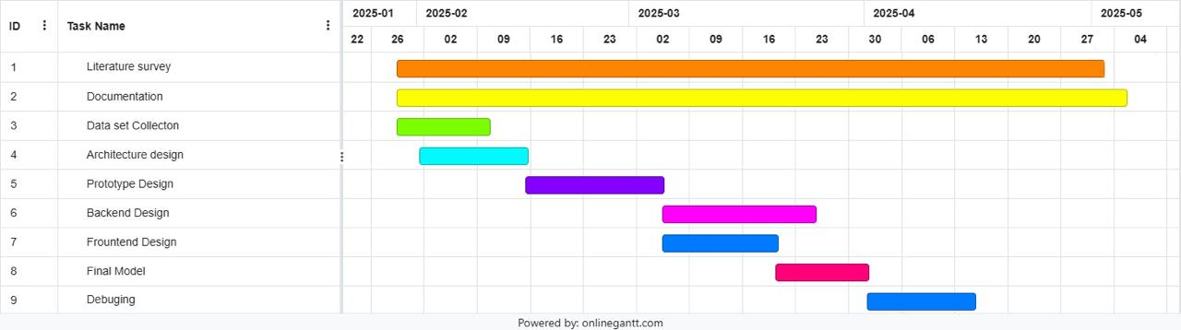
Timeline of Project Edit it

Slide 16
Expected Outcomes
Improved accuracy and efficiency of the system will demonstrate the effectiveness of machine learning in mental health prediction.
The application will help parents and teachers track children's mental health using the DSSA dataset, providing better awareness and early detection of issues.
By using machine learning models like Random Forest, SVM, and Logistic Regression, it will offer real-time insights into stress, anxiety, and depression, allowing timely support and intervention.

Slide 17
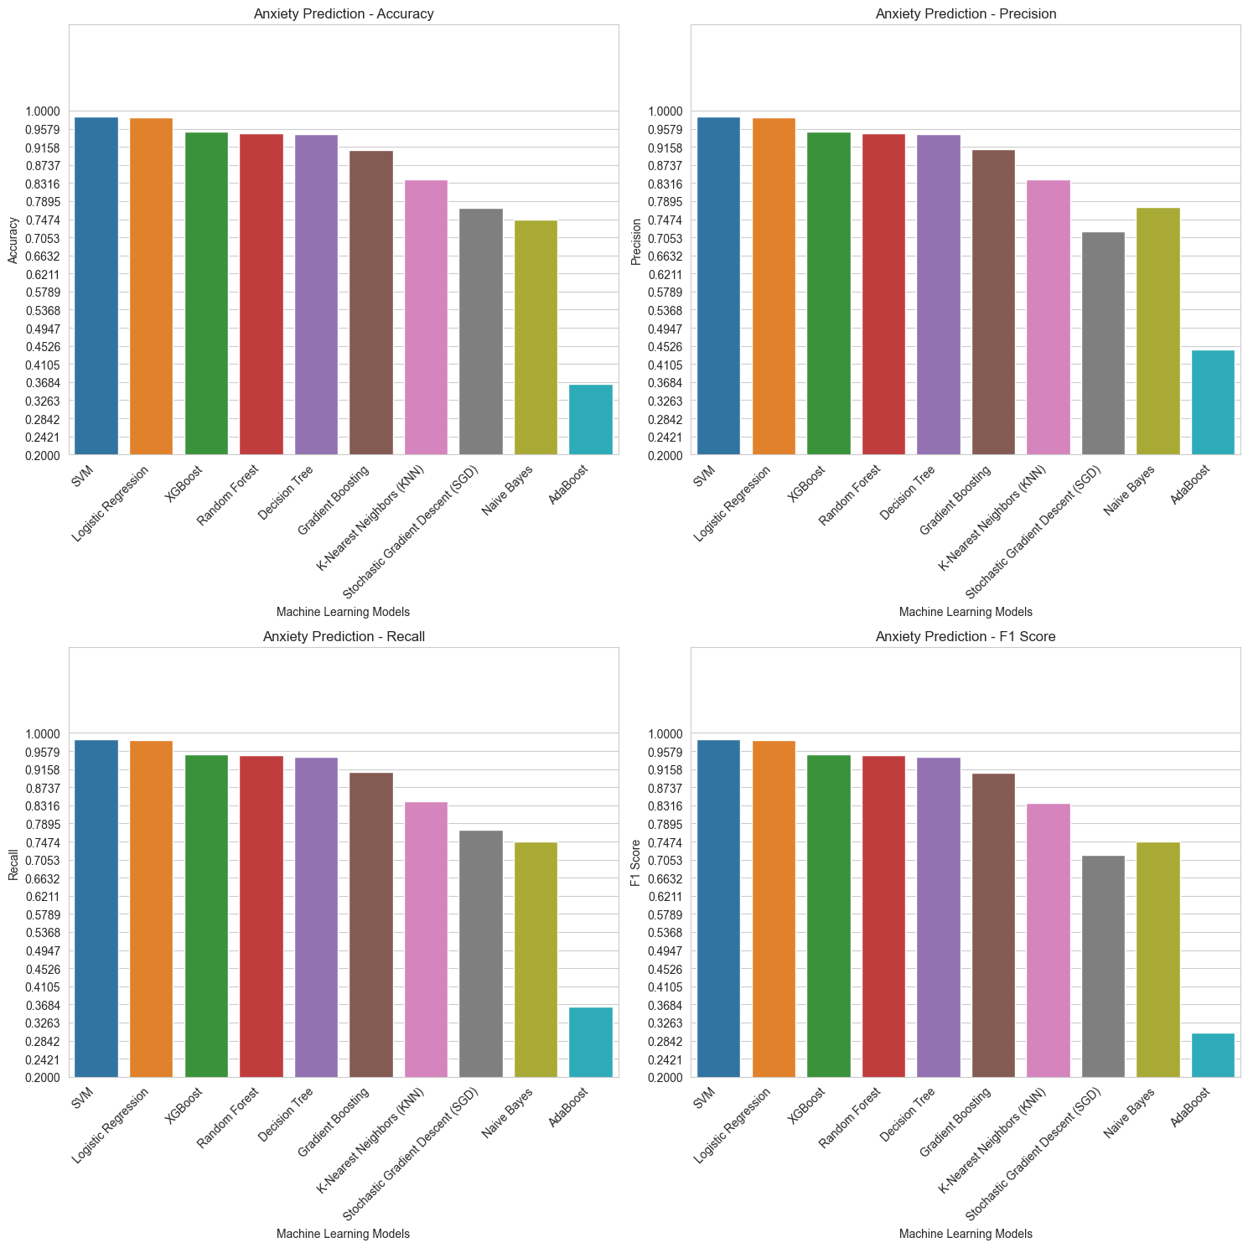
Outcomes
Improved accuracy and efficiency of the system will demonstrate the effectiveness of machine learning in mental health prediction.

Slide 18
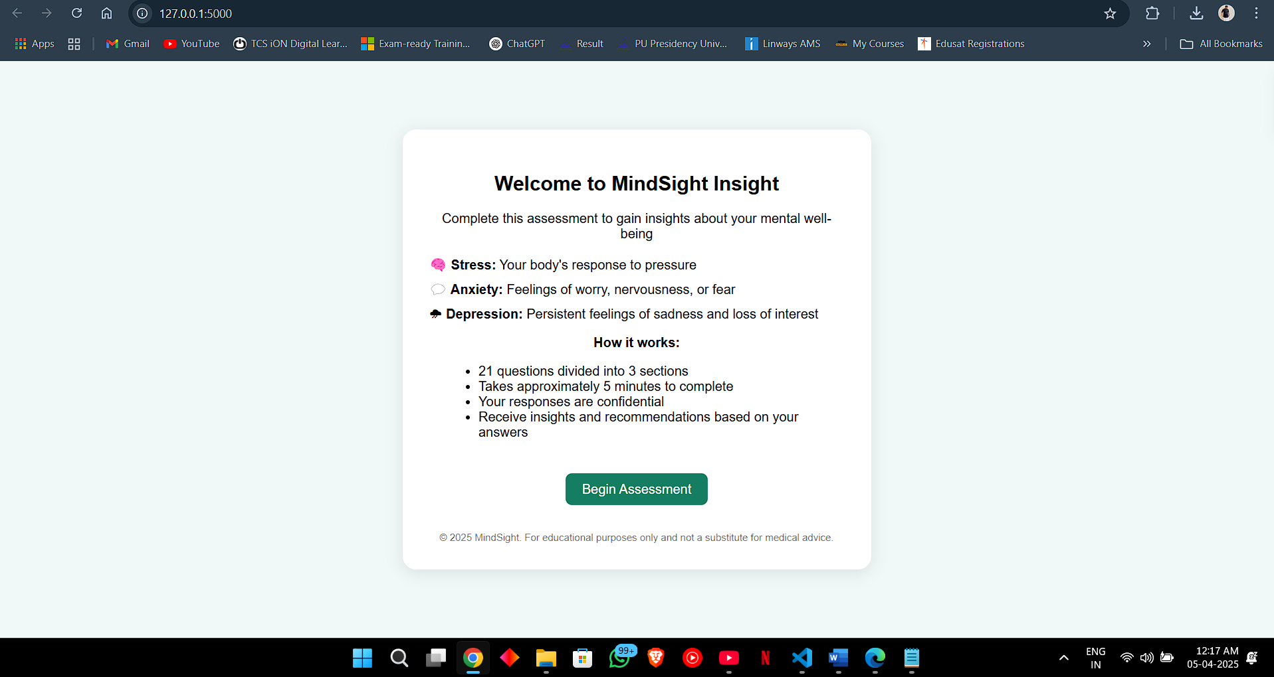
Outcomes
Improved accuracy and efficiency of the system will demonstrate the effectiveness of machine learning in mental health prediction.

Slide 19
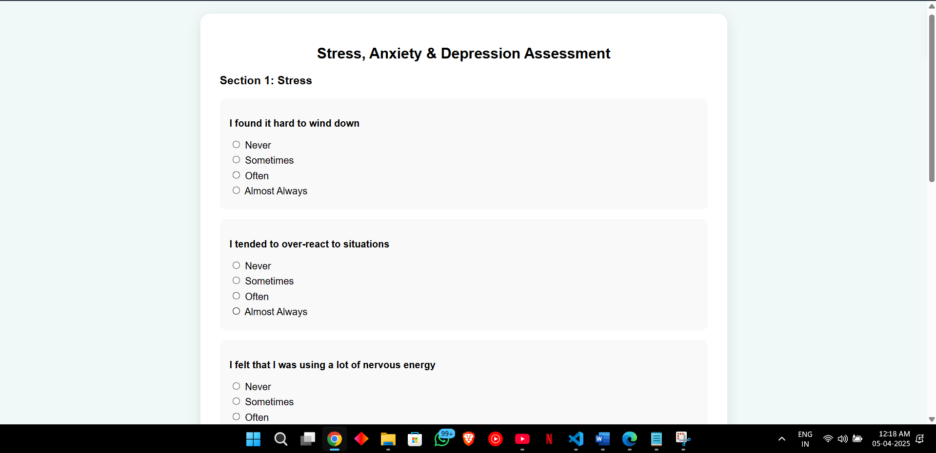
Outcomes
Improved accuracy and efficiency of the system will demonstrate the effectiveness of machine learning in mental health prediction.

Slide 20
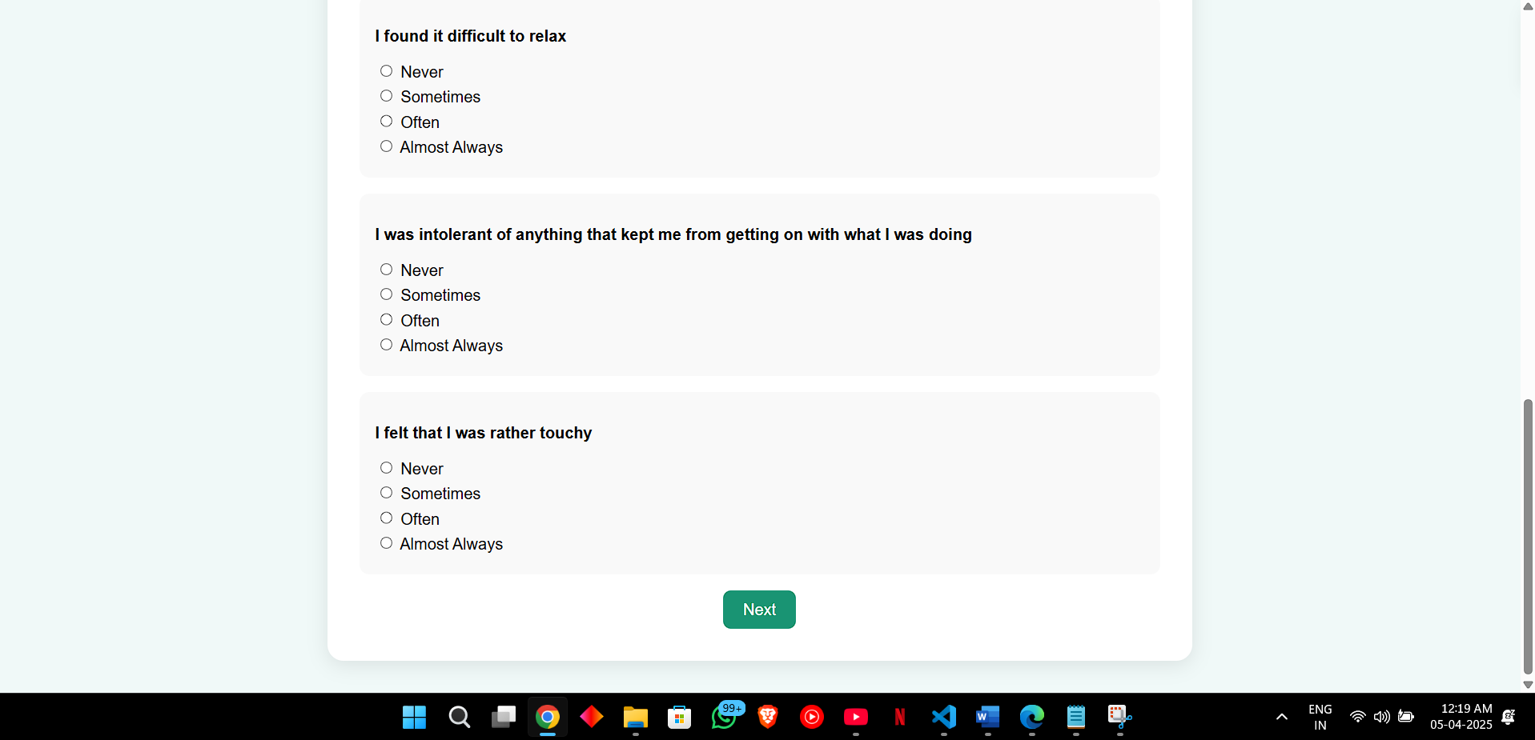
Outcomes
Improved accuracy and efficiency of the system will demonstrate the effectiveness of machine learning in mental health prediction.

Slide 21
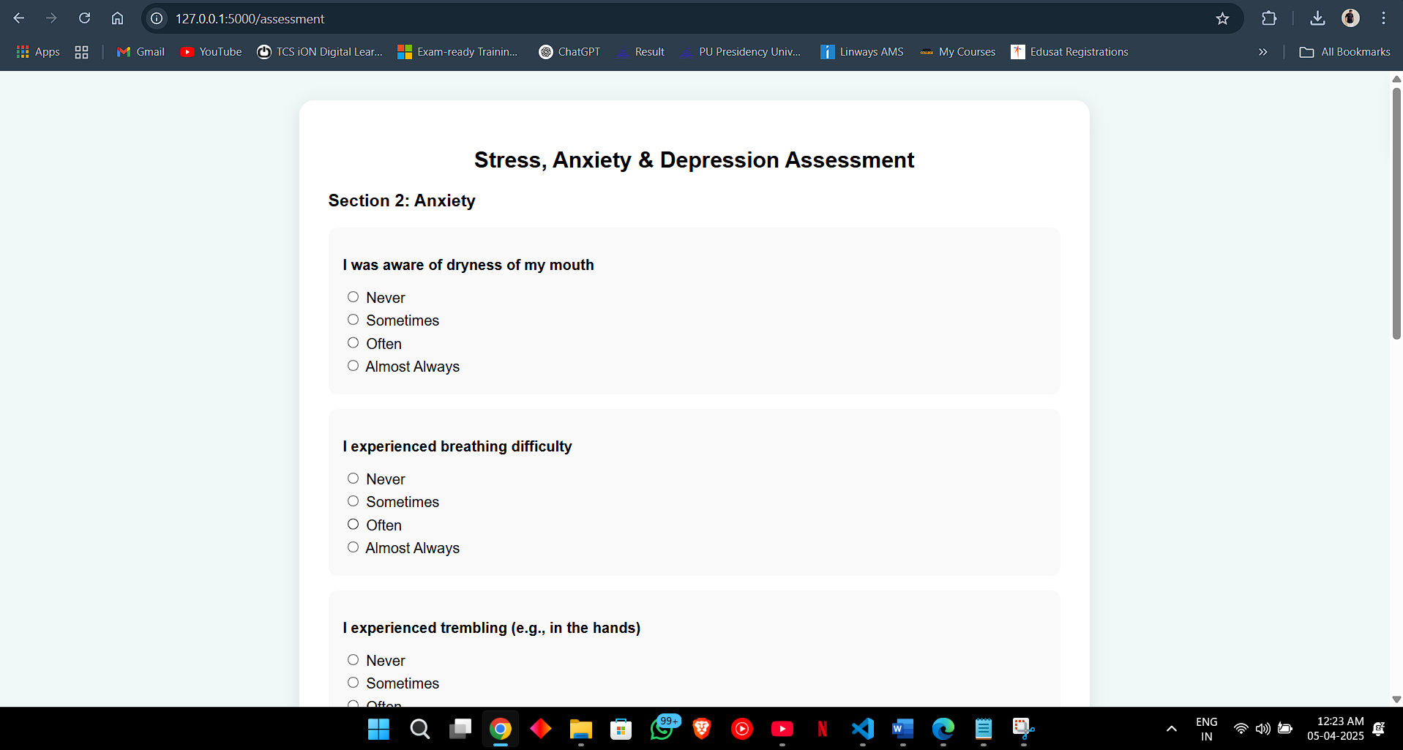
Outcomes
Improved accuracy and efficiency of the system will demonstrate the effectiveness of machine learning in mental health prediction.

Slide 22
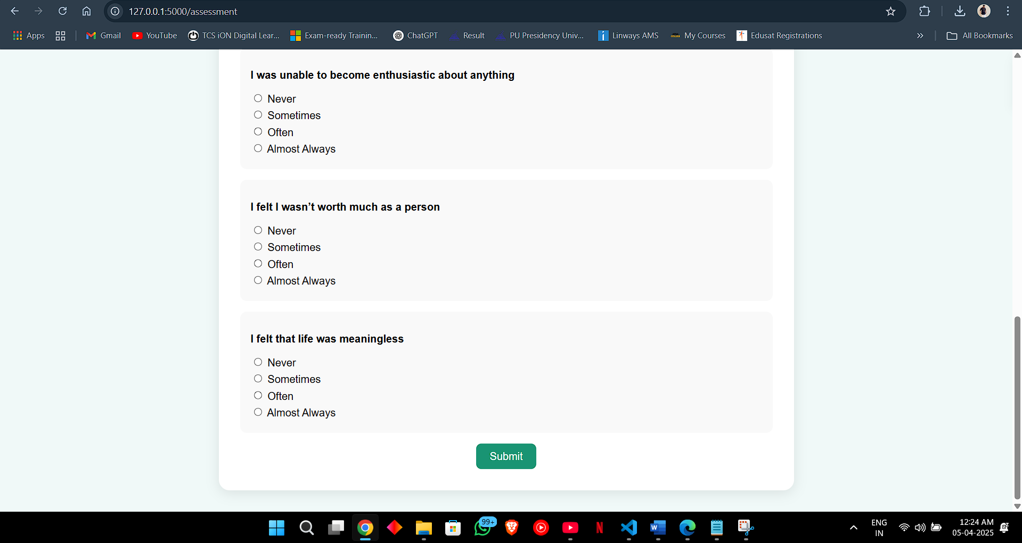
Outcomes
Improved accuracy and efficiency of the system will demonstrate the effectiveness of machine learning in mental health prediction.

Slide 23
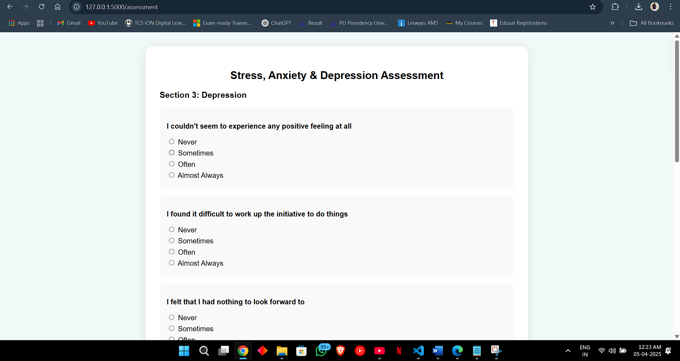
Outcomes
Improved accuracy and efficiency of the system will demonstrate the effectiveness of machine learning in mental health prediction.

Slide 24
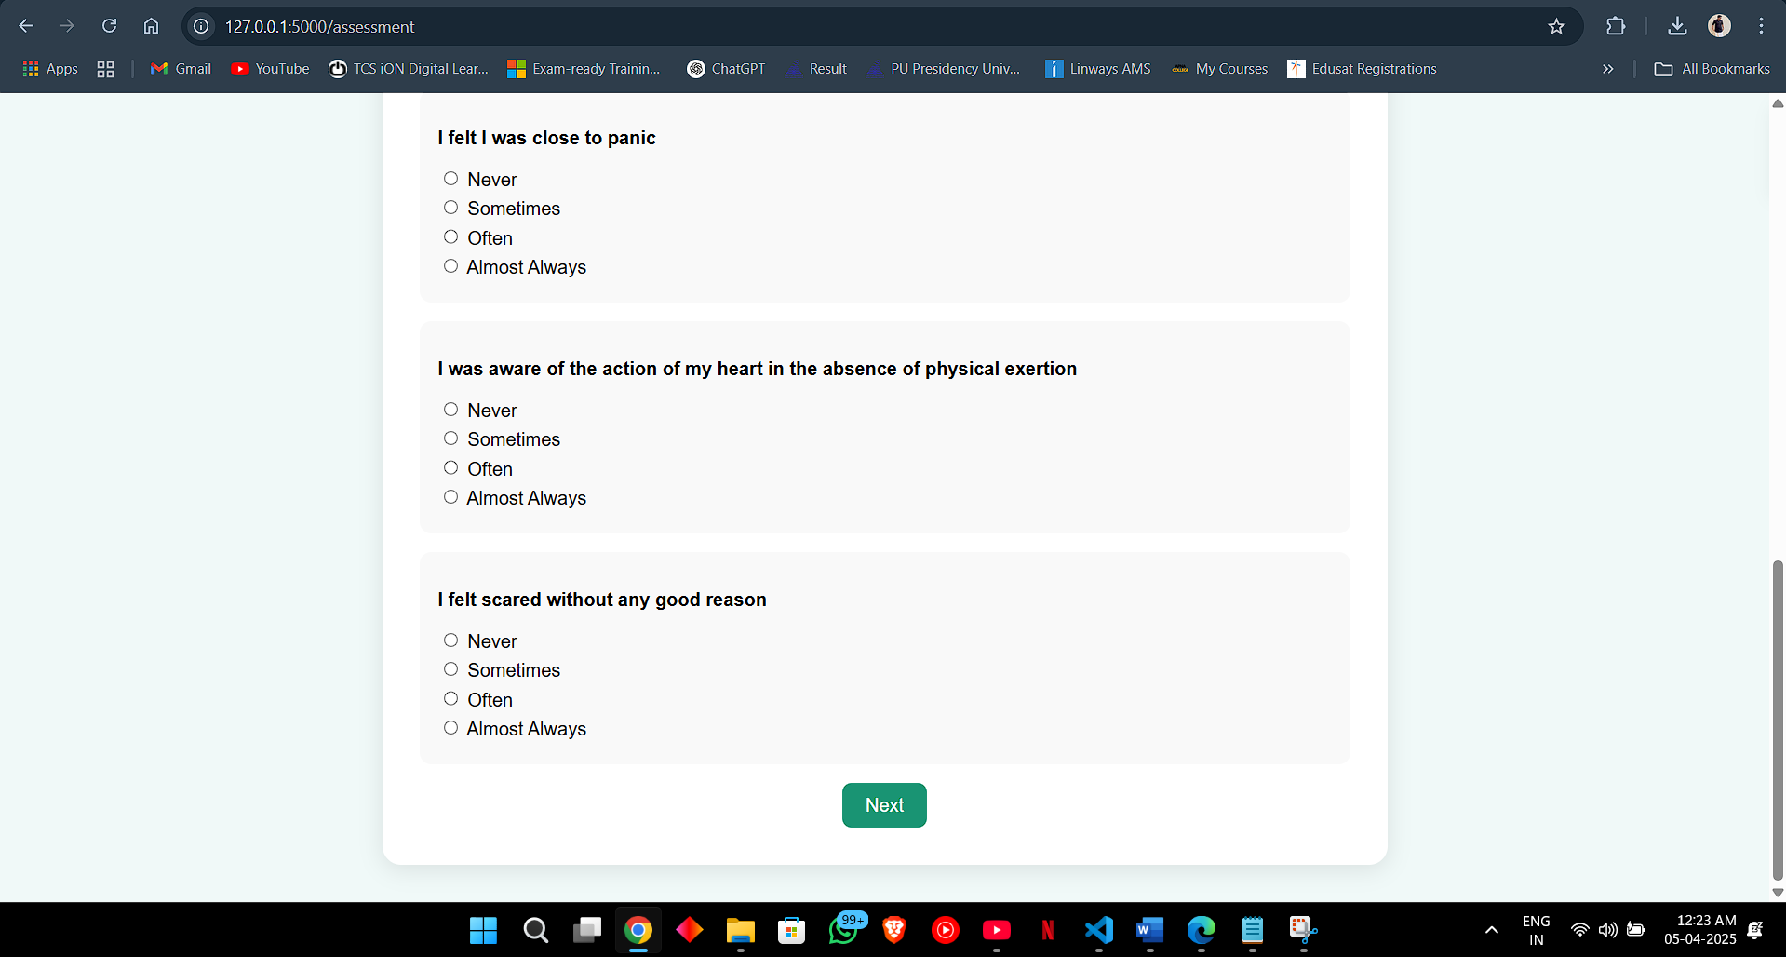
Outcomes
Improved accuracy and efficiency of the system will demonstrate the effectiveness of machine learning in mental health prediction.

Slide 25
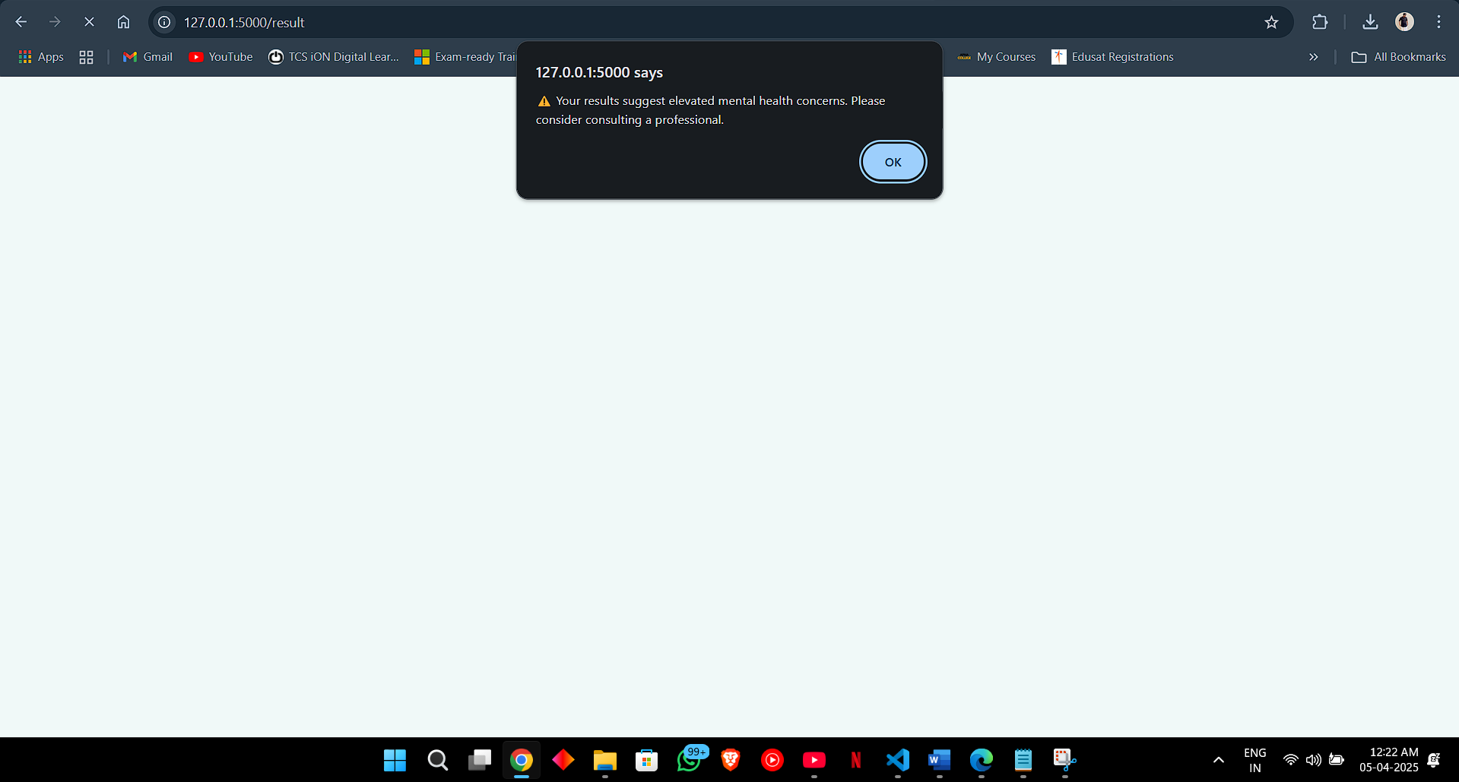
Outcomes
Improved accuracy and efficiency of the system will demonstrate the effectiveness of machine learning in mental health prediction.

Slide 26
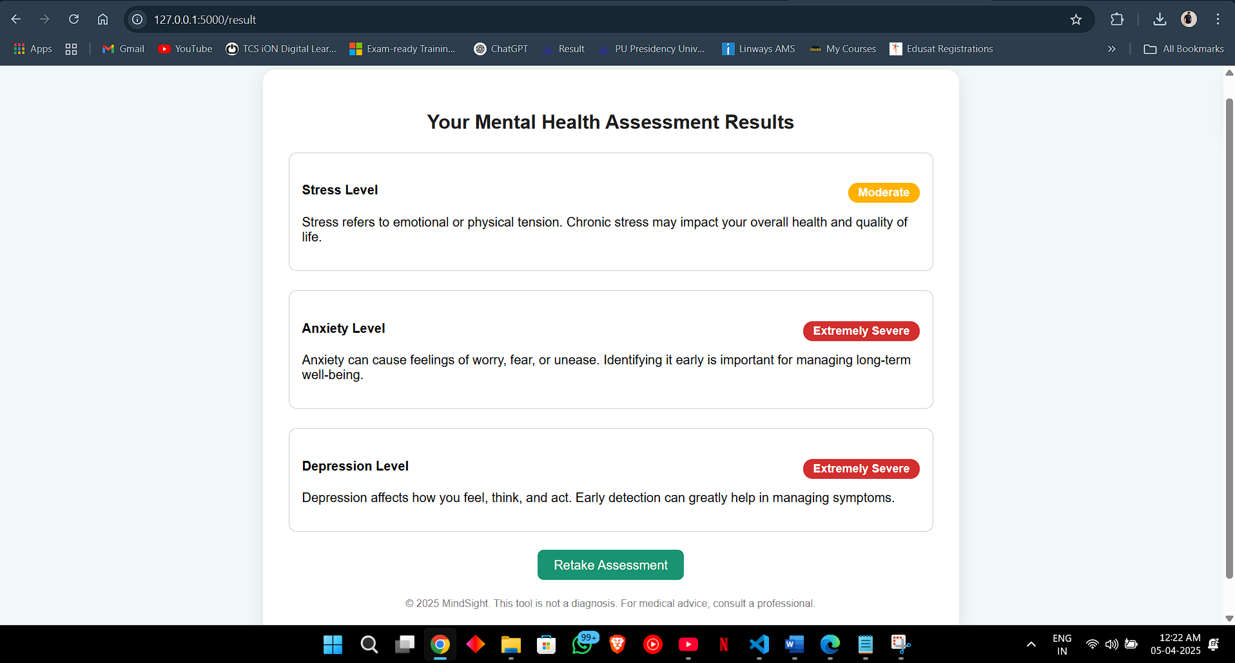
Outcomes
Improved accuracy and efficiency of the system will demonstrate the effectiveness of machine learning in mental health prediction.

Slide 27
Conclusion
This web application uses the DSSA dataset to check children's mental health, helping parents and teachers understand their well-being.
It uses machine learning models like Random Forest, SVM, and Logistic Regression to give results on stress, anxiety, and depression, helping in early support and care.

Slide 28
References
C. M. H. Saibaba, K. V. K. Alekhya, K. Yeshwanth and P. Tumuluru, "Prediction of Public Mental Health by using Machine Learning Algorithms," 2022 Second International Conference on Artificial Intelligence and Smart Energy (ICAIS), Coimbatore, India, 2022, pp. 308-311, doi: 10.1109/ICAIS53314.2022.9742837.
R. Ranjana, T. Subha, K. L. Sreenidhi and K. Akshaya, "Mental Health Prediction using Natural Language Processing," 2022 International Conference on Applied Artificial Intelligence and Computing (ICAAIC), Salem, India, 2022, pp. 824-828, doi: 10.1109/ICAAIC53929.2022.9792893.
Y. Li, "Application of Machine Learning to Predict Mental Health Disorders and Interpret Feature Importance," 2023 3rd International Symposium on Computer Technology and Information Science (ISCTIS), Chengdu, China, 2023, pp. 257-261, doi: 10.1109/ISCTIS58954.2023.10213032.
D. Zhang, T. Guo, S. Han, S. Vahabli, M. Naseriparsa and F. Xia, "Predicting Mental Health Problems with Personality, Behavior, and Social Networks," 2021 IEEE International Conference on Big Data (Big Data), Orlando, FL, USA, 2021, pp. 4537-4546, doi: 10.1109/BigData52589.2021.9671987.
C. E. R. Booc, C. M. D. San Diego, M. L. Tee and J. D. L. Caro, "A mobile application for campus-based psychosocial wellness program," 2016 7th International Conference on Information, Intelligence, Systems & Applications (IISA), Chalkidiki, Greece, 2016, pp. 1-4, doi: 10.1109/IISA.2016.7785426.

Slide 29
M. K. I. Zim, M. A. Hanif and H. Kaur, "Prediction of personality for mental health detection using hybrid deep learning model," 2024 IEEE International Conference on Interdisciplinary Approaches in Technology and Management for Social Innovation (IATMSI), Gwalior, India, 2024, pp. 1-6, doi: 10.1109/IATMSI60426.2024.10503423.
S. BH et al., "Mental Health Analysis of Employees using Machine Learning Techniques," 2022 14th International Conference on COMmunication Systems & NETworkS (COMSNETS), Bangalore, India, 2022, pp. 1-6, doi: 10.1109/COMSNETS53615.2022.9668526.
C. M. H. Saibaba, K. V. K. Alekhya, K. Yeshwanth and P. Tumuluru, "Prediction of Public Mental Health by using Machine Learning Algorithms," 2022 Second International Conference on Artificial Intelligence and Smart Energy (ICAIS), Coimbatore, India, 2022, pp. 308-311, doi: 10.1109/ICAIS53314.2022.9742837.
N. Jayakumar and R. N, "Modeling Mental Health: Advances in Predictive Science towards Proactive Health Care," 2024 IEEE International Conference for Women in Innovation, Technology & Entrepreneurship (ICWITE), Bangalore, India, 2024, pp. 202-206, doi: 10.1109/ICWITE59797.2024.10503111.

Slide 30
Thank You

