Slide 1
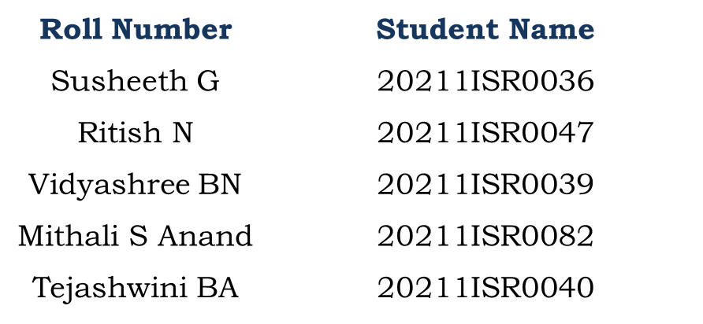
PSCS190-Examination Timetable Generation
PIP104 University Project-II
Review-1
Batch Number:ISR-G03
Under the Supervision of,
Dr. Murali Parameswaran
Professor
School of Computer Science & Engineering
Presidency University
Name of the Program: B.TECH. INFORMATION SCIENCE &ENGINEERING (AI AND ROBOTICS)
Name of the HoD: Dr. Zafar Ali Khan
Name of the Program Project Coordinator: Dr.Afroz Pasha
Name of the School Project Coordinators: Dr. Sampath A K / Dr. Abdul Khadar A / Mr. Md Ziaur Rahman

Slide 2
Introduction
In educational institutions, creating examination timetables is crucial for smooth exam management. Traditional manual methods are inefficient and prone to conflicts. The Examination Timetable Generation System automates this process by considering constraints like room availability, student registrations, and instructor schedules. This report describes the design, development, and implementation of an automated system that uses scheduling algorithms to generate optimal, conflict-free timetables.

Slide 3
Literature Review
Title of Paper | Key Findings
Autonomous Timetable System Using Genetic Algorithm. | The study employs *evolutionary algorithms* and *context-based reasoning* to solve the timetabling problem effectively. - *Adaptive mutation techniques* were used to improve convergence and speed up the timetable generation process.
Automated Timetabling System for University Course | The proposed algorithm improves efficiency and accuracy, significantly reducing the time and effort required for manual timetable creation.
Final exam timetabling: a practical approach | The generator successfully avoids exam conflicts, prevents students from having three consecutive exams, and meets the required number of exams per period, resulting in minimal scheduling issues for students.
A hybrid swarm-based approach to university timetabling | The approach significantly improves solution quality and convergence speed, outperforming state-of-the-art methods across diverse benchmark datasets

Slide 4
A Survey of Solution Methodologies for Exam Timetabling Problems | The need for updated benchmarks and innovative solutions to enhance resource utilization in ETP.
Timetable Recovery After Disturbances in Metro Operations: An Exact and Efficient Solution | Rescheduling up to five upstream trips can improve service regularity by up to 30%, demonstrating superiority over heuristic methods.
Title of Paper
Key Findings

Slide 5
Real-Time Scheduling of Massive Data in Time Sensitive Networks With a Limited Number of Schedule Entries | The approach successfully created *feasible timetables* for real-world data from a university, demonstrating practical applicability and efficiency
Genetic Algorithms With Guided and Local Search Strategies for University Course Timetabling | The proposed algorithms demonstrate promising results on benchmark problems, improving search efficiency and solution quality compared to state-of-the-art methods

Slide 6
Proposed Method
Genetic Algorithm
Concept: Mimics the process of natural selection to find optimal solutions.
Process:
Population Initialization: Create an initial population of possible timetables.
Fitness Evaluation: Assess each timetable based on constraints satisfaction (e.g., conflicts, resource utilization).
Selection: Choose the best-performing timetables for reproduction.
Crossover: Combine elements of two parent timetables to create offspring.
Mutation: Introduce random changes to offspring to explore new solutions.
Iteration: Repeat the evaluation and selection process until an optimal or satisfactory timetable is achieved.
First-Come, First-Serve (FCFS)
Concept: A simple scheduling method where exams are scheduled in the order they are received.
Process:
Data Collection: Gather exams in the order of requests or by priority.
Slot Assignment: Assign the first available time slot to each exam sequentially, checking for conflicts.
Limitations: While straightforward, this method may lead to conflicts or uneven distribution of exams, requiring adjustments later.

Slide 7
Objectives
We are working to automate the creation of examination timetables, ensuring conflict-free scheduling for both students and resources. Our aim is to optimize the allocation of rooms and instructor availability while adhering to constraints such as room capacities and ensuring adequate breaks between exams. Additionally, we aim to reduce the strain on faculty by minimizing scheduling conflicts and allowing more balanced workloads.
We are working to scale the system to handle large datasets involving multiple departments, students, and exams. Additionally, we are focused on providing a user-friendly interface to simplify data input and streamline timetable management for efficient use by faculty and administrators.

Slide 8
Methodology
Requirement Gathering and Analysis:
Engaging stakeholders helps identify the constraints and needs of different groups involved in the timetable, ensuring alignment with real-world requirements.
Data Collection and Preprocessing:
Clean and organized data ensures that the scheduling algorithm receives accurate input, preventing errors in the generated timetable.
Timetable Generation Algorithm:
Clustering and collaborative filtering techniques optimize exam distribution by minimizing overlaps and balancing student workload.
Development of Web Application:
A web application allows easy interaction, where administrators can generate and adjust the timetable without needing direct access to the backend code.

Slide 9
Methodology
Testing and Validation:
Running the generated timetable against historical and simulated data ensures it meets constraints and doesn't cause conflicts for students or faculty.
Deployment and Monitoring:
Real-time deployment and monitoring allow updates to be made seamlessly if course or faculty schedules change unexpectedly.
Maintenance and Iteration:
Continuous feedback and regular updates to the algorithm ensure the system adapts to new data and evolving institutional requirements.

Slide 10
Hardware/software components
SOFTWARE COMPONENTS
Operating System: Windows, macOS, or Linux
Programming Language: Python, Java, or similar for algorithm development
Database: MySQL, PostgreSQL, or equivalent for storing course and exam data
IDE: Visual Studio Code, PyCharm, or Eclipse for development
Optimization Tools: Constraint satisfaction libraries (e.g., Google OR-Tools, PuLP) for scheduling algorithms
User Interface: Web framework (React, Angular, or similar) or desktop interface for displaying timetables
Version Control: Git for code management
Deployment Platform: Cloud-based server (e.g., AWS, Azure) or local server for hosting the application
HARDWARE COMPONENTS
Processor: Intel i5 or higher
RAM: 8 GB or more
Storage: 256 GB SSD or higher
Internet Connection: For accessing cloud services or hosting platform
Display: Standard monitor or laptop display for development and UI testing

Slide 11
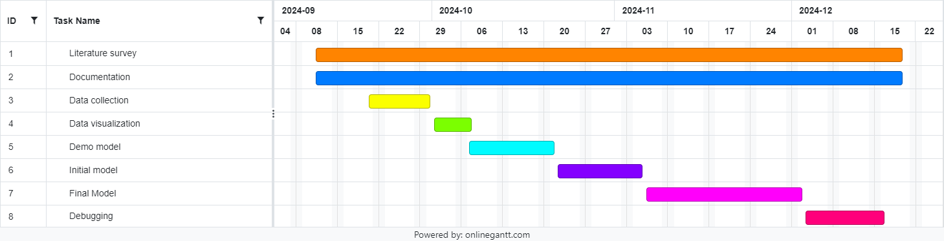
Timeline of Project

Slide 12
Expected Outcomes
Conflict-Free Schedule
All exams are scheduled without overlaps for students and instructors, ensuring that no student is assigned to multiple exams at the same time.
Optimized Resource Utilization
Efficient use of available venues and resources, minimizing idle time and maximizing the number of exams that can be conducted.
Fair Distribution of Exam Loads
Balanced scheduling that minimizes the number of consecutive exams for students and distributes exam times evenly across the available days.
User-Friendly Interface
A clear, accessible interface for students and faculty to view the timetable, with features like search and filtering options.
Adaptability and Flexibility
Ability to accommodate last-minute changes, such as instructor unavailability or venue conflicts, with minimal disruption to the overall schedule.
Data-Driven Insights
Reports and analytics on exam scheduling patterns, allowing for continuous improvement in future scheduling processes.
Increased Satisfaction
Higher satisfaction levels among students and faculty due to a fair and well-structured timetable that respects their preferences and needs.
Reduced Administrative Burden
Streamlined processes for scheduling and managing exams, freeing up administrative resources for other tasks.
Scalability
A system capable of handling increased complexity as the number of courses and students grows, ensuring continued efficiency.
Compliance with Regulations
Adherence to institutional policies and educational regulations regarding exam scheduling.

Slide 13
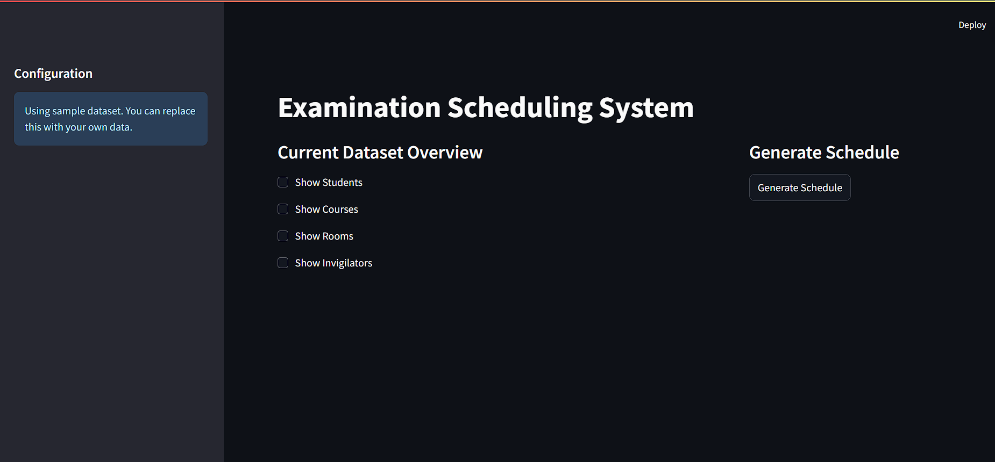
Progress Output

Slide 14
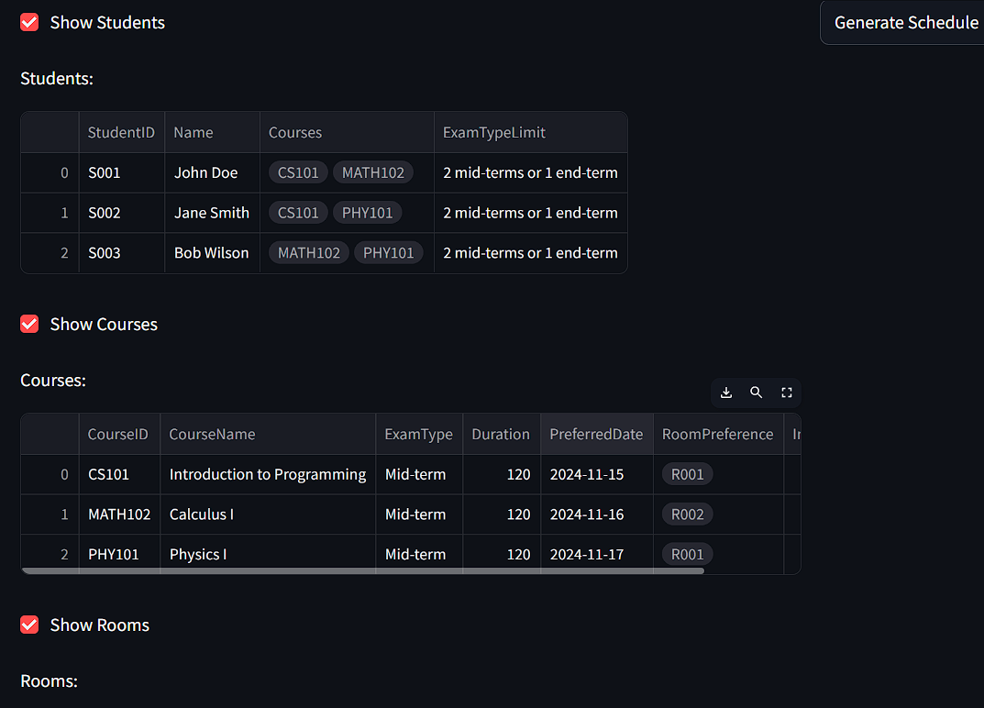
Progress Output

Slide 15
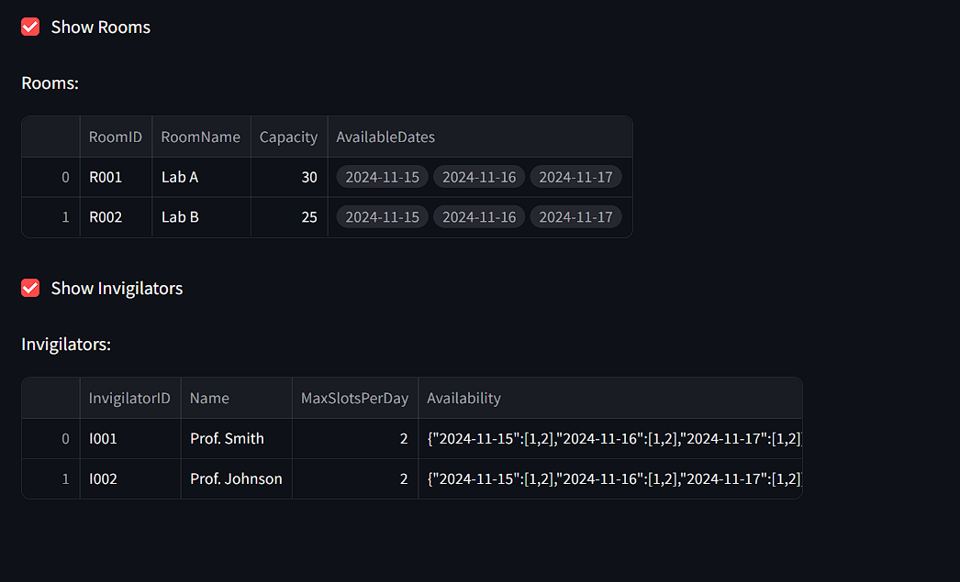
Progress Output

Slide 16
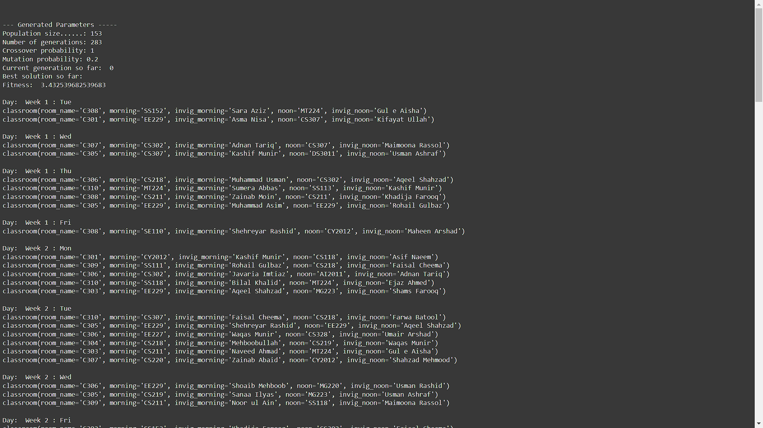
Progress Output

Slide 17
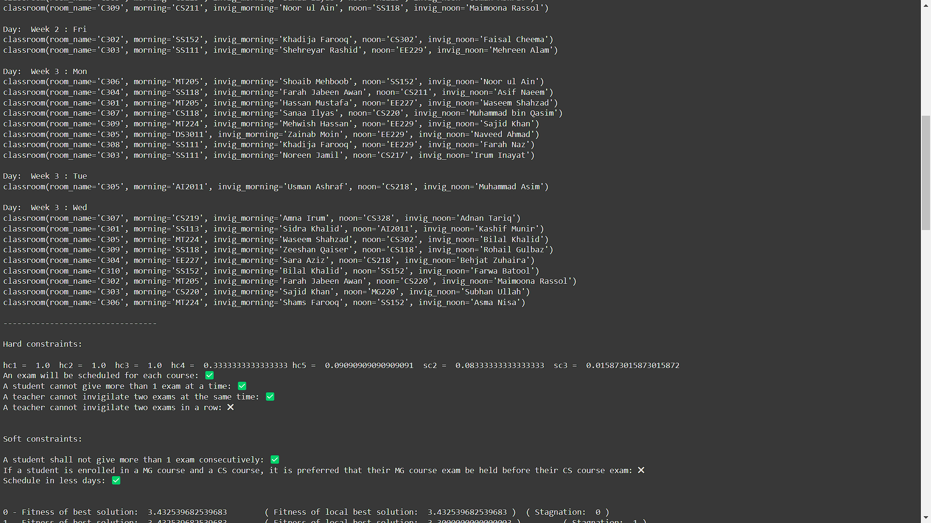
Progress Output

Slide 18
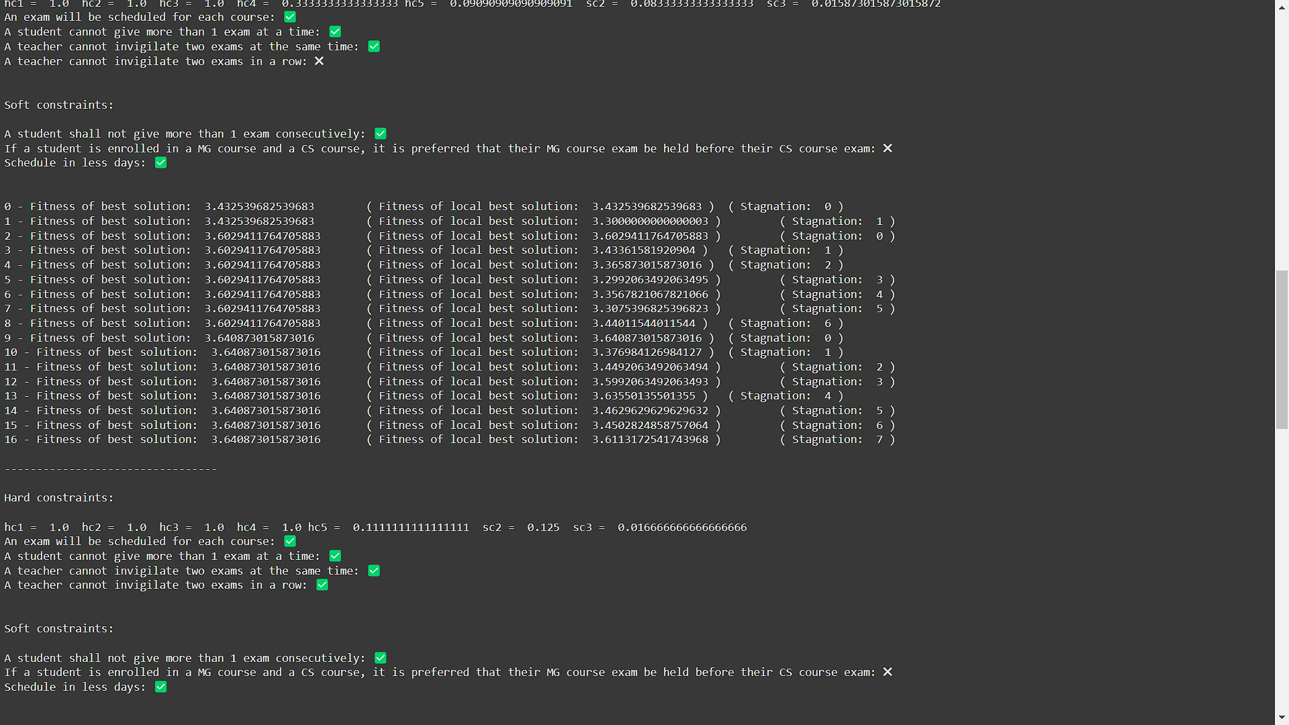
Progress Output

Slide 19
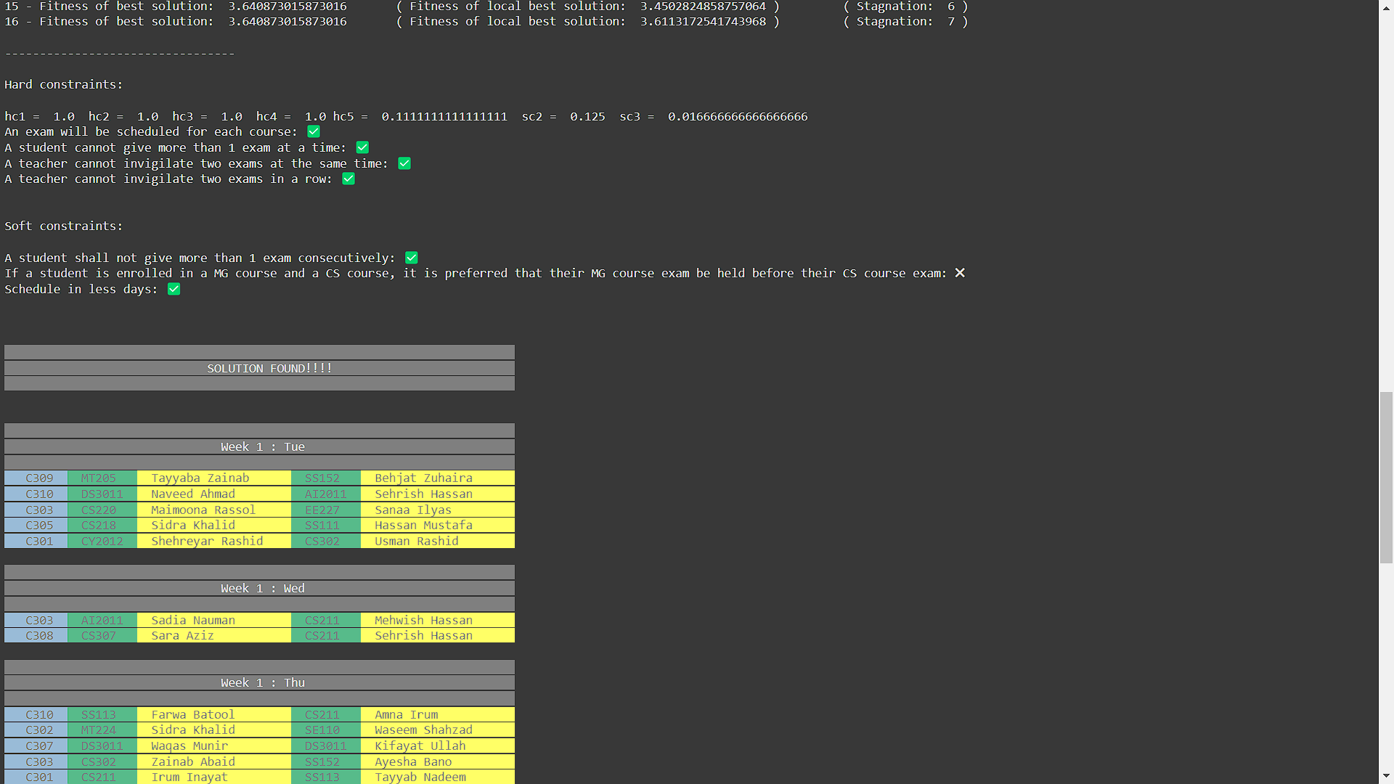
Progress Output

Slide 20
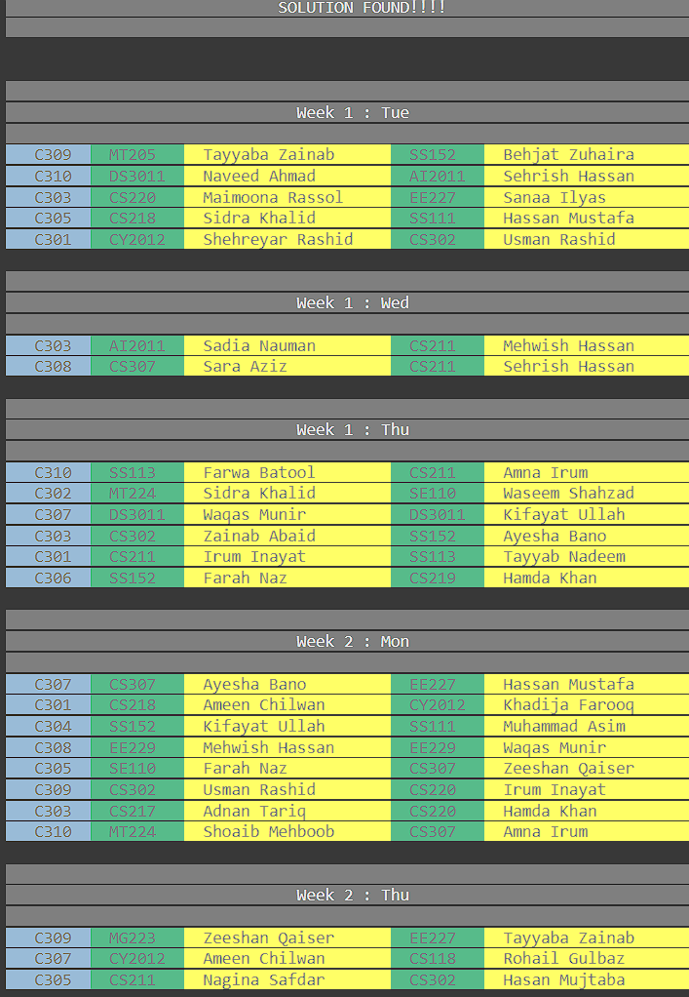
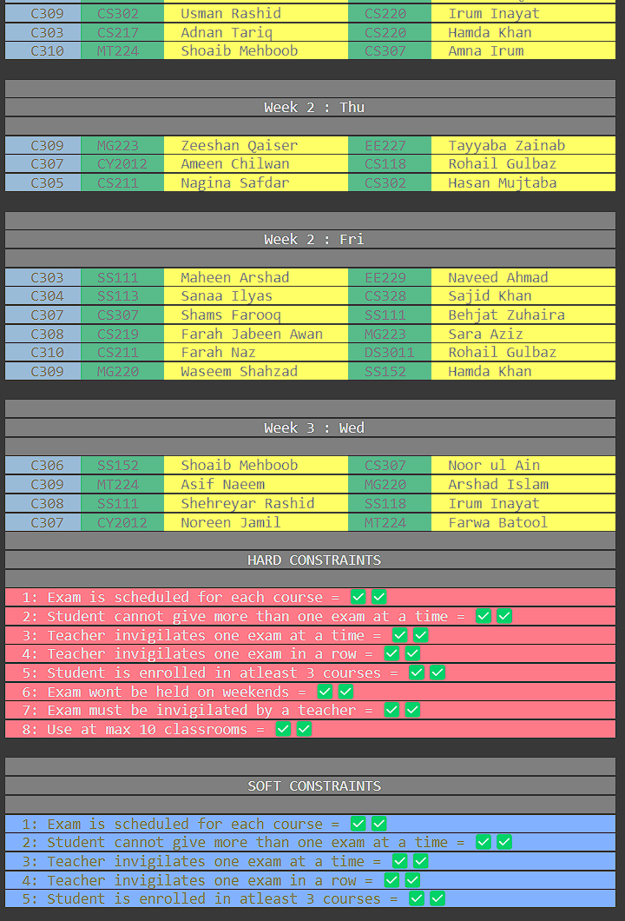
Progress Output

Slide 21
Conclusion
The Examination Timetable Generation System significantly improves the efficiency and accuracy of the scheduling process in educational institutions. By automating timetable creation using algorithms like First-Come First-Served, Greedy Algorithm, and Genetic Algorithm, the system ensures conflict-free schedules while optimizing room and resource utilization.
It successfully addresses challenges associated with manual scheduling, such as human error and resource allocation conflicts. The system is scalable, capable of handling large datasets, and adaptable to different institutional needs. The user-friendly interface further enhances its usability for administrators. Overall, this project demonstrates the potential of advanced scheduling algorithms to streamline administrative tasks and improve academic operations.

Slide 22

Github Link
https://github.com/susheeth1/Timetable-scheduling-problem-for-university-examinations/tree/main

Slide 23
References
Y. S. Chaudhari, V. W. Dmello, S. S. Shah and P. Bhangale, "Autonomous Timetable System Using Genetic Algorithm," 2022 4th International Conference on Smart Systems and Inventive Technology (ICSSIT), Tirunelveli, India, 2022, pp. 1687-1694, doi: 10.1109/ICSSIT53264.2022.9716370.
M. C. Sárkány and A. Kovács, "Timetable generator and optimizer for Hungarian university students," 2023 IEEE 17th International Symposium on Applied Computational Intelligence and Informatics (SACI), Timisoara, Romania, 2023, pp. 000667-000672
T. Wong, P. Cote and P. Gely, "Final exam timetabling: a practical approach," IEEE CCECE2002. Canadian Conference on Electrical and Computer Engineering. Conference Proceedings (Cat. No.02CH37373), Winnipeg, MB, Canada, 2002, pp. 726-731 vol.2, doi: 10.1109/CCECE.2002.1013031.
Fong, C. W., Asmuni, H., & McCollum, B. (2015). A hybrid swarm-based approach to university timetabling. IEEE Transactions on Evolutionary Computation, 19(6), 870-884.
. S. K. Siew, S. N. Sze, S. L. Goh, G. Kendall, N. R. Sabar and S. Abdullah, "A Survey of Solution Methodologies for Exam Timetabling Problems," in IEEE Access, vol. 12, pp. 41479-41498, 2024

Slide 24
6. H. Kanemitsu, M. Hanada and H. Nakazato, "Clustering-Based Task Scheduling in a Large Number of Heterogeneous Processors," in IEEE Transactions on Parallel and Distributed Systems, vol. 27, no. 11, pp. 3144-3157, 1 Nov. 2016
7. R. Nand, E. Reddy, K. Chaudhary and B. Sharma, "Preference-Based Stepping Ahead Firefly Algorithm for Solving Real-World Uncapacitated Examination Timetabling Problem," in IEEE Access, vol. 12, pp. 24685-24699, 2024, doi: 10.1109/ACCESS.2024.3365734
8. D. Srinivasan, Tian Hou Seow and Jian Xin Xu, "Automated time table generation using multiple context reasoning for university modules," Proceedings of the 2002 Congress on Evolutionary Computation. CEC'02 (Cat. No.02TH8600), Honolulu, HI, USA, 2002, pp. 1751-1756 vol.2, doi: 10.1109/CEC.2002.1004507.
9. K. Gkiotsalitis and O. Cats, "Timetable Recovery After Disturbances in Metro Operations: An Exact and Efficient Solution," in IEEE Transactions on Intelligent Transportation Systems, vol. 23, no. 5, pp. 4075-4085, May 2022, doi: 10.1109/TITS.2020.3041151.
10. X. Jin et al., "Real-Time Scheduling of Massive Data in Time Sensitive Networks With a Limited Number of Schedule Entries," in IEEE Access, vol. 8, pp. 6751-6767, 2020, doi: 10.1109/ACCESS.2020.2964690.

Slide 25
11. S. Yang and S. N. Jat, "Genetic Algorithms With Guided and Local Search Strategies for University Course Timetabling," in IEEE Transactions on Systems, Man, and Cybernetics, Part C (Applications and Reviews), vol. 41, no. 1, pp. 93-106, Jan. 2011, doi: 10.1109/TSMCC.2010.2049200.

Slide 26
Thank You

