Slide 1
MapReduce Joins
Shalish.V.J
Notes:
Click to edit the notes format
<number>

Slide 2
A Refresher on Joins
A join is an operation that combines records from two or more data sets based on a field or set of fields, known as the foreign key
The foreign key is the field in a relational table
that matches the column of another table
Notes:
Click to edit the notes format
<number>

Slide 3
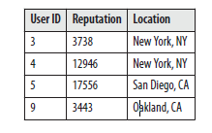
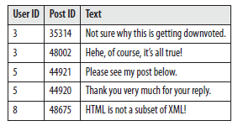
Sample Data Sets : A & B
Two data sets A and B, with the foreign key defined as f
Notes:
Click to edit the notes format
<number>

Slide 4
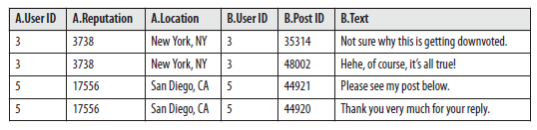
Inner Join
Notes:
Click to edit the notes format
<number>

Slide 5
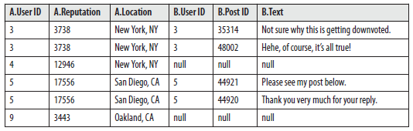
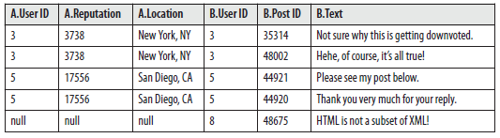
Outer Joins : Left & Right
Notes:
Click to edit the notes format
<number>

Slide 6
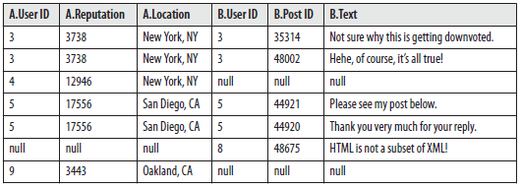

Full Outer & Anti Joins
Notes:
Click to edit the notes format
<number>

Slide 7
Reduce Side Join
Join large multiple data sets together by some foreign key
Can be used to execute any of the types of joins
No limitation on the size of data sets
Require a large amount of network bandwidth
Notes:
Click to edit the notes format
<number>

Slide 8
Reduce Side Join : Structure
Mapper prepares the join operation
Takes each input record from each of the data sets
Extracts foreign key from each record
output key : foreign key
output value : entire input record which is flagged by some unique identifier for the data set
Reducer performs the desired join operation by collecting the values of each
input group into temporary lists
lists are then iterated over and the records from both sets are joined together
output is a number of part files equivalent to the number of reduce tasks
Notes:
Click to edit the notes format
<number>

Slide 9
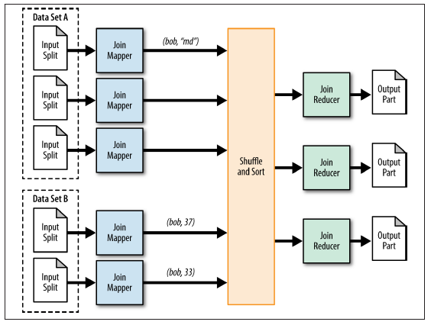
Reduce Side Join : Structure
Notes:
Click to edit the notes format
<number>

Slide 10
Sample Data Sets : A & B
Two data sets A and B, with the foreign key defined as f
Notes:
Click to edit the notes format
<number>

Slide 11
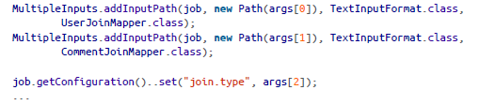
Reduce Side Join : Driver Code
MultipleInputs data types : allows to create a mapper class and input format for
different data sources
Notes:
Click to edit the notes format
<number>

Slide 12

Reduce Side Join : Mappers
Each mapper class outputs the user ID as the foreign key and
entire record as the value along with a single character to flag which record came from what set
UserJoinMapper
CommentJoinMapper
Notes:
Click to edit the notes format
<number>

Slide 13

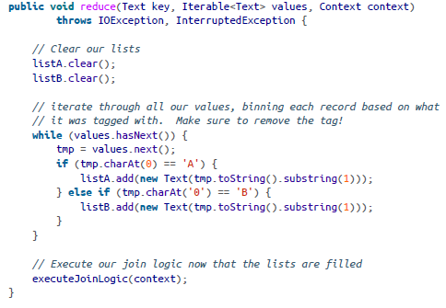
Reduce Side Join : Reducer
Reducer copies all values for each group in memory, keeping track of which record came from what data set
Notes:
Click to edit the notes format
<number>

Slide 14
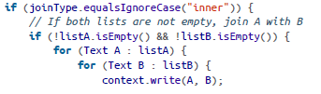
Reduce Side Join : Reducer – Inner Join
For an inner join, a joined record is output if all the lists are not empty
Notes:
Click to edit the notes format
<number>

Slide 15
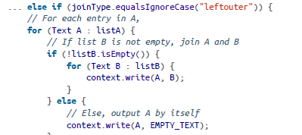
Reduce Side Join : Reducer – Left Outer Join
If the right list is not empty, join A with B.
If the right list is empty, output each record of A with an empty string.
Notes:
Click to edit the notes format
<number>

Slide 16
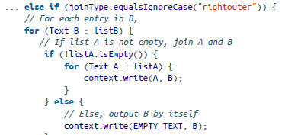
Reduce Side Join : Reducer – Right Outer Join
If the left list is not empty, join A with B.
If the left list is empty, output each record of A with an empty string.
Notes:
Click to edit the notes format
<number>

Slide 17
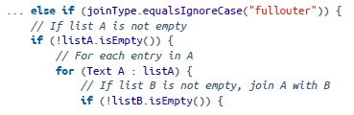
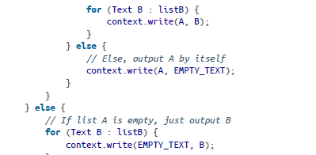
Reduce Side Join : Reducer – Full Outer Join
If list A is not empty, then for every element in A, join with B when the B list is not empty,
or output A by itself.
If A is empty, then just output B.
Notes:
Click to edit the notes format
<number>

Slide 18
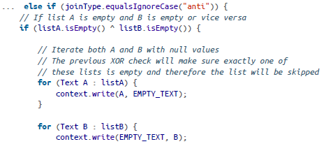
Reduce Side Join : Reducer – AntiJoin
For an antijoin, if at least one of the lists is empty,
output the records from the nonempty list with an empty Text object.
Notes:
Click to edit the notes format
<number>

Slide 19
Performance Analysis
A plain reduce side join puts a lot of strain on the cluster’s network
Notes:
Click to edit the notes format
<number>

Slide 20
Replicated Join
Join operation between one large and many small data sets that can be performed on the map-side
Completely eliminates the need to shuffle any data to the reduce phase
All the data sets except the very large one are essentially read into memory during the setup phase of each map task, which is limited by the JVM heap
Join is done entirely in the map phase, with the very large data set being the input for the MapReduce job.
Restriction : a replicated join is really useful only for an inner or a left outer join where the large data set is the “left” data set
Output is a number of part files equivalent to the number of map tasks
Notes:
Click to edit the notes format
<number>

Slide 21
Replicated Join : Applicability
The type of join to execute is an inner join or a left outer join, with the large input data set being the “left” part of the operation
All of the data sets, except for the large one, can be fit into main memory of each map task
Notes:
Click to edit the notes format
<number>

Slide 22
Replicated Join : Structure
The mapper is responsible for reading all files from the distributed cache during the setup phase and storing them into in-memory lookup tables
Mapper processes each record and joins it with all the data stored in-memory
Notes:
Click to edit the notes format
<number>

Slide 23
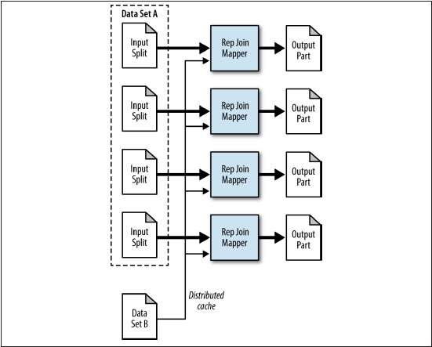
Replicated Join : Structure
Notes:
Click to edit the notes format
<number>

Slide 24
Replicated user-comment example
Small set of user information and a large set of comment
join operation between one large and many data sets performed on the map-sides
eliminates the need to shuffle any data to the reduce phase
useful only for an inner or a left outer join where the large data set is the “left” data set
Notes:
Click to edit the notes format
<number>

Slide 25
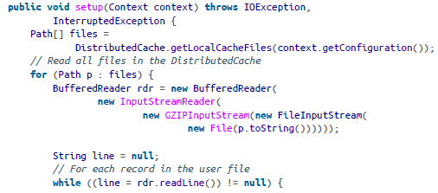
Replicated Join : Mapper : setup
All the data sets except the very large one are read into memory during the setup phase of each map task which is limited by the JVM heap
user ID is pulled out of the record.
user ID and record are added to a HashMap for retrieval
in the map method
Notes:
Click to edit the notes format
<number>

Slide 26
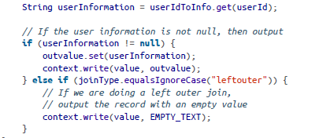
Replicated Join : Mapper : map
consecutive calls to the map method are performed. For each input record,the user ID is pulled from the comment.
This user ID is then used to retrieve a value from the HashMap
If a value is found, the input value is output along with the retrieved value.
If a value is not found, but a left outer join is being executed
Notes:
Click to edit the notes format
<number>

Slide 27
Composite Join
Join operation that can be performed on the map-side with many very large formatted inputs
Eliminates the need to shuffle and sort all the data to the reduce phase
Data sets must first be sorted by foreign key, partitioned by foreign key
Hadoop has built in support for a composite join using the CompositeInputFormat.
This join utility is restricted to only inner and full outer joins
The inputs for each mapper must be partitioned and sorted in a specific way, and each input dataset must be divided into the same number of partitions.
All the records for a particular foreign key must be in the same partition
Notes:
Click to edit the notes format
<number>

Slide 28
Composite Join
Driver code handles most of the work in the job configuration stage
It sets up the type of input format used to parse the data sets, as well as
the join type to execute
The framework then handles executing the actual join when the data is read
Mapper is very trivial. The two values are retrieved from the input tuple and
simply output to the file system
Output is a number of part files equivalent to the number of map tasks
Notes:
Click to edit the notes format
<number>

Slide 29
Performance Analysis
Composite join can be executed relatively quickly over large data sets
Data preparation needs to taken into account in the performance of this
analytic
Notes:
Click to edit the notes format
<number>

Slide 30
Composite user comment join
user and comment data sets have been preprocessed by MapReduce and output using the TextOutputFormat
key of each data set is the user ID, and the value is the user comment
Each data set was sorted by the foreign key,
Each data set was then gzipped to prevent it from being split
two large formatted data sets of user information and comments
CompositeInputFormat utilizes the older mapred API
Notes:
Click to edit the notes format
<number>

Slide 31
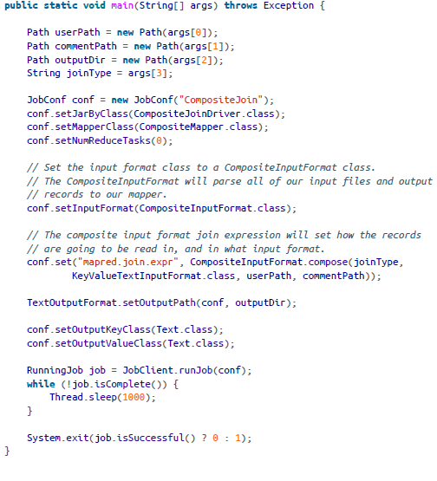
Composite Join
Notes:
Click to edit the notes format
<number>

Slide 32
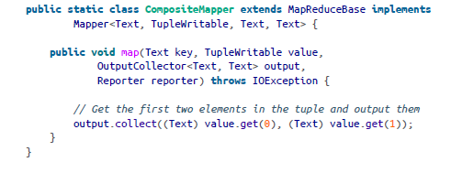
Composite Join : Mapper
Input to the mapper is the foreign key and a TupleWritable
Tuple contains a number of Text objects equivalent to the number of data sets
First input path is the zeroth index
Notes:
Click to edit the notes format
<number>

Slide 33
Thank YOU !!!
Notes:
Click to edit the notes format
<number>

