Slide 1
Project 3 – Plausible information retrieval
Team 11
Team Members:
Kamlesh Patil
Shubham Rai
Rugved Deshmukh
Madhumita Dange
Nishi Yeotikar
Pradnya Mohite
Ninad Vartak

Slide 2
Contents
Introduction
Task-I(Data acquisition)
Task-II(Parsing, index construction)
Task-III(Retrieval model with relevancy judgment )
Task-IV(GUI)
Demonstration

Slide 3
Introduction
The project deals with a modern retrieval framework that takes into account plausibility information expressed in documents.

Slide 4
Task-I
Data acquisition:
  To obtain the data from the ICWSM Spinn3r blog post collection
  The dataset is formatted in XML
    compressed version 142GB
    uncompressed version 266GB

Slide 5
Task-I
The second part was to use the story corpora extraction script to identify the subset of blog posts that contain narrative stories.
The file "icwsm09stories.txt" (7.3GB) created as result of this contains the locations of 1,605,480 personal stories in the Spinn3r Dataset.

Slide 6
Task II(Parsing, index construction)
        Apache Lucene
Single XML file divided into 1500000 XMl files
Removal of XML tags
Collection of tokens
Stemming
Index Creation
Document Index

Slide 7
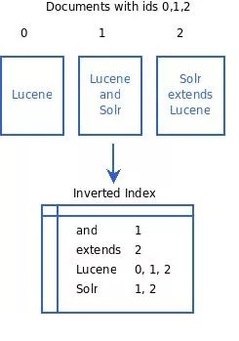
Task II
Apache Lucene Index File Format

Slide 8
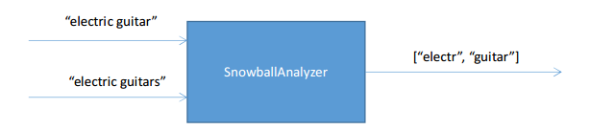

Task II

Slide 9
Task-III
Retrieval model with relevancy judgment
Approaches used:
  Apache lucene
  Bigram Language Model
  Stanford Named Entity Recognizer

Slide 10
Task III
  Bigram Language Model
    Training and Testing:
        Jsoup parser
XML Files
1500000
Add start(<s>) and end tags(</s>)
Create tokens of each document
Remove XML tags
Remove stop words
Language Model Files
1500000
Calculate Unigram and bigram probabilities
Stemming
Unigrams: probability word
Bigrams: probability w1 w2
Query

Slide 11
Task-III
  Stanford Named Entity Recognizer
    It labels sequences of words in a text which are the names of things, such as person
    It comes with well-engineered feature extractors for Named Entity Recognition, and many options for defining feature extractors.
    StanfordNER classified its entities only in 3 classes. Thus, for accuracy we trained our system with our required entities by referring the ontology tree provided to us.

Slide 12
Task III
  Stanford Named Entity Recognizer
Document description text
Stanford
NER
Identifies entities for each word
Ontologies

Slide 13
Task-III
Relevancy
  Considered results for all 3 approaches
  Voting mechanism

Slide 14
Task-IV
Graphical user interface
  Extended code from Task III
  Used Java Swing to build form

Slide 15
Take away from project
Handling 1500000 files
Learning Apache Lucene
Learning Bigram Language model
Learning Stanford NER
Learning about ontologies

Slide 16
Demonstration

