Slide 1

Generic Restrictions in Java
Everything you need to know!
Vladimir Hristakiev No.7 11A

Slide 2

Generic Restrictions - Contents
Opening Slide
Introduction
Advantages and Disadvantages
Examples of Restrictions
Conclusion

Slide 3
Introduction to Generics What is it and why should I use it?
Java Generics were introduced in programming in order to deal with type-safe objects.
It helps code stability by detecting bugs while compiling.

Slide 4
So what are the advantages and disadvantages?
Type casting is not required
Compile-Time Checking
Generics don’t work with primitive types
Code doesn’t retain type information
ADVANTAGES
DISADVANTAGES

Slide 5
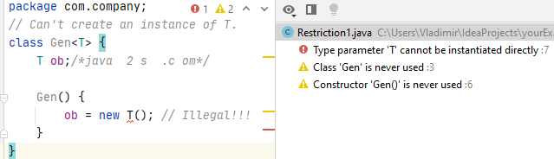
Type Parameters Can't Be Instantiated
Restriction №1
It is not possible to create an instance of a type parameter. For example, consider this class:

Slide 6
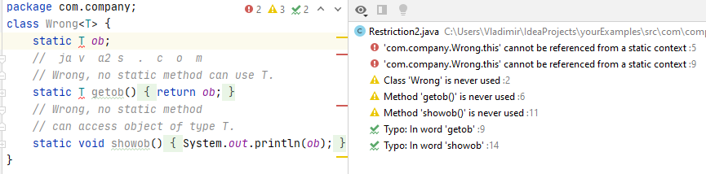

Restrictions on Static Members
Restriction №2
No static member can use a type parameter declared by the enclosing class. For example, all of the static members of this class are illegal:

Slide 7
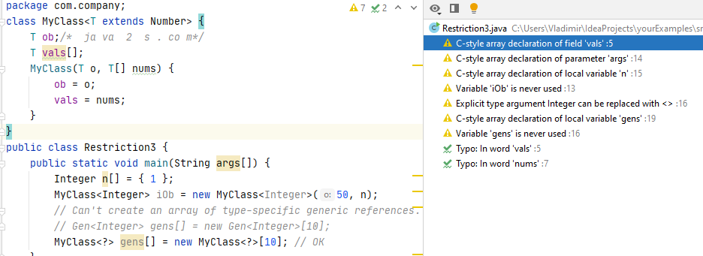
Generic Array Restrictions
Restriction №3
You cannot instantiate an array whose base type is a type parameter. You cannot create an array of type specific generic references.
The following short program shows both situations:

Slide 8
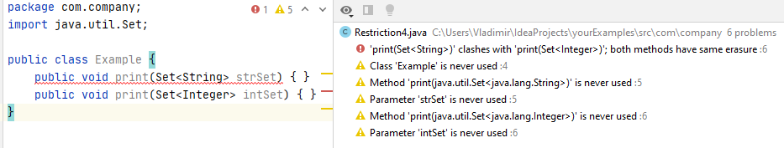
Cannot Overload a Method – Same Erasure
Restriction №4
A class cannot have two overloaded methods that will have the same signature after type erasure.

Slide 9
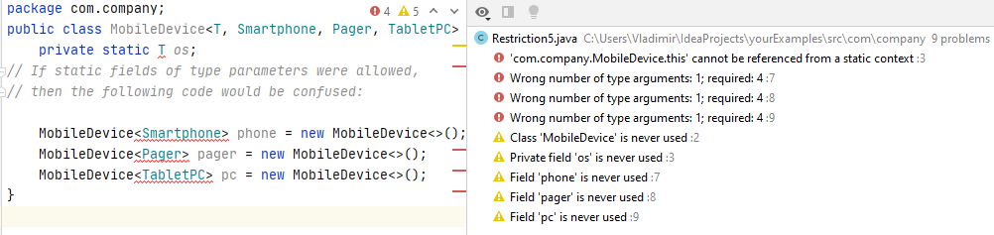
Cannot declare static fields with type parameters
Restriction №5
A class's static field is a class-level variable shared by all non-static objects of the class, and static fields of type parameters are not allowed.

Slide 10

Conclusion
Using Java generics is important,
but you should always look out for these restrictions if you wish to succeed!
Any Questions?

