Slide 1
POLESTAR DATA FIESTA -3.0
ABC Inc. & its challenges
By SAGITTARIUS
MAHARAJA SURAJMAL INSTITUTE OF TECHNOLOGY
MEMBERS: TUSHITA SINGH (Team Leader)
N SUDHA SUSHMA
UTKARSH CHAUHAN

Slide 2
INSIGHTS AND DISCUSSIONS:
1. We can analyze which are the top N SKUs by Units. i.e. Net Sales. Top 5 SKU by units i.e. the most sold products are WATER-CREAM, SILK CANVAS, SEPH-BOTF-2018, SKIN-MIST, PC-OIL.
2. We can analyze which are the top N SKUs by Volume i.e. Total Revenue. Top 5 SKU by Volume i.e. the products that generate the greatest revenue are: WATER-CREAM, SILK CANVAS, ESSENCE, SKIN-MIST, CHANNEL 3-TSV-JUNE-2018-A305748.
3. Total Units i.e. Net Sales and Total Volume i.e. Total Revenue for all the SKUs per month for each year can be analyzed. Net Sales for January 2017, 2018, and 2019 are 2.001M, 3.499M, and 4.562M respectively. Similarly, the Total revenue for January 2017, 2018, and 2019 are 89.204M, 168.720M, and 229.921M respectively.
4. COGS% that is Net Sales * COGS per SKU for the top 3 SKU is 3608.78K for WATER-CREAM, 2678.45K for SILK-CANVAS, and 2098.98K for CHANNEL 3-TSV-JUNE-2018-A305748.
5. The greatest number of sales take place in the Northeast region followed by the Southern and the Central Region. The maximum revenue is generated from the Northeast region followed by the Western and the Central Region.

Slide 3
6. The maximum revenue is generated from the Northeast, Western and Central regions while the maximum profit is generated from International Sales, Canada, and the Northeast region. Hence the sales to maximum profit regions should be increased to maximize revenue.
7. YOY graph can be analyzed to understand the increase or decrease in total revenue in the subsequent years. Total Revenue increased from 14.512M in January 2017 to 19.784M in January 2018 and decreased to 18.620M in January 2019. Similarly, we can analyze the data for different months.
8. The top 5 most profitable SKUs are DRY-RITUAL-KIRI, NORM-DRY-RITUAL-KIRI-V2, SENSITIVE-COMPLETE-KIRI, NORM-RITUAL-KIRI, and NORM-COMPLETE-KIRI with a total profit amount of 614.10, 586.71, 578.50, 578.50 and 578.50 respectively per SKU unit. Top N most profitable SKUs can be analyzed and the least profitable SKUs can be identified.
9. Total Amount that is Net Sales * Total Revenue describes the total revenue generated for all the units sold. The Total Amount increased by 76.141% over a span of 29 Months. The Total Amount increased from 74.69B in January 2017 to 278.39B in December 2017. The Total Amount increased from 281.37B in January 2018 to 331.91B in December 2018. The Total Amount increased from 297.45B in January 2019 to 313.05B in May 2019.
10. Maximum Total revenue was generated in March 2019, with the value for total revenue being 29.797M and the minimum Total revenue was generated in July 2017, with the value for total revenue being 8.509M. The months with the maximum and minimum generated revenue in each year can be analyzed for better business strategies.

Slide 4
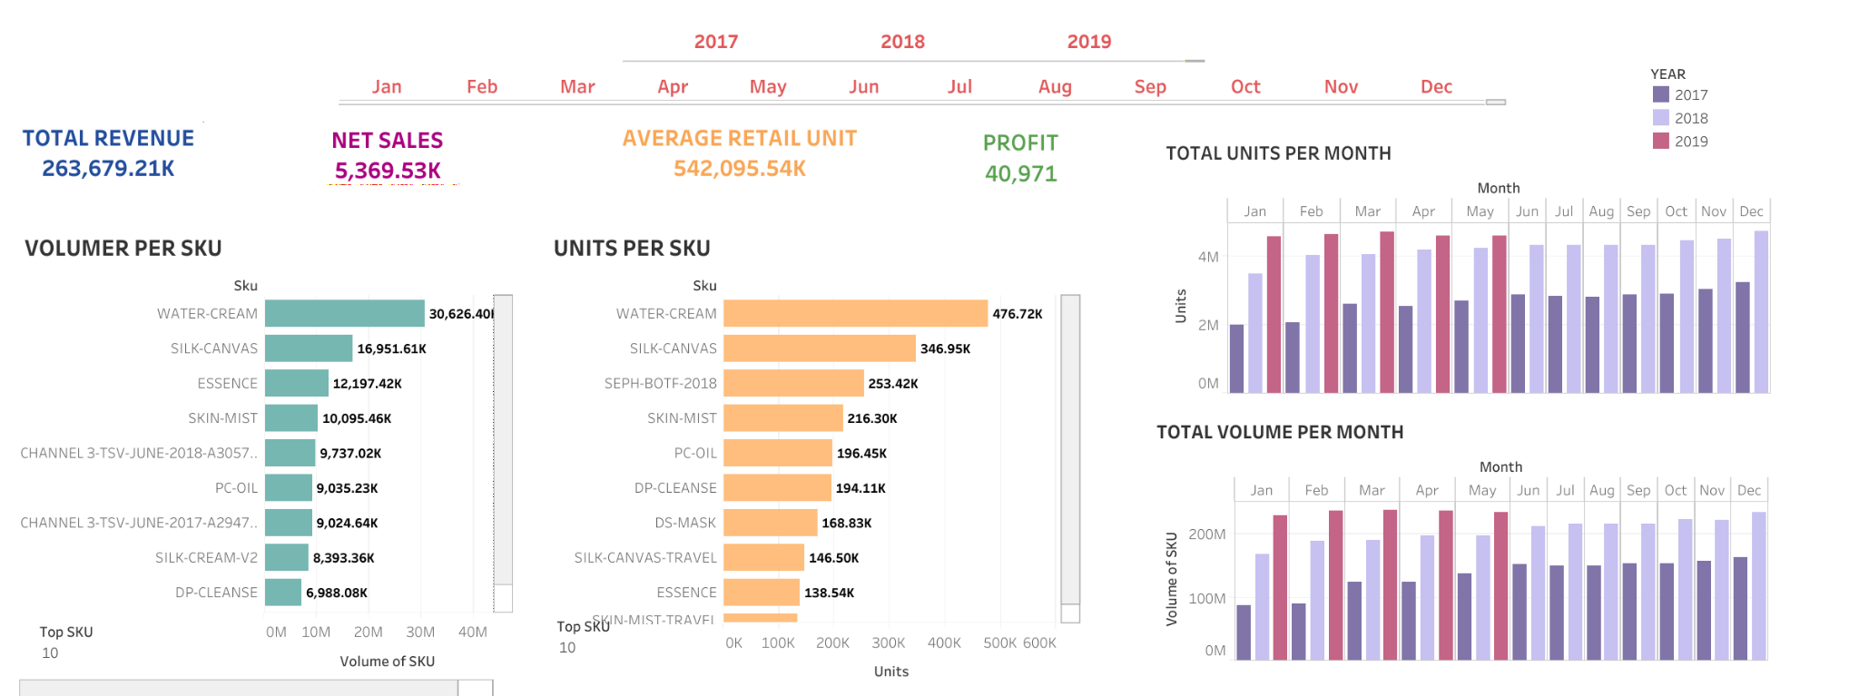
LINK: https://public.tableau.com/views/SalesInsightsforABCInc_1/Dashboard1?:language=en-US&publish=yes&:display_count=n&:origin=viz_share_link

Slide 5
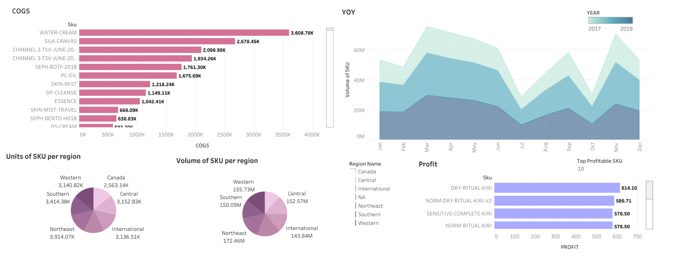
LINK: https://public.tableau.com/views/SalesInsightsforABCInc_2/Dashboard2?:language=en-US&publish=yes&:display_count=n&:origin=viz_share_link

Slide 6
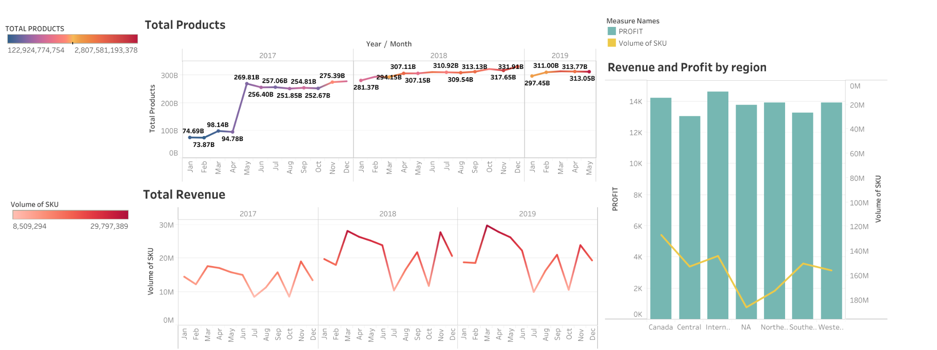
LINK: https://public.tableau.com/views/SalesInsightsforABCInc_3/Dashboard3?:language=en-US&publish=yes&:display_count=n&:origin=viz_share_link
Data Fiesta Calculation: https://docs.google.com/spreadsheets/d/1HG_woW1qPjDoL08HX8KNr09D4KSxZ81L-8L-pzzi34c/edit?usp=sharing

