Slide 1

Assignment-2

Slide 2
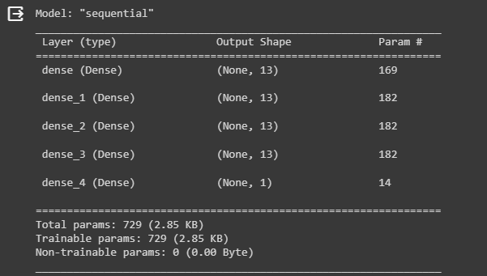
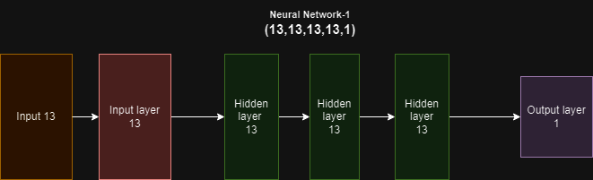
Architecture of Neural Networks Model-1
There is one input layer and 3 hidden layers, each consisting of 13 neurons, and a single output neuron. The model employs the ReLU activation function, the ADAM optimizer with a learning rate of 0.0001, and Mean Squared Error (MSE) as the loss function.
Final R2 Score: 0.6518

Slide 3
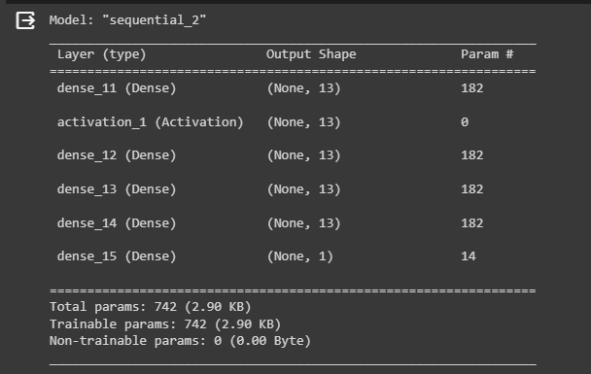
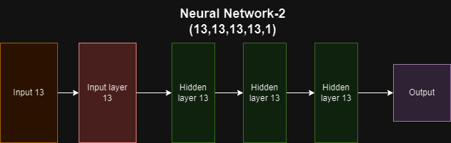

Model-2
a neural network with an architecture of (13,13,13,13,1), indicating a model with an input layer of 13 neurons, followed by three hidden layers with 13 neurons each, and an output layer with a single neuron. The network is designed to use the ReLU activation function, including in the input layer, and is optimized using the ADAM optimizer with a learning rate of 0.0001. The Mean Squared Error (MSE) serves as the loss function. The instructions suggest training the network for 100 epochs

Slide 4
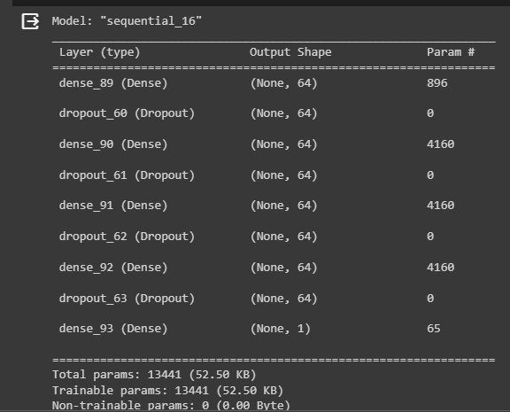
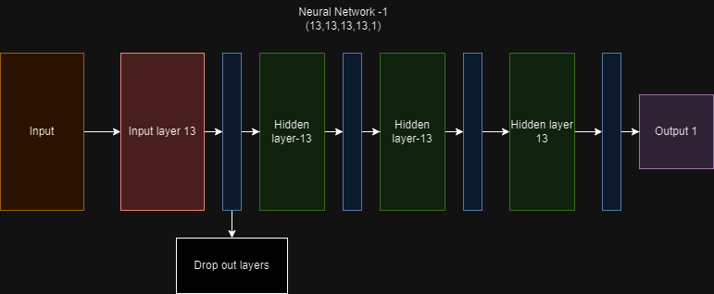
Model-3
a neural network architecture designed for a regression task, aiming to optimize the R² metric and minimize loss. The network consists of an input layer with 13 neurons, multiple hidden layers with 13 neurons each, and a single output neuron. It utilizes the ReLU activation function, ADAM or RMSProp optimizer with a learning rate of 0.0001, and incorporates dropout layers as a regularization technique. The model is trained for 100 epochs
Final R2 Score for Model 3: 0.6870

Slide 5
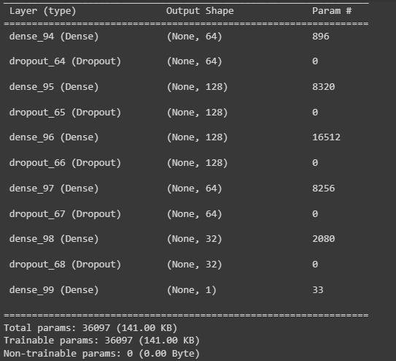
Model-4
a neural network designed for a regression task. The architecture includes an input layer, several hidden layers with 13 nodes each, and an output layer with a single node. Dropout layers are incorporated to mitigate overfitting. The network employs the ReLU activation function, ADAM or RMSProp optimizer with a learning rate of 0.0001, and Mean Squared Error as the loss function. It is trained for 100 epochs with early stopping to maximize R² and minimize loss. Ans also added an extra layer

Slide 6
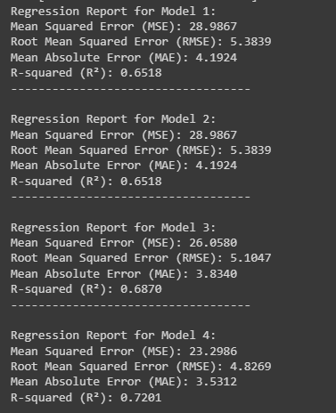
Regression Reports of all Models

Slide 7
Explaining parameters and math on model-4
Input Layer to First Hidden Layer: - Weights: Each of the 13 input features connects to 64 neurons: 13 * 64 - Biases: Each of the 64 neurons has one bias term: 64 - Total: 13 * 64 + 64
First Hidden Layer to Second Hidden Layer: - Weights: Each of the 64 neurons from the first hidden layer connects to 128 neurons: 64 * 128 - Biases: Each of the 128 neurons has one bias term: 128 - Total: 64 * 128 + 128
Second Hidden Layer to Third Hidden Layer: - Same as above, since we have another layer with 128 neurons. - Total: 128 * 128 + 128
Third Hidden Layer to Fourth Hidden Layer: - Weights: Each of the 128 neurons connects to 64 neurons: 128 * 64 - Biases: Each of the 64 neurons has one bias term: 64 - Total: 128 * 64 + 64
Fourth Hidden Layer to Output Layer: - Weights: Each of the 32 neurons connects to the single output neuron: 32 * 1 - Biases: The single output neuron has one bias term: 1 - Total: 32 * 1 + 1
total_params = (13 * 64 + 64) + (64 * 128 + 128) + (128 * 128 + 128) + (128 * 64 + 64) + (32 * 1 + 1)

Slide 8
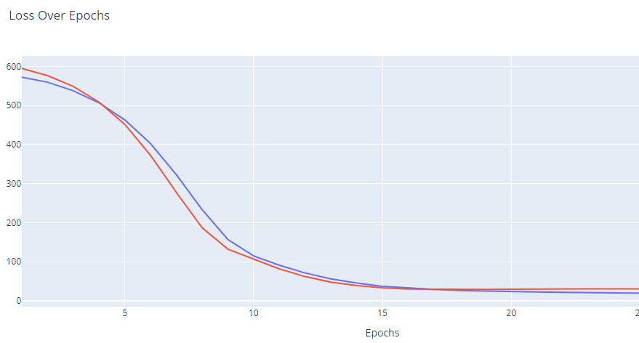
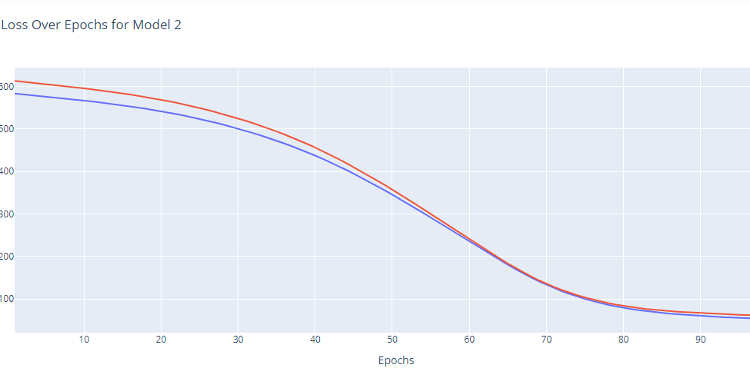
Loss vs epoch

Slide 9
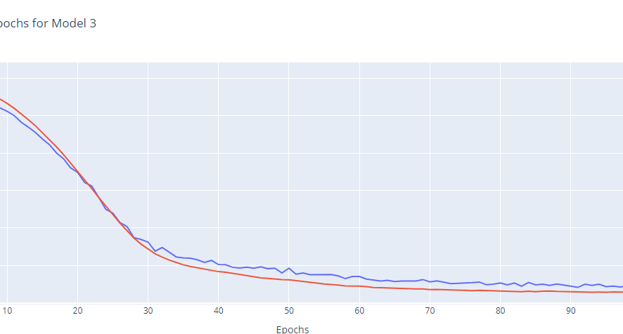
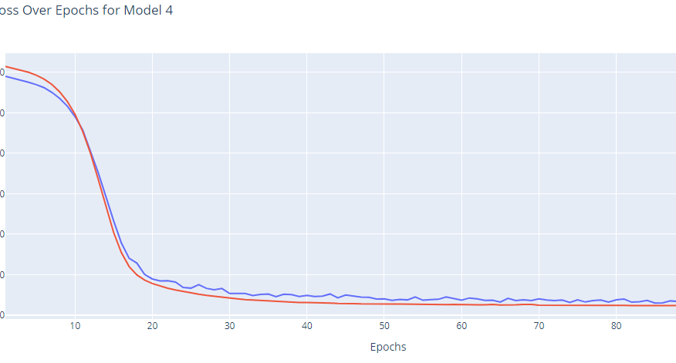
Loss vs epoch

Slide 10
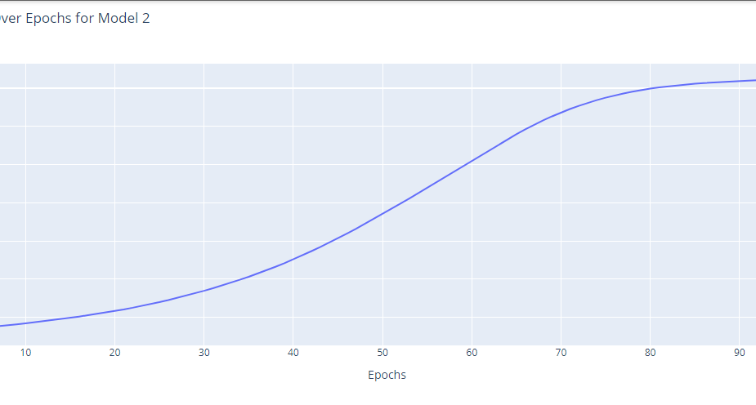
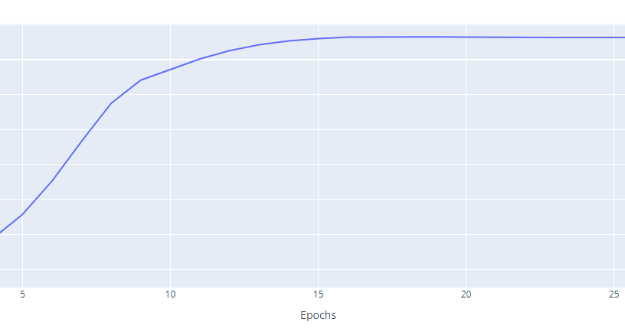
R2 VS EPOCH

Slide 11
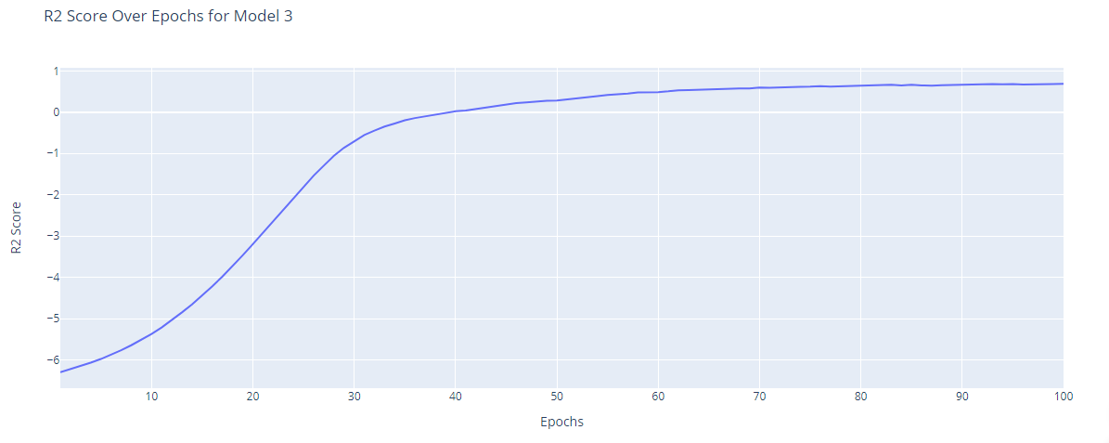
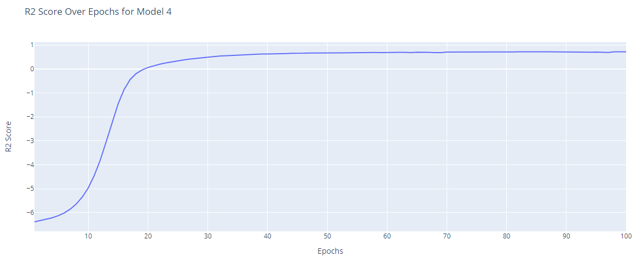
R2 VS EPOCHS

Slide 12
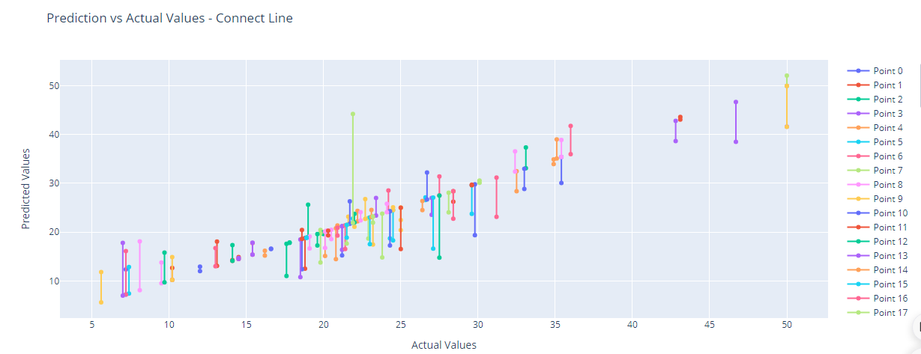
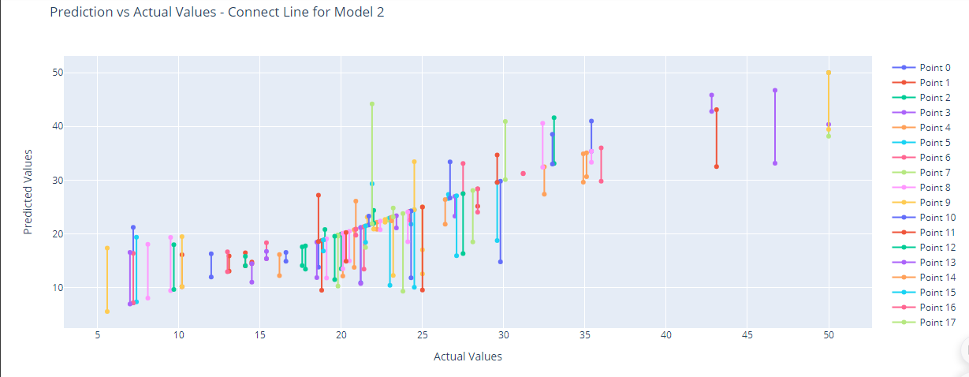
Regression Report Actual vs. Predicted line and Actual vs. Predicted connected

Slide 13
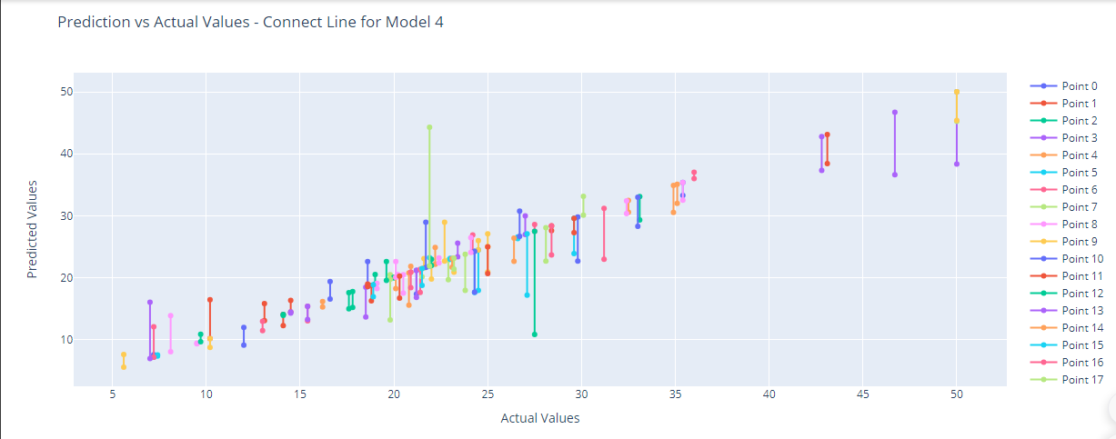
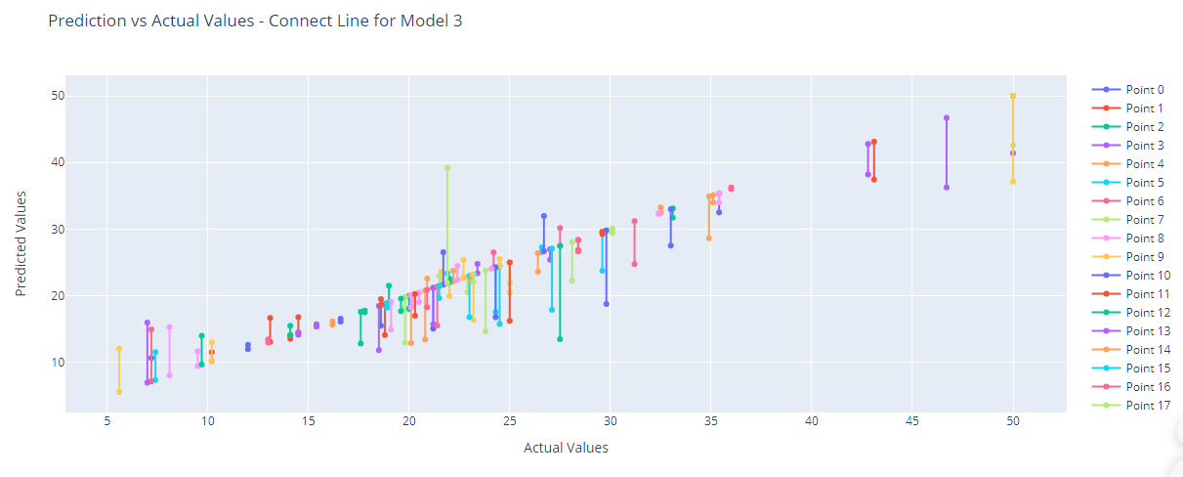
Regression Report Actual vs. Predicted line and Actual vs. Predicted connected

Slide 14

Thank you

