Slide 1
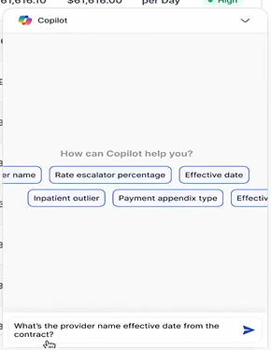
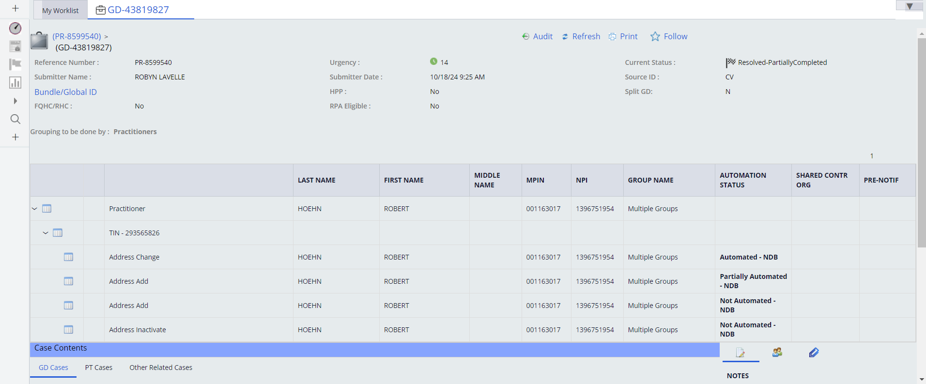
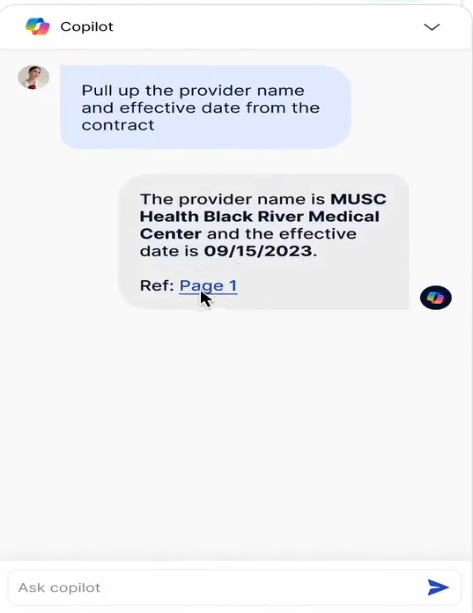
Use case: LOAD Assist (Visual)

Slide 2
Use Case – Load Assist Agent Tasks & Outcome
AI Agent Pre-Load Task#1 > Outcome
NPI Match Found:
Agent systematically moves to Task#2
NPI Match NOT FOUND:
Agent Response: Send a clarification to verify the correct information. Reference: PhyCon Clarification Process S2076
AI Agent Pre-Load Task#1
Task#1: Validate NPI
Review the NPPES NPI Registry.
Determine if the Provider/Group information (First Name, Last Name or Group Name, NPI, etc.) matches both the SOT and GD in PhyCon.
AI Agent uses GD metadata
AI Agent Pre-Load Tasks
Validate NPI
Determine if Provider is Delegated under the TIN
Determine if there is an active Hold Code
PhyCon User clicks on GetNext
GD# is presented on the screen
AI Agent Pre-Load Task#2 > Outcome
Provider has Active Hold Code :
Agent Response: Refer to NDB Active Hold Code Review S1110a to determine if the hold code listed allows for updates.
Provider does not have Active Hold Code:
Agent systematically moves to Task#3
AI Agent Pre-Load Task#2
Task#2: Determine if there is an active Hold Code
User Persona: Load Team
Transaction Name: Address Add
Address Type: Place Of Service
AI Agent Pre-Load Task#2 > Outcome
Provider is Delegated :
Agent Response: Go to Step 16 of Determining a Delegated Provider and PLMI Navigation S1162 to determine next steps.
Provider is NOT Delegated :
Agent Response: Refer Step 2 of SOP Add: A PLSV Address
AI Agent Pre-Load Task#3
Task#3: Determine if Provider is Delegated under the TIN
Call PLMI API to determine if Provider TIN is delegated

Slide 3
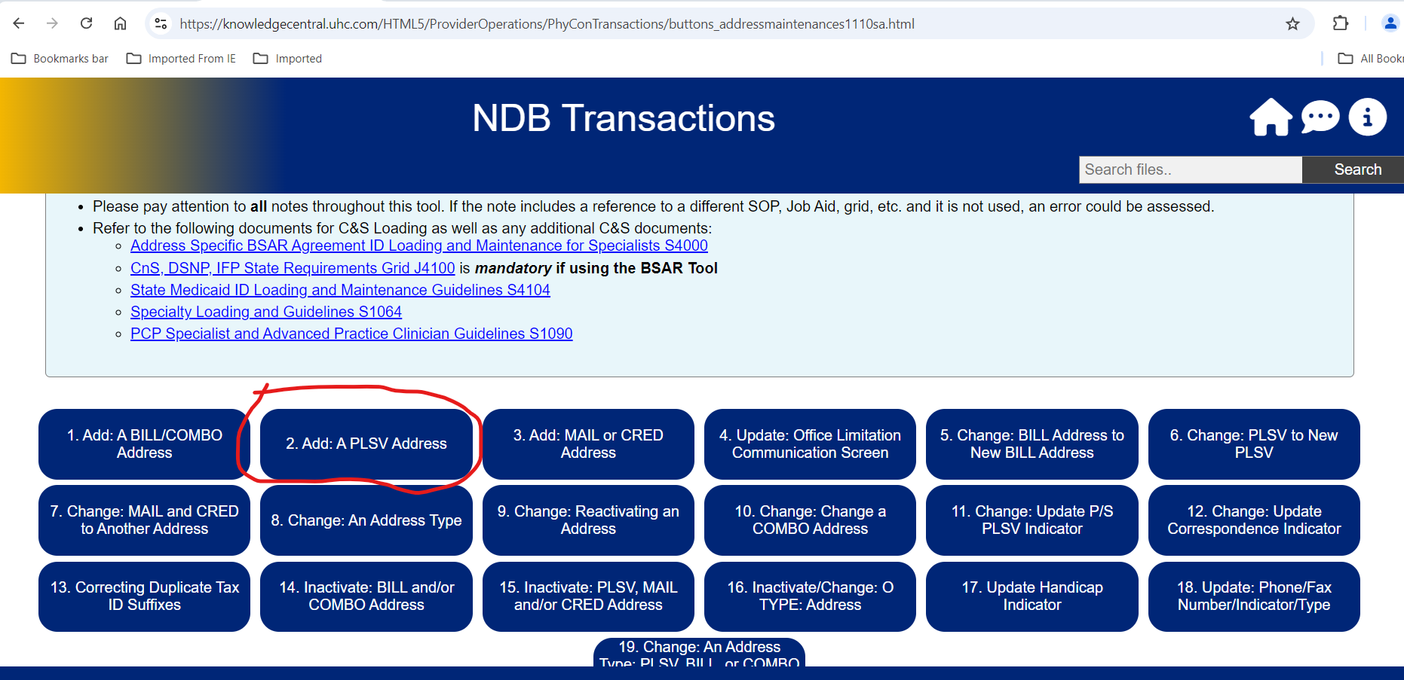
SOP Link
https://knowledgecentral.uhc.com/HTML5/ProviderOperations/PhyConTransactions/buttons_addressmaintenances1110sa.html

Slide 4
Sample GD# with Address Add for PLSV

Slide 5
Team Name
Gaurav Kumar Mishra
Gulshan Arora
Rohit Gupta
Ruchi Kumari
Singh, Leimapokpam (SK)
Sowmya Muddena Thimmaiah
Vathani Sambasivam
Anil Appari
Pragati Agrawal

Slide 6
Project Requirements
User Interface (UI) Development: (SK)
Design and implement a user-friendly interface for the AI agent.
Provide the NPI and Name , Address Type (Billing, PLSV, Combo)
PDF Data Extraction:
Develop the capability for the AI agent to read and extract data from PDF documents.
NPPES Validation Task:
Integrate a feature for the AI agent to validate providers using the National Plan and Provider Enumeration System (NPPES).
Pass Continue
Fail –Invalid Provider
4. Check Active Hold Code – Task (Optional)
AI agent to identify and verify if there is an active hold code
Pass Continue
Fail ---?
5. Determine if Provider is Delegated under the TIN-Task (Optional)
Call PLMI API to determine if Provider TIN is delegated
?
6. SOP/Macro Task:
Ensure the AI agent can provide the Standard Operating Procedure (SOP) link and relevant macros

