Slide 1

EC203 – Applied Econometrics
Term 2, Week 6
Sushil Mathew

Slide 2
So far…

Slide 3
Visual interpretation of coefficients

Slide 4
Regressions are not always a line

Slide 5
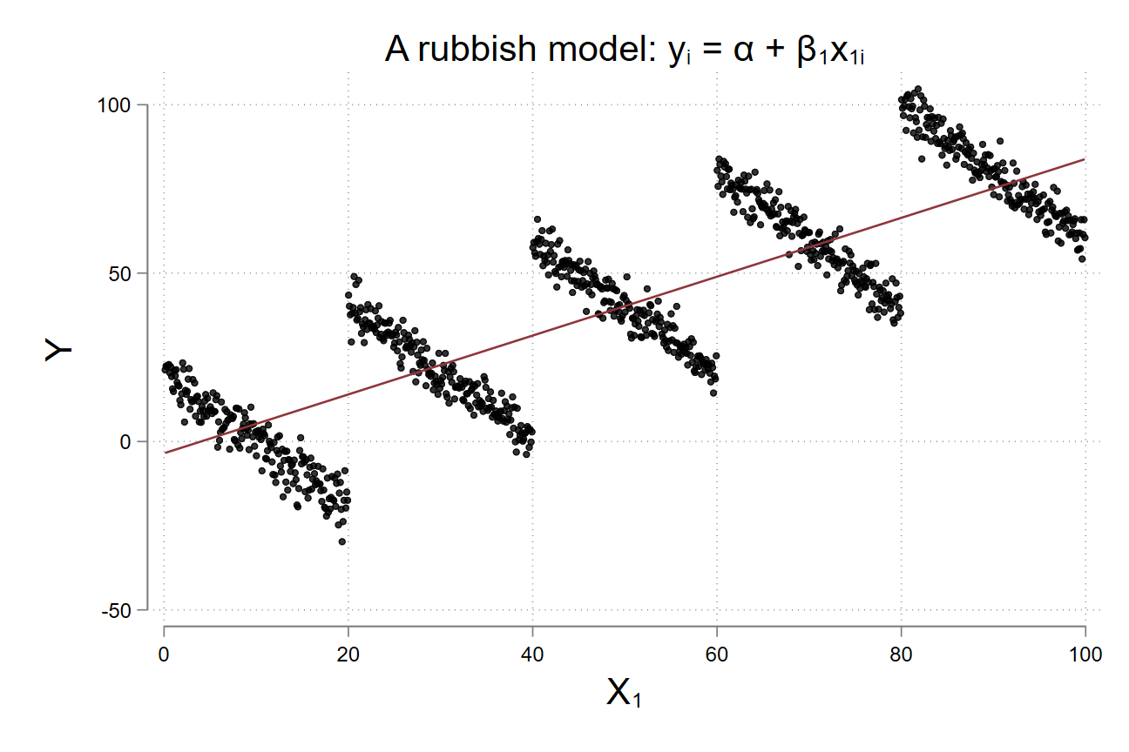
Adding variables to a regression is good

Slide 6
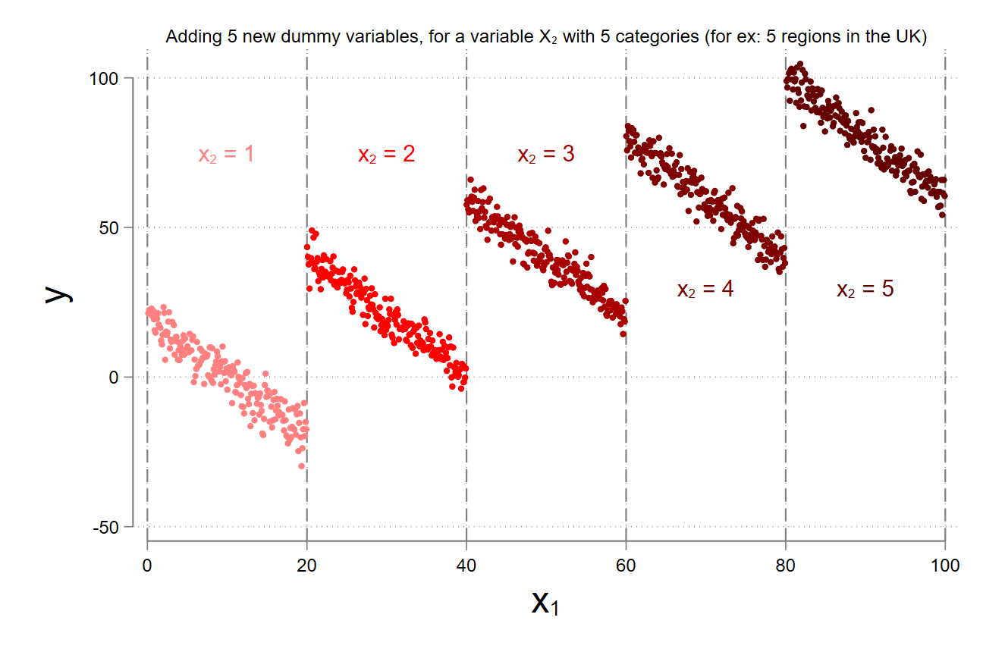
Adding variables to a regression is good

Slide 7
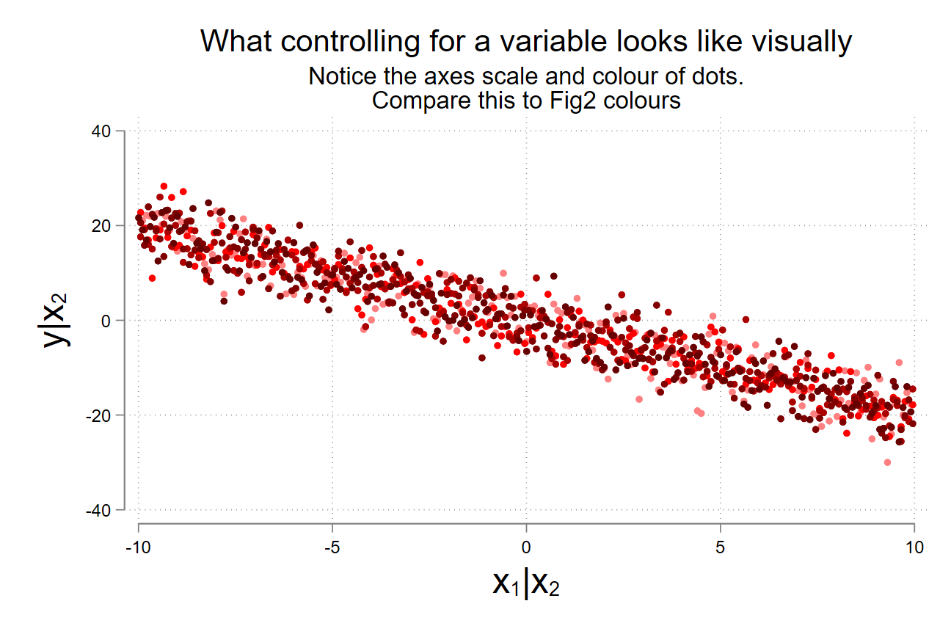
Adding variables to a regression is good

Slide 8
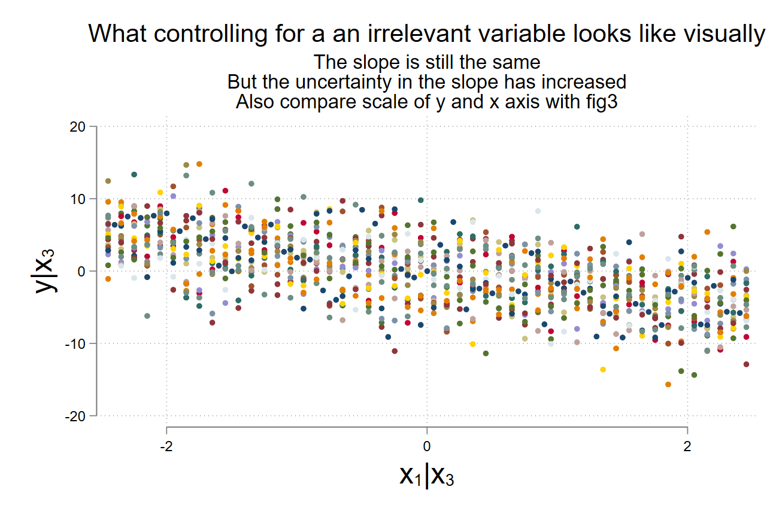
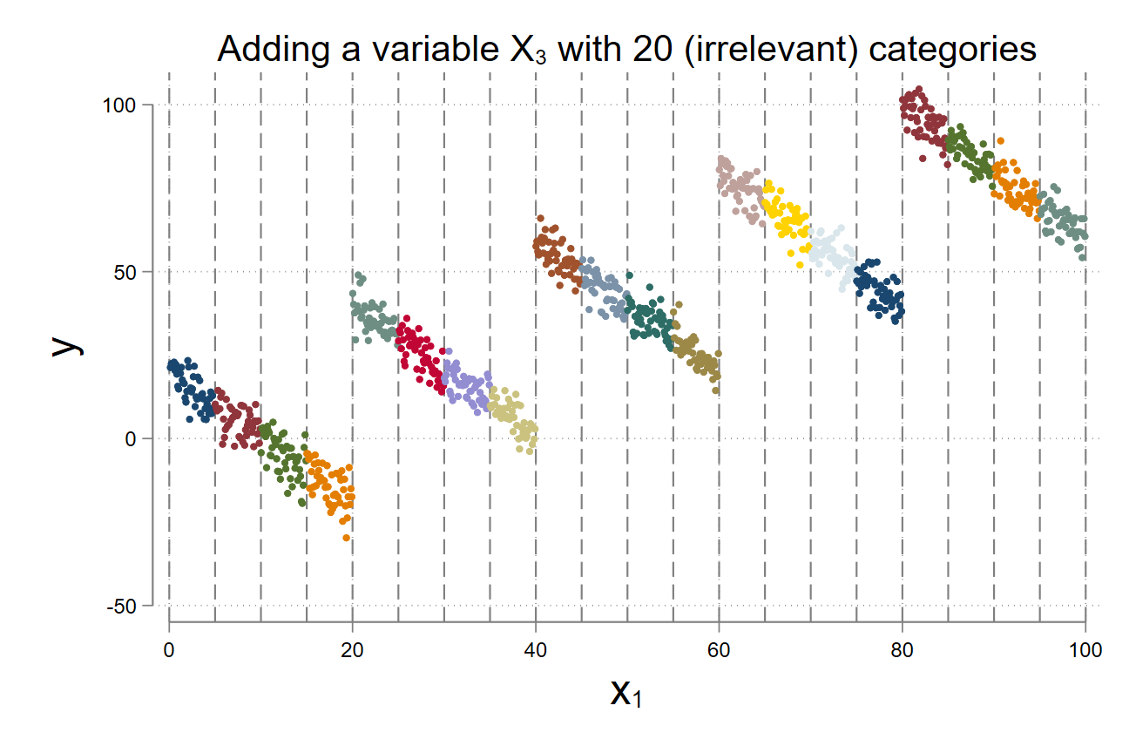
Well….not always

Slide 9
From a causal inference perspective
Single linear regression models are generally bad (omitted relevant variables or omitted variable bias)
Multiple linear regressions are better (fixes omitted variable bias)
Multiple linear regressions are also bad (addition of irrelevant variables)
You can’t randomize education to study the effect of education on wage.

Slide 10
From a causal inference perspective
Single linear regression models are generally bad (omitted relevant variables or omitted variable bias)
Multiple linear regressions are better (fixes omitted variable bias)
Multiple linear regressions are also bad (addition of irrelevant variables)
You can’t randomize education to study the effect of education on wage.

Slide 11
From a causal inference perspective
Single linear regression models are generally bad (omitted relevant variables or omitted variable bias)
Multiple linear regressions are better (fixes omitted variable bias)
Multiple linear regressions are also bad (addition of irrelevant variables)
You can’t randomize education to study the effect of education on wage.

Slide 12
From a causal inference perspective
Single linear regression models are generally bad (omitted relevant variables or omitted variable bias)
Multiple linear regressions are better (fixes omitted variable bias)
Multiple linear regressions are also bad (addition of irrelevant variables)
You can’t randomize education to study the effect of education on wage.

Slide 13

From a causal inference perspective
Single linear regression models are generally bad (omitted relevant variables or omitted variable bias)
Multiple linear regressions are better (fixes omitted variable bias)
Multiple linear regressions are also bad (addition of irrelevant variables)
You can’t randomize education to study the effect of education on wage.

Slide 14

From a causal inference perspective
Single linear regression models are generally bad (omitted relevant variables or omitted variable bias)
Multiple linear regressions are better (fixes omitted variable bias)
Multiple linear regressions are also bad (addition of irrelevant variables)
You can’t randomize education to study the effect of education on wage.

Slide 15
Fortunately, we live in a strange world

