Slide 1
HAPPY NEW YEAR

Slide 2
Update
8 Jan, 2023

Slide 3
Background
Lot of people (mainly in the public sector) are going on strike over wages.
Covid induced retirement:
Lot of older people dropped out (early retirement, passed away etc.)
Women dropped out too perhaps? (maternity, taking care of child, older women more likely to drop out than older men) – Have some anecdotal evidence.

Slide 4
Background
Lot of people (mainly in the public sector) are going on strike over wages
Covid induced retirement:
Lot of older people dropped out (early retirement, passed away etc.)
Women dropped out too perhaps? (maternity, taking care of child, older women more likely to drop out than older men).
All these forces could increase wages.

Slide 5
“Research” Question
Should we be worried about a wage-price spiral?
Potentially how big should the forces mentioned above be to induce a wage-price spiral? For instance, a sudden and high rate of increase in wages, which breaks from the trend might be bad.
Thoughts?

Slide 6
If you think this is an important question...

Slide 7
“Research” Question
Should we be worried about a wage-price spiral?
Potentially how big might the forces mentioned above be?
Example: Consider a simple and extreme case. Suppose everyone working in the undergarment sector gets a 50% raise in wage from 2021 to 2022. But only 0.1% of the economy works in this sector (assume this share is constant across time – this is not a realistic assumption in the data). Then, holding all else constant, aggregate wage increase is 0.05% (50% * 0.1%). Therefore, a small share of workers could counteract the large growth in wages. Net effect is a negligible increase in aggregate wage. In this case, the force is not large enough to cause a spiral.

Slide 8
Given context and research question
Lot of people striking over wages.
Covid induced retirement.
Should we be worried about a wage-price spiral?
Potentially how big might the forces mentioned above be?

Slide 9
Given context and research question
Lot of people striking over wages.
Covid induced retirement.
Should we be worried about a wage-price spiral?
Potentially how big might the forces mentioned above be?
Similar to undergarment example: Decompose aggregate wage growth into wage growth of different “groups”. Example of a group, age 35-40, sex: male, occupation: senior accountant.

Slide 10
“Research” Question stated more precisely
Which “groups” are facing an increase in wage in 2022, compared to 2021?
What is the size of this increase?
Are the share (or change in shares) of people in this “group” large enough to matter?
I did some maths to parameterize above points (nothing complicated). But I’m not sure of it. I’ll send it to you when I’m sure of it. We could then simply make plots of these parameters. Example Fede’s paper.
We also have data for this. I’ll come to the data in a few slides.

Slide 11
An example of a story we could tell from data
A lot of old managers retired.
Young people got promoted to the old person’s role.
The role pays high.
There are a high share of young people earning this high pay.
Young people prioritise consumption over savings (need to give references for this) – will come back to this.
Implying a sharp aggregate increase in prices, and then wages, and so on.

Slide 12
Another version of this story
A lot of old managers retired.
Young people got promoted to the old person’s role.
The role pays high.
There are a high share of people earning this high pay.
Young might have shifted away from consumption patterns and might actually be saving(/investing) leading to higher productivity – will come back to this.
Implying a sharp aggregate increase in prices, and then wages, and so on.

Slide 13
Summary of research question
What we can do immediately: We know the shares of each group and wages, hours worked etc, so can describe it very well (maybe a couple of articles).
What we can’t do immediately IMO (red points from previous slides): Mechanisms through which the story from previous slide could evolve in 2023. Need some theory. Perhaps avenues for future work.
Some preliminary thoughts on where this work could go from here (next few blog posts):
Taxes affect how people save and consume.
Climate change could influence technological investment and productivity.
Maybe on the labour demand side, vacancies are high because of high technological growth after structural break from covid?
Maybe if we found that women have dropped out, they are probably coming back into workforce very soon etc.

Slide 14
On to practical things

Slide 15
Who’s our audience?
I think it should be a super layman/public audience.
In my mind, layman = an interested high school student and/or someone who would read BBC or Daily Mail (because easy language), but would not read Financial Times or The Economist, or a policy brief.
Inspired by Tim Harford’s podcasts: Cautionary Tales, Understanding the Economy, 50 Things that made the modern Economy, More or Less: Behind the stats – very simple language, and really nice! (contd.)

Slide 16
Who’s our audience? (contd.)
I think it should be a super layman/public audience.
Maybe have an appendix for data description, maths, regressions, academic references etc.
Thoughts?

Slide 17
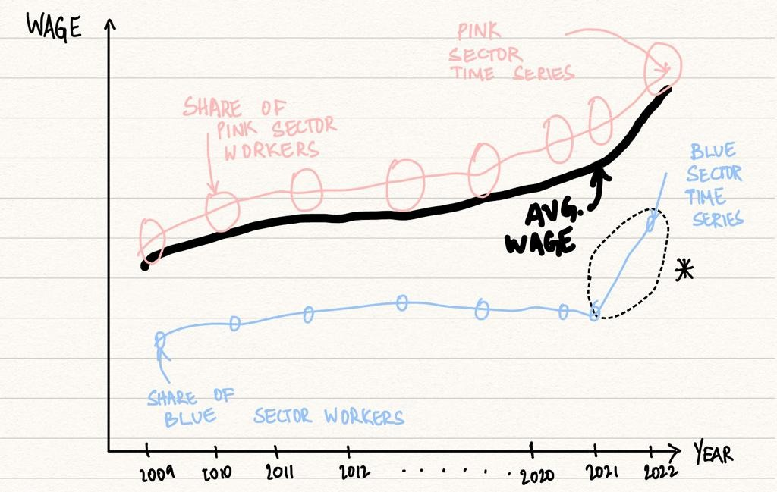
Example of how we could do this
Maybe show an interactive plot like this of a fictional economy with 2 sectors. Explain how things would change if we played around with the parameters (share of workers, average level of wage in each sector, growth from 2021-2022 etc.)
Thoughts?
*Even with a large increase in blue sector wages, the avg wage follows the pink line. Because the blue sector share is very small.

Slide 18
Data
Following data of “groups” from ONS:
Age x Occupation x Sex
Age x Industry x Sex
Public/Private sector (no age)
Wage collected annually
Hours worked (way to measure labour productivity)
Another idea: we can also analyse wage per hour in addition to wage and hours separately. Need to read about this but wage/hour has something to do with the intensive margin.

Slide 19
GitHub for collaboration
Pros:
Integrated into RStudio.
No downloads necessary except for Git, but pretty sure Bank would allow that (fingers crossed).
Only con:
Very steep learning curve. But got two very good guides here: https://happygitwithr.com/index.html and here: https://www.sas.upenn.edu/~jesusfv/Chapter_HPC_5_Git.pdf. When you have time I can also give you a quick intro.

Slide 20
Tasks and how do we split?

