Slide 1
ES6

Slide 2
ES6 Features…
Enhanced Object Properties
De-structuring Assignment
Collections
Promises
For – of
Spread or Rest operator
Template literals
Const keyword
Default Arguments
Function returning multiple values
Lambda functions
Generators(yield keyword)
Modules
Classes
Shadow DOM
Function constructor

Slide 3
ES6 – Enhanced object Literals
Consider the following ES 5 fragment:
function createMonster(name, power)
{
return { type: 'Monster', name: name, power: power };
}
With the new ES6 shorthand form, this can be rewritten as the following code:
function createMonster(name, power)
{
return { type: 'Monster', name, power };
}

Slide 4
ES6 – Enhanced object Literals
Object literals can be computed values as shown below
{
// with property value shorthand
// syntax, you can omit the property
// value if key matches variable
// name
make, // same as make: make
model, // same as model: model
value, // same as value: value
// computed values now work with
// object literals
['make' + make]: true,
// Method definition shorthand syntax
// omits `function` keyword & colon
depreciate() {
this.value -= 2500;
}
}
Assignment: create an object like above, convert to string format and print

Slide 5
ES6 const keyword
“const” keyword was introduced in ES6. It lets you define read only variables using JavaScript. Variables created using “const” are block scoped(or bracket scoped). Redeclaring a “const” variable in the same scope throws an error.
In a scope you cannot redeclare or change value of an “const” variable if a variable with same name is already available for access in that scope.
Can a parameter to a function be const?

Slide 6
ES6 const keyword
Consider below example
const LANGUAGES = ['Js', 'Ruby', 'Python', 'Go'];
LANGUAGES = "Javascript"; // shows error.
LANGUAGES.push('Java'); // Works fine. console.log(LANGUAGES); // ['Js', 'Ruby', 'Python', 'Go', 'Java']
Whenever you define a const variable, Javascript references the address of the value to the variable.
In above example the variable ‘LANGUAGES’ actually references to the memory allocated to the array.
So you cannot change the variable to reference some other memory location later. Throughout the program it can only references to the array.

Slide 7
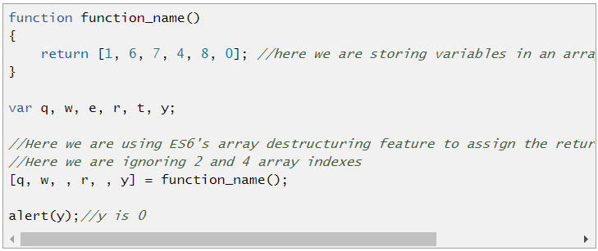
ES6 Function Return Multiple Values
There were many different ways purposed by JavaScript developers for returning multiple values in an function. But ECMAScript 6 has come up with an easy way to do it.
ES6 provides na array like syntax to assign multiple variables to values of array indexes. It also lets you ignore some array indexes.

Slide 8
ES6 Default Function Arguments Values
ES6 provides a new syntax that can be used to define default values to function parameters:
Also, passing undefined is considered as missing an argument.
Defaults can also be expressions.

Slide 9
ES6 Spread operator
ES6 introduced “…” operator which is also called as spread operator. When “…” operator is applied on an array it expands the array into multiple variables in syntax wise. And when its applied to an function argument it makes the function argument behave like array of arguments.
We can use spread operator to take indefinite number of arguments.
If we apply “…” to an array it expands it into multiple variables syntax wise.

Slide 10
ES6 Spread operator
function fun1(...params) { //Rest Parameters
console.log(params.length);
}
fun1();
fun1(5);
fun1(5, 6, 7);
Example of inbuilt function using Spread operator is console.log(); as it takes variable number of parameters

Slide 11
ES6 for of loop
for of loop was introduced in ES6 which allows you to easily iterate over elements of an collection.for of iterates over the values of elements of a collection not the keys. A collection can be an array, set, list, custom collection object etc.
Earlier to ES6 we had to use for loop or Array’s foreach loop to walkthrough elements of an collection. ES6 introduced a new way for iteration.
An iterator is an construct that lets us visit or walkthrough every element of an collection.

Slide 12
Iterating an Custom Collection Object using “for of”
We need to implement Symbol.iterator property on an custom collection.
Symbol.iterator returns a Iterator object i.e., a object with next() property. next() is invoked by for of until next() returns {value: undefined, done: true}.
To continue looping and return an collection element next() has to return {value: element_value, done: false}.

Slide 13
Yield keyword - Generators
ECMAScript 6 specification introduced a new JavaScript feature called as JavaScript Generators.
JavaScript’s yield keyword and function*() syntax together make JS Generators.
In nutshell JavaScript generators provide a new way for functions to return a collection and also a new way of looping(or iterating) through the elements of the returned collection.

Slide 14
Yield keyword - Generators
yield
yield
Call function
For iteration

Slide 15
JavaScript Arrow “=>” Function
ECMAScript 6 provides a new way to create functions which just contain one line of statement. This new type of function is called lambda or arrow function.
You can also write multiple statements in an arrow function by enclosing multiple statements in { and }.
As arrow function actually returns a regular JavaScript function object so they can be used wherever we use regular JavaScript function object.

Slide 16
JavaScript Arrow “=>” Function
One last and most important feature about arrow function is that the “this” pointer inside an asynchronously executed arrow function points to the scope inside which it was passed as callback.
A regular function’s this pointer points to global scope when executed asynchronously.
Lambda within Lambda body
Lambda within Lambda parameter

Slide 17
ES6
Lambda refers to anonymous functions in programming. Lambda functions are a concise mechanism to represent anonymous functions. These functions are also called as Arrow functions.
Lambda Function - Anatomy
There are 3 parts to a Lambda function:
Parameters: A function may optionally have parameters.
The fat arrow notation/lambda notation (=>): It is also called as the goes to operator.

Slide 18
ES6
Statements: Represents the function’s instruction set
Tip: By convention, the use of a single letter parameter is encouraged for a compact and precise function declaration.
Lambda Expression It is an anonymous function expression that points to a single line of code. Following is the syntax for the same.
( [param1, parma2,…param n] )=>statement;

Slide 19
ES6 Destructuring Assignments
Destructuring assignment is a special syntax that allows us to “unpack” arrays or objects into a bunch of variables or a single variable, as sometimes they are more convenient.
Destructuring assignment also works with
object
Any collection
// first and second elements are not needed
let [, , title] = ["Julius", "Caesar", "Consul", "of the Roman Republic"];
alert( title ); // Consul
One or more variables
=
Array or object

Slide 20
ES6 Destructuring Assignments
Works with any iterable on the right-side
let [one, two, three] = new Set([1, 2, 3]);
Looping with .entries()
let user = { name: "John", age: 30 };
// loop over keys-and-values
for (let [key, value] of Object.entries(user))
{
alert(`${key}:${value}`); // name:John, then age:30
}
Using rest…
let [name1, name2, ...rest] = ["Julius", "Caesar", "Consul", "of the Roman Republic"];
alert(name1); // Julius
alert(name2); // Caesar
alert(rest[0]); // Consul
alert(rest[1]); // of the Roman Republic
alert(rest.length); // 2

Slide 21
ES6 Collections
ES6 introduces four new data structures that will add power and expressiveness to the language: Map, Set, WeakSet, and WeakMap.
Map is the first data structure/collection we’ll examine.
Maps are collections of keys and values of any type.
It’s easy to create new Maps, add/remove values, loop over keys/values and efficiently determine their size.
filter, reduce, map

Slide 22
ES6 Collections
Sets are ordered lists of values that contain no duplicates.
Instead of being indexed like arrays are, sets are accessed using keys. Sets already exist in Java, Ruby, Python, and many other languages.
One difference between ES6 Sets and those in other languages is that the order matters in ES6 (not so in many other languages). Here are the crucial Set methods:

Slide 23
ES6 Weak Collections
JavaScript Garbage Collection is a form of memory management whereby objects that are no longer referenced are automatically deleted and their resources are reclaimed.
Map and Set‘s references to objects are strongly held and will not allow for garbage collection.
This can get expensive if maps/sets reference large objects that are no longer needed, such as DOM elements that have already been removed from the DOM.

Slide 24
ES6 Weak Collections
WeakMaps are similar to normal Maps, albeit with fewer methods and the aforementioned difference with regards to garbage collection.
WeakSet
WeakSets are Set Collections whose elements can be garbage collected when objects they’re referencing are no longer needed.

Slide 25
ES6 Template Literals
Template literals are a new feature in ES6 to make working with strings and string templates easier. You wrap your text in `backticks` and you’ll get the features described below.
You can interpolate variables in them
You can actually interpolate using any kind of expression, not just variables
They can be multi-line. Finally!
You can construct raw templates that don’t interpret backslashes

Slide 26
ES6 Template Literals
var host = ‘abc.com'
var text = `this blog lives at ${host}`
console.log(text)
As mentioned you can have any kind of expressions you want in there. Think of whatever expressions you put in there as defining a variable before the template runs, and then concatenating that value with the rest of the string. That means that variables you use, methods you call, and so on, should all be available to the current scope.

Slide 27
ES6 Multi Line String
syntactic sugar is multi-line string. In ES5, we had to use one of these approaches:

Slide 28
ES6 Block-Scoped Constructs Let and Const
let is not a sugarcoating feature. It’s more intricate. let is a new var which allows to scope the variable to the blocks. We define blocks by the curly braces. In ES5, the blocks did NOTHING to the vars:

Slide 29
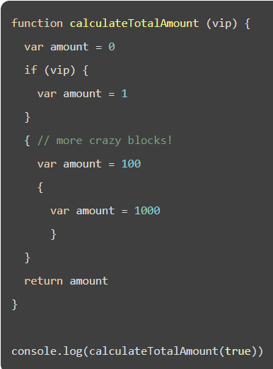
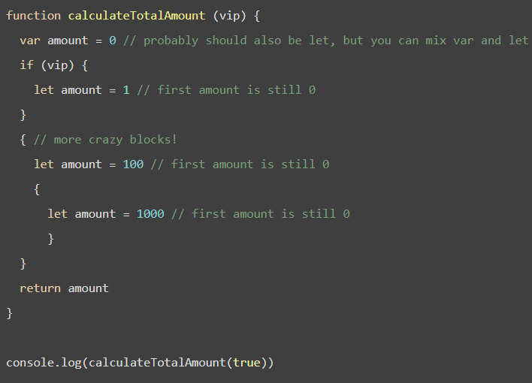
ES6 Block-Scoped Constructs Let and Const

Slide 30
Syntactic Sugar
Are the new ES6 classes just syntactic sugar for the old prototypal pattern?
JavaScript classes are introduced in ECMAScript 6 and are syntactical sugar over JavaScript's existing prototype-based inheritance. The class syntax is not introducing a new object-oriented inheritance model to JavaScript. JavaScript classes provide a much simpler and clearer syntax to create objects and deal with inheritance.

Slide 31
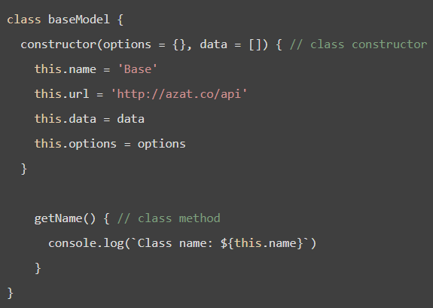
Classes in ES6
It makes writing classes and inheriting from them as easy, Classes creation and usage in ES5 is slightly complex.
Empty Array
Constructor is a keyword
this is keyword, used to specify properties of class

Slide 32
Classes in ES6
default parameter values for options and data. The other big difference is that you can’t assign properties this.NAME the same way as methods, i.e., you can’t say name at the same indentation level as a method.
To set the initial value of a property, simply assign a value in the constructor.
ES6 classes brings a new syntax for getters and setters on object properties. Get and set allows us to run code on the reading or writing of a property.

Slide 33
Class Inheritance in ES6
Classes Advantages in ES6
Improves reusability
Improves Modularity, readability
You can inherit one class from another using extends keyword
Constructor of Base class can be invoked from Derived class constructor using super()

Slide 34
ES6 - Promise
Promises are introduced to handle asynchronous or time consuming activities.
When a time consuming processing is started, it returns a Promise object. To this Promise object we need to provide success and failure handlers
How to use a promise
promise_obj
.then(value => { /* fulfillment */ })
.catch(error => { /* rejection */ });
"Imagine there is a kid. And mom promises him that she'll get him a new phone next week.“
That is a promise. A promise has 3 states. They are:
Promise is pending: He don't know if you will get that phone until next week.
Promise is resolved: His mom really buys him a brand new phone.
Promise is rejected: He don't get a new phone because your mom is not happy.

Slide 35
ES6 Module
As known ES6 Module improves Modularity of client side web application.
If you are developer of the Module, you need to specify members you want to expose externally, using export keyword.
There are two kinds of exports: named exports (several per module) and default exports (one per module).
export
import

Slide 36
What is Design Pattern?
Reusable Design solution to a commonly occurring design problem.
This Design Solution is Documented, Practised, etc… across Software Industry
We will be covering below Design Patterns reg. JavaScript Frameworks
Singleton
Factory
Observer
Facade
Adapter

Slide 37
Shadow DOM
Shadow DOM is a new DOM feature that helps you build Web components.
Shadow DOM can be thought as a scoped subtree inside your element.
Styles inside a shadow tree are scoped to the shadow tree, and don't affect elements outside the shadow tree.
Styles outside the shadow tree also don't match selectors inside the shadow tree. However, inheritable style properties like color still inherit down from host to shadow tree.

Slide 38
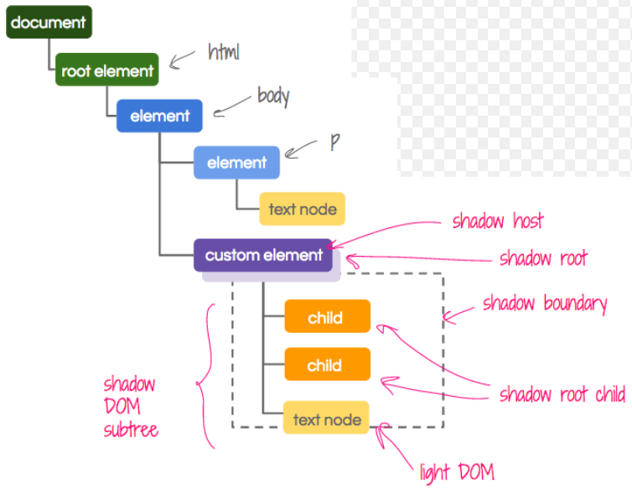
Shadow DOM

Slide 39
Shadow DOM
CSS styles defined inside Shadow DOM are scoped to the ShadowRoot. This means styles are encapsulated by default.
Shadow boundary and it refers to the barrier that separates the regular DOM (the "light" DOM) from the shadow DOM.
One of the primary benefits of the shadow boundary is that it prevents styles that are in the main document from leaking into the shadow DOM.
This means that even though you might have a selector in your main document for all <h3> tags, that style will not be applied to your shadow DOM element unless you specifically allow it.

Slide 40
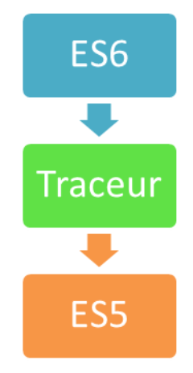
Traceur
Google provides a compiler named Traceur for checking ES6 feature.
Traceur compiles the ES6 code to ES5 for testing ES6 feature.
To install Traceur in NODE machine use the npm install –g traceur in the terminal.

Slide 41
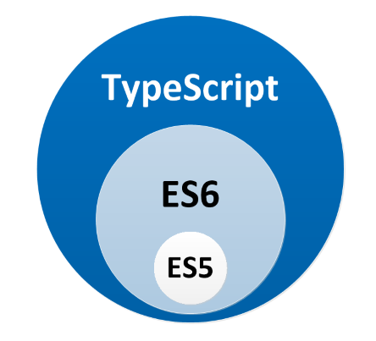
TypeScript is superset of ES6
https://www.typescriptlang.org/
TypeScript is developed by Microsoft
TypeScript is a typed superset of JavaScript that compiles into a plain JavaScript
TypeScript is JavaScript that scales

