Slide 1
Node.js

Slide 2
What is Node.js?
Node.js is an open-source server side runtime environment built on Chrome's V8 JavaScript engine. It provides an
event driven,
non-blocking (asynchronous) I/O and
cross-platform runtime environment for building highly scalable server-side application using JavaScript.
Official Website: nodejs.org

Slide 3
What is Node.js?
Node.js can be used to build different types of applications such as
command line application,
web application,
real-time chat application,
REST API server etc.
However, it is mainly used to build network programs like web servers, similar to PHP, Java, or ASP.NET.
Node.js was written and introduced by Ryan Dahl in 2009.
Node.js official web site: https://nodejs.org

Slide 4
Advantages of Node.js
Node.js is an open-source framework under MIT license. (MIT license is a free software license originating at the Massachusetts Institute of Technology (MIT).)
Uses JavaScript to build entire server side application.
Lightweight framework that includes bare minimum modules.
Other modules can be included as per the need of an application.
Asynchronous by default, So it performs faster than other frameworks.
Cross-platform framework that runs on Windows, MAC or Linux
no marshallibng/unmarshalling

Slide 5
Node.js Process Model
In this section, we will learn about the Node.js process model and understand why we should use Node.js.
Traditional Web Server Model
In the traditional web server model, each request is handled by a dedicated thread from the thread pool. If no thread is available in the thread pool at any point of time then the request waits till the next available thread. Dedicated thread executes a particular request and does not return to thread pool until it completes the execution and returns a response.

Slide 6
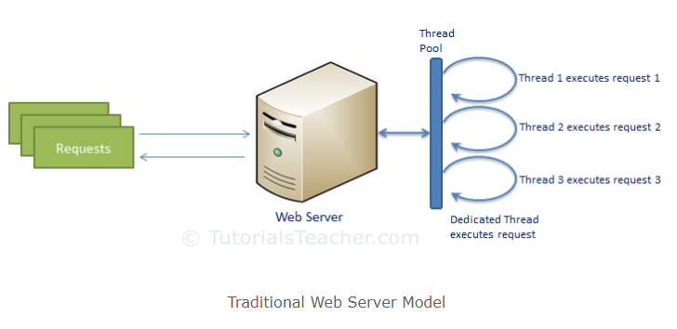
Traditional Web Server Model

Slide 7
Node.js
Node.js Process Model
Node.js processes user requests differently when compared to a traditional web server model. Node.js runs in a single process and the application code runs in a single thread and thereby needs less resources than other platforms. All the user requests to your web application will be handled by a single thread and all the I/O work or long running job is performed asynchronously for a particular request. So, this single thread doesn't have to wait for the request to complete and is free to handle the next request. When asynchronous I/O work completes then it processes the request further and sends the response.
An event loop is constantly watching for the events to be raised for an asynchronous job and executing callback function when the job completes. Internally, Node.js uses libevfor the event loop which in turn uses internal C++ thread pool to provide asynchronous I/O.
The following figure illustrates asynchronous web server model using Node.js.

Slide 8
Node.js
Node.js process model increases the performance and scalability with a few caveats. Node.js is not fit for an application which performs CPU-intensive operations like image processing or other heavy computation work because it takes time to process a request and thereby blocks the single thread.
Setup Node.js Development Environment:
In this section, you will learn about the tools required and steps to setup development environment to develop a Node.js application.
Node.js development environment can be setup in Windows, Mac, Linux and Solaris. The following tools/SDK are required for developing a Node.js application on any platform.
Node.js
Node Package Manager (NPM)
IDE (Integrated Development Environment) or TextEditor
NPM (Node Package Manager) is included in Node.js installation since Node version 0.6.0., so there is no need to install it separately.

Slide 9
Node.js
Install Node.js on Windows
Visit Node.js official web site https://nodejs.org. It will automatically detect OS and display download link as per your Operating System. For example, it will display following download link for 64 bit Windows OS.
Difference between JS engine in Browser and Node

Slide 10
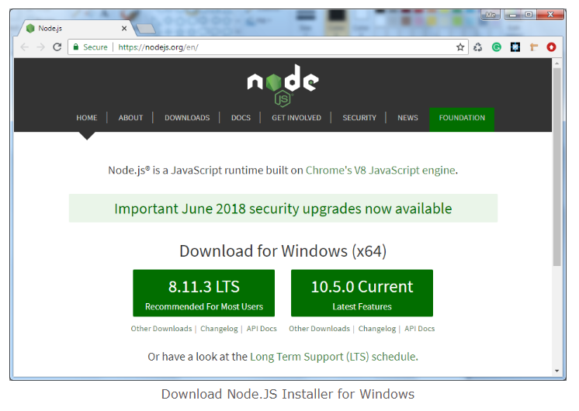
Node.js

Slide 11
Node.js
Download node MSI for windows by clicking on 8.11.3 LTS or 10.5.0 Current button. We have used the latest version 10.5.0 for windows through out these tutorials.
After you download the MSI, double-click on it to start the installation as shown below.

Slide 12
Node.js
Node.js Console – REPL:
Node.js comes with virtual environment called REPL (aka Node shell). REPL stands for Read-Eval-Print-Loop. It is a quick and easy way to test simple Node.js/JavaScript code.
To launch the REPL (Node shell), open command prompt (in Windows) or terminal (in Mac or UNIX/Linux) and type node as shown below. It will change the prompt to > in Windows and MAC.
10 + 20
"Hello" + "World"
var x = 10, y = 20;
x + y

Slide 13
Node.js
Node.js Basics
Node.js supports JavaScript. So, JavaScript syntax on Node.js is similar to the browser's JavaScript syntax.
Primitive Types
Node.js includes following primitive types:
String
Number
Boolean
Undefined
Null
RegExp
Everything else is an object in Node.js.

Slide 14
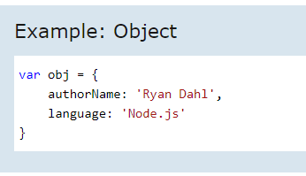
Node.js
Loose Typing
JavaScript in Node.js supports loose typing like the browser's JavaScript. Use var keyword to declare a variable of any type.
Object Literal
Object literal syntax is same as browser's JavaScript.

Slide 15
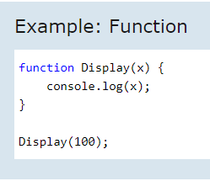
Node.js
Functions:
Functions are first class citizens in Node's JavaScript, similar to the browser's JavaScript. A function can have attributes and properties also. It can be treated like a class in JavaScript.

Slide 16
Node.js
Buffer:
Node.js includes an additional data type called Buffer (not available in browser's JavaScript). Buffer is mainly used to store binary data, while reading from a file or receiving packets over the network.
process object:
Each Node.js script runs in a process. It includes process object to get all the information about the current process of Node.js application.
The following example shows how to get process information in REPL using processobject.

Slide 17
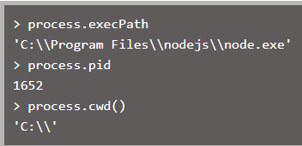
Node.js
Defaults to local
Node's JavaScript is different from browser's JavaScript when it comes to global scope. In the browser's JavaScript, variables declared without var keyword become global. In Node.js, everything becomes local by default.

Slide 18
Node.js
Access Global Scope:
In a browser, global scope is the window object. In Node.js, global object represents the global scope.
To add something in global scope, you need to export it using export or module.export. The same way, import modules/object using require() function to access it from the global scope.
For example, to export an object in Node.js, use exports.name = object.

Slide 19
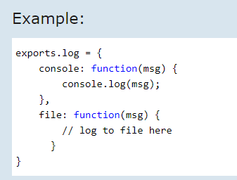
Node.js
Now, you can import log object using require() function and use it anywhere in your Node.js project.
Learn about modules in detail in the next section.

Slide 20
Node.js – Module
Module in Node.js is a simple or complex functionality organized in single or multiple JavaScript files which can be reused throughout the Node.js application.
Each module in Node.js has its own context, so it cannot interfere with other modules or pollute global scope.
Also, each module can be placed in a separate .js file under a separate folder.
Node.js implements CommonJS modules standard. CommonJS is a group of volunteers who define JavaScript standards for web server, desktop, and console application.

Slide 21
Node.js Module Types
Node.js includes three types of modules:
Core Modules
Local Modules
Third Party Modules
Node.js Core Modules:
Node.js is a light weight framework. The core modules include bare minimum functionalities of Node.js. These core modules are compiled into its binary distribution and load automatically when Node.js process starts. However, you need to import the core module first in order to use it in your application.
The following table lists some of the important core modules in Node.js.

Slide 22
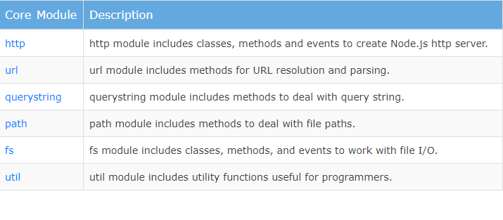

Node.js – Core Modules
Loading Core Modules
In order to use Node.js core or NPM modules, you first need to import it using require() function as shown below.

Slide 23
Node.js
As per above syntax, specify the module name in the require() function.
The require() function will return an object, function, property or any other JavaScript type, depending on what the specified module returns.

Slide 24
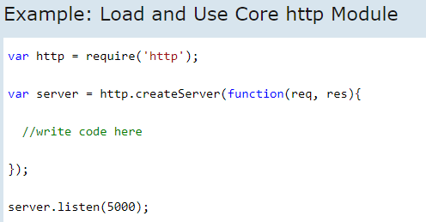
Node.js
In the above example, require() function returns an object because http module returns its functionality as an object, you can then use its properties and methods using dot notation e.g. http.createServer().
In this way, you can load and use Node.js core modules in your application. We will be using core modules throughout these tutorials.
Learn about local modules in the next section

Slide 25
Node.js Local Module:
Local modules are modules created locally in your Node.js application. These modules include different functionalities of your application in separate files and folders. You can also package it and distribute it via NPM, so that Node.js community can use it. For example, if you need to connect to MongoDB and fetch data then you can create a module for it, which can be reused in your application.
Writing Simple Module:
Let's write simple logging module which logs the information, warning or error to the console.
In Node.js, module should be placed in a separate JavaScript file. So, create a Log.js file and write the following code in it.

Slide 26
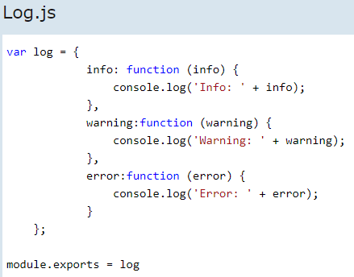
Node.js
In the above example of logging module, we have created an object with three functions - info(), warning() and error(). At the end, we have assigned this object to module.exports. The module.exports in the above example exposes a log object as a module.

Slide 27
Node.js
The module.exports is a special object which is included in every JS file in the Node.js application by default. Use module.exports or exports to expose a function, object or variable as a module in Node.js.
Now, let's see how to use the above logging module in our application.
Loading Local Module:
To use local modules in your application, you need to load it using require() function in the same way as core module. However, you need to specify the path of JavaScript file of the module.
The following example demonstrates how to use the above logging module contained in Log.js.

Slide 28
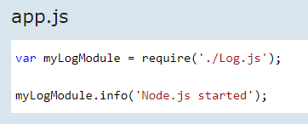
Node.js
In the above example, app.js is using log module.
So, we have specified the path './Log.js' in the require() function. The '.' denotes a root folder.
The require() function returns a log object because logging module exposes an object in Log.js using module.exports. So now you can use logging module as an object and call any of its function using dot notation e.g myLogModule.info() or myLogModule.warning() or myLogModule.error()
Run the above example using command prompt (in Windows) as shown below.

Slide 29

Node.js
Thus, you can create a local module using module.exports and use it in your application.
Let's see how to expose different types as a node module using module.exports in the next section.

Slide 30
Export Module in Node.js:
In this section, you will learn how to expose different types as a module using module.exports.
The module.exports or exports is a special object which is included in every JS file in the Node.js application by default. module is a variable that represents current module and exports is an object that will be exposed as a module. So, whatever you assign to module.exports or exports, will be exposed as a module.
Let's see how to expose different types as a module using module.exports.

Slide 31
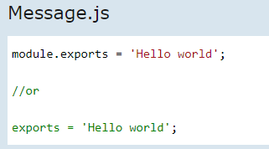
Node.js Export Literals
As mentioned above, exports is an object. So it exposes whatever you assigned to it as a module. For example, if you assign a string literal then it will expose that string literal as a module.
The following example exposes simple string message as a module in Message.js.

Slide 32
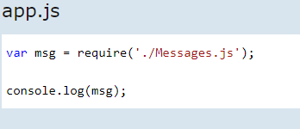

Node.js
Now, import this message module and use it as shown below.
Run the above example and see the result as shown below.

Slide 33
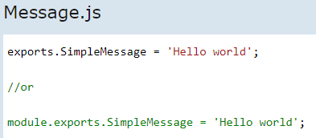
Node.js – Export Object
Note: You must specify './' as a path of root folder to import a local module. However, you do not need to specify path to import Node.js core module or NPM module in the require() function.
Export Object:
exports is an object. So, you can attach properties or methods to it. The following example exposes an object with a string property in Message.js file.

Slide 34
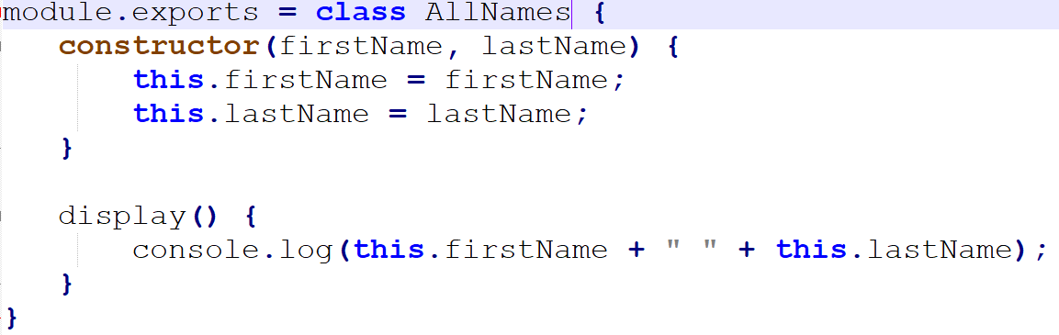
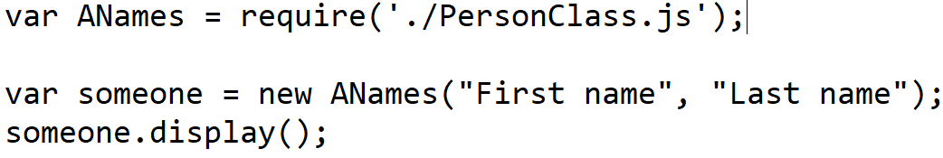
Node.js – Export Class
It is also possible to export a class or multiple classes
Below snippet shows require

Slide 35
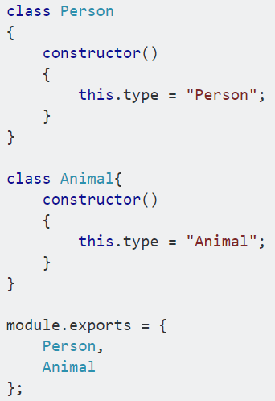
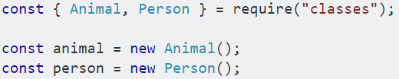
Node.js – Export Class
Multiple class can be exported. Below is syntax

Slide 36
Node Package Manager
Node Package Manager (NPM) is a command line tool that installs, updates or uninstalls Node.js packages in your application.
It has also an online repository for open-source Node.js packages.
The node community around the world creates useful modules and publishes them as packages in this repository.
NPM is included with Node.js installation.
After you install Node.js, verify NPM installation by writing the following command in terminal or command prompt.

Slide 37



Node.js
If you have an older version of NPM then you can update it to the latest version using the following command.
Install Package Locally
Use the following command to install any third party module in your local Node.js project folder.
For example, the following command will install ExpressJS into MyNodeProj folder

Slide 38

Node.js
All the modules installed using NPM are installed under node_modules folder. The above command will create ExpressJS folder under node_modules folder in the root folder of your project and install Express.js there.
Add Dependency into package.json:
Use --save at the end of the install command to add dependency entry into package.json of your application.
For example, the following command will install ExpressJS in your application and also adds dependency entry into the package.json
The package.json of NodejsConsoleApp project will look something like below..

Slide 39
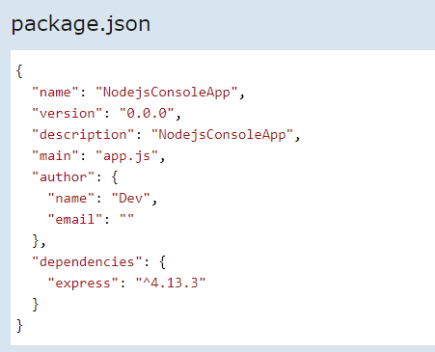
Node.js
Install Package Globally:
NPM can also install packages globally so that all the node.js application on that computer can import and use the installed packages. NPM installs global packages into /<User>/local/lib/node_modules folder.
Apply -g in the install command to install package globally. For example, the following command will install ExpressJS globally.

Slide 40


Node.js
Update Package:
To update the package installed locally in your Node.js project, navigate the command prompt or terminal window path to the project folder and write the following update command.
Uninstall Packages:
Use the following command to remove a local package from your project.

Slide 41
Node.js Project
Step 1:
Create a folder
Invoke npm init this creates package.json
Step 2: Open package.json, and update dependencies
Step 3: invoke npm install to complete installation of dependent packages
Step 4: Now continue to run using node

Slide 42
Node.js Web Server
In this section, we will learn how to create a simple Node.js web server and handle HTTP requests.
To access web pages of any web application, you need a web server. The web server will handle all the http requests for the web application e.g IIS is a web server for ASP.NET web applications and Apache is a web server for PHP or Java web applications.
Node.js provides capabilities to create your own web server which will handle HTTP requests asynchronously. You can use IIS or Apache to run Node.js web application but it is recommended to use Node.js web server.
Create Node.js Web Server:
Node.js makes it easy to create a simple web server that processes incoming requests asynchronously.
The following example is a simple Node.js web server contained in server.js file.

Slide 43
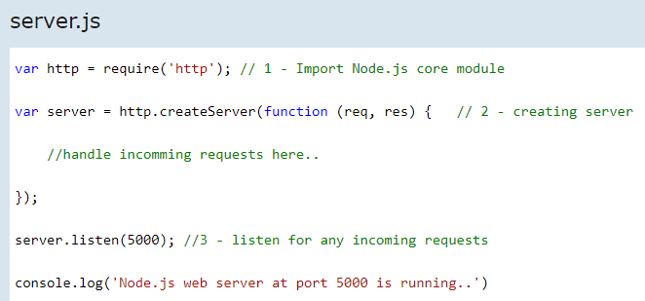
Node.js Simple Web Server
Port number
In the above example, we import the http module using require() function. The http module is a core module of Node.js, so no need to install it using NPM. The next step is to call createServer() method of http and specify callback function with request and response parameter. Finally, call listen() method of server object which was returned from createServer() method with port number, to start listening to incoming requests on port 5000. You can specify any unused port here.

Slide 44

Node.js Simple Web Server
Run the above web server by writing node server.js command in command prompt or terminal window and it will display message as shown below.
This is how you create a Node.js web server using simple steps. Now, let's see how to handle HTTP request and send response in Node.js web server.
Handle HTTP Request
The http.createServer() method includes request and response parameters which is supplied by Node.js. The request object can be used to get information about the current HTTP request e.g., url, request header, and data. The response object can be used to send a response for a current HTTP request.
The following example demonstrates handling HTTP request and response in Node.js.

Slide 45
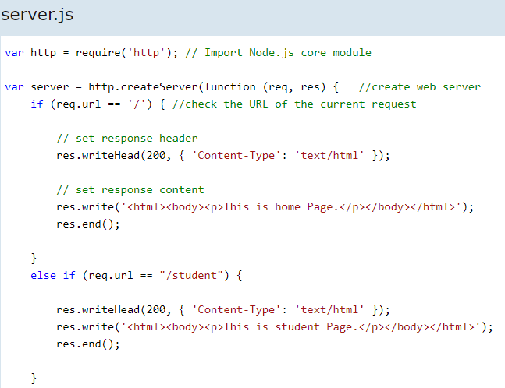
Node.js Simple Web Server
Content which will be sent to server

Slide 46
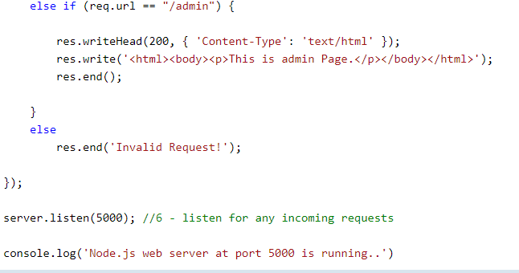
Node.js Simple Web Server

Slide 47

Node.js Simple Web Server
In the above example, req.url is used to check the url of the current request and based on that it sends the response. To send a response, first it sets the response header using writeHead() method and then writes a string as a response body using write() method. Finally, Node.js web server sends the response using end() method.
Now, run the above web server as shown below.
To test it, you can use the command-line program curl, which most Mac and Linux machines have pre-installed.

Slide 48
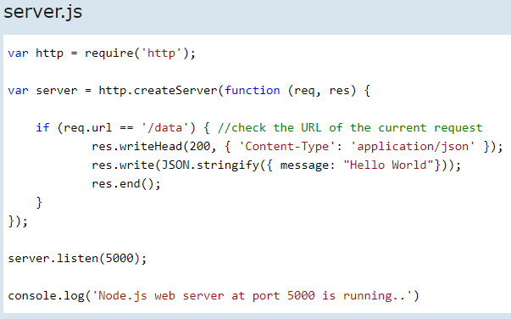
Node.js Web Server – JSON Response
JSON object
So, this way you can create a simple web server that serves different responses.

Slide 49
Node.js File System
Node.js File System:
Node.js includes fs module to access physical file system. The fs module is responsible for all the asynchronous or synchronous file I/O operations.
Let's see some of the common I/O operation examples using fs module.
Reading File:
Use fs.readFile() method to read the physical file asynchronously.

Slide 50

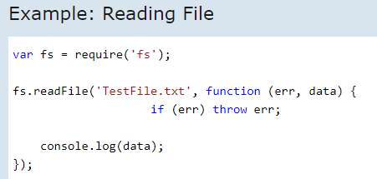
Node.js File System
Parameter Description:
filename: Full path and name of the file as a string.
options: The options parameter can be an object or string which can include encoding and flag. The default encoding is utf8 and default flag is "r".
callback: A function with two parameters err and fd. This will get called when readFile operation completes.
The following example demonstrates reading existing TestFile.txt asynchronously.

Slide 51
Node.js File System
The above example reads TestFile.txt (on Windows) asynchronously and executes callback function when read operation completes.
This read operation either throws an error or completes successfully.
The err parameter contains error information if any.
The data parameter contains the content of the specified file.

Slide 52


Node.js
Now, run the above example and see the result as shown below.
Writing File
Use fs.writeFile() method to write data to a file. If file already exists then it overwrites the existing content otherwise it creates a new file and writes data into it.

Slide 53
Node.js
Parameter Description:
filename: Full path and name of the file as a string.
Data: The content to be written in a file.
options: The options parameter can be an object or string which can include encoding, mode and flag. The default encoding is utf8 and default flag is "r".
callback: A function with two parameters err and fd. This will get called when write operation completes.
The following example creates a new file called test.txt and writes "Hello World" into it asynchronously.

Slide 54
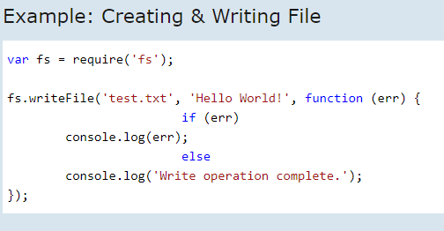
Node.js
Parameter Description:
path: Full path with name of the file as a string.
Flag: The flag to perform operation
Mode: The mode for read, write or readwrite. Defaults to 0666 readwrite.
callback: A function with two parameters err and fd. This will get called when file open operation completes.

Slide 55
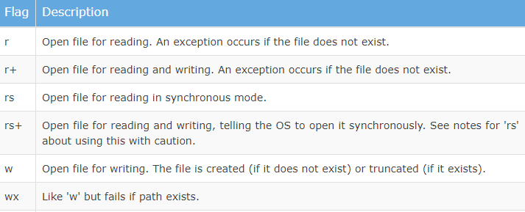
Node.js
Flags:
The following table lists all the flags which can be used in read/write operation.

Slide 56
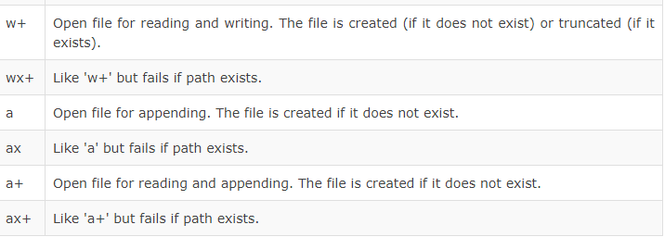
Node.js

Slide 57
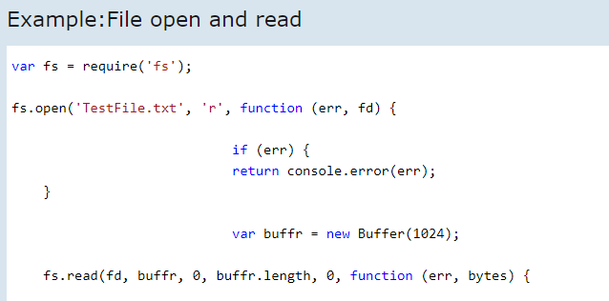
Node.js
The following example opens an existing file and reads its content.

Slide 58
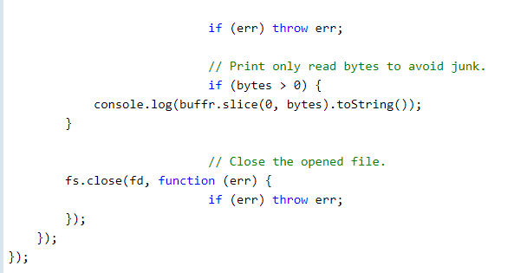
Node.js

Slide 59
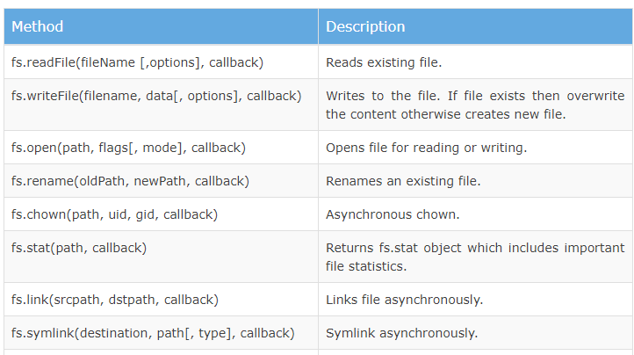
Node.js

Slide 60
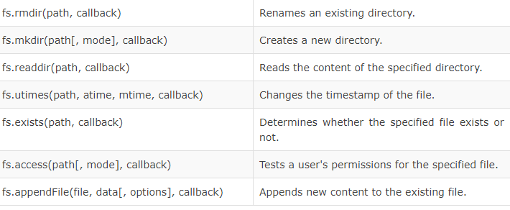
Node.js

Slide 61
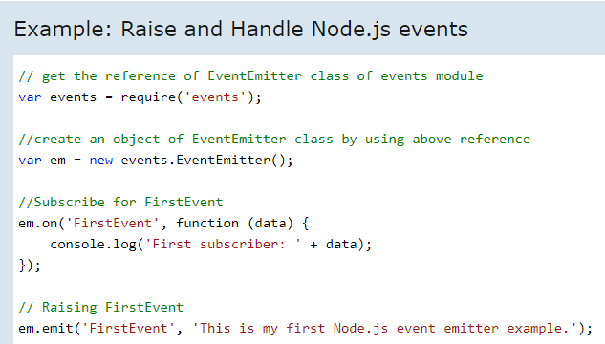
Node.js EventEmitter
Node.js allows us to create and handle custom events easily by using events module. Event module includes EventEmitter class which can be used to raise and handle custom events.
The following example demonstrates EventEmitter class for raising and handling a custom event.

Slide 62
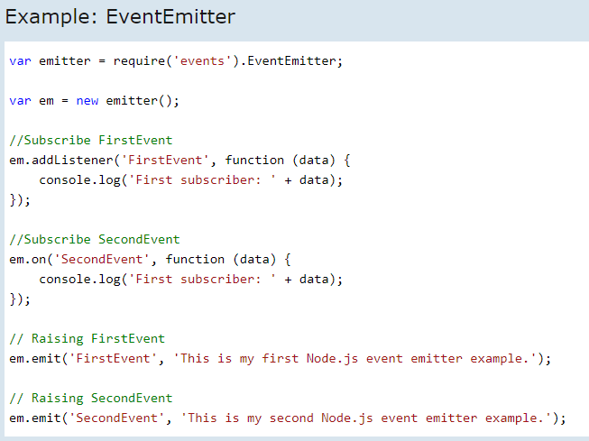
Node.js Event Emitter
You can also use addListener() methods to subscribe for an event as shown below.

Slide 63
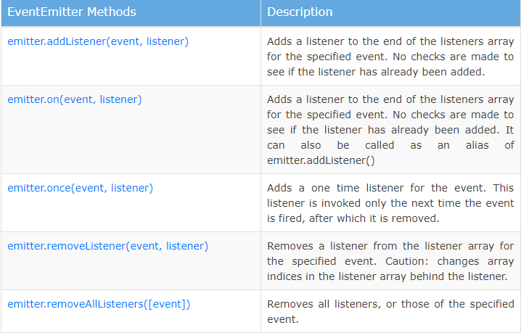
Node.js Event Emitter

Slide 64
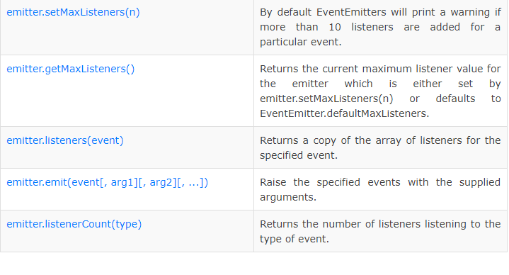
Node.js Event Emitter

Slide 65
Node.js Event Emitter
Common Patterns for EventEmitters
There are two common patterns that can be used to raise and bind an event using EventEmitter class in Node.js.
Return EventEmitter from a function
Extend the EventEmitter class
Return EventEmitter from a function:
In this pattern, a constructor function returns an EventEmitter object, which was used to emit events inside a function. This EventEmitter object can be used to subscribe for the events. Consider the following example.

Slide 66
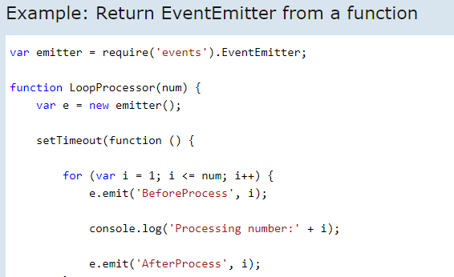
Node.js

Slide 67
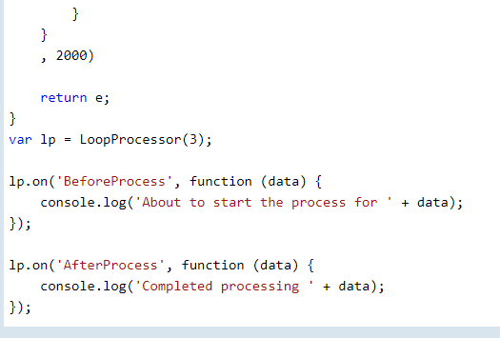
Node.js

Slide 68
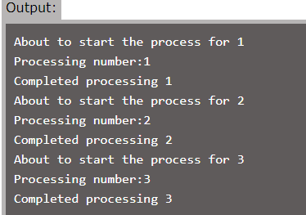
Node.js
In the above LoopProcessor() function, first we create an object of EventEmitter class and then use it to emit 'BeforeProcess' and 'AfterProcess' events. Finally, we return an object of EventEmitter from the function. So now, we can use the return value of LoopProcessor function to bind these events using on() or addListener() function.

Slide 69
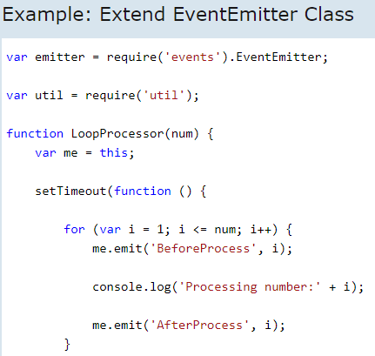
Extend EventEmitter Class
In this pattern, we can extend the constructor function from EventEmitter class to emit the events.

Slide 70
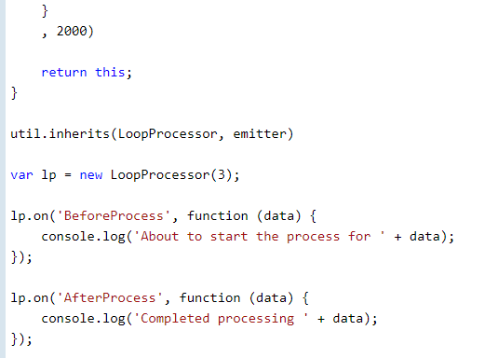
Extend EventEmitter Class

Slide 71
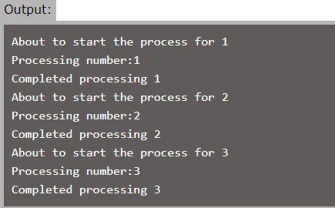
Extend EventEmitter Class
In the above example, we have extended LoopProcessor constructor function with EventEmitter class using util.inherits() method of utility module. So, you can use EventEmitter's methods with LoopProcessor object to handle its own events.
In this way, you can use EventEmitter class to raise and handle custom events in Node.js.

Slide 72
Express.js
Express.js is a web application framework for Node.js. It provides various features that make web application development fast and easy which otherwise takes more time using only Node.js.
Express.js is based on the Node.js middleware module called connect which in turn uses http module. So, any middleware which is based on connect will also work with Express.js.

Slide 73
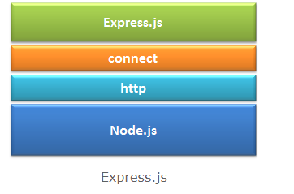
Express.js
Advantages of Express.js:
Makes Node.js web application development fast and easy.
Easy to configure and customize.
Allows you to define routes of your application based on HTTP methods and URLs.
Includes various middleware modules which you can use to perform additional tasks on request and response.

Slide 74
ExpressJS Installation
Assuming you’ve already installed Node.js, create a directory to hold your application, and make that your working directory.
$ mkdir myapp
$ cd myapp
Use the npm init command to create a package.json file for your application.
For more information on how package.json works, see Specifics of npm’s package.json handling.
$ npm init This command prompts you for a number of things, such as the name and version of your application. For now, you can simply hit RETURN to accept the defaults for most of them, with the following exception:
entry point: (index.js) Enter app.js, or whatever you want the name of the main file to be. If you want it to be index.js, hit RETURN to accept the suggested default file name.
Now install Express in the myapp directory and save it in the dependencies list. For example:
$ npm install express --save

Slide 75
ExpressJS Installation
Now run your file, as shown below
node app.js
Open appropriate http://localhost:portno/ in your Browser. (Check your app.js file for port number)

Slide 76
Express.JS
Allows you to define an error handling middleware.
Easy to serve static files and resources of your application.
Allows you to create REST API server.
Easy to connect with databases such as MongoDB, Redis, MySQL
Install Express.js:
You can install express.js using npm. The following command will install latest version of express.js globally on your machine so that every Node.js application on your machine can use it.

Slide 77

Express.JS
The following command will install latest version of express.js local to your project folder.
As you know, --save will update the package.json file by specifying express.js dependency

Slide 78
Express.js Web Application
In this section, you will learn how to create a web application using Express.js.
Express.js provides an easy way to create web server and render HTML pages for different HTTP requests by configuring routes for your application.
Web Server:
First of all, import the Express.js module and create the web server as shown below.

Slide 79
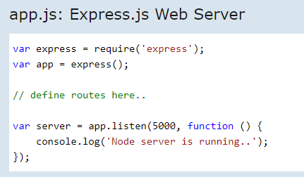
Express.js Web Application
In the above example, we imported Express.js module using require() function. The express module returns a function. This function returns an object which can be used to configure Express application (app in the above example).

Slide 80
Express.js Web Application
https://expressjs.com/en/guide/routing.html
The app object includes methods for routing HTTP requests, configuring middleware, rendering HTML views and registering a template engine.
The app.listen() function creates the Node.js web server at the specified host and port. It is identical to Node's http.Server.listen() method.
Run the above example using node app.js command and point your browser to http://localhost:5000. It will display Cannot GET / because we have not configured any routes yet.
Configure Routes:
Use app object to define different routes of your application. The app object includes get(), post(), put() and delete() methods to define routes for HTTP GET, POST, PUT and DELETE requests respectively.
The following example demonstrates configuring routes for HTTP requests.

Slide 81
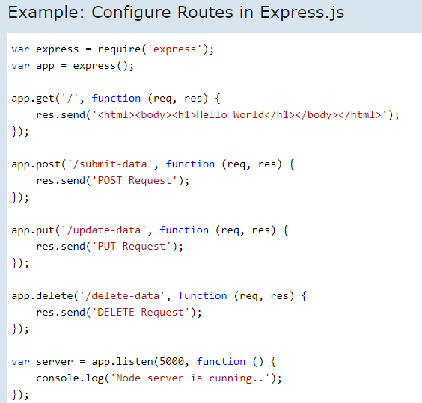
Express.js Web Application - Routes

Slide 82
Express.js Web Application
In the above example, app.get(), app.post(), app.put() and app.delete() methods define routes for HTTP GET, POST, PUT, DELETE respectively.
The first parameter is a path of a route which will start after base URL.
The callback function includes request and response object which will be executed on each request.
Run the above example using node server.js command, and point your browser to http://localhost:5000

Slide 83
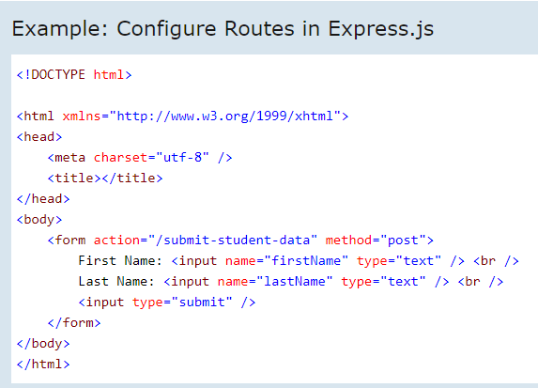
Express.JS POST Request

Slide 84

Node.js
Body Parser:
To handle HTTP POST request in Express.js version 4 and above, you need to install middleware module called body-parser. The middleware was a part of Express.js earlier but now you have to install it separately.
This body-parser module parses the JSON, buffer, string and url encoded data submitted using HTTP POST request. Install body-parser using NPM as shown below.
Now, import body-parser and get the POST request data as shown below.

Slide 85
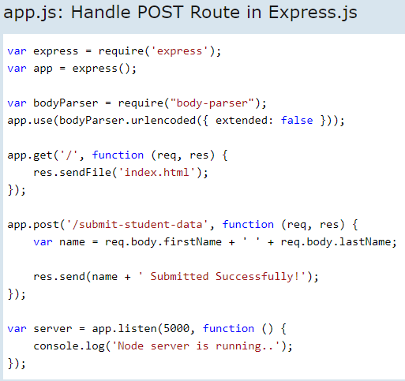
Node.js

Slide 86
Node.js
In the above example, POST data can be accessed using req.body. The req.body is an object that includes properties for each submitted form. Index.html contains firstName and lastName input types, so you can access it using req.body.firstName and req.body.lastName.
Now, run the above example using node server.js command, point your browser to http://localhost:5000 and see the following result.

Slide 87
Node.js
Serving Static Resources in Node.js:
In this section, you will learn how to serve static resources like images, css, JavaScript or other static files using Express.js and node-static module.
Serve Static Resources using Express.js:
It is easy to serve static files using built-in middleware in Express.js called express.static. Using express.static() method, you can server static resources directly by specifying the folder name where you have stored your static resources.
The following example serves static resources from the public folder under the root folder of your application.

Slide 88
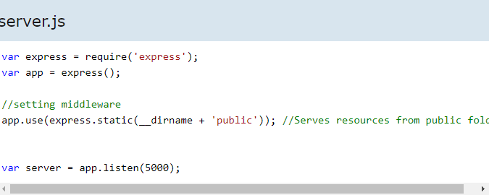
Node.js
Now, run the above code using node server.js command and point your browser to http://localhost:5000/myImage.jpg and it will display myImage.jpg from the public folder (public folder should have myImage.jpg).
If you have different folders for different types of resources then you can set express.static middleware as shown below

Slide 89
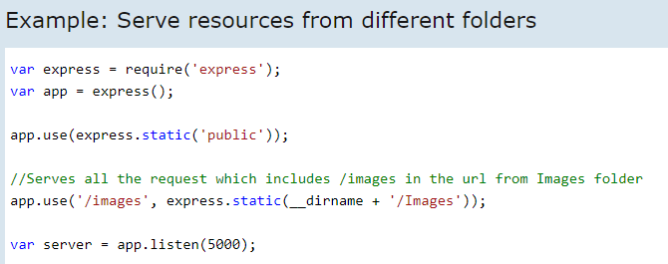
Node.js
In the above example, app.use() method mounts the express.static middleware for every request that starts with "/images". It will serve images from images folder for every HTTP requests that starts with "/images". For example, HTTP request http://localhost:5000/images/myImage.png will get myImage.png as a response. All other resources will be served from public folder.

Slide 90
Node.js
Now, run the above code using node server.js and point your browser to http://localhost:5000/images/myImage.jpg and it will display myImage.jpg from the images folder, whereas http://localhost:5000/myJSFile.js request will be served from public folder. (images folder must include myImage.png and public folder must include myJSFile.js)
You can also create a virtual path in case you don't want to show actual folder name in the url.

Slide 91

Node.js
So now, you can use http://localhost:5000/resources/myImage.jpg to serve all the images instead of http://localhost:5000/images/myImage.jpg.
In this way, you can use Express.js to server static resources such as images, CSS, JavaScript or other files.
Serve Static Resources using Node-static Module
In your node application, you can use node-static module to serve static resources. The node-static module is an HTTP static-file server module with built-in caching.
First of all, install node-static module using NPM as below.

Slide 92

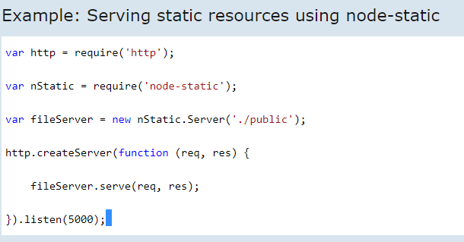
Node.js
After installing node-static module, you can create static file server in Node.js which serves static files only.
The following example demonstrates serving static resources using node-static module.

Slide 93
Node.js
In the above example, node-static will serve static files from public folder by default. So, an URL request will automatically map to the file in the public folder and will send it as a response.
Now, run the above example using
node server.js command and point your browser to http://localhost:5000/myImage.jpg (assuming that public folder includes myImage.jpg file) and it will display the image on your browser. You don't need to give "/public/myImage.jpg" because it will automatically serve all the static files from the public folder.

Slide 94

Node.js - MongoDB
Access MongoDB in Node.js
Learn how to access document-based database MongoDB using Node.js in this section.
In order to access MongoDB database, we need to install MongoDB drivers. To install native mongodb drivers using NPM, open command prompt and write the following command to install MongoDB driver in your application

Slide 95
Node.js - MongoDB
This will include mongodb folder inside node_modules folder. Now, start the MongoDB server using the following command. (Assuming that your MongoDB database is at C:\MyNodeJSConsoleApp\MyMongoDB folder.

Slide 96
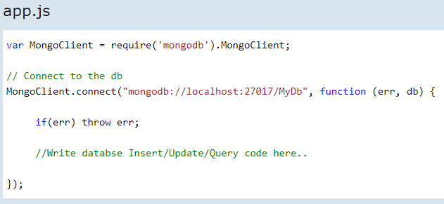
Node.js - MongoDB
In the above example, we have imported mongodb module (native drivers) and got the reference of MongoClient object. Then we used MongoClient.connect() method to get the reference of specified MongoDB database. The specified URL "mongodb://localhost:27017/MyDb" points to your local MongoDB database created in MyMongoDB folder. The connect() method returns the database reference if the specified database is already exists, otherwise it creates a new database.
Now you can write insert/update or query the MongoDB database in the callback function of the connect() method using db parameter

Slide 97
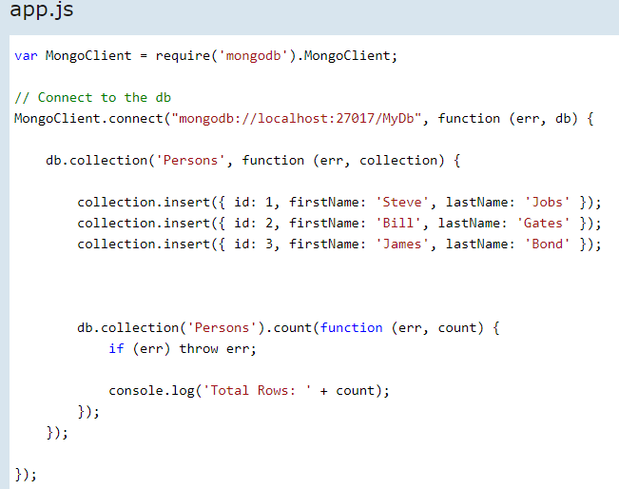
Node.js – Mongo DB
Insert Documents
The following example demonstrates inserting documents into MongoDB database.

Slide 98

Node.js – Mongo DB
In the above example, db.collection() method creates or gets the reference of the specified collection. Collection is similar to table in relational database. We created a collection called Persons in the above example and insert three documents (rows) in it. After that, we display the count of total documents stored in the collection.
Running the above example displays the following result.
Update/Delete Documents
The following example demonstrates updating or deleting an existing documents(records).

Slide 99

Node.js – Mongo DB

Slide 100

Node.js – Mongo DB

Slide 101

Node.js – Mongo DB
Query Database:
The following example demonstrates executing a query in the MongoDB database.

Slide 102
Node.js – Mongoose
NodeJS Applications can be Tested using Jasmine Testing Framework.
Now lets create an Application using below command.
npm init -y
Above command creates a package.json file
There are a few ways to get started with Jasmine. You could install it globally, or locally to the project as a development dependency.
npm install -g jasmine --save-dev
Ensure that above command is given in same path as the project’s package.json file.

Slide 103
Node.js – Testing
NodeJS Applications can be Tested using Jasmine Testing Framework.
Now lets create an Application using below command.
npm init -y
Above command creates a package.json file
There are a few ways to get started with Jasmine. You could install it globally, or locally to the project as a development dependency.
npm install -g jasmine --save-dev
Ensure that above command is given in same path as the project’s package.json file.

Slide 104

Node.js – Testing
Run below command
jasmine init
Inspect the generated configuration file. The configuration file will be stored in the spec/support folder as jasmine.json. This file enumerates the source files and spec files you would like the Jasmine runner to include.
Create a simple Application, like below, name it App.js

Slide 105

Node.js – Testing
Lets name Test file as app.spec.js , here spec is mandatory, as only those files are recognized for Testing
Place this file in spec folder
Run below command to run test files
jasmine

Slide 106
Node.js – Streams
Streams are objects that let you read data from a source or write data to a destination in continuous fashion. In Node.js, there are four types of streams −
Readable − Stream which is used for read operation.
Writable − Stream which is used for write operation.
Duplex − Stream which can be used for both read and write operation.
Transform − A type of duplex stream where the output is computed based on input.
Stream let us read/write huge data, by keeping memory usage low, as the data is read or written in chunks

Slide 107
Node.js – Streams
Each type of Stream is an EventEmitter instance and throws several events at different instance of times. For example, some of the commonly used events are −
data − This event is fired when there is data is available to read.
end − This event is fired when there is no more data to read.
error − This event is fired when there is any error receiving or writing data.
finish − This event is fired when all the data has been flushed to underlying system.

Slide 108

Node.js – Piping Streams
Piping is a mechanism where we provide the output of one stream as the input to another stream.
It is normally used to get data from one stream and to pass the output of that stream to another stream.

Slide 109
Node.js – Chaining Streams
Chaining is a mechanism to connect the output of one stream to another stream and create a chain of multiple stream operations.
It is normally used with piping operations. For example use piping and chaining to first compress a file and then decompress the same.
https://medium.freecodecamp.org/node-js-streams-everything-you-need-to-know-c9141306be93

Slide 110
Node.js – Buffers
Node provides Buffer class which provides instances to store raw data similar to an array of integers but corresponds to a raw memory allocation outside the V8 heap.
Buffer class is a global class that can be accessed in an application without importing the buffer module.
There are three different ways to create a Buffer

Slide 111
Node.js – Buffers
Node Buffer can be constructed in a variety of ways.
Method 1
var buf = new Buffer(10); //non initialized 10 octets
Method 2
var buf = new Buffer([10, 20, 30, 40, 50]); //create BUffer from an array
Method 3
var buf = new Buffer("Testing purpose only", "utf-8"); //Create Buffer from a String, here encoding is optional

Slide 112
Node.js – Write & Read Buffers
Write to Buffer:
buf.write(string[, offset][, length][, encoding])
Read from Buffer:
buf.toString([encoding][, start][, end])
Convert Buffer to JSON:
buf.toJSON()
Concatenate BUffers:
Buffer.concat(list[, totalLength])

Slide 113
Node.js – Buffers operations
Compare Buffers:
buf.compare(otherBuffer);
Copy Buffers:
buf.copy(targetBuffer[, targetStart][, sourceStart][, sourceEnd])
Slice Buffers:
buf.slice([start][, end])
BUffer Length:
sample_buffer.length

Slide 114
Node.js – Mongoose
TBD

