Slide 1
Chapter 7
PROJECT COST MANAGEMENT
the processes involved in planning, estimating, budgeting, financing, funding,
managing, and controlling costs so that the project can be completed within the approved budget
Project cost management processes:- plan cost management, determine cost, estimate budget, control costs

Slide 2
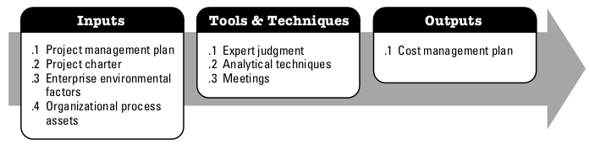
Plan cost management
the process that establishes the policies, procedures, and documentation for planning, managing, expending, and controlling project costs
The key benefit of this process is that it provides guidance and direction on how the project costs will be managed throughout the project

Slide 3
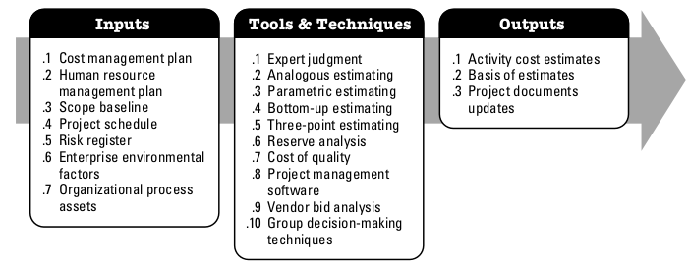
Estimate costs
the process of developing an approximation of the monetary resources needed to complete project activities
The key benefit of this process is that it determines the amount of cost required to complete project work.

Slide 4
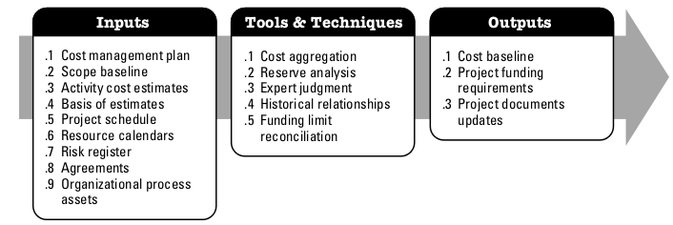
Determine budget
the process of aggregating the estimated costs of individual activities or work packages to establish an authorized cost baseline
The key benefit of this process is that it determines the cost baseline against which project performance can be monitored and controlled.

Slide 5
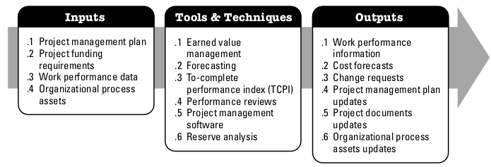
Control cost
the process of monitoring the status of the project to update the project costs and managing changes to the cost baseline
The key benefit of this process is that it provides the means to recognize variance from the plan in order to take corrective action and minimize risk

